Slide 1
Specification
邹欣
构建之法 – 现代软件工程
2014

Slide 2
agenda
Functional Spec exercise
Tie your shoes
Technical Spec Exercise
Elevator exercise (done)
Value of spec in the big picture
Make spec worthwhile

Slide 3
Waterfall
Requirement
Specification
Design
Implementation
Test
Deployment
maintenance
Notes:
the rise and fall of waterfall: Royce Winston
www.youtube.com/watch?v=X1c2--sP3o0

Slide 4
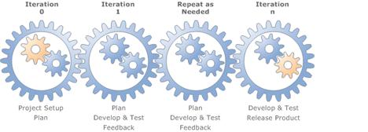
Agile

Slide 5
Both need to specify requirement
Waterfall
Requirements // collect what users, stake holders want
Specification // specify what we build (externally)
Design // specify what we build (internally)
Agile
Plan // combines requirement/specification
Development // part of design
But input/output are still the same
Find out what they want, describe what we deliver
We call the end result - Specification

Slide 6
Understand requirement
最近转手接了一活儿，完事能挣三十万……
拿过图纸一看，不就是盖一烟囱吗?
我们是敏捷 (Agile) 的团队，马上开始干活！
…
都快盖好了，
客户来检查，把我打了一顿！

Slide 7
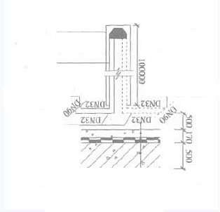
烟囱

Slide 8
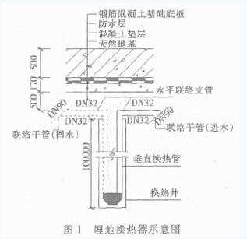
?
☹ ☹ ☹ ☹ ☹ ☹ ☹
图纸看倒了，人家让挖口井。

Slide 9
Spec
Spec = Specification /规格说明书
Functional Spec
Tell people about a feature/function of a product, From user’s perspective
It doesn't care how the thing is implemented. It talks about features. It specifies screens, menus, dialogs, and so on.
Technical Spec (aka design doc)
Tell the software team member or other partners how the function is implemented
data structures, relational database models, choice of programming languages and tools, algorithms, etc.

Slide 10
Spec Exercise – round 1
How long does it take for you to “tie your shoe laces”?
Write a spec so that an alien (外星人) can understand and execute how to “tie your shoe laces” (系鞋带)
Each pair come up with one spec (10 minutes)
Compare with your neighboring pair, pick the winner
Tell us the reason for win/lose
Good points of the winner
Weak areas for the loser

Slide 11
Spec Exercise – Round 2
Definition:
what is “shoe”, “shoe laces”, “tied shoe laces”, and “untied shoe laces”
Benefit of this feature “tie your shoe laces”
The goal of the feature?
What does “success” look like?
Unambiguous steps to achieve from “untied” to “tied”
Written in English, Graph (UML) is optional.
2 pairs work together for a new spec
10 minutes to improve the spec

Slide 12
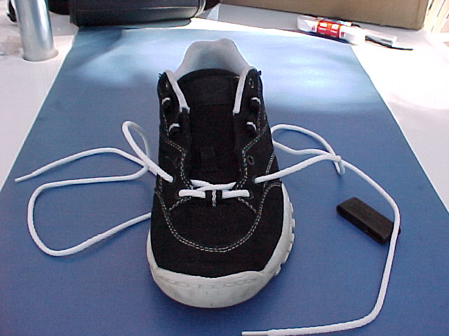
Assumptions
start from empty eyelets?
Or assume user can do that already?

Slide 13
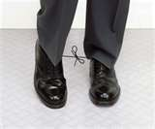
If user follows your spec…
Notes:
What’s the end-result?

Slide 14
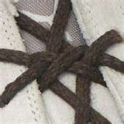
Does it have to be so complicated?

Slide 15
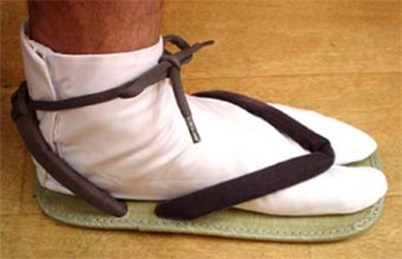
Does your spec cover this?

Slide 16
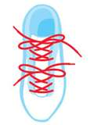
Is this ok?

Slide 17
Final round
What does “success” look like?
Can you use unambiguous words to describe it?
Final Two candidates competing for the winner

Slide 18
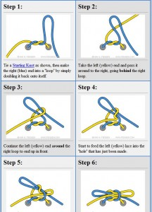
Spec as clear as this?

Slide 19
Functional Spec
Title
Status
Incomplete / complete
Contact person (1 person)
Responsibility and accountability, still based on team input
Overview
Scenarios
How people benefit from the feature you describe
Go as detail as you can
Non-goals
Open issues

Slide 20
Scenario
Scenario (场景), user case (用例)，Story (故事)
Focus on the user, how user is benefited from software/service
A Scenario contains several features
Having disconnected features doesn’t guarantee user’s need is satisfied.
The teapot example
茶壶嘴，茶壶把，茶壶盖，茶壶体
Notes:
http://www.cooper.com/journal/2002/03/reconciling_market_segments_an.html

Slide 21
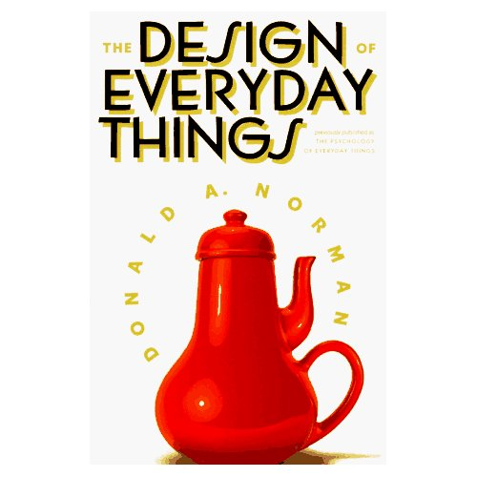

Slide 22
example
Assumption
地铁自动售票机
目的：实现自动售票
现实：总有售票员在售票机前面站着
原因: …
假设
每个人都有两个 一元的硬币在兜里
ASSUME = ASS in front of U and ME
Notes:
http://www.boxesandarrows.com/view/taking_the_you_out_of_user_my_experience_using_personas#comments

Slide 23
Design for the user
We’re not the target user!
More about this in “persona” and “scenario” in

Slide 24
How to get the real “requirement”
What kind of users do we have?
Exercise:
How many different kinds of users for ATM (自动取款机) and its supporting system?
5 minutes to list all different kinds of customers

Slide 25
At least 10 types of users
Current bank customer
Customer from a different bank (跨行查询/取款可收手续费)
Bank branch manager
Bank teller (柜员)
Bank Database administrator
Bank security officer
Bank marketing team (to understand user behavior, or display ads)
Hardware and software maintenance engineers
Auditor (银行业监管者)
And…
Hacker!

Slide 26
Get requirements
How to get different requirements from 10 different kinds of users?
Organize different kinds of users by viewpoints
Exercise:
Organize ATM users to different view points
20 minutes

Slide 27
So many viewpoints…
How to get concrete requirement
Interview
Closed interview
Interviewee return a pre-defined questions
Open interview
Ad hoc discussion
Focus group (loosely defined)
Conduct discussion in a group setting
Ethnography (深入实际/体验生活)
Immerse yourself into customers real environment and work flow
<三国杀> 软件, 也许要玩几个通宵的三国杀?

Slide 28
Finish an end-to-end story
Scenario/场景
场景的开始部分的系统状态描述
关于“成功的事件”的描述
关于可能的错误和错误处理的描述
其他可能在同一时间进行的活动的描述
场景完成之后的系统状态的描述
Exercise
Describe a typical scenario in your team project

Slide 29
Accurately describe the requirement
Use Case (用例) described in UML
see our previous exercises (elevator)

Slide 30
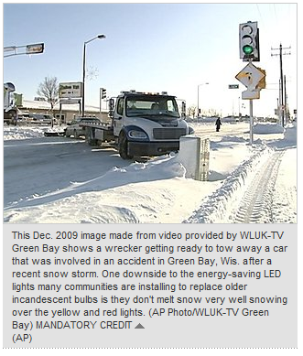
Feature has side effects
LED traffic light
The bulbs don't burn hot enough to melt snow and can become crusted over in a storm — a problem blamed for dozens of accidents and at least one death.
"If you put in the heating elements that would then remove the occasional snow situation, then you start to get rid of the power advantage of LED signals compared to incandescent signals."
Notes:
Pro: saves energy; longer life
Con: Can't Melt Snow

Slide 31
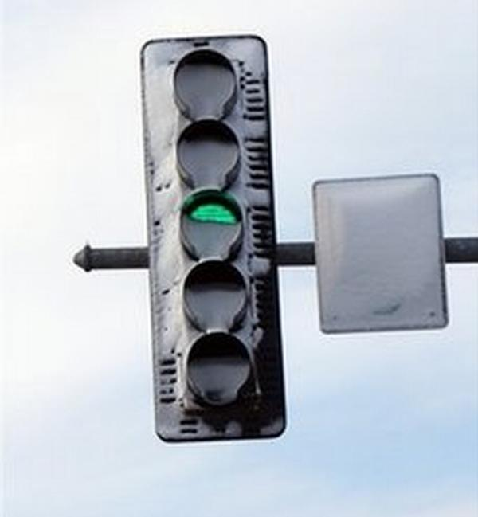
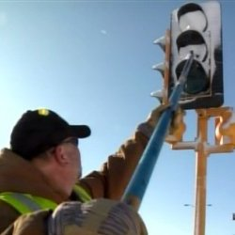
More examples

Slide 32
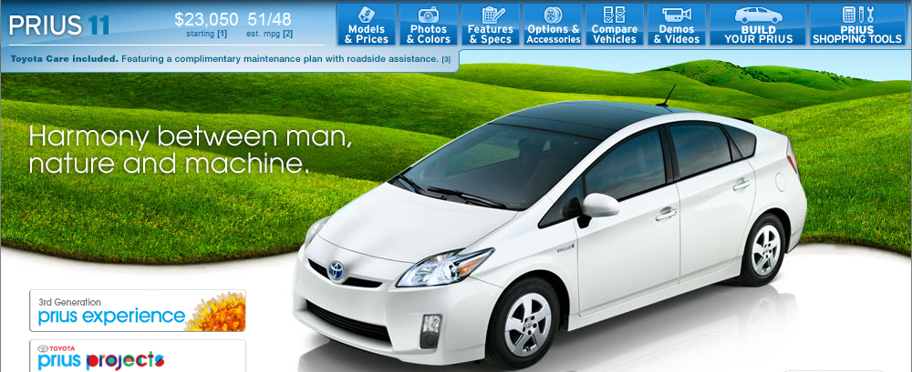
Side effect of new features
Hybrid Car
The engine becomes so quiet, that government request they add some noise while driving
EU considers whether electric cars need noise
Too quiet for blind people…
Notes:
Students Todo, read this:
http://www.hybridcars.com/safety/blind-people-hybrid-safety.html

Slide 33
Technical Spec
Also knows as Design Document (设计文档)
Requirement
Focus on “what user want”
from user’s perspective
Functional spec
Focus on “what user will get”
from SW team perspective
Technical spec
Focus on “how to achieve the end result”.
Internal communication

Slide 34
The Big Picture
Beta Test
User Requirement
Functional test
Blackbox test
Integration
Test
Scenario/Spec
Design Document
Unit Test
Whitebox test
Component
Test
Source Code

Slide 35
做得和顾客要求的一模一样?
Make it 100% like customer wants, Would it make customer 100% happy?
做得顾客要求的一模一样，就好了么？

Slide 36
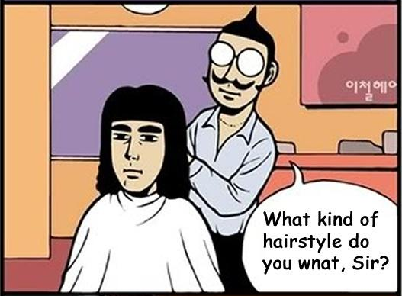
Hair cut spec
Notes:
http://www.memecenter.com/fun/8608/hair-style

Slide 37
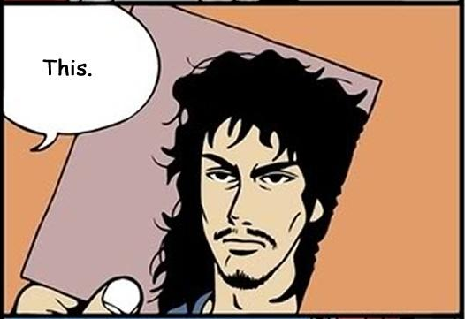
Spec!

Slide 38
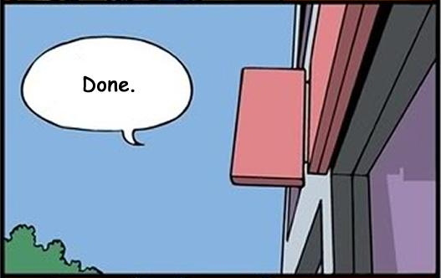
Long implementation …

Slide 39
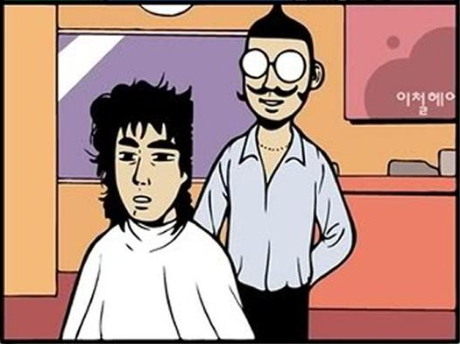
用户的表达能力？

Slide 40
The Owner of The Spec
PM – program manager
Challenges
Nobody reads the spec
It’s boring to read
Spec get out-of-date quickly
Verify the spec is fully implemented

Slide 41
Does Agile need documents?
自习课时，教务主任走进来，问班长“帮我找两个人，我要班花”，于是班长就组织全班投票评选起班花来，闹了一节课，终于统一了意见，选出了班里最PL的两mm，于是两mm很羞涩的去找主任，主任说：“怎么是你们? 跟我去教务处，我要搬花。。。”
当面, 直接的交流当然很敏捷, 但是还是要留下文档, 以明确用户的需求。 #软件工程#

Slide 42
Spec – nobody reads it
The writing and discussion process is still helpful.
But… Once it’s done, it’s outdated
People/project/code all evolve pass the spec

Slide 43
Make it worth reading
How to make people read and understand spec?
Be funny, have real persona and scenarios
Make people easy to execute the spec
Write as simple as possible
Avoid full text in a page!
Picture, tables, bullets, screenshots
Review and re-read
Spec Template (模版) is considered harmful

Slide 44
Spec – keep it up-to-date
How to prevent spec from getting outdated?
Say what can be verified, verify what you said in the spec
Check-in spec in the same place as source code
Link spec to unit tests, test cases, and have reverse link
Update it frequently
Insist on using spec later on
Check the spec first.
Team leaders should refrain from making new decisions without spec

Slide 45
Spec – keep it relevant and helpful
Be flexible, respect people’s creativity
Don’t be overly prescriptive (规定所有细节)
Team members will have new ideas when implement the spec
Things will change
It takes time for people to have new ideas
XP – since things will definitely going to change,
Don’t worry too much about future,
Keep it in small incremental improvement
Notes:
It takes time for people to have new ideas
sometimes, people really understand the problem after fully implemented a feature.

Slide 46
Spec – how to validate it
Turn specs into test cases (测试用例)
Use unambiguous language to describe it
Math, UML, test cases
Our elevators exercise is one example

Slide 47
Spec – How to validate it
Quality of Service (服务质量)
Website can provide answers to one query, but can it provide answers to 10000 queries?
Example
长江三峡 – 到底能防多大的洪水?

Slide 48
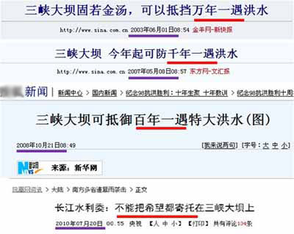
Spec – How to validate it

Slide 49
What spec says
三峡水利枢纽梯级调度通信中心副总工程师赵云发解释说，万年一遇、千年一遇、百年一遇分别是三峡大坝校核、自身设计以及防洪三个标准，是针对不同的情况而发布的。
万年一遇是三峡大坝的校核标准，指的是大坝承受超过流量为12.23万立方米/秒的流量下，容许三峡大坝的主体工程不受影响的情况下，其他设施可能出现影响。
千年一遇则是三峡大坝的自身设计标准，指三峡大坝在9.88万立方米/秒的流量的冲击下，三峡工程各项工程、设施不受影响，可以照常发电。
百年一遇的防洪标准主要是针对下游的荆江河道和洞庭湖等保护区域的防洪效果来讲的。事实上，三峡大坝修建之后，已经将荆江大堤的防洪标准从十年一遇提高到百年一遇。

Slide 50
Secret to good spec
Practice,
practice,
practice!
Let’s practice the elevator technical spec

Slide 51
设计方法论介绍
FDD - Feature Driven Development (功能驱动的设计）

Slide 52
功能驱动的开发 FDD
构造总体模型 Develop Overall Model
The project starts with a high-level walkthrough of the scope of the system and its context.
构造功能列表 Build Feature List
identify a list of features. extract business activities, the steps within each business activity form the categorized feature list.
Features in this respect are small pieces of client-valued functions expressed in the form <action> <result> <object>:
Calculate the total of a sale
Validate the password of a user
Share comments to other users
制定开发计划 Plan By Feature
Produce the development plan – who is going to do it, when?

Slide 53
Design & Build
功能设计阶段 Design By Feature
团队成员在主程序员的带领下，分析一组相关的实体及其功能，通过时序 图（Sequence Diagram）和其他工具，展示各个实体和函数如何动态地结合起来实现一 个功能。.
实现具体功能 Build By Feature
具体的团队成员要实现类/ 函数，进行相关的单元测试，并在代码复审之后，把代码集成 到产品构建当中。

Slide 54
FDD – Best Practices
Domain Object Modeling.
领域实体模型 Domain Object Modeling 现实世界是怎样的，有什么实体，他们的静态和动态关系是怎样的？在这个模型上面，我们才能系统地开发和增加功能
功能驱动地开发 Developing by Feature.
如果功能太复杂，我们就把它分解，直到能在较短时间完成（两周）。
模块的负责人Individual Class (Code) Ownership.
每个模块都有单一的负责人，此人负责这个模块（类）的语义完整性和一致性。（不能因为实现的方便，胡乱添加功能，导致一个模块的内在逻辑受到破坏）
功能小组 Feature Teams.
小团队，动态组合，平等讨论、合作完成功能。

Slide 55
FDD – Best Practices
复审 Inspections.
设计，代码复审 争取早日发现问题
每日构建 Regular Builds.
保证最新的版本总是可用的，早日发现系统集成方面的问题.
经常报告进度和测试结果 Visibility of progress and results.
这样相关角色能知道团队的进度，问题，并做好应对，降低风险

Slide 56
Backup slides

Slide 57
Exercise
Number Game
Client/server version
Taximeter

Slide 58
rules
Pick 3 teams,
Understand the spec, then give test

Slide 59
PM: write a spec for Taxi meter
Basic Info
Initial rate, initial mileage, rate per kilo.
Input
Route information: a series of
(Speed, time)
Output
The total taxi fare
Total travel time
Total stoppage time

Slide 60
Technical Spec - GroupThink
It’s important to keep all people “in the same page”
GroupThink is used @ MIT software courses
Paper published by Prof. Michael Ernst

