Slide 1
创新的迷思
邹欣
构建之法 – 现代软件工程
2014

Slide 2
Definitions
Invention (发明)
Introducing new ideas (you can patent an invention)
科研: 是将金钱转化为知识的过程
大学/研究所 – 探索未知，揭示规律
Innovation (创新)
The process of introducing something new to market place or practice
创新: 是将知识转化为金钱的过程
企业 – 用技术的进步解决问题，获得回报

Slide 3
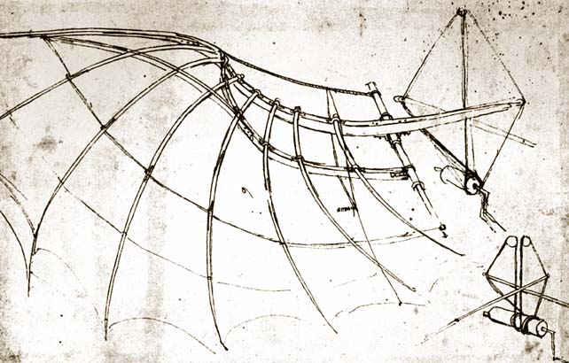
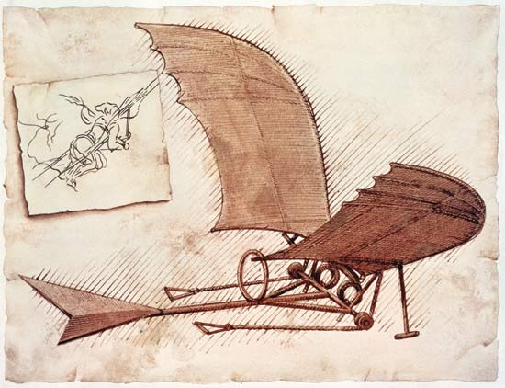
Inventions

Slide 4
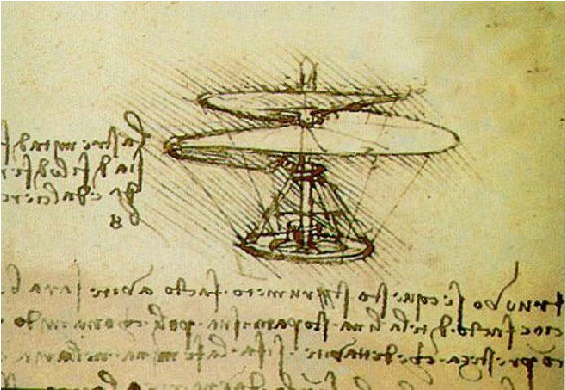
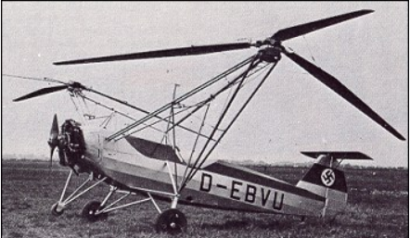
Inventions (more)
Invent (1493)
First functional Helicopter (1936)

Slide 5
A Number Game
Everyone write down
Your name
A rational number (有理数) in (0, 100), can’t be 0, or 100.
Winner = whose value closest to G.
G = 0.618 * average (all numbers)
Loser = whose value farthest from G.

Slide 6
Agenda
Myths (迷思)
Innovation starts with epiphany
People love innovation
The best ideas win
Innovator leads the way
Successful companies can do better innovation
Experts can better innovate
Discussion

Slide 7
Myth #1: big epiphany
Epiphany – 顿悟，灵光闪现，[神]显现
Examples
Archimedes (阿基米德) Eureka
Newton (牛顿) Apple moment
But…
They have built a foundation and work hard for that magic moment of “Epiphany”
Ideas never stand alone, Look at our cell phone
It’s a combination of past inventions and engineering work
Telephone, computers, radio waves, display, circuit
USB (both data link and charger)
Location aware – GPS, cell tower, WiFi AP

Slide 8
The last missing piece of a puzzle
Is the last piece more magical than others?
Notes:
Epiphany is the moment when the last piece of work fits into place. However, the last piece isn’t any more magical than the others, and has no magic without its connection to the other pieces

Slide 9
Modern day examples? No more
No more “Eureka” moment
Microprocessor
Personal Computer
Mouse
World Wide Web
Web Browser
Search Engine
None of them is the result of “Eureka!”
Legend sometimes glorified the “last piece”, ignored the other pieces.
Notes:
Now we have full record of most of our innovation activities, and we know that it’s filled with noise, failure, and second-guesses.

Slide 10
Anti-Eureka moments
Your demo crashes
Your UI looks ugly
Your demo looks great, but doesn’t solve any problem
Your demo can’t scale up
…

Slide 11
Demystify the myth
We shouldn’t wait for the Epiphany, rather, we should focus on each piece of our work
Lay the foundation for the “last piece” of puzzle
Don’t look for the “biggie”, working on practical solution, step by step
Notes:
Peter Drucker –
Those entrepreneurs who start out with the idea that they’ll make it big – and in a hurry – can be guaranteed failure.

Slide 12

相声表演
画扇面

Slide 13
Myth #2:People love innovation
Negative responses to innovators:
This will never work
No one will want this
It can’t work in practice.
People won’t understand it
This isn’t a problem.
This is a problem, but no one cares.
This is a problem, and people care, but it’s already solved.
This is a problem, and people care, but it will never make money.
This is a solution in search of a problem.
Get out of my office now!

Slide 14
More ways to reject an idea
We tried that already
This will never work
We never done that before
This will never work
We don’t do it that way here
This will never work
Not in our budget
This will never work
We don’t have time
Executives will never go for it
It’s out of scope for this milestone
And I don’t know about next milestone…
You’re smarter with your mouth shut!

Slide 15
Why?
Ego/envy:
I can’t accept this because I didn’t think of it
Pride and politics:
this makes me look bad.
Priority:
I have 10 innovative proposals, but no enough resource
Security:
I may lose something
Consistency
This violates my deeply held principles (whatever those are)
Motivation
I don’t care – what’s in it for me?

Slide 16
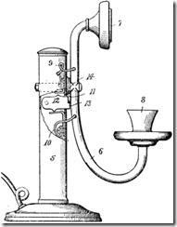
Even innovator hates innovation
想象一下, 你发明了电报, 用毕生心血打造了电报王国…
有一个年轻人向你报告他的新发明: 电话
Notes:
It looks ugly, but it will replace everything you’ve struggled all your life to build.
This is what we call – disruptive technology
What’s your reaction?

Slide 17
Different types of innovation
Sustaining Innovation
维持/改良式的创新
Disruptive Innovation
颠覆式的创新

Slide 18
Myth #3: Better Idea wins?
Better technology = better innovation?
Diamond, human labor, (bloody diamond)
When you invent a new technology to enable mass producing diamonds from cheap materials
What’s the impact to the current marketplace?
How are the current industry look at you?

Slide 19
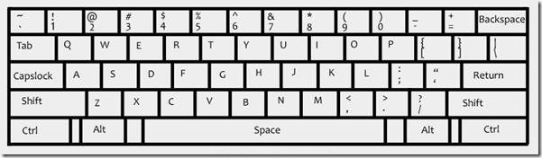
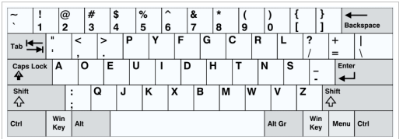
Which is the better keyboard?

Slide 20
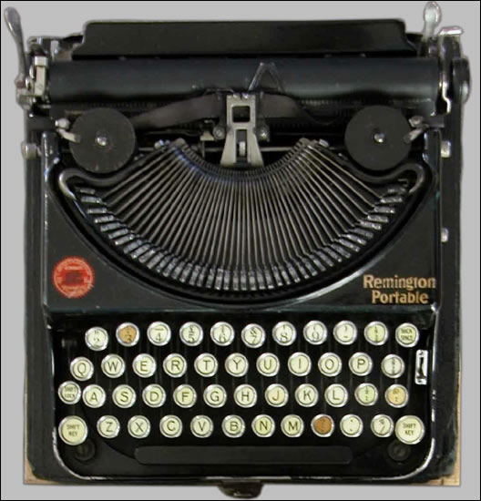
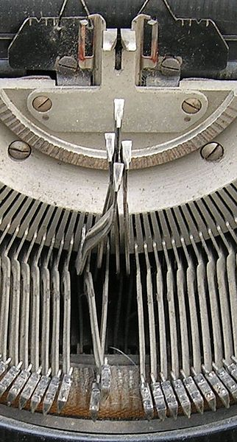
Old typewriter

Slide 21
Advanced Technology != acceptable innovation
Technical advancement doesn’t automatically transfer to acceptable innovation
火车票实名制
国际标准衡量制度 (meter) vs. 英制 (inch, feet, yard, mile)
A proposal was passed in US congress ~ 200 years ago, but no one make it happen
“what’s in it for me?”

Slide 22
What’s in it for me?
After Faraday (法拉第) discovered the basic principle of electromagnetic induction (电磁感应) in 1831, a skeptical politician asked him what this was good for.
Faraday responded: “Sir, I do not know what it is good for. However, of one thing I am quite certain, some day you will tax it.

Slide 23
How to convince people …
to like (or at least not hate) your innovation?
Relative Advantage
Compatibility
Complexity (avoid)
Trialability
Observability
Provide “what’s in it for me?” for stakeholders
Does your innovation have all of the above?

Slide 24
Watch the following convention
http://www.wimp.com/greatestinvention/
Relative advantage?
Compatibility
Complexity
Trial-ability
Observability?

Slide 25
To crush the myth:
Build your innovation to be acceptable
Compatible
Trialability
Relative advantage
Find friends, sponsors, not enemies
They will help you when they know you’re helping them
Find users
Let users be the judge

Slide 26
Myth #4: innovator always leads the way
Do great innovators always enter market first and keep the lead?
No! Google entered search market very late
iPod
There existed bigger capacity MP3 players when iPod first released
Many more appeared after iPod
1997: first PAD released
1998: Rio
1999: PJB-100 has 4.8 G HardDrive
… creative labs… and many more
2001-10-23: Apple released iPod, 5G
2002: Archos released audio/video player
…

Slide 27
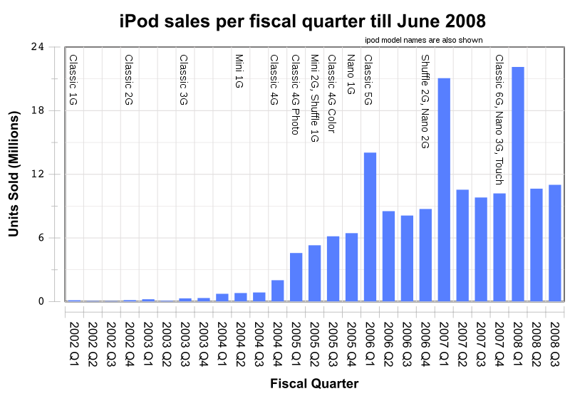
Growth of iPod

Slide 28
Web calendar
Google Calendar/Gmail
When it entered the market, Yahoo! Mail/Calendar and Hotmail/Calendar are there already, for many years.
Everybody has at least 2 email accounts already
Who needs another email/calendar account?

Slide 29
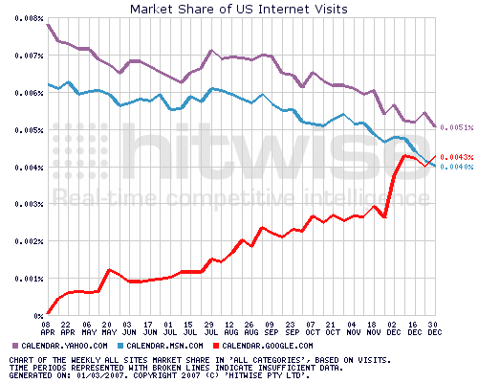
It caught up in just 2 years

Slide 30
Story of first VCD player
1992年，姜万勐 看到 MPEG芯片
Epiphany –
用MPEG1 把图像和声音同时存储在一张小光盘上 VCD（Video Compact Disc）。
1993年9月
万燕第一批1000台VCD机下线。
几乎都被国内外家电公司买去解剖做样机
万燕VCD 100% 市场份额
1995年
各路仿制的VCD机大举进军市场，竞争激烈。
1996年
全国VCD机销量超过600万台，而万燕VCD机市场占有率不足3%
Notes:
http://tech.163.com/09/0811/17/5GF0RKI200093IHH.html

Slide 31
What we learn here…
FMA – First Mover Advantage
SMA – Second Mover Advantage
There are always chances for late comers
Innovator can play catch-up games very well!
Current market leaders are not FM.
“the second mover gets the cheese”
Notes:
http://michael.hightechproductmanagement.com/2006/03/the_myth_of_firstmover_advanta.html
The class can discuss the fma/sma

Slide 32
First Mover vs. Market Leader
Personal Computer:
First Mover: Altair (1975)
Market Leader: Dell (2006)
Word Processing Software:
First Mover: WordStar (1979)
Market Leader: Microsoft Word (2006)
Web Browser:
First Mover: Mosaic (1992)
Market Leader: Microsoft Internet Explorer (2006)
Internet Search Engine:
First Mover: Excite (1993)
Market Leader: Google (2006)
MP3 player
First Mover: Rio
Market Leader: iPod
Online Bookstore
First Mover: Books.com
Market Leader: Amazon.com (2nd mover)
Personal Finance Software
First Mover (unknown)
Market Leader: Intuit (the 47th mover)

Slide 33
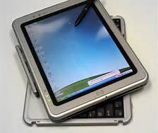
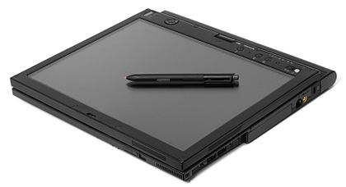
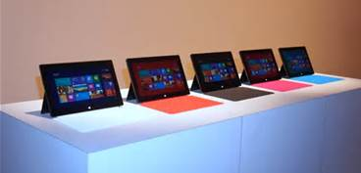
Microsoft as First Mover
2001: MS Tablet PC
2010: Apple’s iPad
2012: MS Surface

Slide 34
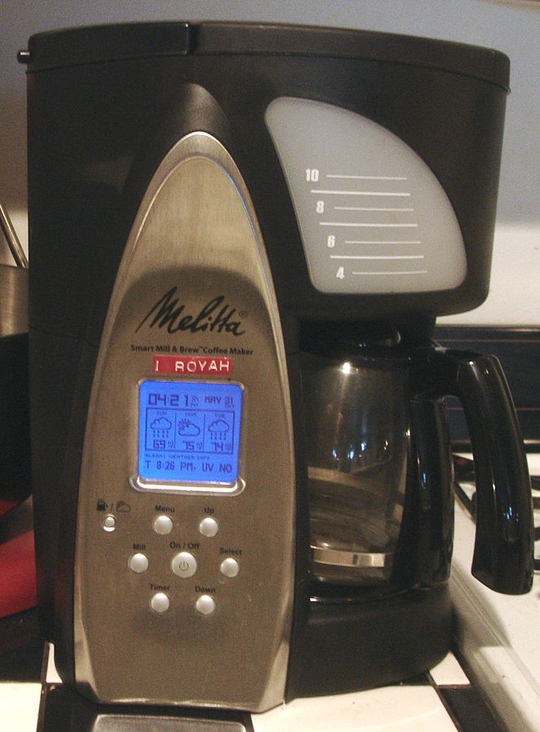
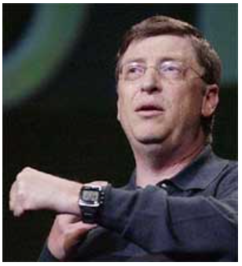
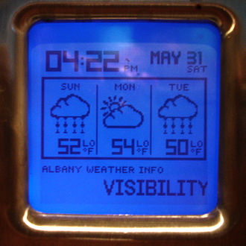
Microsoft as First Mover
2003: MS announced SPOT SPOT watch
…
2013: many new watches and wearables

Slide 35
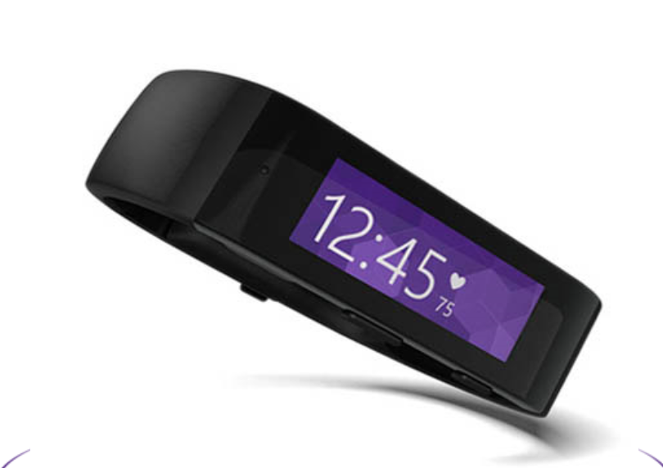
Microsoft Band

Slide 36
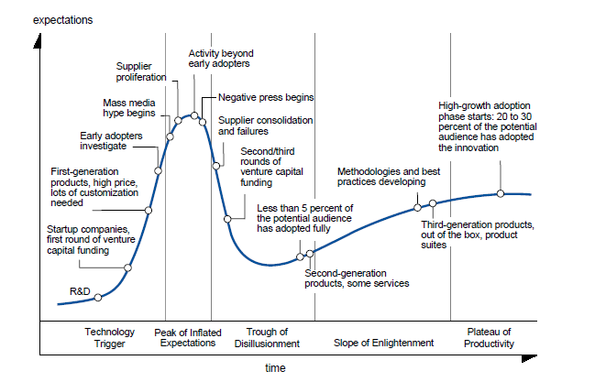
Timing is important
Technology Trigger
Peak of Inflated Expectation
Trough of Disillusion
Slop of enlightenment
Plateau of productivity
Notes:
随着一个新技术经历不同的阶段, 公众对它的期望值, 炒作值也有很大的差别.
1）技术触发期 （技术走出实验室, 天使投资, 第一轮产品出现, 尝鲜者试用）
2）期望膨胀期 （博客/微博/媒体炒作, 泡沫达到最大, 大众开始跟进, 负面报道出现）
3）迷茫期 (开始整合, 第二/三轮融资, 但是只有 5% 的目标用户正式使用产品，第二版产品出现)
4）低调发展期 （漫长的低调发展, 最佳的方法和实践开始出现, 第三代产品出现, 易用性, 和其他产品的整合更好 ）
5）主流发展期 (成为成熟的技术, 市场以20-30% 的速度成长)

Slide 37
Exercise time
Discuss the FMA and SMA advantage

Slide 38
A powerful myth… (#5)
You should be the area expert before you can successfully innovate
Look at WWW – invented by a physicist (~20 years ago).
“vague, but exciting” was the first comment to his proposal.
C.S. experts didn’t like the WWW idea at the first place.

Slide 39
Experts didn’t like Nokia
Nokia:
Making forest products, rubber boots, near-bankrupt.
Finland market: 5 million people.
Decided to go into telecomm business
Experts laughed at them…
15 years later …
$79 billion in revenue
Now, it has its own problems…

Slide 40
Experts didn’t like Sony and its Walkman
Walkman (单放机)
Experts thought the walkman will fail
It doesn’t have “record” feature
Who needs such machine that couldn’t record?
Experts had done users studies to prove walkman doesn’t have a future
Experts even thought the name is wrong
Should be called “Walking Man”!

Slide 41
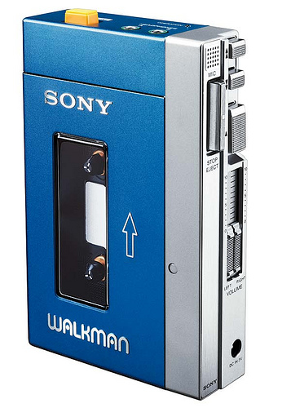
Sony and Walkman
1979: launched
2004: 200 Million sold

Slide 42
These are not the exceptions…
70% of innovators said they got their best ideas by exploring areas they were NOT experts in.
Xerox PARC has 4 Turing Award winners, but only one of the many inventions turn to commercial success (Laser Printer)
GUI, Ethernet, Mouse, WYSIWYG, Laptop, SmallTalk, Video Processing …
Some hobbyists without college degree finishes the innovation (Steve Jobs, Bill Gates)
Is Jack Ma (马云) an experts in B2B web services?

Slide 43
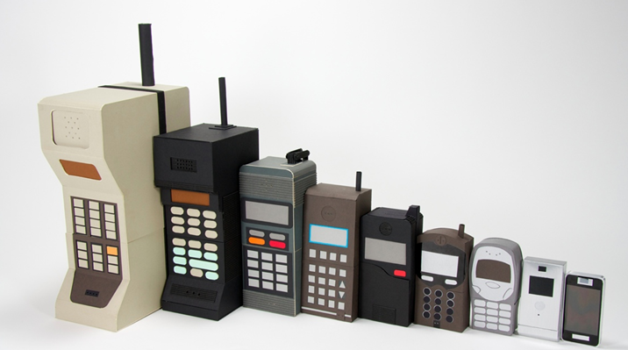
Technologies drive cell phone evolution
Technology played an important role in the evolution of cell phone.
But the cell phone with most advanced technology failed ()
Notes:
http://www.kylebean.co.uk/portfolio/#mobileevolution/1

Slide 44
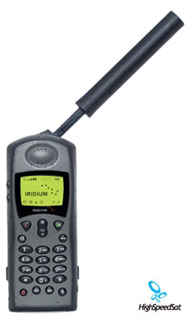
Iridium satellite phone
Most advanced technology
66 satellites, anywhere, anytime
1998.11 launched service
1999.8 bankruptcy protection

Slide 45
Myth #6: technical innovation is key
innovation is not always about technology.
Different kind of innovation:
business model innovation
buy/sell books online
online bidding
micro-payment
UX innovation, simplify feature set
iPod (4 buttons)
Hao123 (a page of static links)
twitter (1 feature)

Slide 46
Innovation != sum(parts)
茶壶的功能
茶壶盖
茶壶体
茶壶把
茶壶嘴
各个功能还要有机结合起来，满足用户的需求
下面的茶壶满足了用户的需求了么？

Slide 47


Slide 48
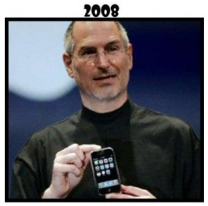
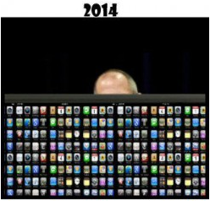
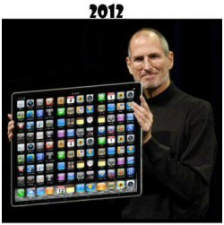
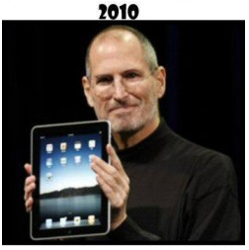
Innovation != adding more features

Slide 49
Myth #7: Successful companies can do better innovation
Myth:
When a company succeeds in building a business by innovation, they will continue focusing on new innovation
Reality
When market matures, technology becomes “sustaining technology”
In most “sustaining technology” situations, technical leadership is NOT crucial.
When you’re the best and biggest, do you really want to innovate? (C.S. dept example)
Notes:
That’s why sustaining tech product teams (office/windows) pay attention to incremental Tech Transfer, but they shun away from disruptive innovation.

Slide 50
2 types of technologies
Sustaining technologies
You own the fundamental technology
you know the customer and competitor
Its market grows at predictable pace
Requires:
careful planning, aggressive execution, like Office ship cycles
Disruptive technologies
It’s new, it’s not stable, it’s not cost effective
You don’ know the market, the user, and competitor
Most prediction from experts about disruptive technologies are WRONG
Requires…
Discover-driven planning, agnostic marketing

Slide 51
Existing customers won’t tell you much about disruptive technology
Discovery-driven planning, agnostic marketing
If Henry Ford asked his existing customers – what do you want?
“a faster horse!” - answered the customer
“car” has never existed in customer’s mind, so market research won’t reveal it.

Slide 52
When you’re big & successful…
You have different value system
You have big numbers to worry about
MS Annual Revenue is ___, profit is ___
Stock holders expect MS to grow at ___% per year
which means ___ new profit per year, ___ profit per quarter
Notes:
Harry’s complaint to Eric
Revenue: 68B, profit: 50B in profit. Cash: 48B

Slide 53
When you’re big & successful…
Your apatite is big
Small market cannot satisfy the near-term growth requirements of big organizations
You have things to take care of
Many existing products and customers
Who is watching out for the
disruptive technology and disruptive innovation?
Notes:
Harry’s complaint to Eric
46B in profit.

Slide 54
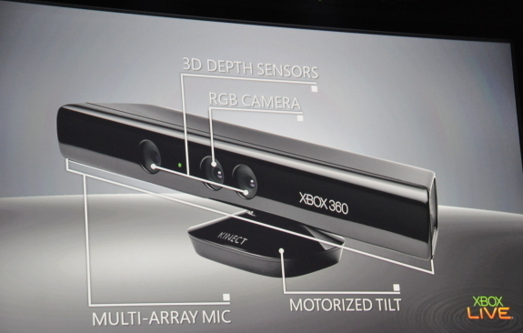
Can MS still innovate?

Slide 55
Xbox Kinect
Depth camera (Infrared laser)
Motion Capture, Skeleton tracking
Face recognition
Voice recognition
It sold an average of 133,333 units per day with a total of 8 million units in its first 60 days.
150$ * 8M = 1.2 Billion in 2 months

Slide 56
When you’re big & successful
You have “value” – the criteria to pick new projects
DEC, an once very successful minicomputer maker
50% or more margin = good business
40% or less = bad business
PC? 10% margin
This puts PC at lower priority than its mini-computer.
Notes:
The president of DEC and many other engineers understand the importance of PC.

Slide 57
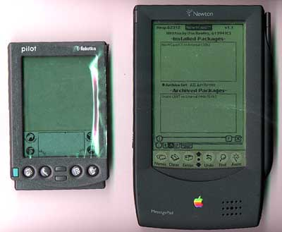
Newton & Palm Pilot
Notes:
What if newton comes from another small company? Like Palm.

Slide 58
Newton & Palm Pilot
Apple Sold 43,000 Apple II on 1979
Viewed as a big success
Newton
First PDA, handwriting recognition
Apple CEO John Scullery personally drives this project
It was a market-creating, disruptive product targeted at an indefinable set of users.
Selling 140,000 Newton on 1994, about 1% of Apple’s revenue.
Viewed as big failure
Notes:
What if Newton comes from another small company? Like Palm.

Slide 59
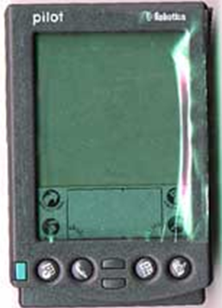
Palm Pilot
1996, US Robotics published Palm Pilot
First year sale: 350,000, fewer features than Newton
Viewed as big success
Define the PDA industry

Slide 60
When you’re big & successful
You process matures
You have “product cycle”
DEC cycle for mini-computer: 2-3 years
DEC cycle for PC: 2-3 years
Other PC makers’ Cycle: 0.5 - 1 year
The result?
Fast evolution, more agile, more chances for success
Similar examples?
Windows Mobile product cycle?
LG/Nokia product cycle?
山寨机 product cycle?

Slide 61
When you’re big & successful
You listen to your customers
Your customers don’t like disruptive technologies
You follow your customer, and you don’t pay attention to them

Slide 62
When you’re big & successful
You have “culture”
Culture: ways of working and making decision by assumption.
Your parents do it this way…
Your grandparents do it this way…
Your dev lead does it this way…
Your dev manager does it this way…
This is how we’re successful…
“this is the way we do things here”
Such culture might not welcome innovation

Slide 63
Discover-driven planning; agnostic marketing
Successful companies cares about the future, they hire “reasonable” people to predict the future
a pocket-size calculator from HP
Conventional method suggested - 10,000 units, don’t do it.
Cell phone for AT&T
Consulting firms predicts by 2000, no enough market to support cell phone
For disruptive technologies
Future is hard to predict
Market is indefinable

Slide 64
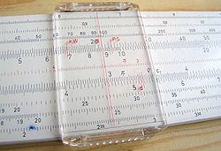
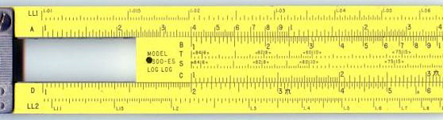
Market Research – sustaining technology
Current tool: slide rule (计算尺)
History: since 1600
Price: ~$20, User no power
College course to teach how to user it
Every scientist uses it
Has incremental enhancements (even digital parts)

Slide 65
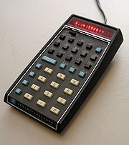
The disruptive technology
Idea: a pocket-size calculator
Supporting trigonometric and exponential functions
A powerful scientific calculator that can fit in a shirt pocket
Cost:
$395 ($2000 in 2008 money)
Power only lasts 3 hr
Market Research
Only 10,000 unit per year.
Recommendation: DON’T DO IT.
HP’s CEO: William Hewlett:
Go for it

Slide 66
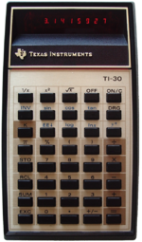
In the real market
Actual sales
10,000 after first month
100,000 for the 1st year (1972)
Create a new market
Other models appearing (Texas Instrument, Casio)
Price drop to $25 in 1976
Result:
Slide rule exits the market
No more college course on slide rules

Slide 67
Successful companies care about future? Yes!
But predictions about disruptive future are usually wrong!
AT&T, in 1980 hired consultants to forecast cell-phone use by 2000.
The prediction: 900,000 subscribers.
Actual number 109 million, 120 times difference!
Reasonable argument –
“when everyone has wired phone, who needs wireless”?
AT&T paid for its mistaken giveaway.
In 1993, to re-join the cellular market, it paid $12.6 billion to enter.
Notes:
AT&T, along with everyone else, still underestimated the potential of cellular technology. In 1980 the corporation had commissioned McKinsey & Company to forecast cell-phone use by 2000. The consultant’s prediction: 900,000 subscribers. This was off by a factor of about 120; the actual figure was 109 million. AT&T paid dearly for its mistaken giveaway. In 1993, to rejoin the cellular market, it bought Craig McCaw’s patched-together nationwide network, McCaw Cellular, for $12.6 billion.

Slide 68
To crush this myth
Don’t take everything for granted
We’re successful, we might not be good at innovation
Distinguish
Sustaining technology (守成)
Disruptive technology (创业)
Keep trying for the new/unknown market

Slide 69
Key indicator of a “sustaining technology”
Performance oversupply
The performance of a feature has exceed the market need
CPU speed, Monitor Screen Resolution, image size of digital camera, capacity of USB drive
Number of features in word processor software
Companies compete in different categories:
Functionality -> reliability -> convenience -> price
When all technology about a product are sustaining technology (mature), the only thing left to compete is:
Price (白菜价)
Notes:
Some salesperson’s comment –
those stupid customers are just treating out product like it was a commodity. Can’t they see how much better out product is than the competition’s?
customers don’t care about your “better” part if it’s in “performance oversupply” category.

Slide 70
The shift of competition
Focus
reliability
Convenience
User
Early majority
Late majority
price
All of us
functionality
Early adopters
Stage
Break-out
Established
Mainstream
Saturated
Some innovations couldn’t go beyond the “early adopters” user base. Why?
Notes:
15 years ago, I was proposing a MIS project to a hotel, eventually we can do all the features, but so can all other proposals, but we have to do it for free!
You don’t want to be in such industry/area.

Slide 71
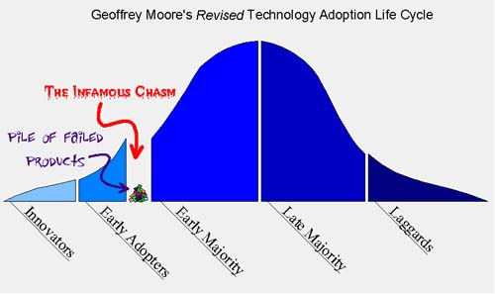
We all love it, why don’t they love it?
They couldn’t cross the chasm

Slide 72
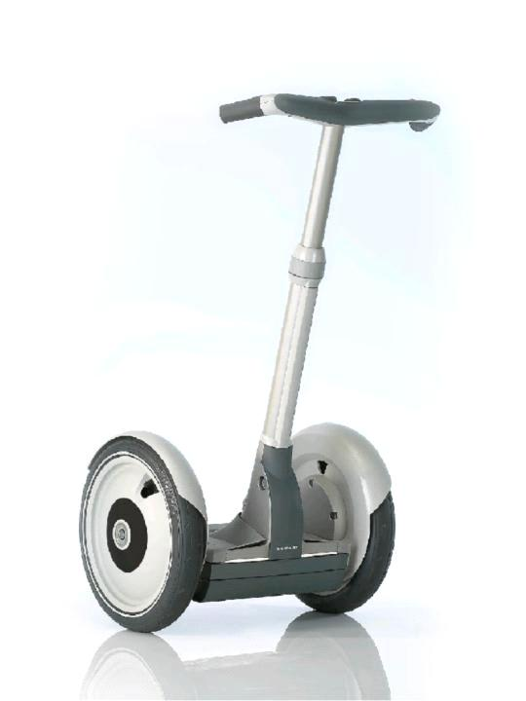
Examples
Segway Human Transporter
It’s advanced, hi-tech
Did it cross the chasm?
寻呼机/小灵通是创新么?
曾经是
它现在处于那一个阶段?

Slide 73
Where is my chance to innovate?
Know the timing
when to focus on “early adopters”,
and when to cross to “early majority”
When you publish a paper
You target who?
When one technology becomes “sustaining”, usually a disruptive technology can change the base of competition
We need to find out the best timing.

Slide 74
Bonus Myth - personality
Are innovators risk-takers?
No. They are not risk-focused, they are opportunity-focused
Opportunity –
the needs that haven’t been served by competitors.

Slide 75
Agenda - recap
The myths of epiphany
People love innovation
The best ideas win
Innovators leads the way
…
Successful companies CAN still innovate, if we understand the impact of:
Sustaining technology
Disruptive technology
And how to deal with existing value/process/resource priority of our successful company

Slide 76
Group Exercise
Let’s pick your own project
What’s the history of innovation in this area?
Is our project the 1st mover, 2nd mover or N^{th} Mover?
What’s sustaining technology, performance oversupply, and disruptive technology in this area?
Any unaddressed “user need” still out there?
What is “success” for such project? Why your product can win?
How to win in 6 – 12 month?
One person from each group to give us a report

Slide 77
NABCD model
1) N (Need 需求)
你的创意解决了用户的什么需求?
我们要充分了解用户的痛苦, 他们对已有软件, 服务不满意的地方。但是用户往往也不知道颠覆型的创新
2) A (Approach 做法)
你有什么招数, 特别是独特的招数, 来解决用户的痛苦。
这些招数不光是技术上的, 也可以是商业模式上的, 地域的, 人脉的, 行业的.
3) B (Benefit 好处)
那你这个产品会给用户带来什么好处呢?
Benefit/Cost (成本) 的问题。
4) C (Competitors 竞争)
竞争对手也没有闲着, 这个市场有多大, 目前有多少竞争者在瓜分, 你了解么? 你如果不是最先进入某个市场的产品, 你还能赢么?
5) D (Delivery 推送)
你有一个很厉害的想法, hao123.com，你怎么把这个产品交到众多用户手里?

Slide 78
Discussion

