Slide 1
产品分析讨论
邹欣
构建之法 – 现代软件工程
2015

Slide 2
Intro
研究生水平课程
What is expected
Before the session:
Read and view data mining reports, blogs, videos;
https://www.youtube.com/watch?v=Ye19fWux5RY
decide on the analytical target
During the session:
Discussion, Drill down on details, using the discussion framework
Present your analytical report
Propose an action plan for the next 3 - 9 months. ( “road map” doc).
We learn from each other

Slide 3
Challenge
Each team will respond to the challenge assigned to the team.
如何发布一个有独特价值的软件，让大量用户都来使用我们的产品

Slide 4
Why analytical?
Emotional (illogical) ←→ Analytical
http://www.youtube.com/watch?v=-4EDhdAHrOg
Emotional goes too far
Emotional Problem Solving
我来的时候, 大家就做这个功能了
我觉得爽, 我就做这个产品/功能
我们已经在这个行业很久了, 我们不能输, 要战斗到最后！
别人做这个赚钱, 我们也做
全面赶超竞争对手，每个功能都全面提高
用户提到的需求我都做!
我要做到行业最好
这个功能太简单了, 我不想做
老板说啥就做啥
这个做的人太多，我不做
这个做的人太少，我不做
…

Slide 5
Framework – 解决问题的框架
It’s not the solution, but it provides a set of vocabulary for solution
Performance and Power
动能/惯性 (inertia) 和势能/加速度 (potential/acceleration)
Claim: the planning process in big corporations always over-emphasis on existing Performance, neglecting Potential
Different Power
Category Power
Company/Market Power
Offer Power
Execution Power

Slide 6
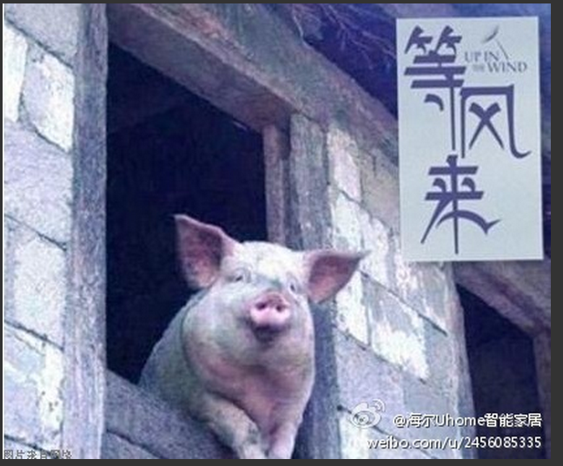
Power – Category Power
What kind of business we’re in?
Functional cell phone software
Smart phone software
film-based camera (胶卷相机)? 卡片照相机? 大型单反照相机? 微型单反?
烧汽油的汽车? 混合动力的汽车? 摩托车? 电单车?
Category Power is the #1 predicator of future economic performance
只要站在风口，猪也能飞起来

Slide 7
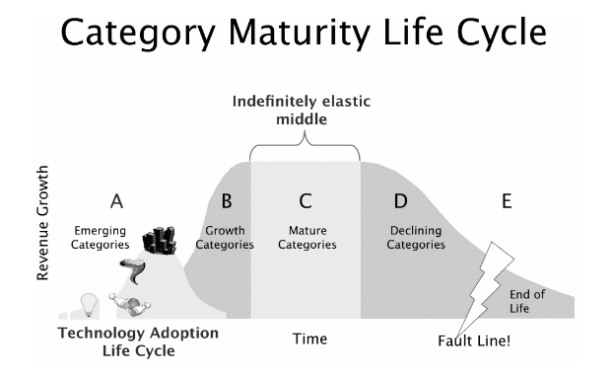
Product maturity curve
Which stage is your current project at?

Slide 8
Company/Market Power
Company Power: The brand name (leadership) and influence (market share) of a company
Market Power: The company power in a specific market
Crown jewels:
Resources we currently have and can help us change our company/market power
Can your crown jewel show 10X benefit difference than your competitors?

Slide 9
Power – Offer Power
What we offer to the users 我们给用户提供什么样的价值？
When consider new product/feature
Is this offer a proven hit, a potential hit, or a me-too product?
Is this offer sufficiently differentiated to existing competitors?
What can we do to amplify the differentiation further?
Where are we wasting resources on non-differentiating features?

Slide 10
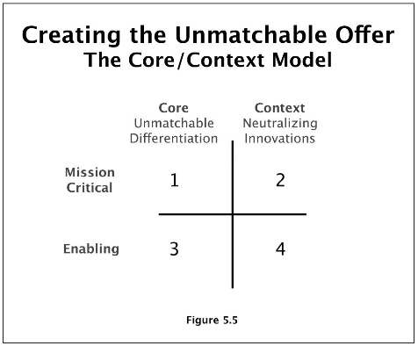
Different offer power
Core vs. Context offer
我的杀手功能 vs. 大家都能做的功能（普通功能）
Mission Critical vs. Enabling
刚需 vs. 辅助功能
Dictionary app for example:
杀手: 我有OCR 文字识别技术, 我有独家权威词典, 我有独特学习英语的模式和内容
普通: 良好的界面设计
刚需: 翻译准确性
辅助: 可以做各种皮肤

Slide 11
Offer Power – 10x
Salesforce.com:
10X reduction in enterprise software installation and operation costs
Skype:
10X reduction in consumer long-distance telephony cost (crown jewel: p2p internet protocol)
Cisco:
10X improvement in video-conference (routing and switching over internet)
Wikipedia:
10X improvement in the accessibility and currency of an encyclopedia. (crown jewel: collaborative governance model, crowd source)
VMWare:
10X reduction in the cost of data center (crown jewel: hypervisor virtualization)
Palm:
10X more usable PDA
Dell:
10X better shopping experience
Motorola:
10X more elegant mobile phone (RAZR) (crown jewel: radio technology, design)
中国公司的例子? 360
让中国普通用户感到 10 倍安全, 10倍地容易杀毒

Slide 12
Power – Execution Power 执行力
Vision without Execution is hallucination
The ability to outperform your competitors in a leveled playfield (执行力)
Ability to execute a game-changing shift in operating priorities.
做出改变的能力
Innovate -> deployment -> tipping point
NABCD
Need (用户的痛点)
Approach (解决问题的独特办法 – crown jewel)
Benefit (对于用户的好处, 用户要花多少代价才能得到这个好处)
Competition (竞争对手的强项/弱项)
Delivery (如何把服务送到用户那里)

Slide 13
Exercise
For the product your group had picked up
What category is it in?
What are the crown jewels the product team can have?
What areas do you want to invest in the following different ways (Asymmetric Bet)
Productivity (maintain with lowest cost)
Neutralization (quickly achieve good enough)
Optimization (best in class via costly and long process)
Differentiation (create 10X value to user)
Write up a report, put your ideas into the 4 quadrants

Slide 14
Appendix
Video
https://www.youtube.com/watch?v=Ye19fWux5RY
Book
http://www.amazon.com/Escape-Velocity-Free-Companys-Future/dp/0062040898/ref=sr_1_2?s=books&ie=UTF8&qid=1376461940&sr=1-2
Blog about NABCD
http://www.cnblogs.com/xinz/archive/2010/12/01/1893323.html

