Slide 1
个人技术和流程
邹欣
构建之法 – 现代软件工程

Slide 2
Agenda
Class business
Team Project
It’s ok to do “small” projects
Software Engineering (again)
How to grow skills
PSP – Personal Software Process
How to show you have obtained such skills
How to evaluate performance?

Slide 3
What Consists of SE?
It encompasses techniques and procedures, often regulated by a software development process, with the purpose of improving the effectiveness, reliability, and maintainability of software systems.
We have:
Personal Software Process
Team Software Process

Slide 4

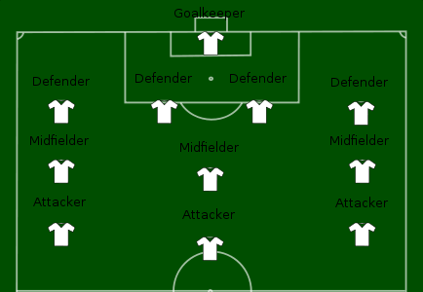
Use Soccer as Example
Personal Soccer Process
体能
技术
意识
Ph.D. degree?
C.S. student?
Team Soccer Process
阵型
配合
临场
Process is not the goal.
Winning is the goal.
Notes:
Without personal skills, team work is impossible, even when we have healthy, upright, PhD degree team members. This is why we want everyone to focus on individual skills, the right set of skills, which are the foundation of our team work.

Slide 5
Role of “individual”
Most components in a software system is developed and maintained by Individual Contributor (IC)
IC needs to –
Understand the current situation
Find the solution
Estimate the work
Communicate the proposal to stake holders and customers
Carry out the work
Be accountable for the outcome
The quality of each individual can directly affect the quality of shipped product.
Notes:
Work is carried out by each individual
Skills as an “Individual Contributor” is important

Slide 6
How Are You Doing?
作为一个软件工程师, 你觉得自己表现如何?
有没有这样的体会:
看书的时候觉得“技止此耳”，开发项目的时候才觉得实际情况和书上讲的都有一些出入，一些重要的细节书上没有提。很多人是边看asp.net的书, 边开发asp.net 的项目，这相当于一边看医学书一边动手术。。。
如果你是病人, 你希望你的医生:
刚刚在书上看到你的病例, 一边看书一边开刀…
开刀的过程中突发奇想, 然后在你身上试验…
已经做了多年此类手术, 可以一边做手术, 一边和别人聊天
你在写软件的时候, 是哪种情况?
那一个软件工程师如何成长，如何证明自己的成长?
Personal Software Process

Slide 7
How to “learn” knowledge
知识体系是构建出来的, 而不是接收到的
与其灌输知识, 远不如让学生自己构建
人的认知模型改变得非常缓慢
搞那些速成的, 疯狂的, 喊口号的培训未必改变了人的认知模型
提问能帮助构建知识体系
鼓励学生思考, 辩论,
身心投入, 回顾总结是成长的关键

Slide 8
How to Grow Skills – PSP0
Personal Software Process
Body of knowledge (PSP)
Process The Input to PSP is the requirements;
requirement document is completed and delivered to the engineer.
Output: metrics telling how good an engineer is.
PSP0 has 3 phases:
planning,
development (design, coding, test)
postmortem.
Is this the process of your I-Project?
Notes:
http://www.sei.cmu.edu/library/abstracts/reports/05sr003.cfm
A baseline is established of current process measuring: time spent on programming, faults injected/removed, size of a program. In a post mortem, the engineer ensures all data for the projects has been properly recorded and analysed. PSP0.1 advances the process by adding a coding standard, a size measurement and the development of a personal process improvement plan (PIP). In the PIP, the engineer records ideas for improving his own process.

Slide 9
How to Grow Skills – PSP0.1
PSP0.1, based on PSP0, Adding
Coding Standard
Size Measurement
Process Improvement Plan (PIP) – engineer records ideas for improving his own process
Do you have these in your I-Project?

Slide 10
PSP1
PSP1, PSP1.1 (Introduces estimating and planning)
Based upon the baseline data collected in PSP0 and PSP0.1, the engineer estimates how large a new program will be and prepares a test report (PSP1).
Accumulated data from previous projects is used to estimate the total time.
Each new project will record the actual time spent.
This information is used for task and schedule planning and estimation (PSP1.1).
Did you have estimation before Coding?
How far off was your estimation?
Notes:
PSP1, PSP1.1 (Introduces estimating and planning) Based upon the baseline data collected in PSP0 and PSP0.1, the engineer estimates how large a new program will be and prepares a test report (PSP1). Accumulated data from previous projects is used to estimate the total time. Each new project will record the actual time spent. This information is used for task and schedule planning and estimation (PSP1.1).

Slide 11
PSP2
PSP2, PSP2.1 (Introduces quality management and design)
PSP2 adds two new phases:
Design Review and Code Review.
Defect Prevention and removal are the focus at the PSP2.
Engineers construct and use checklists for design and code reviews.
PSP2.1 introduces design specification and analysis techniques
Did you do Self-review of your design?
Do you have a check-list of your code?
Notes:
PSP2, PSP2.1 (Introduces quality management and design) PSP2 adds two new phases: design review and code review. Defect prevention and removal are the focus at the PSP2. Engineers learn to evaluate and improve their process by measuring how long tasks take and the number of defects they inject and remove in each phase of development. Engineers construct and use checklists for design and code reviews. PSP2.1 introduces design specification and analysis techniques

Slide 12
PSP Evolution
PSP0
Planning
Development
Design
Coding
Test
Postmortem
PSP0.1
Planning
Development
Coding Standard
Design
Coding
Test
Size Measurement
Postmortem
Process Improvement Plan
PSP1
Planning
Estimate
Development
Coding Standard
Design
Coding
Test
Test Report
Size Measurement
Postmortem
Process Improvement Plan

Slide 13
PSP Evolution (cont.)
PSP1.1
Planning
Estimate
Development
Coding Standard
Design
Coding
Test
Record Time Spent
Test Report
Size Measurement
Postmortem
Process Improvement Plan
PSP2
Planning
Estimate
Development
Design Review
Coding Standard
Design
Coding
Code Review
Test
Record Time Spent
Test Report
Size Measurement
Postmortem
Process Improvement Plan
PSP2.1
Planning
Estimate
Development
Analysis
Design Spec
Design Review
Coding Standard
Design
Coding
Code Review
Test
Record Time Spent
Test Report
Size Measurement
Postmortem
Process Improvement Plan

Slide 14
DATA
One of the core aspects of the PSP is using historical data to analyze and improve process performance. PSP data collection is supported by four main elements:
Scripts
Measures
Standards
Forms

Slide 15
Core Measures:
The PSP scripts provide expert-level guidance to following the process steps and they provide a framework for applying the PSP measures. The PSP has four core measures:
Size – the size measure for a product part, such as lines of code (LOC).
How big is the task
Effort – the time required to complete a task, usually recorded in minutes.
How big is the effort
Quality – the number of defects in the product.
How good is your result
Schedule – a measure of project progression, tracked against planned and actual completion dates.
How timely is the delivery

Slide 16
Measures
Based on this principle:
You can’t improve what you can’t measure.
The key data collected in the PSP tool are time, defect, and size data –
the time spent in each phase;
when and where defects were injected, found, and fixed;
and the size of the product parts.
Software developers use many other measures that are derived from these three basic measures to understand and improve their performance.
Notes:
The key data collected in the PSP tool are time, defect, and size data – the time spent in each phase; when and where defects were injected, found, and fixed; and the size of the product parts. Software developers use many other measures that are derived from these three basic measures to understand and improve their performance. Derived measures include:
estimation accuracy (size/time)
prediction intervals (size/time)
time in phase distribution
defect injection distribution
defect removal distribution
productivity
reuse percentage
cost performance index
planned value
earned value
predicted earned value
defect density
defect density by phase
defect removal rate by phase
defect removal leverage
review rates
process yield
phase yield
failure cost of quality (COQ)
appraisal COQ
appraisal/failure COQ ratio

Slide 17
PSP ISSUES
In small, start-up team, high quality requirement is hard to find
If the input is in low quality, how can the quality of PSP be ensured?
Depends on data
Requires developers to enter data to log various activities
What if data is missing, or inaccurate?
Conflict of interest? Should I honestly record how bad I am?
Micro-measurement
Do we need to measure code size everyday?
Writing your own code vs. re-use, use libraries
One strong dev removed 2000 LOC bad code, what’s his performance?
What’s the end goal?
Measuring how to effectively execute on a requirement
NOT measuring how customers are satisfied by the product.
Notes:
“Gone with the Wind” – more than 7 years in writing.
“<红楼梦>”

Slide 18
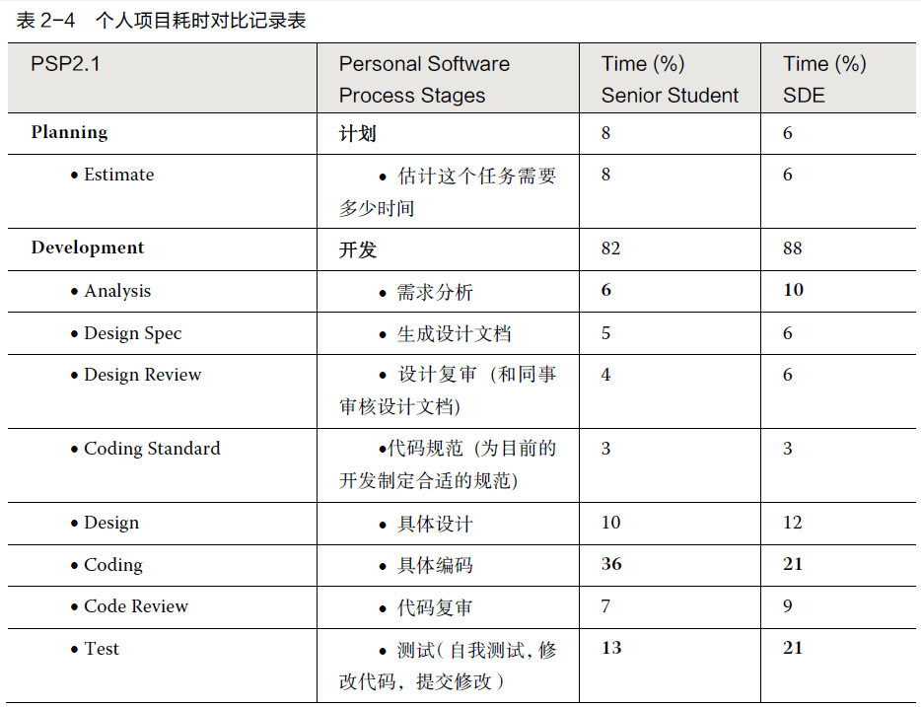
PSP data (大三学生 vs. 工作三年的工程师）

Slide 19
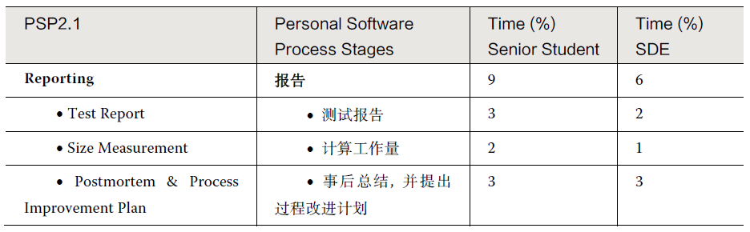
续表

Slide 20
大三 vs. 研究生毕业+工作三年
软件工程师比大四学生多读了 3 年书, 多工作了3 年，两类人任务的质量要求也不一样。
工程师在 “需求分析” 和 “测试” 这两方面明显地要花更多的时间（多 60% 以上）；但是在具体编码上, 工程师比学生 要少花1/3 强的时间。
显然, 从学生到职业程序员, 并不是更加没完没了地写程序——花在写代码上的时间反而少了许多。
请同学们汇报自己在写个人项目时候的时间分布，发布到博客上。

Slide 21
PSP ISSUES (cont.)
How do you measure efficiency?
一群人把一堆砖头从A地搬到B地。
一个剧组排演话剧
一群画家一起创作 “百里长城图”
一群队员在职业球队踢球
一群医生/护士轮流值夜班
一群老师教一个系中不同的课
一群学生做软工项目
如何衡量个人在各自团队的效率？
Notes:
“Gone with the Wind” – more than 7 years in writing.
“<红楼梦>”

Slide 22
PSP ISSUES (cont.)
How do you measure creativity?
写诗歌最多的人是谁?
最有创造力的诗人是谁?
Is software Art or Engineering?
How do you measure an Artist?
“Gone with the Wind” by Margaret Mitchell;
<红楼梦> by 曹雪芹
Notes:
“Gone with the Wind” – more than 7 years in writing.
“<红楼梦>”

Slide 23
Art vs. Follow the rules
念奴娇 · 赤壁怀古 大江东去，浪淘尽， 千古风流人物。 故垒西边，人道是，三国周郎赤壁。 乱石崩云，惊涛裂岸，卷起千堆雪。 江山如画，一时多少豪杰。 遥想公谨当年，小乔初嫁了。 羽扇纶巾，谈笑间，樯橹灰飞烟灭。 故国神游，多情应笑我，早生华发。 人生如梦，一樽还酹江月。
-----------------
找出上面重复的字
-----------------
[南宋]俞文豹：今人看人文字，未论其大体如何，先且指点重字。
Notes:
3: 江， 人，
2: 国，生， 千，故，如

Slide 24
What is SE
Which role is corresponding to software engineer?
房地产老板
投标，买地
建筑设计师
设计建筑
土木工程师
设计土木结构
建筑工人
具体建设
工程监理
监管质量
装修工人
楼房销售
楼房中介
Should software engineering include elements of art?
软件工程师/码农
要做的事情

Slide 25
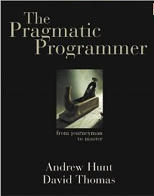
The Pragmatic Approach
Book - TPP
<the Pragmatic Programmer – from Journeyman to Master>
How does TPP guide engineer in:
Planning
Development
Design,
design review and code review
coding standard
Coding
Performance analysis
Test
Postmortem

Slide 26
TPP - Planning
Estimation – consider 2 developers
Al improves his task finish time from 10 days to 7 days; Bob improves it from 10 days to 8 days. Is Al better?
Assignment | Al’s estimation | Al’s delivery | Bob’s estimation | Bob’s delivery
1,2,3 | 10 days | 5, 10, 15 | 10 day | 5, 10, 15
4,5,6 | 7 days | 1, 9, 11 | 8 days | 7,8,9
 |  | Average = 7 |  | Average=8
 |  | StdDev=5.3 |  | StdDev=1
Notes:
Standard deviation is key to the quality of service, and key to build trust. <Jack Welch>

Slide 27
Standard Deviation
Standard deviation is key to the quality of service, and key to build trust.
- Jack Welch
Estimation/Promise vs. Delivery
How is your (or your team’s) Standard Deviation?

Slide 28
What is a skill?
When can you claim you have the skill?
What’s the opposite of skill?
Unskilled?
“problem solving”
http://www.billbuxton.com/xc.html
Quality vs. Quantity
Story of making pottery, the “quantity group” vs. “quality group”

Slide 29
不同层次的问题

Slide 30
“精通”魔方
那怎么才能考察出一个人是否“精通”魔方呢?
a) 给面试者一个各面打乱颜色的魔方；
b) 要求他把六面还原；
c) 如果还原了, 要求他把魔方恢复成我最初给他的那个混乱的局面, 必须一模一样。
精通魔方的同学, 来吧。

Slide 31
课堂演示
单元测试
效能分析

Slide 32
编程作业 vs. 软件工程作业
在软件工程课上的编程作业通常有三类：
学习某种编程语言的特性，例如学习C++ 语言的类的各种知识。这是学习编程语言的基础，不是软件工程作业。
练习某些算法或按某种模式处理数据， 例如：对输入数据进行排序处理，并输出。这是算法和数据结构的练习，不是软件工程作业。
按照给定的需求实现一个较复杂的软件系统，但没有要求系统进行大规模的测试、模拟、实际运行，或后续演化。全国大学生交上来的成千上万的“图书馆信息系统” 就是其中翘楚。这个作业有一定的复杂性，但是离实际的软件还差很远。
软件工程作业是为了练习用工具来解决软件的复杂性

Slide 33
软件的复杂性、易变性
复杂性和易变性。
程序 = 算法 + 数据结构；
软件 = 程序 + 软件工程。
软件工程的编程作业，不仅仅是程序，而是要加入软件工程的要素（复杂性、易变性和其他），有价值的软件工程的作业必须要触及这两个基本要素！

Slide 34
两个原则
单一职责原则（Single Responsibility Principle, SRP）指出
一个模块（类）应该只有一个导致它变化的原因，一个模块应该完全对某个功能负责。
另一个重要的软件设计原则是开放- 封闭原则（Open-Close Principle， OCP）:
软件实体应该是可以扩展的，同时是不可修改的。
允许扩展（Open for extension）。当应用的需求发生改变时，我们可以对模块进行扩 展，从而改变模块的功能。
不允许修改（Closed for modification）。对模块行为进行扩展时，不必改变模块的本身。

Slide 35
何时需要应用这些原则？
在什么情况下使用这些原则呢？
变化的轴线仅当变化实际发生时才具有真正的意义。如果没有征兆，那么去应用SRP，或者其他原则都是不明智的。
遵循 OCP 的代价也是昂贵的……显然，我们希望把 OCP 的应用限定在可能会发生的变化上。……最终，我们会一直等到变化发生时才采取行动。

Slide 36
如何引入“变化的轴线” (1)
从数据方面扩展：
从数据本身的属性扩展，例如处理“ 最大子数组的和”的程序，可以扩展到大数（超 过64 位的数字），这样引入大数的处理。
从数据的数量扩展，很多老师出题就假设数组只有六七个元素，直接写死在程序中。 如果这个数组有一万个、十万个元素呢？如果元素保存在文件里呢？
从数据的维度扩展，如果数据是在多维数组中呢？
从数据的其他属性扩展，例如，如果你的程序能处理北京的地铁数据，如何改进你的 程序，让它能动态处理上海或其他城市的数据呢？这样程序就要引入某种抽象来表示“地点”，而不是僵化地假设数据就是北京的。

Slide 37
如何引入“变化的轴线” (2)
从需求方面扩展, 很多程序的需求都是非常抽象，可以用数学公式描述和验证的，例如：“找出数组中的最大值”，然而实际需求的复杂度往往超过了数学公式的表达能力。请考虑下面几种扩展的方式：
不是仅仅要求结果，而是要让程序把计算的过程显示出来。请搜索各种“动画显示排 序过程”的资料，然后自己实现一下。
从需求的维度方面扩展，例如学生写了一个“统计程序有多少行” 的程序，我们可以 进一步要求，能把注释行、空行、只有一个字符的行去掉么？能处理目录里面的多个文件么？
重复一个成熟的、学生比较熟悉的需求，这也是可行的，关键是要体现“ 工程”的特 点。 例如做一个文档编辑软件，要求能处理10M 大小的文本文件；做一个图书信息系统，要求有10 万本书，100 万条借/ 还书记录。很多同学做的图书馆信息系统只有不到10 本书的记录，这是图书馆么？
在已有的需求上增量改进，例如，让文档编辑软件支持 markdown 语法，支持无限的 “后悔”操作；让图书馆信息系统支持手机客户端。如果图形编辑器支持三种图形模板，现在引入五种新的模板，在这种情况下，程序员就会审视自己的设计是否能遵循一些设计原则，来高效率地满足需求。
探索创新的方式来满足已有的需求，或即将出现的需求。

Slide 38
如何引入“变化的轴线” (3)
从用户方面扩展：绝大部分大作业都是单机运行，给一个用户（老师）看一次，看完就万事大吉。我们可以考虑下面的扩展方式：
单用户第二次使用这个软件的时候，能有什么功能，让单用户更喜欢这个软件？（例 如：记住上次的状态，自动展现上次文档最后编辑的地方，等等。）
如果多用户使用这个系统，会出现什么问题，例如，学生的图书馆信息系统考虑到有 100 人同时查询的情况么？如何模拟这样的测试？我们在课堂上让几十个学生玩的“黄金点”游戏，如果是全世界的用户都可以编程序玩这个游戏，会出现什么9 ？如何设计游戏的服务？
用户从世界各地来，怎么办？你的“程序”能提供多种语言的界面么？
用户有善意的和恶意的，如何让你的程序更安全？如何测试安全性？

Slide 39
如何引入“变化的轴线” (4)
从软件构建方面扩展：
如果是把一个已有的软件从一个平台迁移到另一个平台，怎么办？
大多数的“程序”都是用单一的语言写的，如果软件有多个语言写成的不同模块，如 何定义彼此的接口（API） ？
如果软件已经在服务中（例如图书馆信息系统），如何升级部分模块，同时尽量减少 系统下线的时间？

Slide 40
高级工程师 和 初级爱好者的区别
能够计划，并按时交付
能够通过单元测试等实践来保证质量
能够使用工具，做程序的效能分析
能“精通”一些领域，在此基础上发挥效率并创新。
结合中国软件行业的特点，我们可以归纳出在中国IT 行业“好工程师”的要素，并做成一个自我评价清单（Check-list）
http://www.cnblogs.com/xinz/p/3852177.html

Slide 41
Homework
http://www.cnblogs.com/xinz/p/3803109.html
how do you measure the performance of each team member?
一群人把一堆砖头从A地搬到B地
一个剧组排演话剧
爵士乐小组的演奏 / 交响乐团成员的演奏
推荐 Miles Davis 爵士乐队的演奏
一群队员在职业球队踢球
医生, 护士, 麻醉师做手术
一群画家合作“万里长城” 画卷
计算机系的一群老师教课
一群学生做软工项目 (PM, Dev, Test) (this is your focus)
如何衡量个人在各自团队的效率和绩效？
团队有 (n * 30) 分浮动分数，如何分配?
Write a blog ☺

Slide 42
Questions and Answer

Slide 43
Homework
做医生的有希波克拉底誓言, 做程序员的应该有类似的誓言:
从道德标准中任选一条或者几条, 举一个实际的例子说明软件公司/个人遵守或违反此标准的例子。
写在小组博客上。

