Slide 1
个人技术和流程
邹欣
构建之法 – 现代软件工程

Slide 2
课程安排
软件工程是什么？ (复习)
怎样提高技术
PSP – Personal Software Process
怎样告诉别人你已经获得了这些技术？
怎样衡量你的工作效率?

Slide 3
软件工程由什么要素组成?
It encompasses techniques and procedures, often regulated by a software development process, with the purpose of improving the effectiveness, reliability, and maintainability of software systems.
个人软件流程
Personal Software Process
团队软件流程
Team Software Process

Slide 4

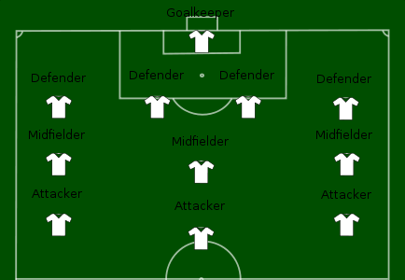
Use Soccer as Example
Personal Soccer Process
体能
技术
意识
Team Soccer Process
阵型
配合
临场
流程并不是最终目标，按时发布好软件才是目标
Notes:
Without personal skills, team work is impossible, even when we have healthy, upright, PhD degree team members. This is why we want everyone to focus on individual skills, the right set of skills, which are the foundation of our team work.

Slide 5
个人在软件团队中的作用
Most components in a software system is developed and maintained by Individual Contributor (IC)
IC needs to –
Understand the current situation（理解当前的问题）
Find the solution （找到解决方案）
Estimate the work （估计工作时间）
Communicate the proposal to stake holders and customers（和众多利益相关人士交流）
Carry out the work （执行工作）
Be accountable for the outcome （对结果负责）
个人工作的质量直接影响产品质量
Notes:
Work is carried out by each individual
Skills as an “Individual Contributor” is important

Slide 6
How Are You Doing?
作为一个软件工程师, 你觉得自己表现如何?
有没有这样的体会:
看书的时候觉得“技止此耳”，开发项目的时候才觉得实际情况和书上讲的都有一些出入，一些重要的细节书上没有提。很多人是边看asp.net的书, 边开发asp.net 的项目，这相当于一边看医学书一边动手术。。。
如果你是病人, 你希望你的医生:
刚刚在书上看到你的病例, 一边看书一边开刀…
开刀的过程中突发奇想, 然后在你身上试验…
已经做了多年此类手术, 可以一边做手术, 一边和别人聊天
你在写软件的时候, 是哪种情况?
那一个软件工程师如何成长，如何证明自己的成长?
Personal Software Process

Slide 7
How to “learn” knowledge
知识体系是构建出来的, 而不是接收到的
与其灌输知识, 远不如让学生自己构建
人的认知模型改变得非常缓慢
搞那些速成的, 疯狂的, 喊口号的培训未必改变了人的认知模型
提问能帮助构建知识体系
鼓励学生思考, 辩论,
身心投入, 回顾总结是成长的关键

Slide 8
How to Grow Skills – PSP0
Personal Software Process
Body of knowledge (PSP)
Process The Input to PSP is the requirements;
requirement document is completed and delivered to the engineer.
Output: metrics telling how good an engineer is.
PSP0 has 3 phases:
planning,
development (design, coding, test)
postmortem.
Is this the process of your I-Project?
Notes:
http://www.sei.cmu.edu/library/abstracts/reports/05sr003.cfm
A baseline is established of current process measuring: time spent on programming, faults injected/removed, size of a program. In a post mortem, the engineer ensures all data for the projects has been properly recorded and analysed. PSP0.1 advances the process by adding a coding standard, a size measurement and the development of a personal process improvement plan (PIP). In the PIP, the engineer records ideas for improving his own process.

Slide 9
How to Grow Skills – PSP0.1
PSP0.1, based on PSP0, Adding
Coding Standard
Size Measurement
Process Improvement Plan (PIP) – engineer records ideas for improving his own process
Do you have these in your I-Project?

Slide 10
PSP1
PSP1, PSP1.1 (Introduces estimating and planning)
Based upon the baseline data collected in PSP0 and PSP0.1, the engineer estimates how large a new program will be and prepares a test report (PSP1).
Accumulated data from previous projects is used to estimate the total time.
Each new project will record the actual time spent.
This information is used for task and schedule planning and estimation (PSP1.1).
Did you have estimation before Coding?
How far off was your estimation?
Notes:
PSP1, PSP1.1 (Introduces estimating and planning) Based upon the baseline data collected in PSP0 and PSP0.1, the engineer estimates how large a new program will be and prepares a test report (PSP1). Accumulated data from previous projects is used to estimate the total time. Each new project will record the actual time spent. This information is used for task and schedule planning and estimation (PSP1.1).

Slide 11
PSP2
PSP2, PSP2.1 (Introduces quality management and design)
PSP2 adds two new phases:
Design Review and Code Review.
Defect Prevention and removal are the focus at the PSP2.
Engineers construct and use checklists for design and code reviews.
PSP2.1 introduces design specification and analysis techniques
Did you do Self-review of your design?
Do you have a check-list of your code?
Notes:
PSP2, PSP2.1 (Introduces quality management and design) PSP2 adds two new phases: design review and code review. Defect prevention and removal are the focus at the PSP2. Engineers learn to evaluate and improve their process by measuring how long tasks take and the number of defects they inject and remove in each phase of development. Engineers construct and use checklists for design and code reviews. PSP2.1 introduces design specification and analysis techniques

Slide 12
PSP Evolution
PSP0
Planning
Development
Design
Coding
Test
Postmortem
PSP0.1
Planning
Development
Coding Standard
Design
Coding
Test
Size Measurement
Postmortem
Process Improvement Plan
PSP1
Planning
Estimate
Development
Coding Standard
Design
Coding
Test
Test Report
Size Measurement
Postmortem
Process Improvement Plan

Slide 13
PSP Evolution (cont.)
PSP1.1
Planning
Estimate
Development
Coding Standard
Design
Coding
Test
Record Time Spent
Test Report
Size Measurement
Postmortem
Process Improvement Plan
PSP2
Planning
Estimate
Development
Design Review
Coding Standard
Design
Coding
Code Review
Test
Record Time Spent
Test Report
Size Measurement
Postmortem
Process Improvement Plan
PSP2.1
Planning
Estimate
Development
Analysis
Design Spec
Design Review
Coding Standard
Design
Coding
Code Review
Test
Record Time Spent
Test Report
Size Measurement
Postmortem
Process Improvement Plan

Slide 14
DATA
One of the core aspects of the PSP is using historical data to analyze and improve process performance. PSP data collection is supported by four main elements:
Scripts
Measures
Standards
Forms

Slide 15
Core Measures:
The PSP scripts provide expert-level guidance to following the process steps and they provide a framework for applying the PSP measures. The PSP has four core measures:
Size – the size measure for a product part, such as lines of code (LOC).
How big is the task
Effort – the time required to complete a task, usually recorded in minutes.
How big is the effort
Quality – the number of defects in the product.
How good is your result
Schedule – a measure of project progression, tracked against planned and actual completion dates.
How timely is the delivery

Slide 16
Measures
Based on this principle:
You can’t improve what you can’t measure.
The key data collected in the PSP tool are time, defect, and size data –
the time spent in each phase;
when and where defects were injected, found, and fixed;
and the size of the product parts.
Software developers use many other measures that are derived from these three basic measures to understand and improve their performance.
Notes:
The key data collected in the PSP tool are time, defect, and size data – the time spent in each phase; when and where defects were injected, found, and fixed; and the size of the product parts. Software developers use many other measures that are derived from these three basic measures to understand and improve their performance. Derived measures include:
estimation accuracy (size/time)
prediction intervals (size/time)
time in phase distribution
defect injection distribution
defect removal distribution
productivity
reuse percentage
cost performance index
planned value
earned value
predicted earned value
defect density
defect density by phase
defect removal rate by phase
defect removal leverage
review rates
process yield
phase yield
failure cost of quality (COQ)
appraisal COQ
appraisal/failure COQ ratio

Slide 17
PSP ISSUES
In small, start-up team, high quality requirement is hard to find
If the input is in low quality, how can the quality of PSP be ensured?
Depends on data
Requires developers to enter data to log various activities
What if data is missing, or inaccurate?
Conflict of interest? Should I honestly record how bad I am?
Micro-measurement
Do we need to measure code size everyday?
Writing your own code vs. re-use, use libraries
One strong dev removed 2000 LOC bad code, what’s his performance?
What’s the end goal?
Measuring how to effectively execute on a requirement
NOT measuring how customers are satisfied by the product.
Notes:
“Gone with the Wind” – more than 7 years in writing.
“<红楼梦>”

Slide 18
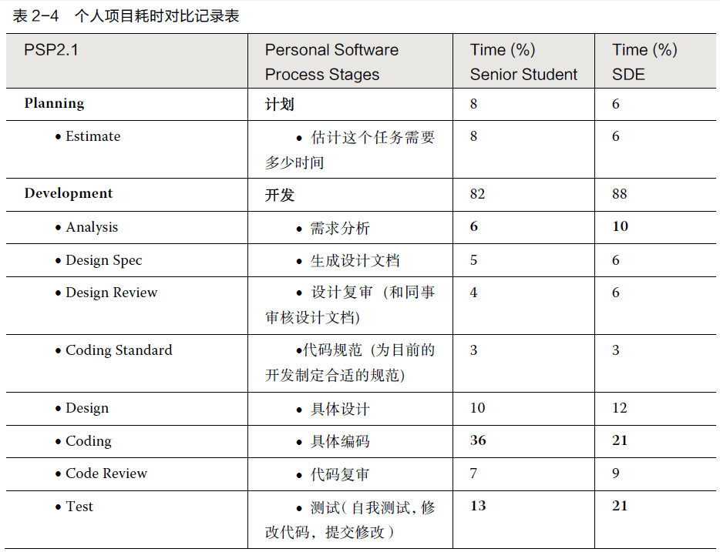
PSP data (大三学生 vs. 工作三年的工程师）

Slide 19
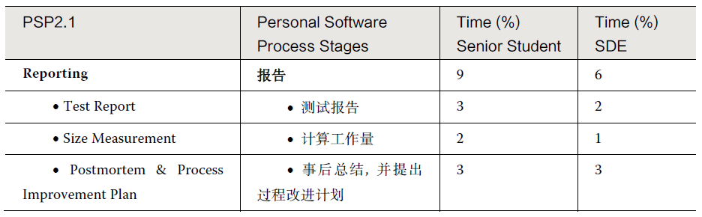
续表

Slide 20
大三 vs. 研究生毕业+工作三年
软件工程师比大四学生多读了 3 年书, 多工作了3 年，两类人任务的质量要求也不一样。
工程师在 “需求分析” 和 “测试” 这两方面明显地要花更多的时间（多 60% 以上）；但是在具体编码上, 工程师比学生 要少花1/3 强的时间。
显然, 从学生到职业程序员, 并不是更加没完没了地写程序——花在写代码上的时间反而少了许多。
请同学们汇报自己在写个人项目时候的时间分布，发布到博客上。

Slide 21
PSP ISSUES (cont.)
How do you measure efficiency?
一群人把一堆砖头从A地搬到B地。
一个剧组排演话剧
一群画家一起创作 “百里长城图”
一群队员在职业球队踢球
一群医生/护士轮流值夜班
一群老师教一个系中不同的课
一群学生做软工项目
如何衡量个人在各自团队的效率？
Notes:
“Gone with the Wind” – more than 7 years in writing.
“<红楼梦>”

Slide 22
PSP ISSUES (cont.)
How do you measure creativity?
写诗歌最多的人是谁?
最有创造力的诗人是谁?
Is software Art or Engineering?
How do you measure an Artist?
“Gone with the Wind” by Margaret Mitchell;
<红楼梦> by 曹雪芹
Notes:
“Gone with the Wind” – more than 7 years in writing.
“<红楼梦>”

Slide 23
Art vs. Follow the rules
念奴娇 · 赤壁怀古 大江东去，浪淘尽， 千古风流人物。 故垒西边，人道是，三国周郎赤壁。 乱石崩云，惊涛裂岸，卷起千堆雪。 江山如画，一时多少豪杰。 遥想公谨当年，小乔初嫁了。 羽扇纶巾，谈笑间，樯橹灰飞烟灭。 故国神游，多情应笑我，早生华发。 人生如梦，一樽还酹江月。
-----------------
找出上面重复的字
-----------------
[南宋]俞文豹：今人看人文字，未论其大体如何，先且指点重字。
Notes:
3: 江， 人，
2: 国，生， 千，故，如

Slide 24
What is SE
Which role is corresponding to software engineer?
房地产老板
投标，买地
建筑设计师
设计建筑
土木工程师
设计土木结构
建筑工人
具体建设
工程监理
监管质量
装修工人
楼房销售
楼房中介
Should software engineering include elements of art?
软件工程师/码农
要做的事情

Slide 25

The Pragmatic Approach
Book - TPP
<the Pragmatic Programmer – from Journeyman to Master>
How does TPP guide engineer in:
Planning
Development
Design,
design review and code review
coding standard
Coding
Performance analysis
Test
Postmortem

Slide 26
TPP - Planning
Estimation – consider 2 developers
Al improves his task finish time from 10 days to 7 days; Bob improves it from 10 days to 8 days. Is Al better?
Assignment | Al’s estimation | Al’s delivery | Bob’s estimation | Bob’s delivery
1,2,3 | 10 days | 5, 10, 15 | 10 day | 5, 10, 15
4,5,6 | 7 days | 1, 9, 11 | 8 days | 7,8,9
 |  | Average = 7 |  | Average=8
 |  | StdDev=5.3 |  | StdDev=1
Notes:
Standard deviation is key to the quality of service, and key to build trust. <Jack Welch>

Slide 27
Standard Deviation
Standard deviation is key to the quality of service, and key to build trust.
- Jack Welch
Estimation/Promise vs. Delivery
How is your (or your team’s) Standard Deviation?

Slide 28
What is a skill?
When can you claim you have the skill?
What’s the opposite of skill?
Unskilled?
“problem solving”
http://www.billbuxton.com/xc.html
Quality vs. Quantity
Story of making pottery, the “quantity group” vs. “quality group”

Slide 29
不同层次的问题

Slide 30
“精通”魔方
那怎么才能考察出一个人是否“精通”魔方呢?
a) 给面试者一个各面打乱颜色的魔方；
b) 要求他把六面还原；
c) 如果还原了, 要求他把魔方恢复成我最初给他的那个混乱的局面, 必须一模一样。
精通魔方的同学, 来吧。

Slide 31
课堂演示
单元测试
效能分析

Slide 32
高级工程师 和 初级爱好者
能够计划，并按时交付
能够通过单元测试等实践来保证质量
能够使用工具，做程序的效能分析
能“精通”一些领域，在此基础上发挥效率并创新。
结合中国软件行业的特点，我们可以归纳出在中国IT 行业“好工程师”的要素，并做成一个自我评价清单（Check-list）
http://www.cnblogs.com/xinz/p/3852177.html

Slide 33
Homework
http://www.cnblogs.com/xinz/p/3803109.html
how do you measure the performance of each team member?
一群人把一堆砖头从A地搬到B地
一个剧组排演话剧
爵士乐小组的演奏 / 交响乐团成员的演奏
推荐 Miles Davis 爵士乐队的演奏
一群队员在职业球队踢球
医生, 护士, 麻醉师做手术
一群画家合作“万里长城” 画卷
计算机系的一群老师教课
一群学生做软工项目 (PM, Dev, Test) (this is your focus)
如何衡量个人在各自团队的效率和绩效？
团队有 (n * 30) 分浮动分数，如何分配?
Write a blog ☺

Slide 34
Questions and Answer

Slide 35
Homework
阅读
http://www.cnblogs.com/xinz/archive/2011/03/28/1997566.html
做医生的有希波克拉底誓言, 做程序员的应该有类似的誓言:
从道德标准中任选一条或者几条, 举一个实际的例子说明软件公司/个人遵守或违反此标准的例子。
写在小组博客上。

