Slide 1
用户调研 - User Study
Xin Zou （邹欣）
2014
构建之法 – 现代软件工程

Slide 2
Different types of user study
Usability Studies
Focus Groups
Card sorting
Surveys
Ethnographic Studies
Paper Prototype Studies
Eye Tracking Studies
Diary Studies
In-depth Interview

Slide 3

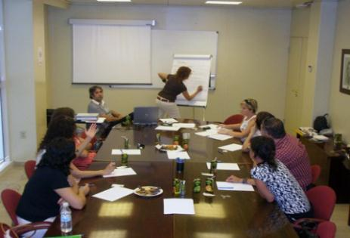
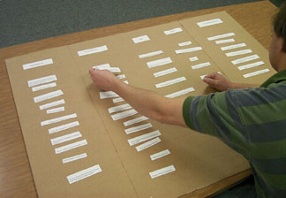
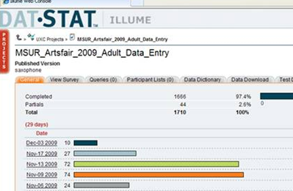

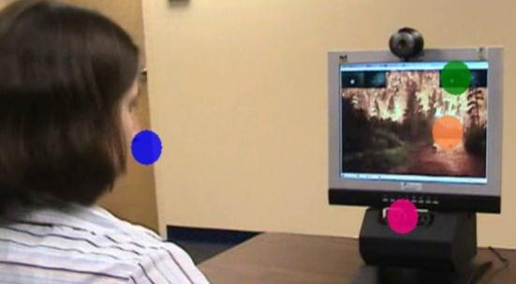
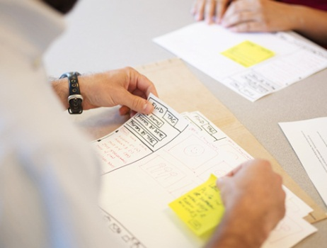
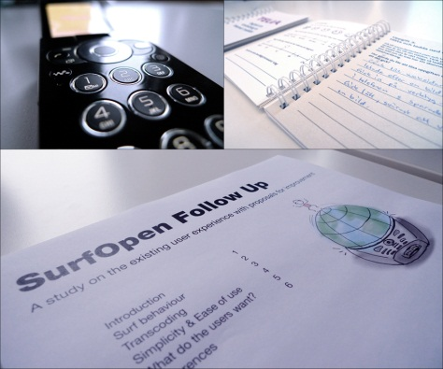


Research Methods
Usability Studies
可用性调查
Focus Groups
焦点小组
Card Sorting
卡片分类
Surveys
调查问卷
Ethnology Study
人类学调查
Eye Tracking Studies
眼动跟踪研究
Paper Prototype Studies
纸上模型研究
In-depth Interview
深入面谈
Diary Studies
日志调研

Slide 4
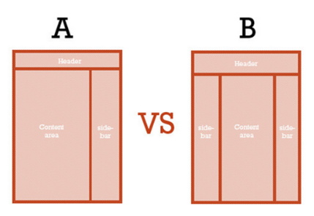
Research Methods – A/B Testing
A/B Test
A/B 测试

Slide 5
Dimensions of Different Methods
Behavioral
行为
What people do
Usability benchmarking
Usability lab study
Ethnographic study
Eye tracking
Why & How to fix
How much & How many
Card sorting
Diary study
Participatory design
Focus group
What people say
Survey
Attitudinal
态度
Qualitative / 感觉
Quantitative / 数量化的

Slide 6
Dimensions of Different Methods
Behavioral
行为/观其行
A/B Testing
Usability benchmarking
Usability lab study
Ethnographic study
Eye tracking
Card sorting
Diary study
Attitudinal
态度/听其言
In-depth interview
Focus group
User Survey
Qualitative /定性/为啥/怎样改进
Quantitative / 定量/是多少

Slide 7
用户有多种
我们说了这么多用户调研, 很多人假设评价软件的就是购买软件的，就是使用软件的，但是未必。看下面的例子:
a) 你要写一个中学生学习英语的软件，你找谁去做用户调研?
中学生 - 最终用户 家长 - 他们是要掏钱的人，他们不会每天都用软件，有些人都不太会英语，但是他们也有需求 学校老师 - 他们是有巨大影响力的人，他们说不定立下一道规矩，我们班级就用某某软件!
b) 你要写一个企业管理软件, 你要找谁去做用户调研?

Slide 8
做过头了会怎样？
我们有这么多各式各样的工具, 互联网给我们带来了这么多用户和数据, 这是好事, 也有副作用。 世界上能访问用户数据, 并根据数据做分析和改进的公司, 大概 Google 是其中翘楚, 这种 data-centric 的做法做过了头, 也有悲剧发生:
Douglas Bowman 曾经是Google 的视觉设计主管, 2009 年的一天, 他受不了了:
Yes, it's true that a team at Google couldn't decide between two blues, so they're testing 41 shades between each blue to see which one performs better. I had a recent debate over whether a border should be 3, 4, or 5 pixels wide, and was asked to prove my case. I can't operate in an environment like that. I've grown tired of debating such minuscule design decisions...
当你的公司要你用数据来证明 41 中蓝色到底哪一种更好, 或者为一个边栏宽度是3, 4, 或5 而争执不休, 纷纷表示要拿数据来证明的时候, 你怎么办?

Slide 9
Is it too late to do user study now？
In Agile world, it’s never too late
When you present your software to user, the learning has just started.
当你把软件交给用户的时候，学习才刚刚开始
下面每个小组做 user study
选一种 user study 方法.
为你的小组找到一个目标用户 （到教室外找到别的班级的同学）
让她使用软件解决真实的问题 (观察，记录)
没有软件可以展示的小组可以采取 “调查问卷/深入采访” 的办法
总结用户反馈

Slide 10
What is Quick Pulse Study?
A quicker study than traditional usability study; can be seen as an agile version
Regularly recruit 3 users to come
15 - 30 for each participant
PM/Design will provide test materials
Quick way to start gathering user feedback without a lot of planning overhead
Provides a “gut check” when there isn’t time for a “full” usability study
Provide a way to quickly test lower priority items that may not make it into a “full” usability study
NOT a replacement for a “full” usability studies

