Slide 1
One-ways as a Traffic Intervention
Project Mentor:
Jayati Deshmukh
Interns:
Prakhar Rastogi
Shubhanshu Agrawal
Duration:
15/05/2022 - 27/07/2022

Slide 2
Abstract
The goal of our project was to implement a fully functioning one-way traffic intervention framework, which would allow us to try out a lot of different simulation scenarios. The framework would recommend particular roads to be made one-way. We would then analyse the before and after of the traffic interventions in order to decide if the traffic intervention is actually helping us or not.

Slide 3
Status of the project:
What we started with:
We began from scratch.
We tried to get some real time traffic data from google and bing maps api, but in the end weren’t able to do so.
We then got started with coming up with an algorithm to decide which roads to be made one way
What we ended with:
We created a fully functioning framework where one can run different intervention scenarios and get the appropriate top 5 roads that should be made one-way
We have 3 traffic simulations: moderate, high, very high
Moderate: 529 vehicles
High: 1678 vehicles
Very high: 3801 vehicles
We run our code for all of them and then compare the before and after of our traffic intervention.

Slide 4
Sprint Details:
We first familiarized with SUMO and traci and learnt all the requirements of the project
We then tried to implement real time traffic simulation in SUMO using some map api’s.
We started working on initial one way algorithm and tried to make a basic skeleton.
We then completed our algorithm(for one metric only) and check it for 3-traffic scenarios.
We also tried if we get same road one-way by using centrality of edge.

Slide 5
Challenges we faced:
Which roads are to be made one-way.
How to ensure that making a road one way will not disconnect our network.
Found that our LCC algorithm will fail in some cases and hence had to come up with a completely new logic to ensure connectivity of the network
We considered the traffic flow at a particular timestep, thus considering the traffic in terms of the whole simulation, our results weren’t accurate enough.
Weren’t able to implement some real life traffic data into our simulation.

Slide 6
Dealing with Challenge-1
The algorithm we came up with is as follows:
For a particular timestep, for every road, we calculate the difference between the incoming and outgoing traffic and store it.
Using the difference in traffic as a metric, we can choose a particular amount of roads to me made one-way ( let’s say 5).
We then will make the outputted roads one-way in our network file
Finally we will compare before and after traffics conditions.
For now we are considering only one metric, i.e the difference in flows. Once we have a working solution, we plan to extend this to more metrics for increased accuracy.

Slide 7
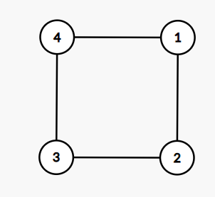
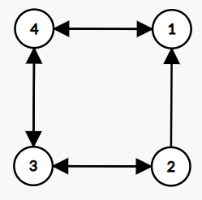
Challenge-2
Let say we have a network as a Figure-1. Now if we make road 1-2 one-way, i.e going from 2 to 1, we have to ensure that every vehicle should be able to reach any point between 1-2. For eg:- vehicle previously travelling from 4-1-3 will now should travel from 4-3-2-1.
Figure 1
Figure 2

Slide 8
Challenge-2 : Solution
Brute force method is to traverse for all the road and check that can we reach every edge of the road from other path.
This is a bulky process and while converting the whole map to graph will also give some issues as there are some paths in the map which are already one-way.
So we took the largest connected component of the graph and we will select the one-way edge from the this component only.
My code will extract out the largest component of the graph and from that we can apply our previous algorithm to check whether the road should be made one way or not

Slide 9
Dealing with Challenge-3
We tried LCQ and we found out that if we make one road as one way that means removing one edge from the LCQ. Now we are no more sure that if we remove another edge, i.e make one more road one-way, it will be still connected.
So the solution for the above issue is that every time we remove the edge from graph,i.e make the road one-way, we will make sure that the number of strongly connected components still remain same in the graph.

Slide 10
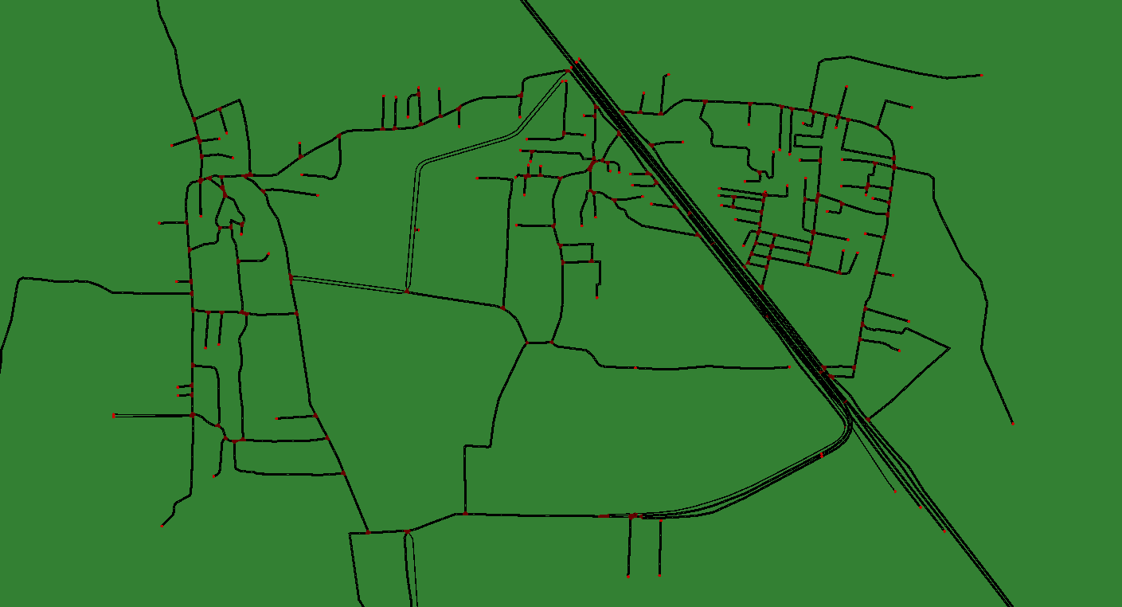
Original Network
This is the network that we worked on

Slide 11
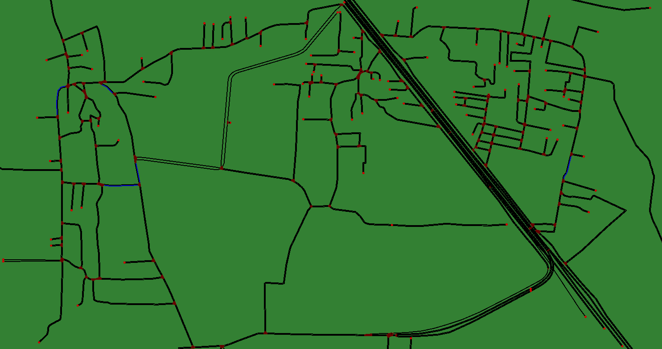
Moderate traffic Results:
The roads that are highlighted in blue are the ones we made oneway according to the output of our algorithm:

Slide 12
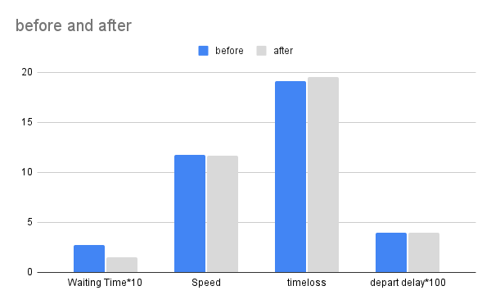
Moderate traffic Results:

Slide 13
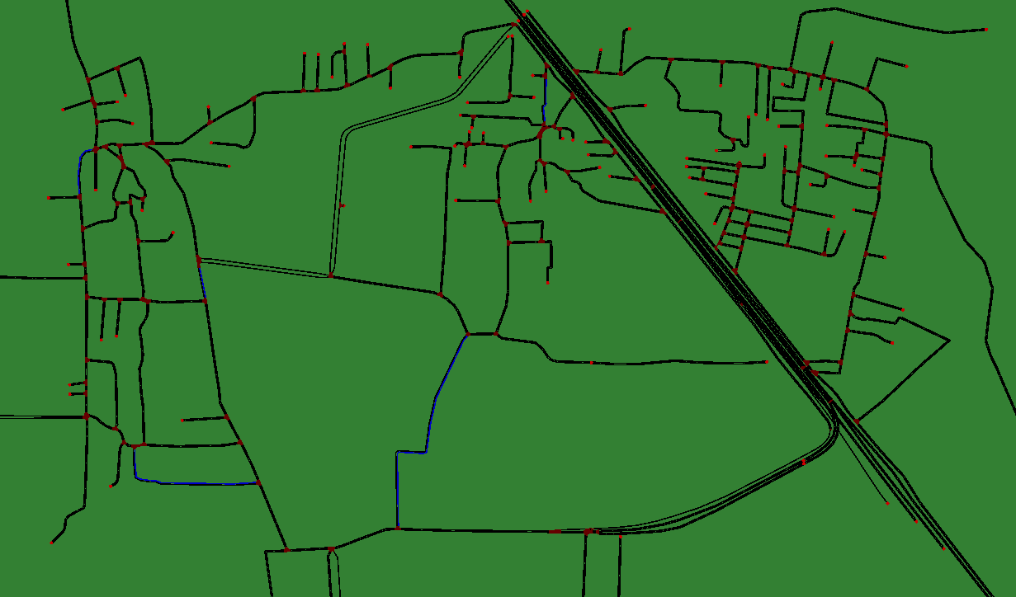
High traffic Results:
The roads that are highlighted in blue are the ones we made one way according to the output of our algorithm:

Slide 14
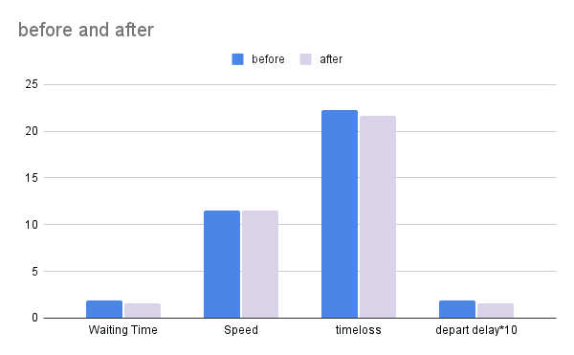
High traffic Results:

Slide 15
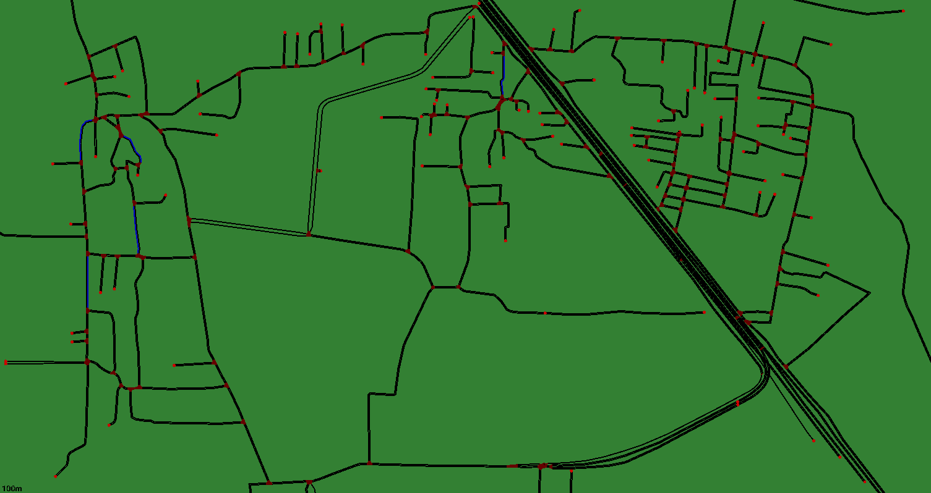
Very High traffic Results:
The roads that are highlighted in blue are the ones we made one-way according to the output of our algorithm:

Slide 16
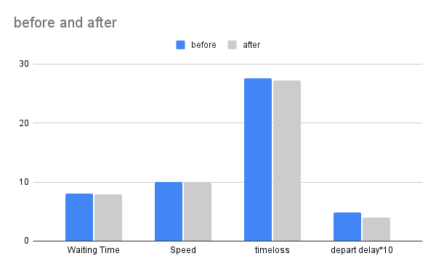
Very High traffic Results:

Slide 17
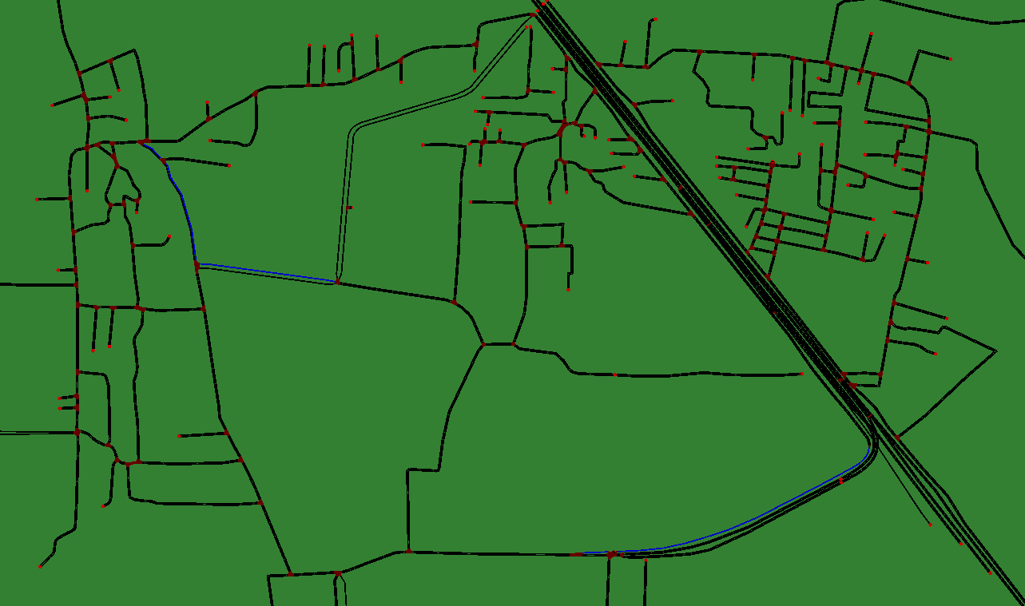
Centrality Results:
The roads that are highlighted in blue are the ones we made oneway according to the output of our algorithm:

Slide 18
Future Scope:
We plan to incorporate a few more metrics into our algorithm to enhance the accuracy.
Possibly try to combine the Adaptive traffic light intervention and our Oneway intervention.
Using real time data for analysis (tried to solve, weren’t able to).

Slide 19
THANK YOU

