Slide 1
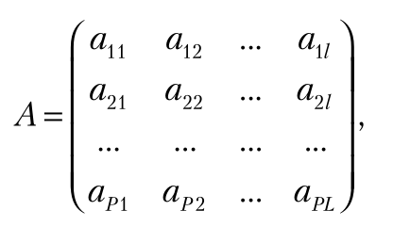
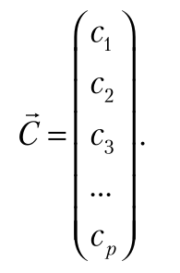
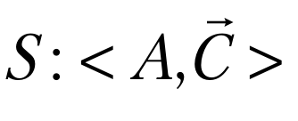
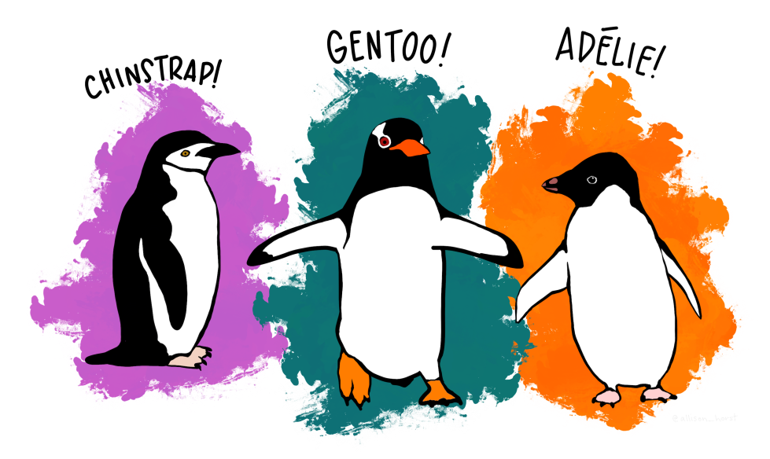
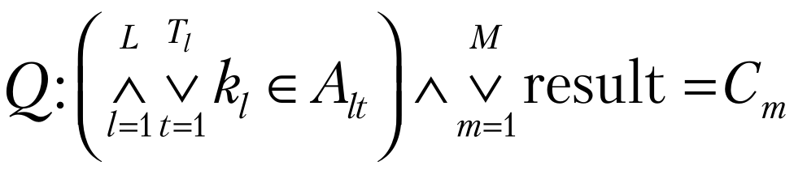
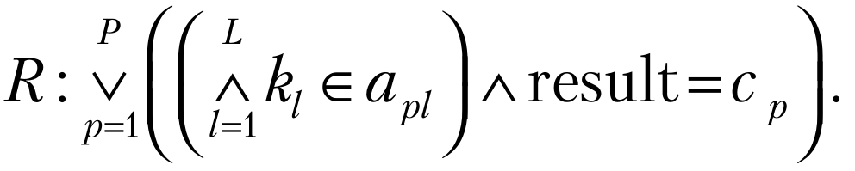
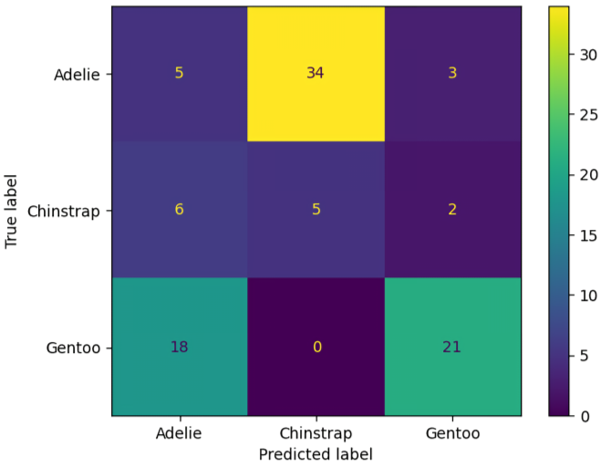
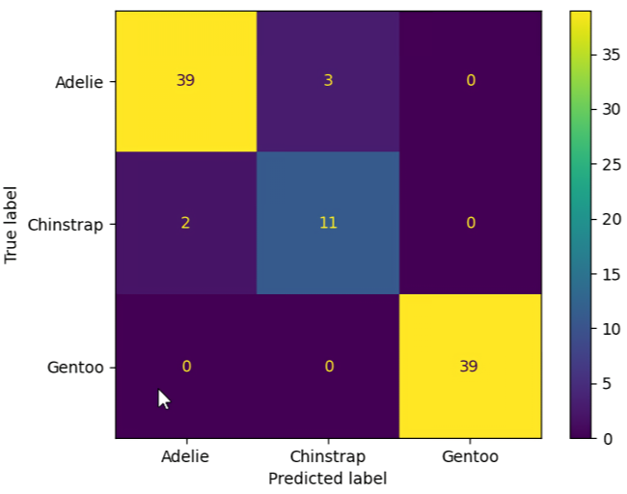
Automatic formation of fuzzy production rules on the basis of a training sample
training sample
A - the matrix of Antecedents,
B – the column vector of Consequents.
Hoare triple: {Q}⋅S⋅{R}
Checking the knowledge base for correctness
Dataset
Contradiction matrices – 250/94 (training/test):
test samples
Checking the correctness of the rule base for solv­ing the classification problem
before training after training

