Slide 1

C Pointers Workshop
Max Petrushin

Slide 2
Objectives
Learn C pointer rules & syntax
Understand advanced pointer concepts (array, structure, pointers to pointers)
Understand why C pointers are important (use cases for pointers)
Go over example problems

Slide 3
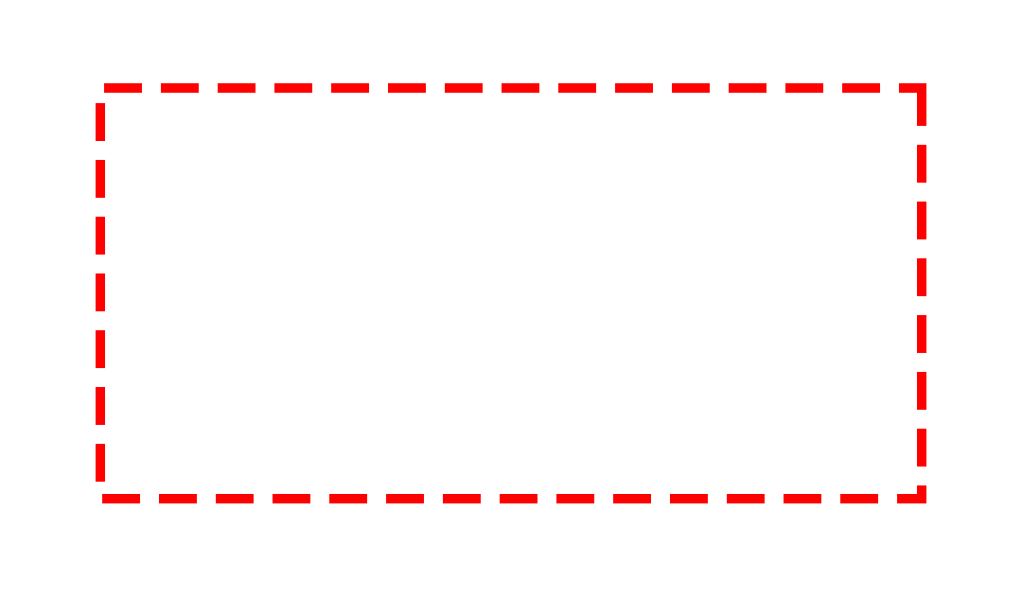
C Pointer Rules
Memory
1) Getting address of a variable
&(variable_name) // notation to get address of variable
Ex:
int a = 5; &a // address of integer a
double b = 0.2; &(b) // address of double b
print:
printf(“%p”, &a); // %p short for pointer (hex format)
printf(“%d”, &(a)); // %d prints address in decimal format
0x0000
0x0004
0x0008
0x000C
0x0010
...
...
...
...
0xFFF0
0xFFF4
0xFFF8
0xFFFC
a
5
0.2
b

Slide 4
C Pointer Rules
Memory
2) Dereference - going from address to variable (content of that address)
*(&(variable_name)) // notation to dereference the address of variable
Ex:
*(&a) // Dereferencing the address of a
*(&b) // Dereferencing the address of b
print:
printf(“%d”, *(&a) ); // prints value of a (5)
printf(“%f”, *(&b) ); // prints value of b (0.2)
0x0000
0x0004
0x0008
0x000C
...
...
...
...
...
0xFFF0
0xFFF4
0xFFF8
0xFFFC
a
5
0.2
b

Slide 5
C Pointer Rules
Memory
3) Pointer type (another C data type, just like int, double, char, etc…)
data_type* variable_name; // notation to define a pointer variable
Ex:
int* x; // Integer pointer x
double* y; // Double pointer y
0x0000
0x0004
0x0008
0x000C
...
...
...
...
...
0xFFF0
0xFFF4
0xFFF8
0xFFFC
a
5
0.2
b
x
y

Slide 6
C Pointer Rules
Memory
4) Pointer type == Address of a variable
Pointer type exists to store the address of the variable (just like integer type exists to store integers)
Ex:
int a = 5; // integer a
int* x; // integer pointer x
x = &a; // integer pointer x stores address of integer a\
print(“%d”, *x); // prints “5”
double b = 0.2; // double b
double* y; // double pointer y
y = &b; // double pointer y stores address of double b
print(“%f”, *y); // prints “0.2”
0x0000
0x0004
0x0008
0x000C
...
...
...
...
...
0xFFF0
0xFFF4
0xFFF8
0xFFFC
a
5
0.2
b
x
0x0004
y
0x000C

Slide 7
C Pointer Rules
Many meanings of * (star)
Multiplication
int x = 2 * 3; // x is assigned to 6 (2*3)
Pointer data type indication
int* y; // we use * to replace word “pointer” in “integer pointer”
float* z; // we use * to replace word “pointer” in “float pointer”
Dereferencing
y = &x; // pointer y is assigned to address of x
*(y); // dereferencing pointer y, gives you “6”
*(&x); // dereferencing the address of x, gives you “6”

Slide 8
C Pointer Rules
Declaration vs. Initialization of Pointers
int x = 5;
int* a; // Declaration of pointer a
a = &x; // Assigning …
int x = 5;
int* a = &x; // Initialization of pointer a
They both do the same thing. Both are valid.

Slide 9
Advanced Pointer Concepts
Memory
1) Pointer to Pointers
Before, we looked at Pointers to Variables!
Now, we’re looking at Pointers to Pointers … (Double-Pointer)
int x; // declaring an integer x
x = 5;
int* y; // declaring a pointer to integer
y = &x; // assigning it to address of integer
int** z; // declaring a pointer to a pointer to integer
z = &y; // assigning it to address of …
0x0000
0x0004
0x0008
0x000C
...
...
...
...
...
0xFFF0
0xFFF4
0xFFF8
0xFFFC
x
5
y
0x0004
z
0x000C

Slide 10
Advanced Pointer Concepts
Memory
1) Pointer to Pointers
Dereferencing double-pointers
printf(“%d”, x); // prints “5”
printf(“%d”, *y); // prints “5”
printf(“%d”, **z); // prints “5”
printf(“%p”, z); // prints “0x000C”
printf(“%p”, &y); // prints “0x000C”
printf(“%p”, y); // prints “0x0004”
printf(“%p”, &x); // prints “0x0004”
0x0000
0x0004
0x0008
0x000C
...
...
...
...
...
0xFFF0
0xFFF4
0xFFF8
0xFFFC
x
5
y
0x0004
z
0x000C

Slide 11
Advanced Pointer Concepts
Memory
2) Pointer Arithmetic
x = x + 2; // Regular int arithmetic, x is now “7”
y = y + 1; // Pointer arithmetic, y is now “0x0008”
How big is increment (or decrement)? Depends on what it’s pointing to!
4 bytes - int // y++; makes y equal to “0x0008”
8 bytes - double // y++; makes y equal to “0x000C”
1 bytes - char // y++; makes y equal to “0x0009”
Depends on a machine too (32bit vs 64bit etc…)
0x0000
0x0004
0x0008
0x000C
0x0010
...
...
...
...
0xFFF0
0xFFF4
0xFFF8
0xFFFC
x
5
y
0x0004

Slide 12
Advanced Pointer Concepts
Memory
3) Arrays and Pointers
Array - variables of same type continuously stored in a single block
int arr[3] = {0, 1, 2}; // Initializing array of size 3
Array variables name is actually a pointer to it’s first element! Just remember this…
arr == &arr[0] // Just remember this…
arr // This is a pointer to arr[0]
arr+1 // This is a pointer to arr[1]
arr+2 // This is a pointer to arr[2]
arr
0x0004
0x0000
0x0004
0x0008
0x000C
...
...
...
...
...
0xFFF0
0xFFF4
0xFFF8
0xFFFC
arr[0]
0
arr[1]
1
arr[2]
2

Slide 13
Advanced Pointer Concepts
Memory
3) Arrays and Pointers
Accessing array elements through pointer arithmetic
*(arr) // “0”
*(arr+1) // “1”
*(arr+2) // “2”
Is equivalent to:
arr[0] // “0”
arr[1] // “1”
arr[2] // “2”
arr
0x0004
0x0000
0x0004
0x0008
0x000C
...
...
...
...
...
0xFFF0
0xFFF4
0xFFF8
0xFFFC
arr[0]
0
arr[1]
1
arr[2]
2

Slide 14
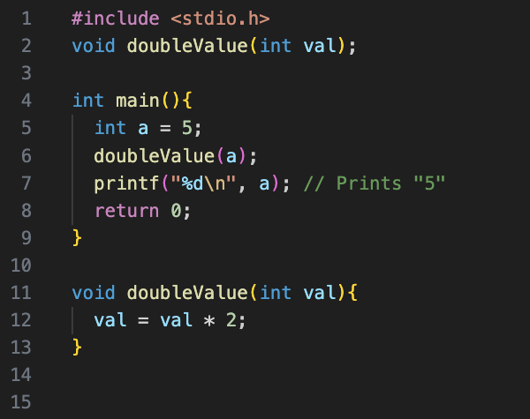
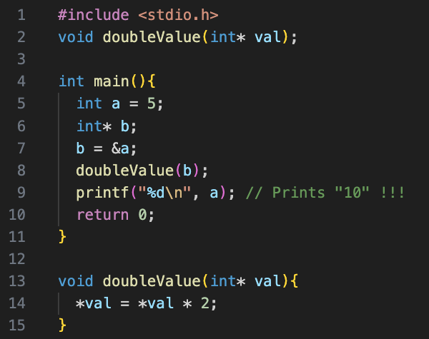
Why C pointers are Important?
1) Pointers allow us to manipulate (change) variable values from any scope (function) of the program
Pass By Value
Pass By Reference

Slide 15
Why C pointers are Important?
Memory
1) What are we passing in both scenarios?
main
0x0000
0x0004
0x0008
0x000C
...
...
...
...
...
0xFFF0
0xFFF4
0xFFF8
0xFFFC
a
5
Pass By Value
b
0x0004
doubleValue
Pass By Reference
val
?

Slide 16
Why C pointers are Important?
2) Memory allocation/reservation! Computer doesn’t know how much memory your arrays and structures need. Sometimes even you don’t know it!
We need a way to request X amount of memory from computer, at the time we learn what our X is (at a dynamic time).
There is a tool (function) that helps with it. It is called malloc (memory allocate)
Malloc makes a call to Operating System (OS)
OS decides which “chunk” of memory to “reserve” for our program
OS tells us which exact “chunk” it reserved for us by returning us a pointer to that “chunk”
When we are done using that memory “chunk”, we must free that “chunk” otherwise we will eventually run out of the usable memory (memory leak)

Slide 17
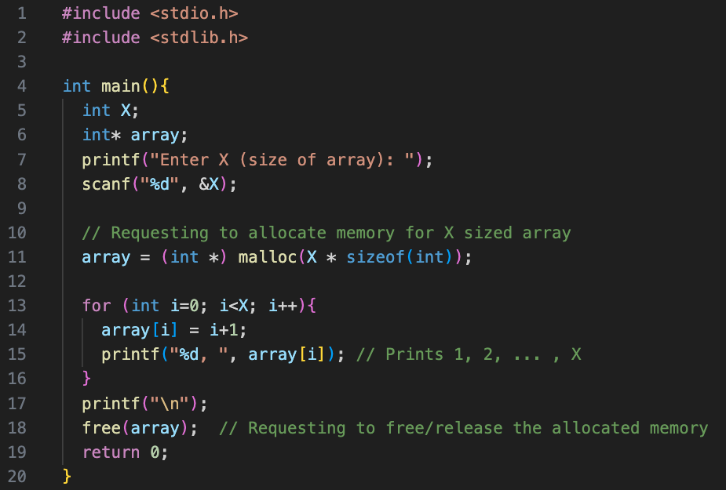
Why C pointers are Important?
2) Memory allocation/reservation! (and then releasing/free-ing)
int* arr = (int *) malloc(23 * sizeof(int) ); // allocates enough memory for an integer array of size 23 elements
free(arr); // frees the memory
Match every malloc with a free
Always!
Don’t forget #include <stdlib.h>

Slide 18
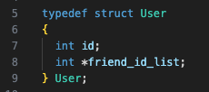
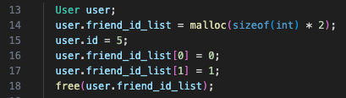
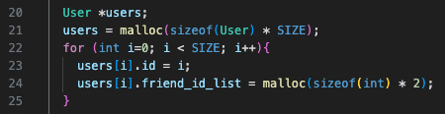

Why C pointers are Important?
3) Working with Structures
Elements of the structure can be pointers (can be allocated dynamically)
Structures as a whole can be pointers and can be dynamically allocated with malloc!

Slide 19
Why C pointers are Important?
3) Working with Structures
Accessing structure array elements:
users[1].id // result is “1”
(*(users+1)).id // result is “1”
-> (arrow) notation
(users+1)->id // result is “1”
-> notation does 2 things in 1:
dereference the pointer
. (dot) to access the field of the structure (id in our case)

Slide 20
Example Problems
Board work (in IDE) solving pointer problems

