Slide 1
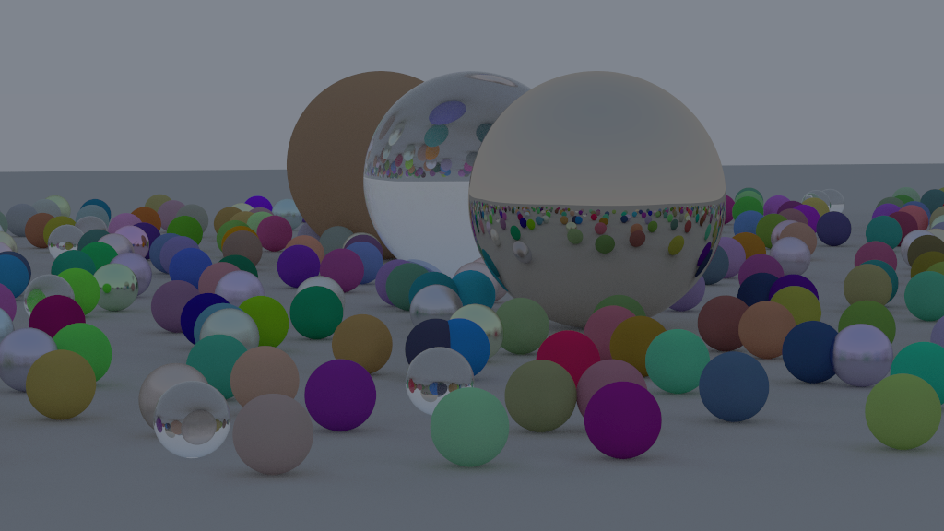
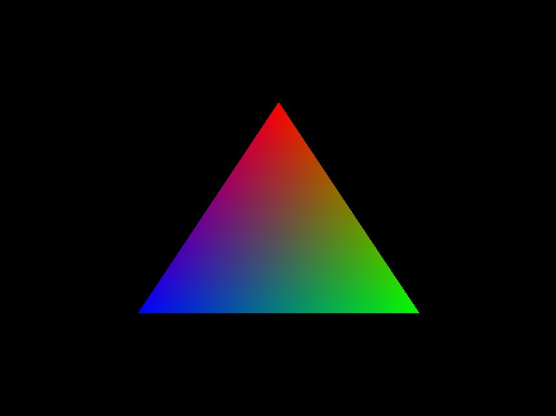
What is Graphics Programming
Graphics and Shader Programming KH x SASE
A field in computer science that focuses on image modification

Slide 2
What is Graphics Programming
A field in computer science that focuses on image modification
Graphics and Shader Programming KH x SASE

Slide 3
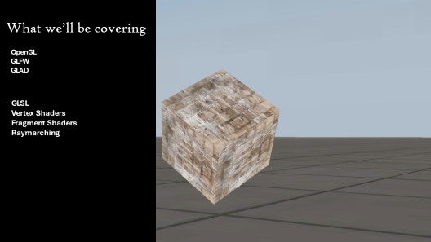
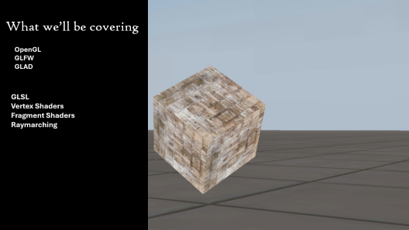
What are Shaders?
Shaders are programs that utilize graphics hardware
Graphics and Shader Programming KH x SASE

Slide 4
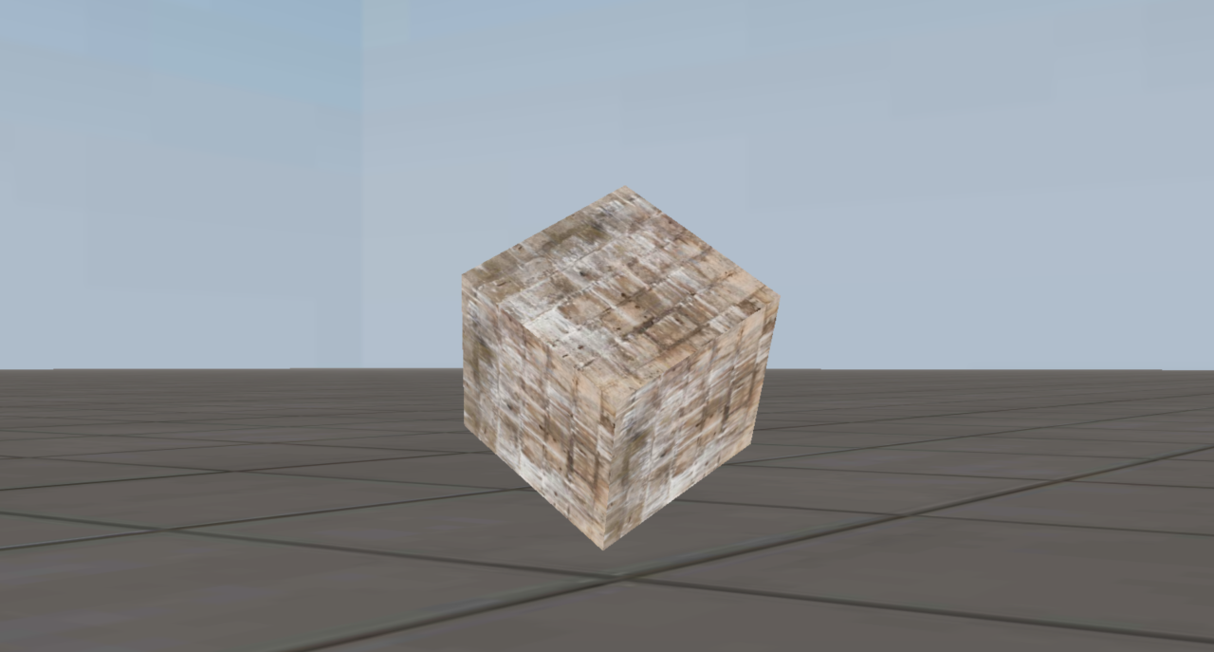
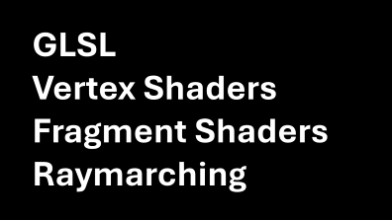

What we’ll be covering

Slide 5

OpenGL GLFW GLAD

Slide 6
GLSL
Vertex Shaders Fragment Shaders Raymarching

Slide 7
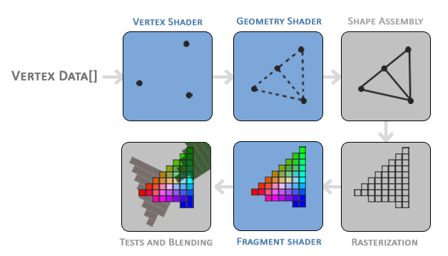
Graphics Pipeline

Slide 8
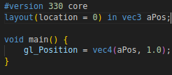
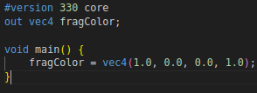
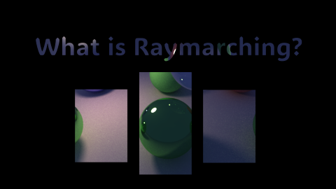
GLSL
GLSL stands for OpenGL Shading Language and is the language we will be using to communicate to our GPU! Here’s what you’ll need to know!
Here is very simple vertex shader. We define out version at the top, the location we get vec3 from, and set it to gl_Position (a predefined variable)
Types: int float bool vec2, vec3, vec4 mat2, mat3, mat4
Here is a very simple fragment shader. We’ll be focusing on this.
Uniforms: These are constants that are passed from the CPU and main execution cycle.

Slide 9
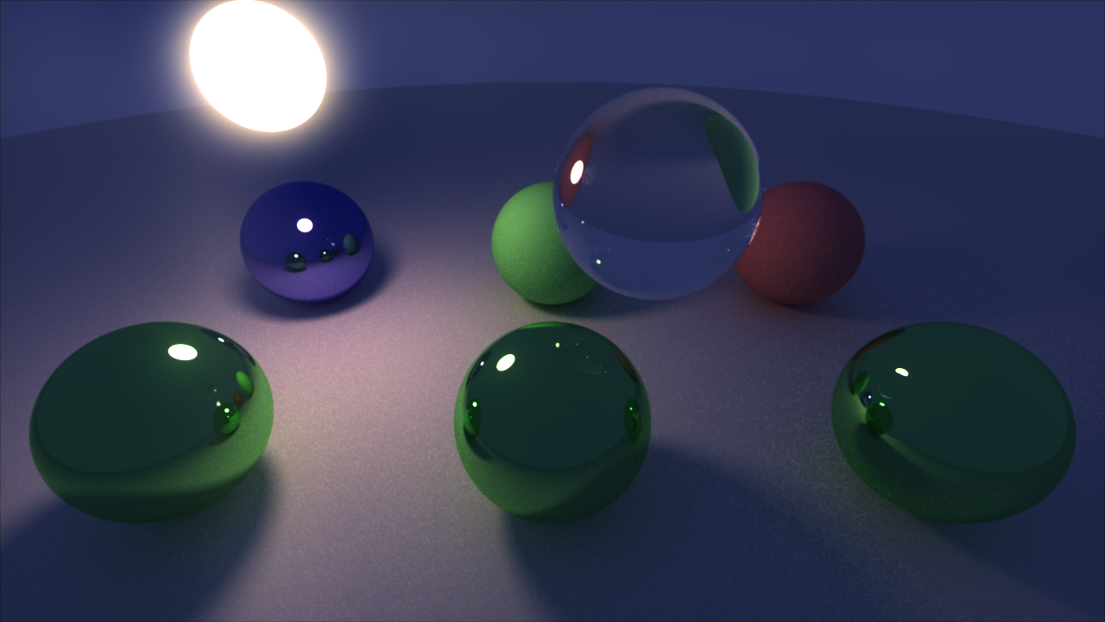

Slide 10
In simple terms, raymarching is a graphics technique where we extend a ray onto a simulated map. We first start a point and find how far away we are from the closest object. We use that distance to know the minimum safe distance it is to move forward. We keep moving like this until we get too close to an object or too far away.
Ray Marching

Slide 11
