Slide 1
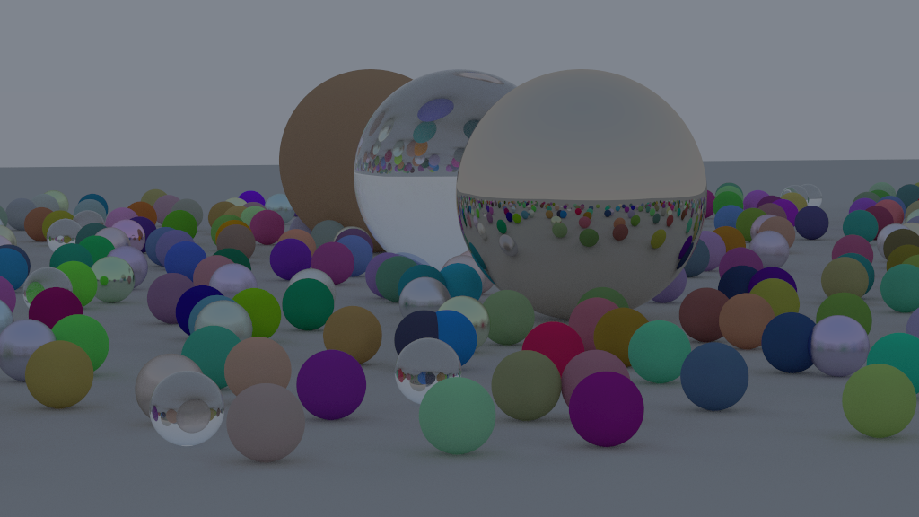
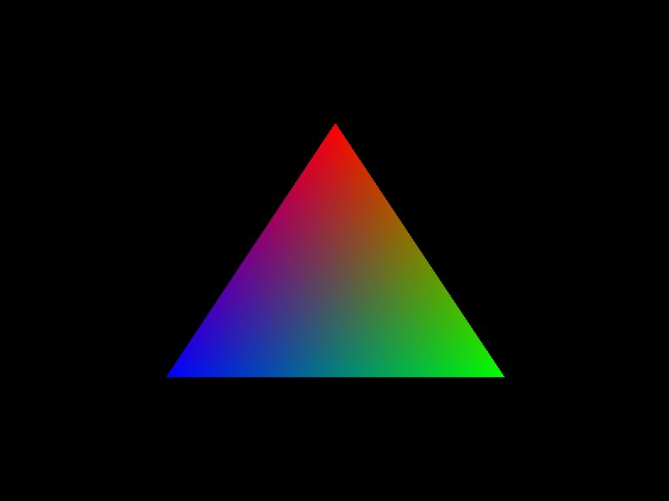
What is Graphics Programming
Graphics and Shader Programming KH x SASE
A field in computer science that focuses on image modification

Slide 2
What is Graphics Programming
A field in computer science that focuses on image modification
Graphics and Shader Programming KH x SASE

Slide 3
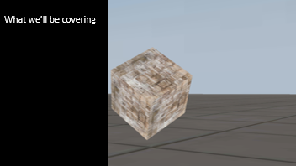
What are Shaders?
Shaders are programs that utilize graphics hardware
Graphics and Shader Programming KH x SASE

Slide 4
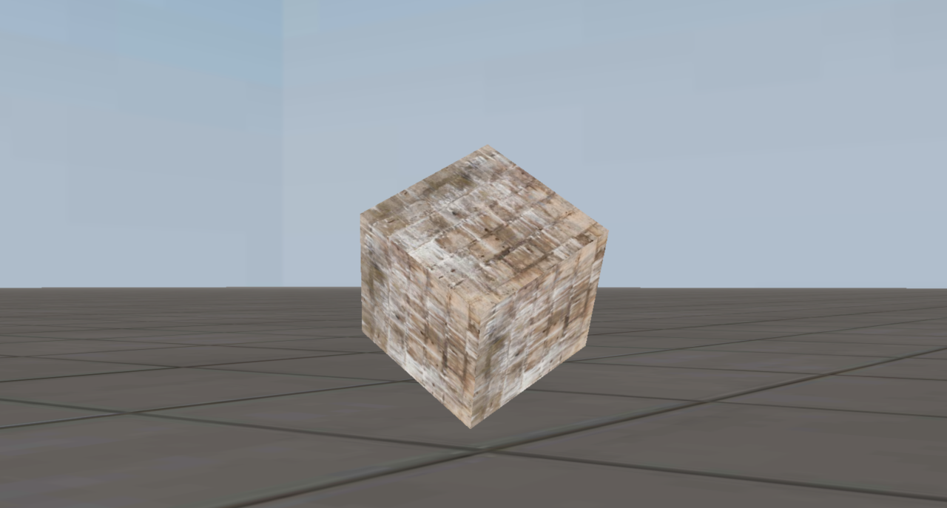
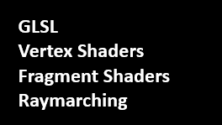
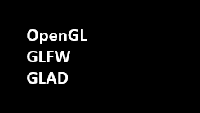
What we’ll be covering

Slide 5
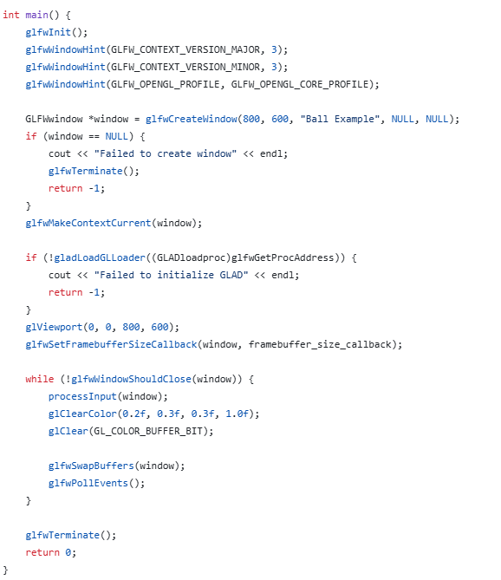
GLFW
GLFW is an OpenGL Library that adds the ability to create windows, and other sorts of inputs in which OpenGL would respond to.
Over here you can see how GLFW is being used to create the window, in which we will be creating our cool designs and shapes!

Slide 6
GLAD
GLAD is what allows us to compile OpenGL applications on different operating systems, by giving us variables and data types to work with instead of the native C++ and C integers, doubles, floats for example. C/C++ compiles and runs differently on all systems, so GLAD helps make sure that no matter where you write your OpenGL code, it will run on that system
As you can see here, we are using GLuint instead of unsigned int. We use GLAD's GLuint here to make sure that glCreateProgram(); will always have parity in all operating systems this application will run in.

Slide 7
OpenGL GLFW GLAD
https://shorturl.at/WErMZ

Slide 8
Mac Installation
You can follow the README on the Github, but you want to make sure you have homebrew installed. When it installs, do brew intstall glfw. Extract the zip, open the folder in vscode, create a .vscode folder, drag the tasks.json in, and go to your main.cpp file. Hit CMD + SHIFT + B and it should compile.

Slide 9
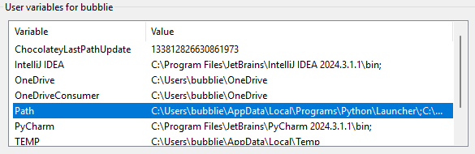
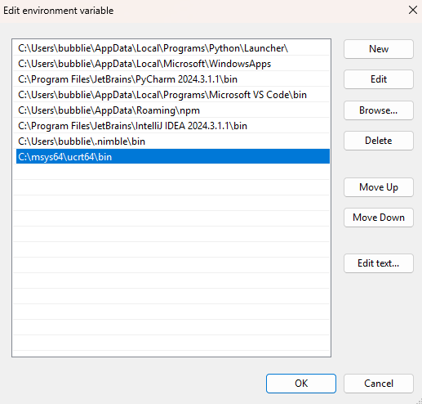
Windows and MinGW Installation
Navigate to https://www.msys2.org/ and install the exe. Once that is done, type this command in, and it should be on the site as well: pacman -S mingw-w64-ucrt-x86_64-gcc
Once that is finished, go to windows search bar, type "edit environment variables" and hit enter.
Navigate to Path, double-click, then the edit environment variable will pop up. Hit new, navigate to msys64 then ucrt64 then bin, hit done, and it should be added to your path! Now hit ok on everything and it should be saved, then run the windows template on main.cpp with CMD + SHIFT + B and it should compile! Execute it like a normal exe.

Slide 10
Linux/WSL Installation
You can follow the README on the Github. To keep it short Run this command: sudo apt install libglfw3-dev libgl1-mesa-dev Compile using the Makefile found in the Template make

Slide 11
GLSL
Vertex Shaders Fragment Shaders Raymarching

Slide 12
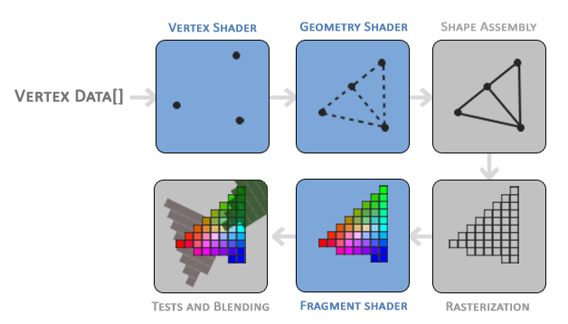
Graphics Pipeline

Slide 13
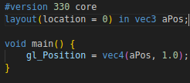
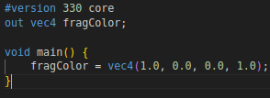
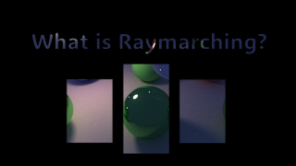
GLSL
GLSL stands for OpenGL Shading Language and is the language we will be using to communicate to our GPU! Here’s what you’ll need to know!
Here is very simple vertex shader. We define out version at the top, the location we get vec3 from, and set it to gl_Position (a predefined variable)
Types: int float bool vec2, vec3, vec4 mat2, mat3, mat4
Here is a very simple fragment shader. We’ll be focusing on this.
Uniforms: These are constants that are passed from the CPU and main execution cycle.

Slide 14
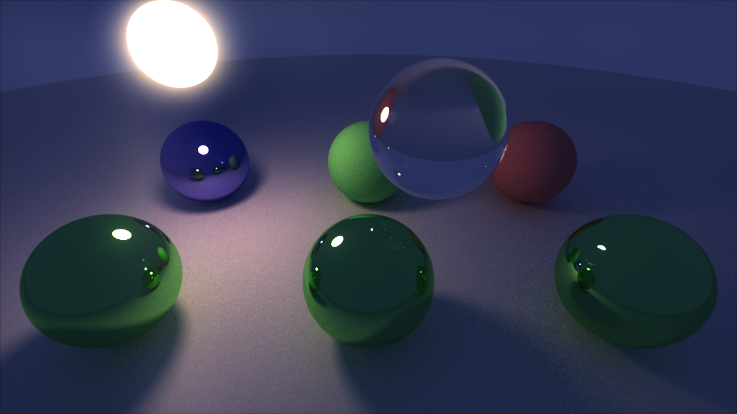

Slide 15
In simple terms, raymarching is a graphics technique where we extend a ray onto a simulated map. We first start a point and find how far away we are from the closest object. We use that distance to know the minimum safe distance it is to move forward. We keep moving like this until we get too close to an object or too far away.
Ray Marching

Slide 16
