Slide 1

2017

Slide 2
Linux Performance Profiling & Visualization
Barry Song & Bob Liu & Mac Xu

Slide 3

performance measurements
top
iotop
vmstat
Sar oprofile
perf
… ... ... ... ... ... ... ... ... ... ... ...
Notes:
A variety of tools such as top, iotop, iostat, vmstat, sar oprofile, perf etc exist in Linux system; however, it is extremely difficult for people to address the problems from the raw data printed by these tools

Slide 4

Problems in existing tools
RAW data, difficult for non-experts to understand
e.g. load average…

Slide 5
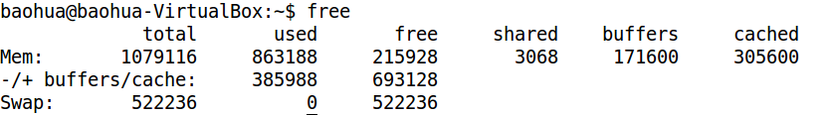
Problems in existing tools
Not visualized
e.g. how many memory used in Linux?

Slide 6
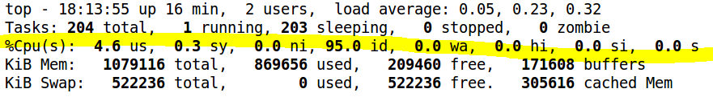
Problems in existing tools
Lack of the description for changes
e.g. how the CPU usage is changing during a period?

Slide 7
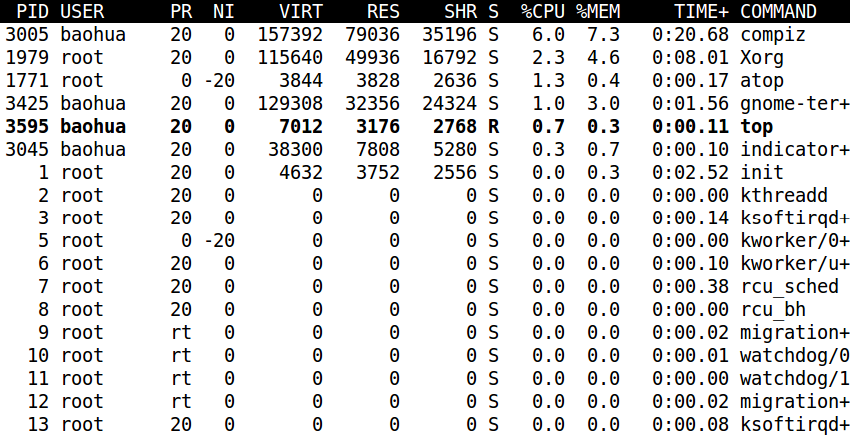
Problems in existing tools
Cannot interact with users smoothly
e.g. what if we only care about a particular process in “top”?

Slide 8


Why we need LEP
A story of fixing a memory leak issue
One year vs. 3 days

Slide 9
Why we need LEP(cont.)
A story of improving network throughput
Softirq on 1 core vs. SoftIRQ balanced

Slide 10
Who need LEP more?

Slide 11
A Solution
Intuitive
Visualized
Interactive
Ease of Use
LEP
Notes:
CURVED LINE
PIE diagram
BAR diagram
COLORED
interactive

Slide 12
What is LEP
Linux Easy Profiling
Web-based
Open-source
All-In-One
Notes:
LEP(Linux Easy Profiling) is a web-based open-source tool suite to make them be all-in-one and visualized, and its key developers, for this moment, include
Baohua Song
Bob Liu
Mac Xu
More developers are coming(eg, Ping Liu, Ray Chen, Joy Zhou….)

Slide 13







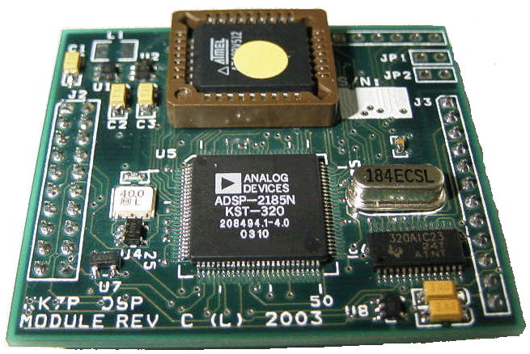






LEP architecture
JSONRPC
LEPD
HTML
JS
LEPV
LEPD
Django
Python
LEPD
Restful API

Slide 14
LEP Summary
C/S
PC / Embedded Board
Linux / Android
JSONRPC
Web App
Restful API
Docker

Slide 15
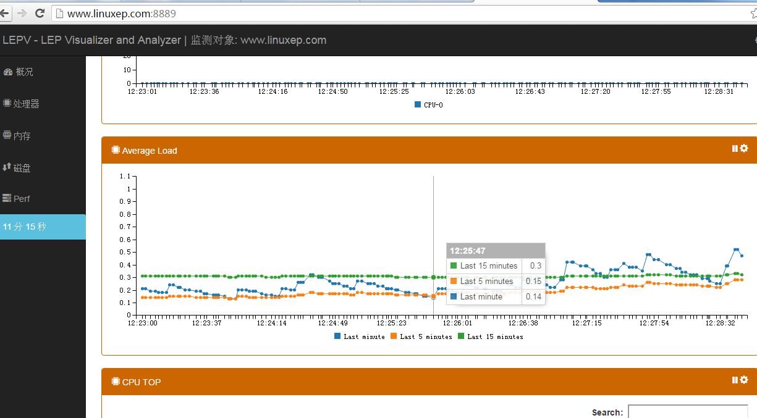


LEP Dataflow
HTTP GET
AVG LOAD
{
'last15':Decimal('2.13'),
'last5':Decimal('2.25'),
'last1':Decimal('2.58')
}
LEPV
{
'result':'2.58 2.25 2.13 4/110 19674\n'
}
LEPD
JSON RPC
AVG LOAD
/proc/loadavg
Notes:
cJSON & jsonrpc-c
RPC provided
Read proc entries / Execute a command

Slide 16

Live Demo
DEMO

Slide 17
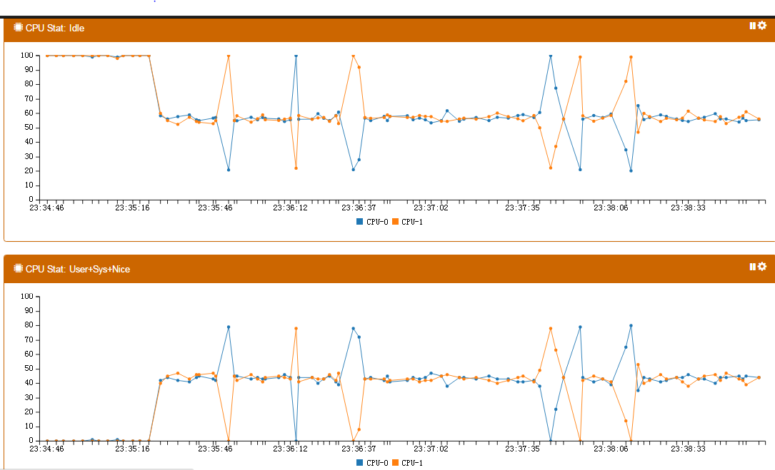
LEP: Load balance view

Slide 18
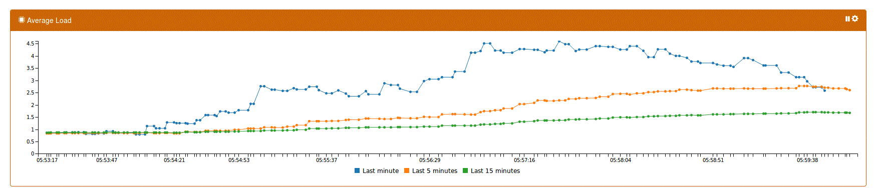
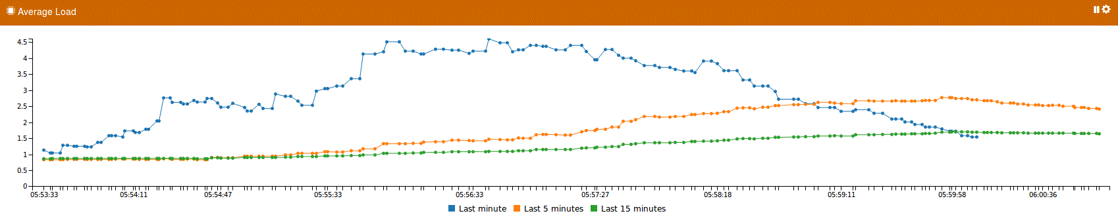
LEP: Average load view

Slide 19
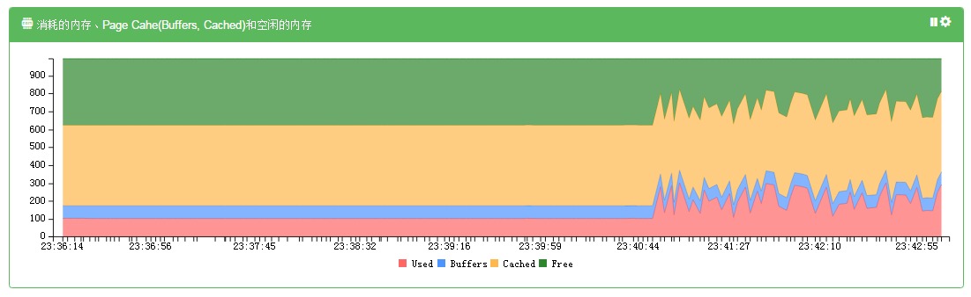
LEP: Memory consumption view

Slide 20
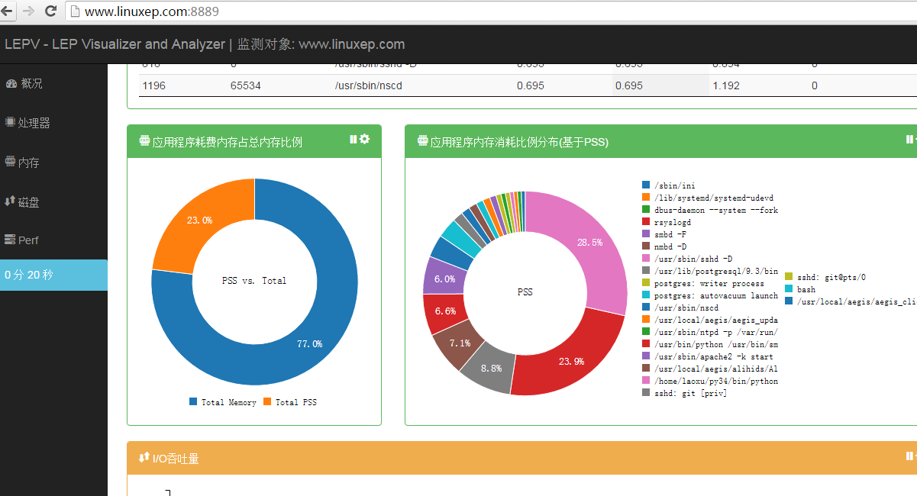
LEP: App memory usage view

Slide 21
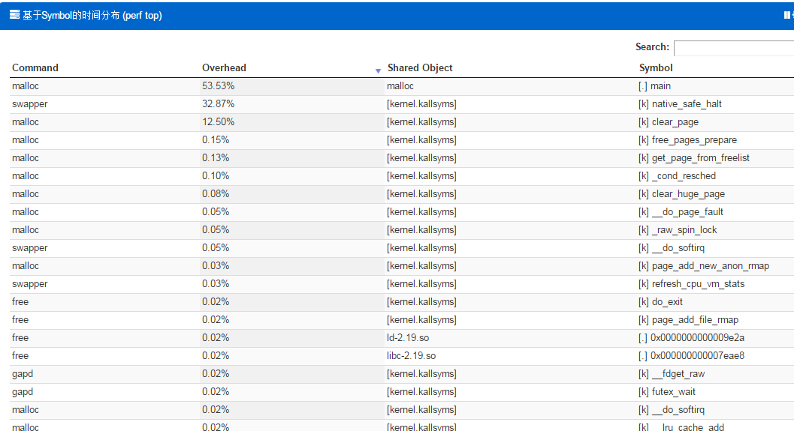
LEP: Symbol level view

Slide 22
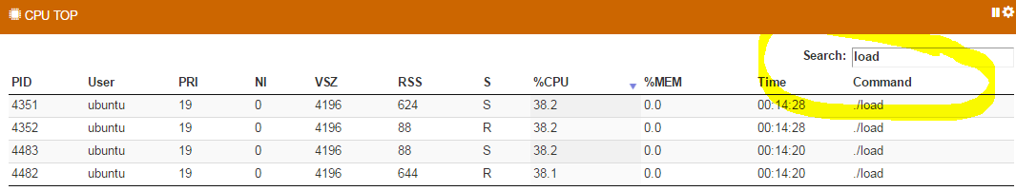
LEP: Interaction with users

Slide 23
Next steps for LEP
More features
Better documentations

Slide 24
Upcoming features
Database
Scenerios based analysis
Deeply analyze and alert
Lacking functions implementation
QA/tests

Slide 25
Contributors
Barry Song
Bob Liu
Mac Xu
Song Chen
More developers are coming
YOU
Notes:
LEP(Linux Easy Profiling) is a web-based open-source tool suite to make them be all-in-one and visualized, and its key developers, for this moment, include
Baohua Song
Bob Liu
Mac Xu
More developers are coming(eg, Ping Liu, Ray Chen, Joy Zhou….)

Slide 26
Fork the code here:
LEP
http://www.linuxep.com
LEPD:
https://github.com/linuxep/lepd
LEPV:
https://github.com/linuxep/lepd

Slide 27
Q&A

