Slide 1

2016

Slide 2
Linux Performance Profiling & Visualization
Barry Song & Bob Liu & Mac Xu

Slide 3

performance measurements
top
iotop
vmstat
Sar oprofile
perf
… ... ... ... ... ... ... ... ... ... ... ...
Notes:
A variety of tools such as top, iotop, iostat, vmstat, sar oprofile, perf etc exist in Linux system; however, it is extremely difficult for people to address the problems from the raw data printed by these tools

Slide 4

Problems in existing tools
RAW data, difficult for non-experts to understand
e.g. load average…

Slide 5
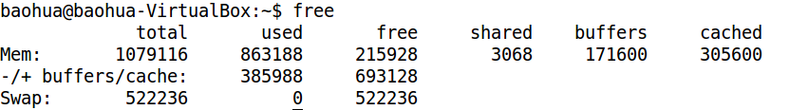
Problems in existing tools
Not visualized
e.g. how many memory used in Linux?

Slide 6
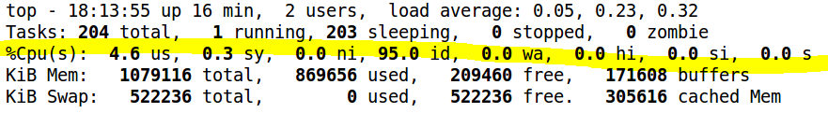
Problems in existing tools
Lack of the description for changes
e.g. how the CPU usage is changing during a period?

Slide 7
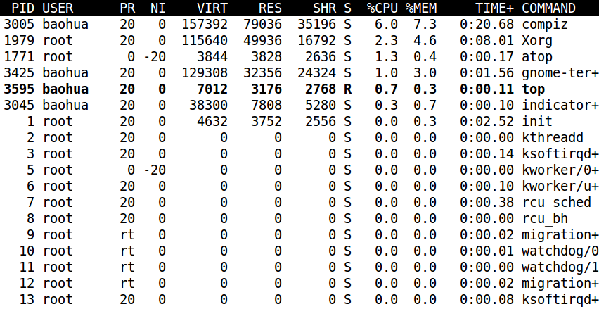
Problems in existing tools
Cannot interact with users smoothly
e.g. what if we only care about a particular process in “top”?

Slide 8
A Solution
Intuitive
Visualized
Interactive
Ease of Use
LEP
Notes:
CURVED LINE
PIE diagram
BAR diagram
COLORED
interactive

Slide 9
What is LEP
Linux Easy Profiling
Web-based
Open-source
All-In-One
Notes:
LEP(Linux Easy Profiling) is a web-based open-source tool suite to make them be all-in-one and visualized, and its key developers, for this moment, include
Baohua Song
Bob Liu
Mac Xu
More developers are coming(eg, Ping Liu, Ray Chen, Joy Zhou….)

Slide 10



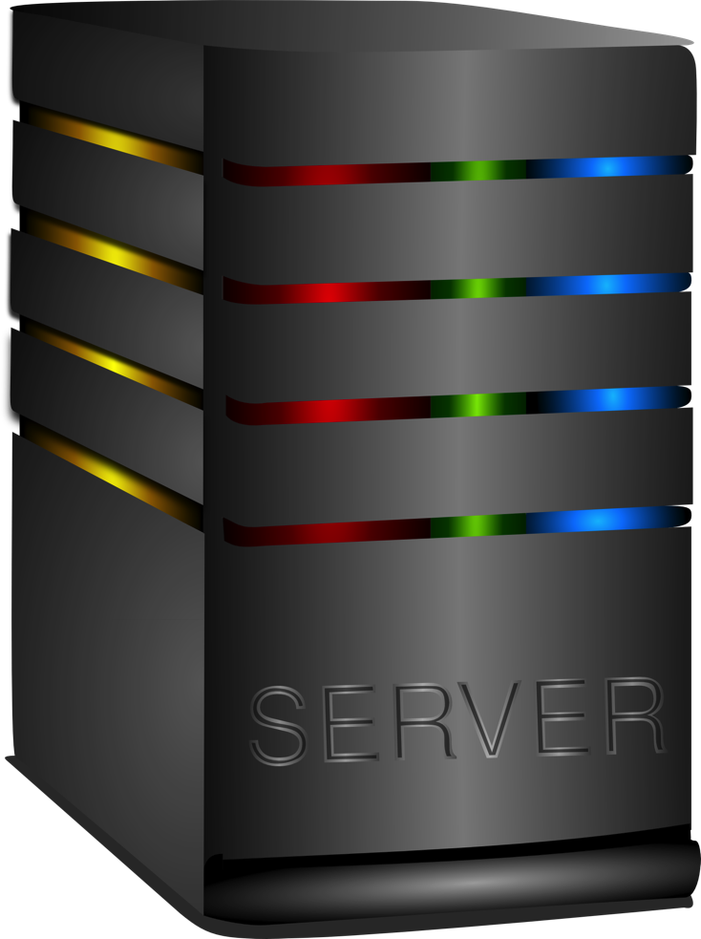



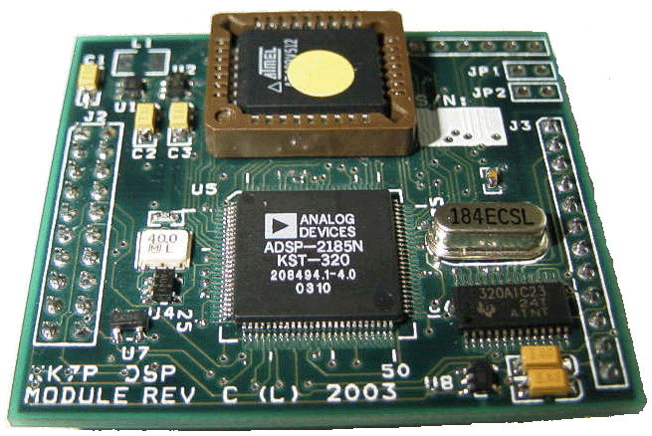






LEP architecture
JSONRPC
LEPD
HTML
JS
LEPV
LEPD
Django
Python
LEPD
Restful API

Slide 11
LEP Summary
C/S
PC / Embedded Board
Linux / Android
JSONRPC
Web App
Restful API
Docker

Slide 12
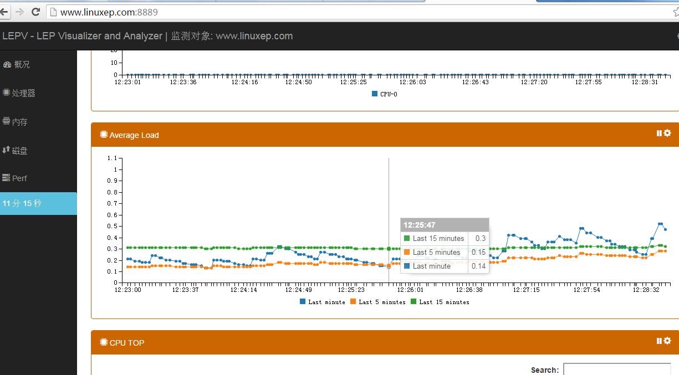


LEP Dataflow
HTTP GET
AVG LOAD
{
'last15':Decimal('2.13'),
'last5':Decimal('2.25'),
'last1':Decimal('2.58')
}
LEPV
{
'result':'2.58 2.25 2.13 4/110 19674\n'
}
LEPD
JSON RPC
AVG LOAD
/proc/loadavg
Notes:
cJSON & jsonrpc-c
RPC provided
Read proc entries / Execute a command

Slide 13

Live Demo
DEMO

Slide 14
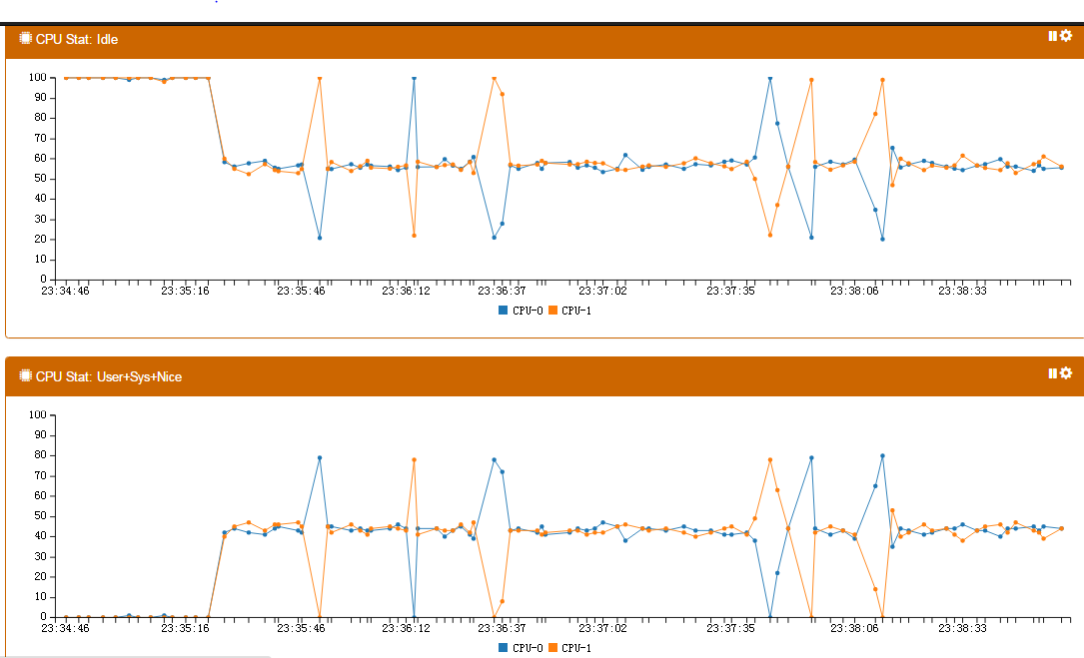
LEP: Load balance view

Slide 15
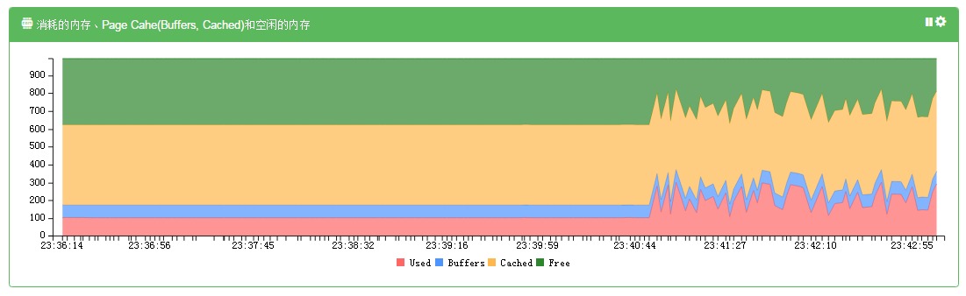
LEP: Memory consumption view

Slide 16
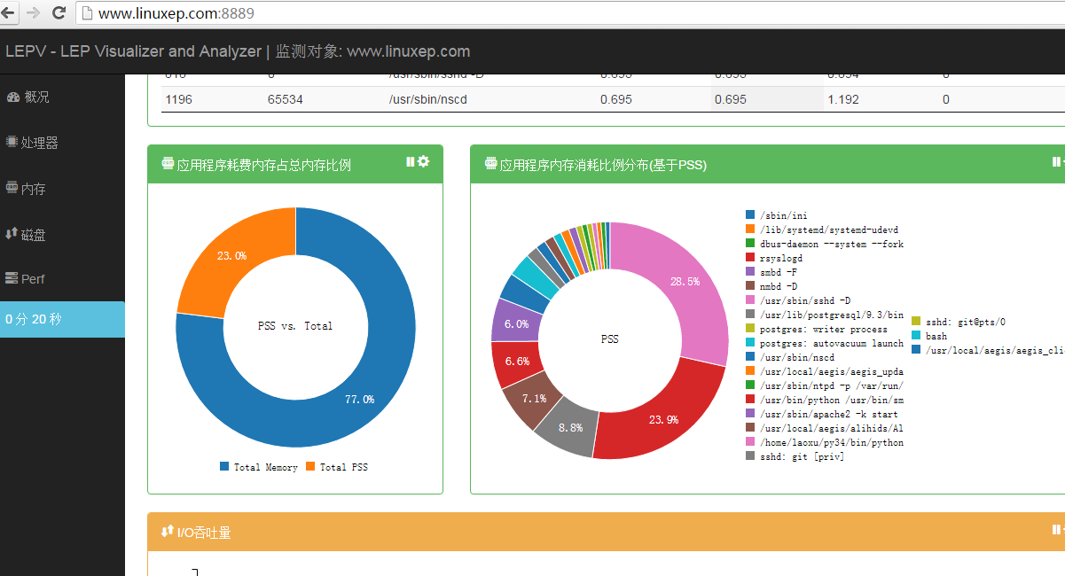
LEP: App memory usage view

Slide 17
LEP: Average load view

Slide 18
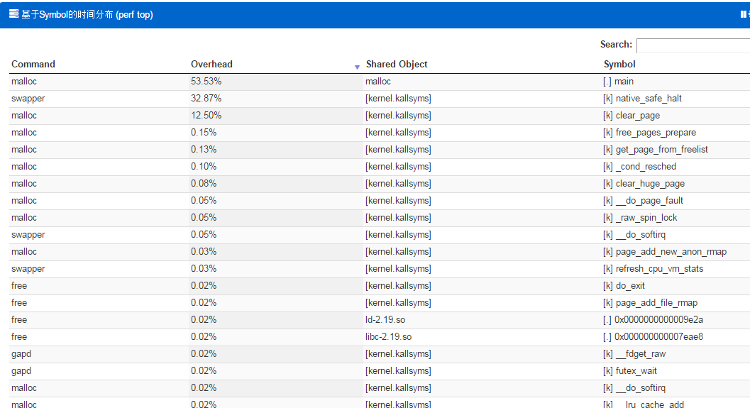
LEP: Symbol level view

Slide 19
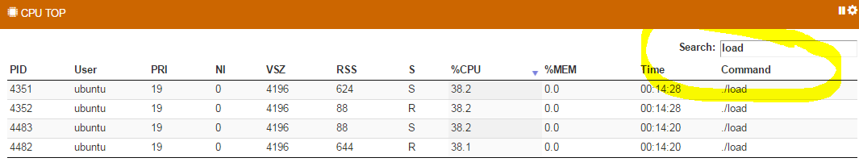
LEP: Interaction with users

Slide 20
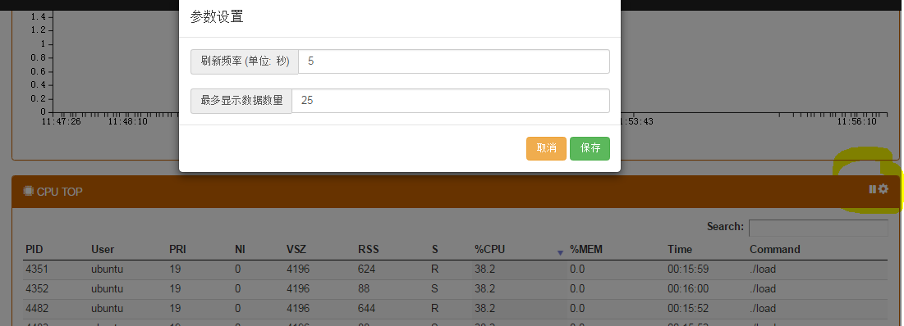
LEP: Interaction with users

Slide 21
Next steps for LEP
More features
Better documentations

Slide 22
Upcoming features
ARM support
Predict memory leak for an application and kernel
Analyze cache miss
Analyze time consumption for one native/Java processes
Benchmark integration
I/O queues
Kernel memory details such as buddy, slab, CMA etc.
Runtime scheduler(CPU/IO)
Boot procedure
….

Slide 23
Plans - LE series
LEB
LET
LEP
Easy Building
Easy Testing
Easy Profiling

Slide 24
Contributors
Barry Song
Bob Liu
Mac Xu
More developers are coming
Ping Liu
Ray Chen
Joy Zhou
YOU
Notes:
LEP(Linux Easy Profiling) is a web-based open-source tool suite to make them be all-in-one and visualized, and its key developers, for this moment, include
Baohua Song
Bob Liu
Mac Xu
More developers are coming(eg, Ping Liu, Ray Chen, Joy Zhou….)

Slide 25

Fork the code here:
LEPD: git@www.linuxep.com:repo/lep/lepd
LEPV: git@www.linuxep.com:repo/lep/lepv

Slide 26
Q&A

