Slide 1
AUTOSCHEDULER
Workload-aware CPU
scheduling
OBSERVE
SELECT
SCHEDULE
Machine-learning-guided CPU scheduling prototype
The system observes recent workload behavior and selects an existing scheduling policy. It keeps the policy implementations separate from the learning layer.
Academic project review
Notes:
AutoScheduler studies whether a compact model can observe recent workload behavior and choose among existing CPU scheduling policies. The current result is a validated research prototype, not a deployed kernel scheduler.

Slide 2
AUTOSCHEDULER
Problem and research gap
One fixed policy cannot serve every workload equally well
What earlier work established
Interactive
Needs a quick first response
Policy prediction and scheduler tuning can improve workload-specific outcomes [1], [4].
CPU-heavy
Needs sustained processor service
Learned routers can choose among expert policies while stability filters limit rapid switching [2].
I/O-heavy
Blocks and returns often
Recent systems separate learned control from a small execution path [3], [6].
Changing
Needs stable policy transitions
AutoScheduler contribution
A lightweight selector, observed-only features, guarded switching, and one shared simulator for all policy comparisons.
Prior work: [1] Biswas et al. [2] Wang et al. [3] Fu et al. [4] Lee et al. [6] Seo et al.
02
Notes:
Static schedulers make different trade-offs. AutoScheduler builds on policy prediction, learned routing, adaptive priority control, parameter tuning, and interpretable safety controls.
Sources:
[1] https://doi.org/10.1109/STI59863.2023.10464816
[2] https://arxiv.org/abs/2511.11628
[3] https://www.usenix.org/system/files/atc24-fu.pdf
[4] https://doi.org/10.3390/app12147072
[6] https://doi.org/10.1109/VTC2025-SPRING65109.2025.11174897

Slide 3
AUTOSCHEDULER
Dataset sources and split discipline
CAPTURED LINUX TRACES
CONTROLLED DYNAMIC V3 CORPUS
9 accepted traces
144 grouped development traces
CPU and compression scenarios recorded on all CPUs in a Linux VM.
Generated by the project simulator across controlled workload families and changing phases.
2,590,010
25
1,053
10,387
100 / 22 / 22
scheduler events
processes
state snapshots
decision rows
trace-group split
5,265 action-cost rows
60 separate validation workloads
Cleaned and anonymized. Incomplete traces rejected. Group split: 6 train, 1 validation, 2 test.
Used to compare model families and exercise changing-workload routing under controlled conditions.
Capture
Clean
Extract
Split
Evaluate
all CPUs
remove identity
past events
whole traces
locked groups
03
Notes:
The project uses two evidence tracks. Captured Linux traces validate the real trace pipeline. The larger controlled corpus supports model-family comparison and the Dynamic V3 routing demonstration. Whole trace groups remain in one split to prevent leakage.
Sources:
/Users/knightnm/Documents/AutoScheduler-SL-CPU-Scheduler/data/processed/linux/full-002/cleaned.jsonl
/Users/knightnm/Documents/AutoScheduler-SL-CPU-Scheduler/data/processed/linux/full-002/observed_features.csv
/Users/knightnm/Documents/AutoScheduler-SL-CPU-Scheduler/data/processed/linux/full-002/action_costs.csv
/Users/knightnm/Documents/AutoScheduler-SL-CPU-Scheduler/artifacts/dynamic_v3_demo01/training.csv
/Users/knightnm/Documents/AutoScheduler-SL-CPU-Scheduler/artifacts/dynamic_v3_demo01/split.json

Slide 4
AUTOSCHEDULER
Observed-only feature extraction
Linux observation window
Decision interval
2 seconds
500 ms
Decision-time boundary
PAST EVENTS
DECISION
QUEUE STATE
DELAY AND SERVICE
arrivals_seen
ready_count
blocked_count
running_count
wait_mean_ms
wait_p95_ms
observed_service_mean_ms
observed_service_variance_ms2
Every feature comes from events observed before this line.
Allowed
Queue size, waiting history, completed service, I/O returns, priority, wakeups, and prior switches.
BURST AND I/O HISTORY
SCHEDULING CONTEXT
completed_burst_mean_ms
completed_burst_variance_ms2
io_returns
wakeups
priority_mean
priority_variance
context_switches
cpu_busy_fraction
Excluded
Future arrivals, declared total work, true remaining burst, later outcomes, and oracle identity.
Why these features: process history can predict scheduler behavior, while recent queue and service history supports adaptive control [3], [5].
Feature precedent: [3] ALPS [5] Negi and Pusukuri
04
Notes:
Feature extraction uses only the information available at each decision time. The 16 features summarize queue state, delays, observed service, completed burst behavior, I/O activity, priority, context switches, wakeups, and CPU busy fraction.
Sources:
[3] https://www.usenix.org/system/files/atc24-fu.pdf
[5] https://doi.org/10.1109/TENCON.2005.300837
/Users/knightnm/Documents/AutoScheduler-SL-CPU-Scheduler/configs/real_desktop_ml.json

Slide 5
AUTOSCHEDULER
System modules and data flow
1
2
3
4
5
Trace and workload input
Data preparation
Model comparison
Dynamic V3 router
Shared simulator
Linux scheduler events and controlled workload traces.
Cleaning, replay, feature extraction, and grouped splitting.
Action-cost labels compare five candidate model families.
Confidence, dwell, and safe-boundary checks control switching.
Policies run through one engine with metrics, logs, and a Gantt chart.
Raw behavior enters the system.
Past events become safe model inputs.
The lowest-cost validated model is frozen.
The model suggests. Guardrails decide.
Every scheduler faces the same test.
Frozen research contract
Fixed policy set, score weights, feature rules, seeds, latency gate, and evidence boundary.
Architecture precedents: [1] policy selection [2] learned routing [3] separated learning and execution
05
Notes:
The architecture has five modules. The data module creates safe observed-state rows. The comparison module freezes a model. Dynamic V3 applies confidence and dwell safeguards. Every policy executes through the same simulator and reporting path.
Sources:
[1] https://doi.org/10.1109/STI59863.2023.10464816
[2] https://arxiv.org/abs/2511.11628
[3] https://www.usenix.org/system/files/atc24-fu.pdf

Slide 6
AUTOSCHEDULER
Five model families under one experiment contract
01
Dummy
Minimum baseline
Repeats a simple reference prediction.
02
Ridge
Fast linear estimator
Fits one regularized linear cost function.
03
Decision Tree
Interpretable nonlinear rules
Splits observed states into readable decisions.
04
Random Forest
Averaged tree ensemble
Reduces single-tree variance by voting across trees.
05
Histogram Gradient Boosting
Sequential tree ensemble
Adds compact trees that correct earlier errors.
Same 16 features, grouped split, action-cost targets, and tuning budget for every model.
Methods: [7] scikit-learn [8] Ridge [9] Trees [10] Random Forest [11] Gradient Boosting Scheduling use: [1], [5]
06
Notes:
The bake-off holds the data, features, group split, target, and tuning budget constant. This isolates model-family behavior from dataset changes.
Sources:
[7] F. Pedregosa et al., Journal of Machine Learning Research, 2011.
[8] https://doi.org/10.1080/00401706.1970.10488634
[9] https://doi.org/10.1007/BF00116251
[10] https://doi.org/10.1023/A:1010933404324
[11] https://doi.org/10.1214/aos/1013203451
[1] https://doi.org/10.1109/STI59863.2023.10464816
[5] https://doi.org/10.1109/TENCON.2005.300837

Slide 7
AUTOSCHEDULER
Model comparison: scheduling outcome decides the prototype
Model | Val. acc. | Test acc. | Val. score | Val. regret | Test regret
Dummy | 21.27% | 36.77% | 0.162973 | 0.008352 | 0.011888
Ridge | 27.53% | 35.35% | 0.143103 | 0.005457 | 0.005816
Decision Tree | 43.46% | 42.23% | 0.120669 | 0.004216 | 0.004394
Random Forest | 44.82% | 43.18% | 0.126164 | 0.003888 | 0.004612
Histogram Gradient Boosting | 27.65% | 44.84% | 0.140503 | 0.004523 | 0.004257
Validation score × 1,000 | lower is better
Accuracy means agreement with the deterministic lowest-cost action. Raw accuracy did not choose the winner.
Prototype choice
Decision Tree produced the lowest validation scheduling score: 0.120669.
Captured traces: Ridge and Decision Tree tied on cost and action agreement. Decision Tree had lower P99 latency, while the configured simplicity rule selected Ridge.
07
Notes:
The controlled grouped split shows that action accuracy and scheduling outcome can disagree. Decision Tree has the lowest validation scheduling score, so the prototype freezes it. In the separate captured-trace bake-off, Ridge and Decision Tree tie on realized cost and action agreement. The configured simplicity rule selects Ridge, even though the tree has lower measured P99 inference time.
Sources:
/Users/knightnm/Documents/AutoScheduler-SL-CPU-Scheduler/results/dynamic_v3_demo01/REPORT.md
/Users/knightnm/Documents/AutoScheduler-SL-CPU-Scheduler/results/dynamic_v3_demo01/model_family_bakeoff.csv
/Users/knightnm/Documents/AutoScheduler-SL-CPU-Scheduler/results/real_desktop_ml/decision-tree-demo/prototype_comparison_report.md

Slide 8
AUTOSCHEDULER
Classifier tree and policy-cost tree answer different questions
Metric | Classifier tree | Policy-cost tree
Validation action accuracy | 47.67% | 36.06%
Test action accuracy | 40.81% | 46.62%
Test action regret | 0.006111 | 0.003887
Validation scheduling score | 0.119128 | 0.128198
P95 response | 31.593 | 73.526
Starvation count | 15.317 | 14.500
Classifier tree
Directly proposes one scheduler from the observed state.
Policy-cost tree
Predicts every scheduler's cost, then selects the minimum estimate.
Frozen for the demonstration
Classifier tree, because its validation scheduling score and response time were better. The policy-cost tree remains an evaluated alternative.
08
Notes:
The classifier optimizes direct policy choice. The policy-cost tree estimates each candidate action. The classifier is frozen for the demonstration because it produced the lower validation scheduling score and much lower P95 response, even though the policy-cost tree had lower test action regret and fewer starvation events.
Sources:
/Users/knightnm/Documents/AutoScheduler-SL-CPU-Scheduler/results/dynamic_v3_demo01/tree_variant_comparison.json

Slide 9
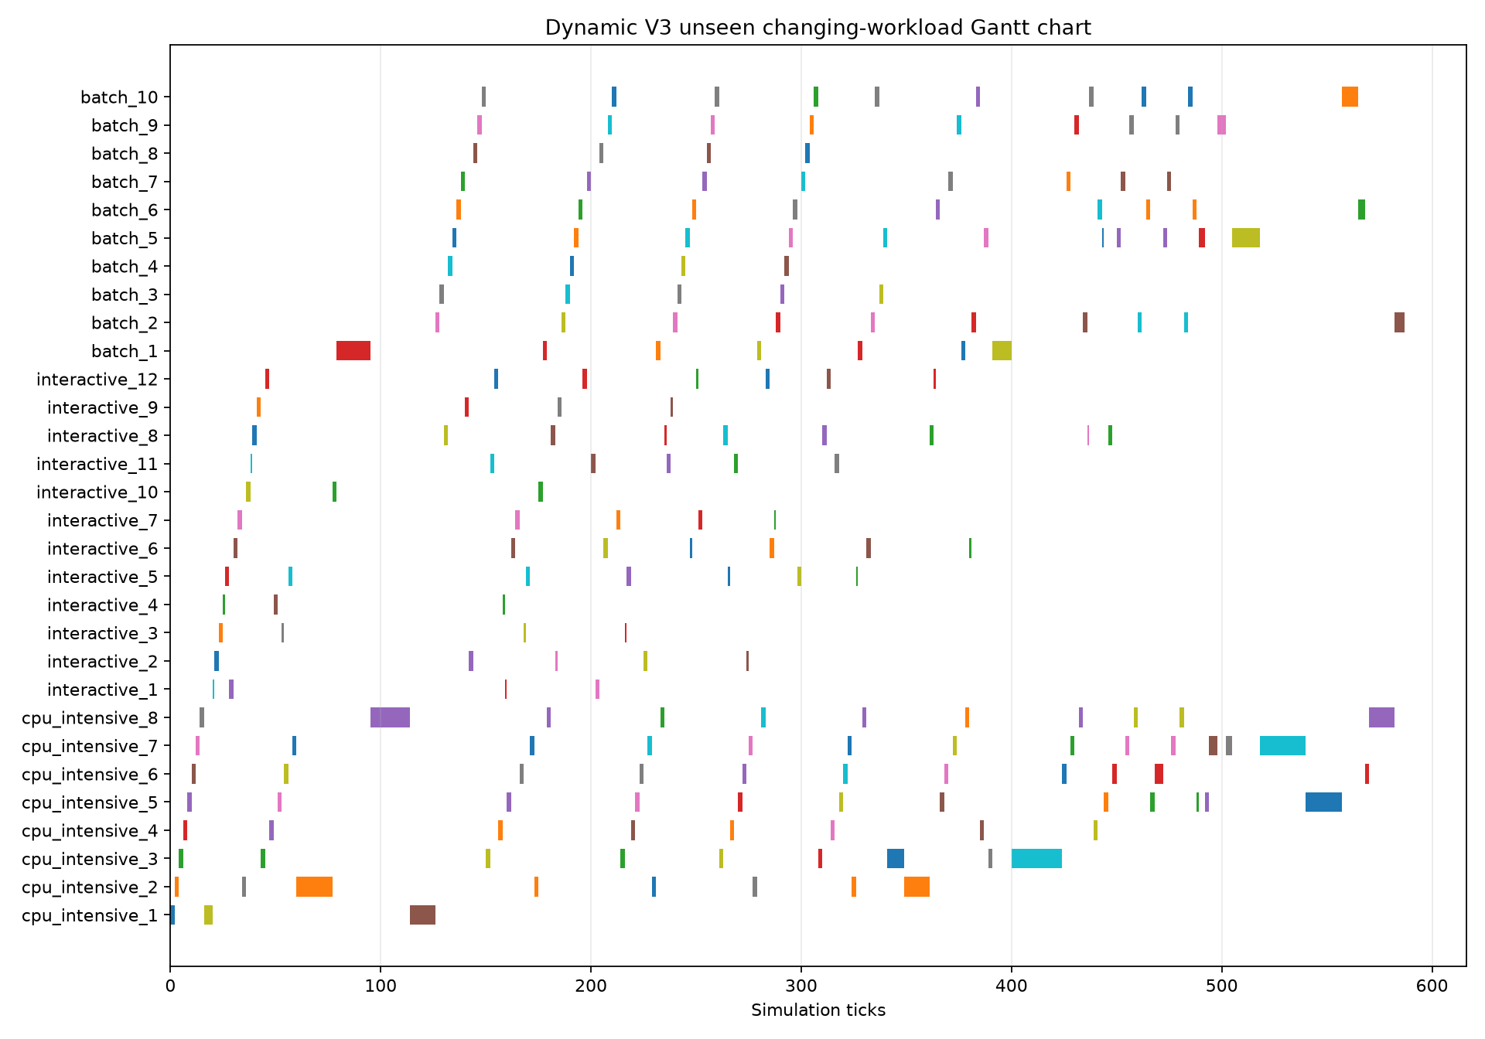
AUTOSCHEDULER
End-to-end Dynamic V3 demonstration
Router loop
1
Observe every 10 ticks
2
Model proposes a policy
3
Confidence and dwell checks
4
Switch at a safe boundary
52 reviews
8 accepted switches
Initial: MLFQ
Final: Priority
Decision P99
0.456 ms
Result: the full model-selection and guarded-routing workflow runs within the prototype latency target. This does not establish kernel performance or universal policy superiority.
09
Notes:
This demonstration uses an unseen changing workload with CPU-intensive, interactive, and batch phases. The router reviews the observed state every 10 ticks. Confidence, a 20-tick minimum dwell, and safe dispatch boundaries limit switching. The result proves the prototype control flow and measured decision latency for this run. It does not prove Linux kernel scheduling performance or superiority over every fixed scheduler.
Sources:
/Users/knightnm/Documents/AutoScheduler-SL-CPU-Scheduler/results/dynamic_v3_demo01/summary.json
/Users/knightnm/Documents/AutoScheduler-SL-CPU-Scheduler/results/dynamic_v3_demo01/decision_log.csv
/Users/knightnm/Documents/AutoScheduler-SL-CPU-Scheduler/results/dynamic_v3_demo01/gantt.png

Slide 10
AUTOSCHEDULER
References
SCHEDULING AND SYSTEMS
MODEL FOUNDATIONS
[1] S. Biswas et al., “A Machine Learning Approach for Predicting Efficient CPU Scheduling Algorithm,” STI, 2023, doi: 10.1109/STI59863.2023.10464816.
[7] F. Pedregosa et al., “Scikit-learn: Machine Learning in Python,” Journal of Machine Learning Research, vol. 12, pp. 2825–2830, 2011.
[2] X. Wang et al., “Mixture-of-Schedulers: An Adaptive Scheduling Agent as a Learned Router for Expert Policies,” arXiv:2511.11628, 2025.
[8] A. E. Hoerl and R. W. Kennard, “Ridge Regression: Biased Estimation for Nonorthogonal Problems,” Technometrics, vol. 12, no. 1, pp. 55–67, 1970.
[3] Y. Fu et al., “ALPS: An Adaptive Learning, Priority OS Scheduler for Serverless Functions,” USENIX ATC, 2024.
[9] J. R. Quinlan, “Induction of Decision Trees,” Machine Learning, vol. 1, pp. 81–106, 1986.
[4] H. Lee, S. Jung, and H. Jo, “STUN: Reinforcement-Learning-Based Optimization of Kernel Scheduler Parameters,” Applied Sciences, 2022.
[10] L. Breiman, “Random Forests,” Machine Learning, vol. 45, pp. 5–32, 2001.
[5] A. Negi and K. K. Pusukuri, “Applying Machine Learning Techniques to Improve Linux Process Scheduling,” TENCON, 2005.
[11] J. H. Friedman, “Greedy Function Approximation: A Gradient Boosting Machine,” Annals of Statistics, vol. 29, no. 5, pp. 1189–1232, 2001.
[6] D. Seo et al., “SCHED: Safe CPU Scheduling Framework with Reinforcement Learning and Decision Trees,” VTC-Spring, 2025.
10
Notes:
IEEE-style bibliography for all numbered citations used in the deck.
Sources:
/Users/knightnm/Documents/OS_Project/AutoSchedulerPapers.md

