Slide 1
AutoScheduler
Machine-learning-guided CPU scheduling prototype
Observes recent workload behavior.
Selects an existing CPU scheduling policy.
Keeps the learning layer separate from scheduler implementations.
Academic project review
Notes:
AutoScheduler studies whether a compact model can observe recent workload behavior and choose among existing CPU scheduling policies. The current result is a validated research prototype, not a deployed kernel scheduler.

Slide 2
Problem and research gap
Why one fixed scheduler is insufficient
What earlier work established
Interactive workloads need a quick first response.
CPU-heavy workloads need sustained processor service.
I/O-heavy workloads block and return frequently.
Changing workloads need stable policy transitions.
Policy prediction and scheduler tuning can improve workload-specific outcomes [1], [4].
Learned routers can choose among expert policies while stability filters reduce rapid switching [2].
Recent systems separate learned control from a small execution path [3], [6].
AutoScheduler contribution
Lightweight model selection using observed-only features.
Guarded switching through confidence, dwell, and safe-boundary checks.
One shared simulator for comparable scheduler results.
[1] Biswas et al. [2] Wang et al. [3] Fu et al. [4] Lee et al. [6] Seo et al.
2
Notes:
Static schedulers make different trade-offs. AutoScheduler builds on policy prediction, learned routing, adaptive priority control, parameter tuning, and interpretable safety controls.
Sources:
[1] https://doi.org/10.1109/STI59863.2023.10464816
[2] https://arxiv.org/abs/2511.11628
[3] https://www.usenix.org/system/files/atc24-fu.pdf
[4] https://doi.org/10.3390/app12147072
[6] https://doi.org/10.1109/VTC2025-SPRING65109.2025.11174897

Slide 3
Dataset sources
Captured Linux traces
Controlled Dynamic V3 corpus
Nine accepted all-CPU traces from a Linux VM.
CPU and compression workload scenarios.
2,590,010 scheduler events across 25 processes.
1,053 observed-state snapshots and 5,265 action-cost rows.
Cleaning removed identifying details and rejected incomplete traces.
Whole-trace allocation: 6 train, 1 validation, 2 test.
144 grouped development traces from the project simulator.
Controlled workload families and changing workload phases.
10,387 decision rows.
Trace-group allocation: 100 train, 22 validation, 22 test.
60 separate workloads for validation of scheduling outcomes.
Split rule
Related traces stay in one split to prevent information leakage.
3
Notes:
The project uses two evidence tracks. Captured Linux traces validate the real trace pipeline. The larger controlled corpus supports model-family comparison and the Dynamic V3 routing demonstration. Whole trace groups remain in one split to prevent leakage.
Sources:
/Users/knightnm/Documents/AutoScheduler-SL-CPU-Scheduler/data/processed/linux/full-002/cleaned.jsonl
/Users/knightnm/Documents/AutoScheduler-SL-CPU-Scheduler/data/processed/linux/full-002/observed_features.csv
/Users/knightnm/Documents/AutoScheduler-SL-CPU-Scheduler/data/processed/linux/full-002/action_costs.csv
/Users/knightnm/Documents/AutoScheduler-SL-CPU-Scheduler/artifacts/dynamic_v3_demo01/training.csv
/Users/knightnm/Documents/AutoScheduler-SL-CPU-Scheduler/artifacts/dynamic_v3_demo01/split.json

Slide 4
Observed-only feature extraction
Linux timing
Decision-time rule
Two-second observation window.
Decision every 500 ms.
Every feature uses events observed before the decision time.
Allowed: queue size, waiting history, completed service, I/O returns, priorities, wakeups, and prior context switches.
Excluded: future arrivals, declared total work, true remaining burst, later outcomes, and oracle identity.
The 16 features
Queue state: arrivals, ready, blocked, and running counts.
Delay and service: mean wait, P95 wait, service mean, and service variance.
CPU and I/O history: completed-burst mean, completed-burst variance, I/O returns, and wakeups.
Scheduling context: priority mean, priority variance, context switches, and CPU busy fraction.
Selection rationale
Process history can predict scheduler behavior [5].
Recent queue and service history supports adaptive control [3].
[3] Fu et al. [5] Negi and Pusukuri
4
Notes:
Feature extraction uses only the information available at each decision time. The 16 features summarize queue state, delays, observed service, completed burst behavior, I/O activity, priority, context switches, wakeups, and CPU busy fraction.
Sources:
[3] https://www.usenix.org/system/files/atc24-fu.pdf
[5] https://doi.org/10.1109/TENCON.2005.300837
/Users/knightnm/Documents/AutoScheduler-SL-CPU-Scheduler/configs/real_desktop_ml.json

Slide 5
System modules
The prototype runs through five modules
Trace and workload input: Linux scheduler events and controlled workload traces enter the system.
Data preparation: cleaning, replay, feature extraction, and grouped splitting create safe model inputs.
Model comparison: action-cost labels compare five model families and freeze the validated choice.
Dynamic V3 router: confidence, dwell, and safe-boundary checks decide whether a suggested switch can occur.
Shared simulator and reporting: every policy runs through one engine that produces metrics, a decision log, and a Gantt chart.
Frozen research contract
Fixed policy set, score weights, feature rules, seeds, latency gate, and evidence boundary.
Architecture precedents: [1] policy selection [2] learned routing [3] separated learning and execution
5
Notes:
The architecture has five modules. The data module creates safe observed-state rows. The comparison module freezes a model. Dynamic V3 applies confidence and dwell safeguards. Every policy executes through the same simulator and reporting path.
Sources:
[1] https://doi.org/10.1109/STI59863.2023.10464816
[2] https://arxiv.org/abs/2511.11628
[3] https://www.usenix.org/system/files/atc24-fu.pdf

Slide 6
Five machine-learning models
Dummy: minimum reference baseline.
Ridge: fast regularized linear cost estimator.
Decision Tree: interpretable nonlinear decision rules.
Random Forest: averaged tree ensemble that reduces single-tree variance.
Histogram Gradient Boosting: sequential trees that correct earlier errors.
Fair comparison
All models receive the same 16 features.
All models use the same grouped split, action-cost targets, and tuning budget.
[7] scikit-learn [8] Ridge [9] Decision Trees [10] Random Forest [11] Gradient Boosting Scheduling use: [1], [5]
6
Notes:
The bake-off holds the data, features, group split, target, and tuning budget constant. This isolates model-family behavior from dataset changes.
Sources:
[7] F. Pedregosa et al., Journal of Machine Learning Research, 2011.
[8] https://doi.org/10.1080/00401706.1970.10488634
[9] https://doi.org/10.1007/BF00116251
[10] https://doi.org/10.1023/A:1010933404324
[11] https://doi.org/10.1214/aos/1013203451
[1] https://doi.org/10.1109/STI59863.2023.10464816
[5] https://doi.org/10.1109/TENCON.2005.300837

Slide 7
Model comparison results
Model | Val. acc. | Test acc. | Val. score | Val. regret | Test regret
Dummy | 21.27% | 36.77% | 0.162973 | 0.008352 | 0.011888
Ridge | 27.53% | 35.35% | 0.143103 | 0.005457 | 0.005816
Decision Tree | 43.46% | 42.23% | 0.120669 | 0.004216 | 0.004394
Random Forest | 44.82% | 43.18% | 0.126164 | 0.003888 | 0.004612
Histogram Gradient Boosting | 27.65% | 44.84% | 0.140503 | 0.004523 | 0.004257
Accuracy measures agreement with the deterministic lowest-cost action. It does not decide the winner by itself.
Decision Tree produced the lowest validation scheduling score: 0.120669.
Captured traces gave Ridge and Decision Tree equal realized cost and action agreement. The configured simplicity rule selected Ridge.
7
Notes:
The controlled grouped split shows that action accuracy and scheduling outcome can disagree. Decision Tree has the lowest validation scheduling score, so the prototype freezes it. In the separate captured-trace bake-off, Ridge and Decision Tree tie on realized cost and action agreement. The configured simplicity rule selects Ridge, even though the tree has lower measured P99 inference time.
Sources:
/Users/knightnm/Documents/AutoScheduler-SL-CPU-Scheduler/results/dynamic_v3_demo01/REPORT.md
/Users/knightnm/Documents/AutoScheduler-SL-CPU-Scheduler/results/dynamic_v3_demo01/model_family_bakeoff.csv
/Users/knightnm/Documents/AutoScheduler-SL-CPU-Scheduler/results/real_desktop_ml/decision-tree-demo/prototype_comparison_report.md

Slide 8
Classifier tree and policy-cost tree
Metric | Classifier tree | Policy-cost tree
Validation action accuracy | 47.67% | 36.06%
Test action accuracy | 40.81% | 46.62%
Test action regret | 0.006111 | 0.003887
Validation scheduling score | 0.119128 | 0.128198
P95 response | 31.593 | 73.526
Starvation count | 15.317 | 14.500
How they differ
Classifier tree directly proposes one scheduler.
Policy-cost tree predicts each scheduler's cost and selects the minimum estimate.
Prototype choice
The demonstration freezes the classifier tree because its validation scheduling score and P95 response were better.
The policy-cost tree remains an evaluated alternative.
8
Notes:
The classifier optimizes direct policy choice. The policy-cost tree estimates each candidate action. The classifier is frozen for the demonstration because it produced the lower validation scheduling score and much lower P95 response, even though the policy-cost tree had lower test action regret and fewer starvation events.
Sources:
/Users/knightnm/Documents/AutoScheduler-SL-CPU-Scheduler/results/dynamic_v3_demo01/tree_variant_comparison.json

Slide 9
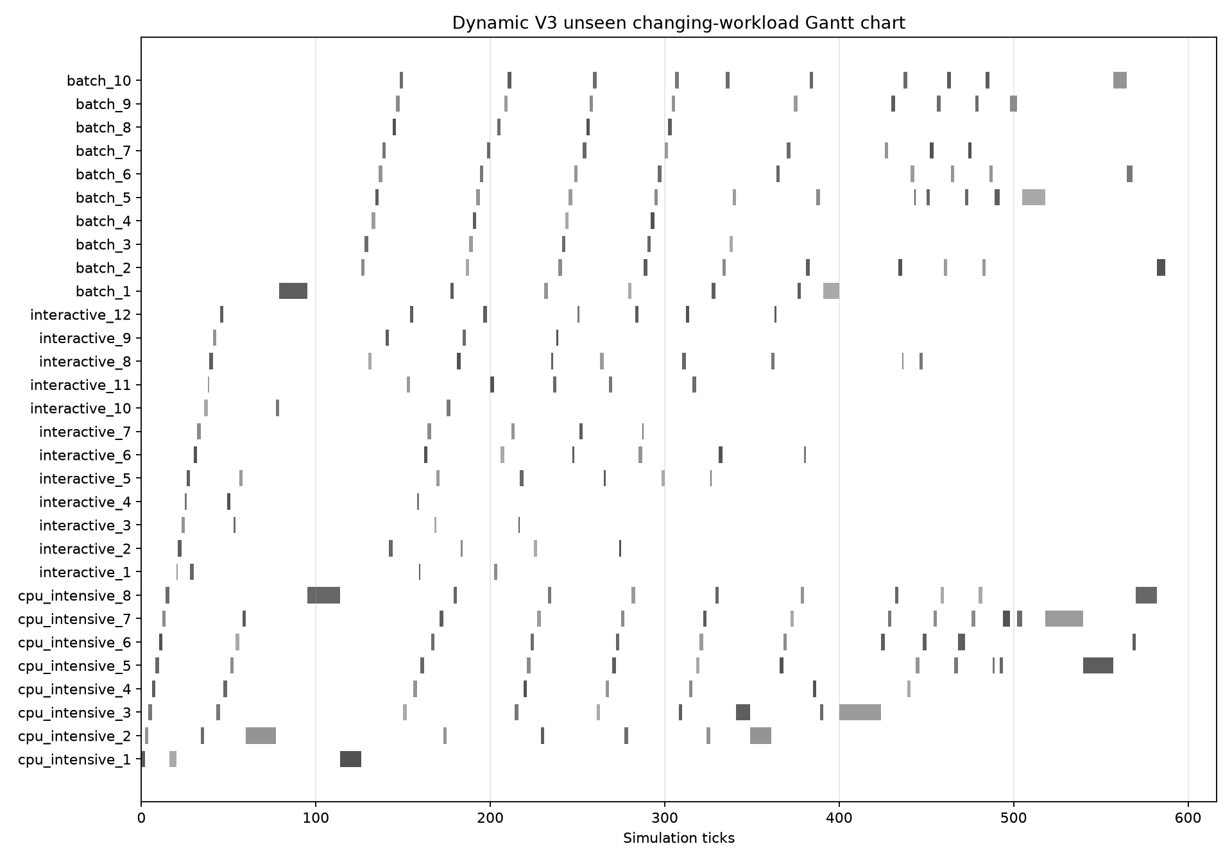
End-to-end Dynamic V3 demonstration
Router workflow
Observe the workload every 10 ticks.
The classifier proposes a scheduler.
Confidence and 20-tick dwell checks review the proposal.
The router switches only at a safe dispatch boundary.
Observed result
52 reviews and 8 accepted switches.
Initial policy: MLFQ. Final policy: Priority.
Decision P99: 0.456 ms.
The demonstration validates the prototype workflow and latency target. It does not establish Linux kernel performance or universal policy superiority.
9
Notes:
This demonstration uses an unseen changing workload with CPU-intensive, interactive, and batch phases. The router reviews the observed state every 10 ticks. Confidence, a 20-tick minimum dwell, and safe dispatch boundaries limit switching. The result proves the prototype control flow and measured decision latency for this run. It does not prove Linux kernel scheduling performance or superiority over every fixed scheduler.
Sources:
/Users/knightnm/Documents/AutoScheduler-SL-CPU-Scheduler/results/dynamic_v3_demo01/summary.json
/Users/knightnm/Documents/AutoScheduler-SL-CPU-Scheduler/results/dynamic_v3_demo01/decision_log.csv
/Users/knightnm/Documents/AutoScheduler-SL-CPU-Scheduler/results/dynamic_v3_demo01/gantt.png

Slide 10
References
[1] S. Biswas et al., “A Machine Learning Approach for Predicting Efficient CPU Scheduling Algorithm,” STI, 2023, doi: 10.1109/STI59863.2023.10464816.
[7] F. Pedregosa et al., “Scikit-learn: Machine Learning in Python,” Journal of Machine Learning Research, vol. 12, pp. 2825–2830, 2011.
[2] X. Wang et al., “Mixture-of-Schedulers: An Adaptive Scheduling Agent as a Learned Router for Expert Policies,” arXiv:2511.11628, 2025.
[8] A. E. Hoerl and R. W. Kennard, “Ridge Regression: Biased Estimation for Nonorthogonal Problems,” Technometrics, vol. 12, no. 1, pp. 55–67, 1970.
[3] Y. Fu et al., “ALPS: An Adaptive Learning, Priority OS Scheduler for Serverless Functions,” USENIX ATC, 2024.
[9] J. R. Quinlan, “Induction of Decision Trees,” Machine Learning, vol. 1, pp. 81–106, 1986.
[4] H. Lee, S. Jung, and H. Jo, “STUN: Reinforcement-Learning-Based Optimization of Kernel Scheduler Parameters,” Applied Sciences, 2022.
[10] L. Breiman, “Random Forests,” Machine Learning, vol. 45, pp. 5–32, 2001.
[5] A. Negi and K. K. Pusukuri, “Applying Machine Learning Techniques to Improve Linux Process Scheduling,” TENCON, 2005.
[11] J. H. Friedman, “Greedy Function Approximation: A Gradient Boosting Machine,” Annals of Statistics, vol. 29, no. 5, pp. 1189–1232, 2001.
[6] D. Seo et al., “SCHED: Safe CPU Scheduling Framework with Reinforcement Learning and Decision Trees,” VTC-Spring, 2025.
10
Notes:
IEEE-style bibliography for all numbered citations used in the deck.
Sources:
/Users/knightnm/Documents/OS_Project/AutoSchedulerPapers.md

