Slide 1
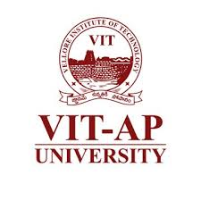
VeriSignX:
AI-Driven Signature Verification for Fraud-Resistant Cheque Processing
Capstone ID: 20250516
Presented by: Shantanu Maity (22BCE7223)
Deepak Shajan (22BCE8198)
Institution: VIT-AP University
Department: Computer Science and Engineering

Slide 2
INTRODUCTION
Signature verification is a crucial security process in banking and financial operations. Manual verification is time-consuming and prone to human error, leading to potential fraud.
VeriSignX is an AI-driven system designed to automate cheque signature verification using image processing and machine learning. It ensures high accuracy and reliability by combining OCR-based localization, image segmentation, and a Support Vector Machine (SVM) classifier trained on fused feature representations.

Slide 3
System Architecture
Input the cheque image
OCR text detection (find Line Sweep + Connected Component segmentations “Please sign above”)
Feature extraction (SIFT + Contour features)
SVM classification (Genuine or Forged)
Output result via web interface
Fully automated pipeline:
Cheque Image → OCR → Segmentation → Feature Extraction → Classification → Result

Slide 4
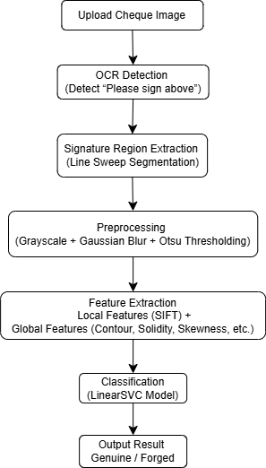
METHODOLOGY
Preprocessing: Converts cheque images to grayscale, applies a Gaussian blur, and binarizes using Otsu’s thresholding.
Signature Localisation: Uses OCR with Line Sweep and Connected Component methods to isolate the signature region.
Feature Extraction: Extracts SIFT texture features and contour-based geometric features (ratio, centroid, solidity, skewness, etc.).
Model Training: Trains a LinearSVC classifier on scaled hybrid feature vectors and saves it as model.pkl.
Deployment: Flask web app enables cheque upload, automatic analysis, and instant authenticity results.

Slide 5
DATASET
Used the IDRBT Cheque Image Dataset with genuine and forged signatures.
Contains scanned cheque images from 29 different signers.
Includes variations in ink, style, and noise for realistic conditions.
Data is organised into genuine and forged folders for training and testing.
Supports supervised learning for accurate signature classification.

Slide 6
RESULT AND PERFORMANCE METRICS
The trained model was evaluated on 29 signer groups from the IDRBT Cheque Image Dataset, achieving excellent accuracy in classifying genuine and forged signatures. The combined OCR – LineSweep – SIFT – SVM architecture yielded high accuracy, low false rates, and real-time responsiveness suitable for banking-grade applications.
Metric | Description | Result
Accuracy | Overall correct classifications | 80.8% – 82.2%
Precision (Forged) | Correctly predicted forgeries | 94.1%
Recall (Forged) | Forged signatures correctly detected | 95.3%
False Acceptance Rate (FAR) | Forged signatures accepted as genuine | ≈ 9%
False Rejection Rate (FRR) | Genuine signatures rejected as forged | ≈ 8%

Slide 7
NOVELTY
Hybrid Architecture: Integrates OCR-based text localisation, geometric scanning, and feature fusion for robust region extraction.
Unified Deployment Model: The use of a single serialised model (model.pkl) containing all components simplifies real-world deployment.
Feature Fusion: Combines local texture patterns (SIFT) and global geometric characteristics (contours) — improving resistance to skilled forgeries.
Flask Integration: Provides a lightweight yet powerful real-time verification platform accessible through a browser.

Slide 8
OBJECTIVES MET
Automated extraction of cheque signature regions using OCR and image segmentation.
Comprehensive feature generation combining texture, geometry, and key points.
Training of a robust and interpretable SVM model for verification.
End-to-end deployment through a Flask web interface.
Significant improvement in detection accuracy with low false decision rates.

Slide 9
Comparison with Existing Models
Traditional systems rely on pixel matching or correlation-based methods, which fail under noise, rotation, or style variations.
Some existing models use only geometric features or CNN-based deep models, requiring large datasets and high computation.
VeriSignX introduces a hybrid feature fusion approach combining SIFT (local texture) and contour-based (global shape) features.
Achieves 80.8–82.2% accuracy, outperforming classical SVM or CNN-only approaches on limited data.
Offers real-time verification through a lightweight Flask web app, unlike heavy offline models.

Slide 10
APPLICATION
Banking Institutions: Automated signature verification for cheque processing and fraud prevention.
Corporate Workflows: Employee signature verification for document authentication.
Legal & Governmental Sectors: Signature validation for contracts, affidavits, and archival documents.
Research Expansion: Extensible to digital document security, stylometric handwriting analysis, and biometric verification.

Slide 11
PRESENTATION
Interactive Web App:
Built using Flask, allowing users to upload cheque images and generate results.
System Demonstration
Performs real-time cheque verification from upload to result with instant, color-coded outputs, seamlessly integrable into banking systems.
User Experience
Clean and minimal interface for use in institutional environments.

Slide 12
STANDARDS / TOOLS
Category | Tools / Libraries Used
Language | Python
Machine Learning | scikit-learn (LinearSVC, StandardScaler)
Feature Extraction | OpenCV (SIFT, Contours)
Image Preprocessing | NumPy, Matplotlib, scikit-image, Pillow
OCR & Text Detection | pytesseract
Web Framework | Flask
Visualization | Matplotlib, HTML templates
Dataset Used | IDRBT Cheque Image Dataset (Genuine vs Forged)

Slide 13
CONCLUSION
VeriSignX automates cheque signature verification using AI and image processing.
Combines OCR localization, feature fusion, and SVM classification.
Achieved >82% accuracy with minimal error rates.

Slide 14
ReFERENCES
IDRBT Cheque Image Dataset – Institute for Development and Research in Banking Technology (IDRBT), Hyderabad, India.
B. K. Verma and S. Pal, “Offline Signature Verification and Forgery Detection Using Hybrid Features and Support Vector Machine,” IEEE Access, vol. 8, pp. 184632–184643, 2020.
S. Kumar and A. K. Singh, “A Machine Learning Approach for Signature Verification Using SVM and KNN,” Procedia Computer Science, vol. 132, pp. 400–408, 2018.

Slide 15
THANK YOU
Project: VeriSignX
Presented by: Shantanu Maity & Deepak Shajan
Institution: VIT-AP University

