Slide 1
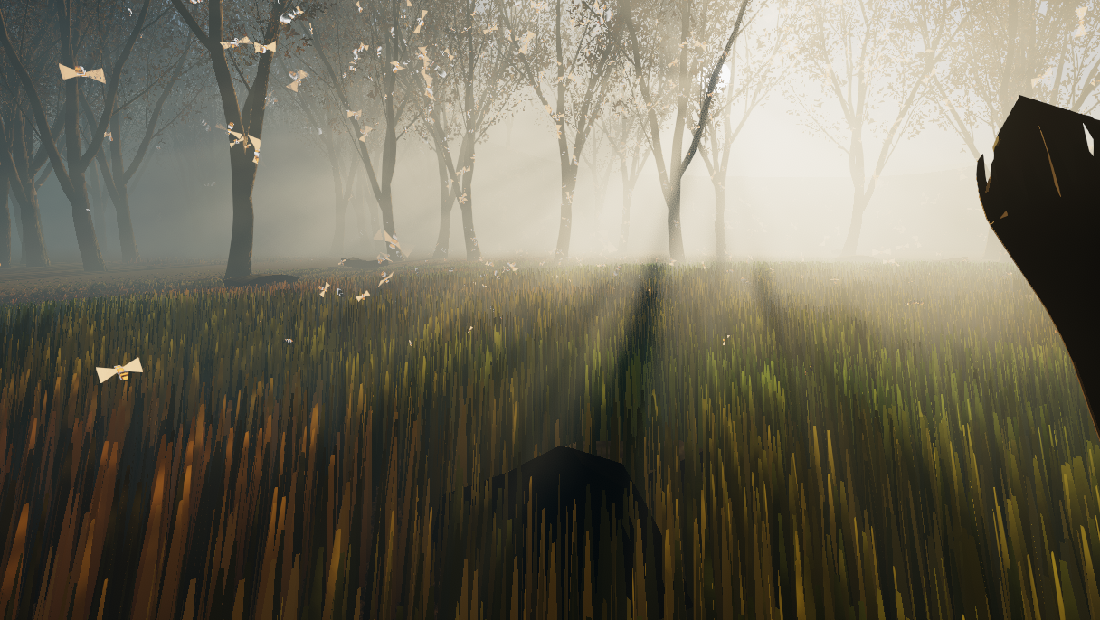
Shaders
Luca Türk, Samuel Knöthig, Sven Lüpke

Slide 2
Fog Demo (1 min)

Slide 3
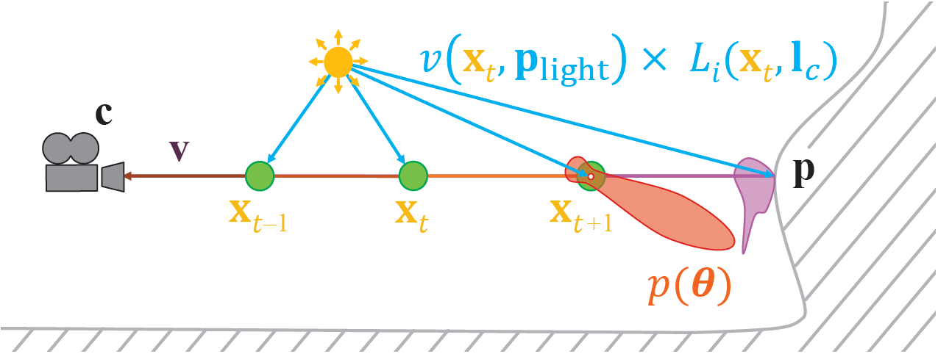
Light Scattering Theory
Beer-Lambert-Law
Phase function
Might be wavelength dependent
$$L_{i}\left(c, −v\right)=T_{r}\left(c, p\right)L_{o}\left(p,v\right)+\int_{t=0}^{\left\|p−c\right\|}{T_{r}\left(c, c−vt\right)L_{scat}\left(c−vt, v\right)σ dt}$$

Slide 4
Implementation (1 min)
Frustum oriented voxel grid (3d texture)
In-scattering in RGB
Scattering coefficient in Alpha
Exponential depth distribution
3 compute passes, apply fog in pixel shader

Slide 5
Temporal Supersampling
Use previous frames to increase sample count
Exponential moving average
Halton sequence
Neighborhood clamping to avoid ghosting
Raymarch
Compute Density and Lighting
Average and clamp
History Buffer

Slide 6
Dithering (30 sec)
Blue noise
Offset depth
Better sample distribution
Dithered sampling -> TAA

Slide 7
Atmosphere Rendering

Slide 8
Performance

Slide 9
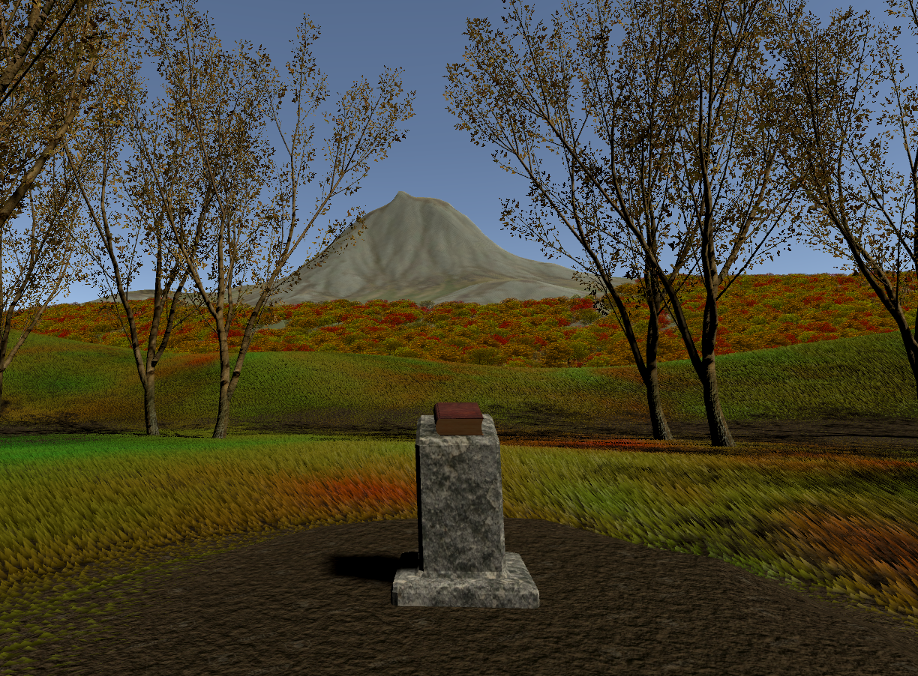
Vegetation

Slide 10
Grass Shader – General
Generate grass geometry in tessellation and geomety stage
Allow artist to pass properties such as height, color distribution and wind displacement
Collide grass blades with player and other specified objects

Slide 11
Grass Shader – Tessellation
Create additional ground verticies for geometry shader to work on, effectively increasing grass density
Optimizations: Tessellation fractors decrease with distance to player, and input verticies are frustum culled

Slide 12

Grass Shader – Geometry
Initially, a single grass blade was added in the centre of the input triangle.
But, a lot of tessellation required for the dense grass look.
==> Add multiple blades for each triangle

Slide 13

Grass Shader – Geometry
Grass blades are constructed out of four verticies, which allows for less pointy looking blades, by pushing down the top verticies.

Slide 14
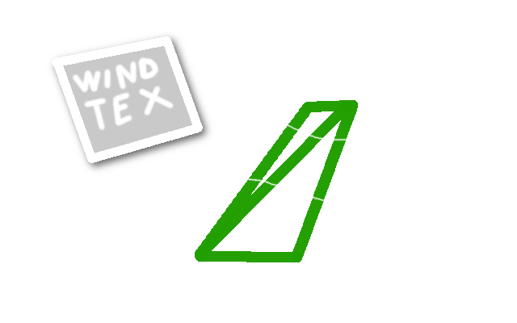
Grass Shader – "External" Influences
Grass Blades are influenced by wind, achieved by a displacement texture applied to the top vertex positions.

Slide 15
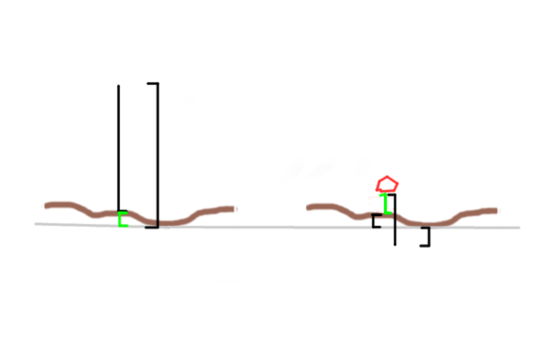
Grass Shader – "External" Influences
Additionally grass will collide with players or other objects, and bend away.

Slide 16
Grass Shader – Live Demo

