Slide 1
Shader
Luca Türk, Samuel ???, Sven Lüpke

Slide 2
Overview
Physically Based Volumetric Fog
Grass
BOIDs

Slide 3
Fog Demo (1 min)

Slide 4
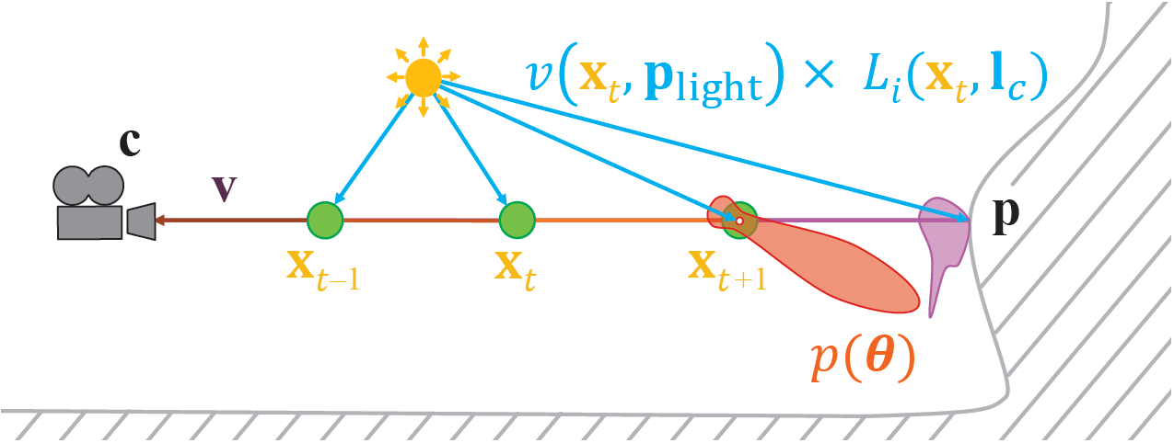
Light Scattering Theory
Beer-Lambert-Law
Phase function
Might be wavelength dependent
$$L_{i}\left(c, −v\right)=T_{r}\left(c, p\right)L_{o}\left(p,v\right)+\int_{t=0}^{\left\|p−c\right\|}{T_{r}\left(c, c−vt\right)L_{scat}\left(c−vt, v\right)σ dt}$$

Slide 5
Implementation (1 min)
Frustum oriented voxel grid (3d texture)
In-scattering in RGB
Scattering coefficient in Alpha
Exponential depth distribution
3 compute passes, apply fog in pixel shader

Slide 6
Temporal Supersampling
Use previous frames to increase sample count
Exponential moving average
Halton sequence
Neighborhood clamping to avoid ghosting
Raymarch
Compute Density and Lighting
Average and clamp
History Buffer

Slide 7
Dithering (30 sec)
Blue noise
Offset depth
Better sample distribution
Dithered sampling -> TAA

Slide 8
Atmosphere Rendering

Slide 9
Performance

Slide 10
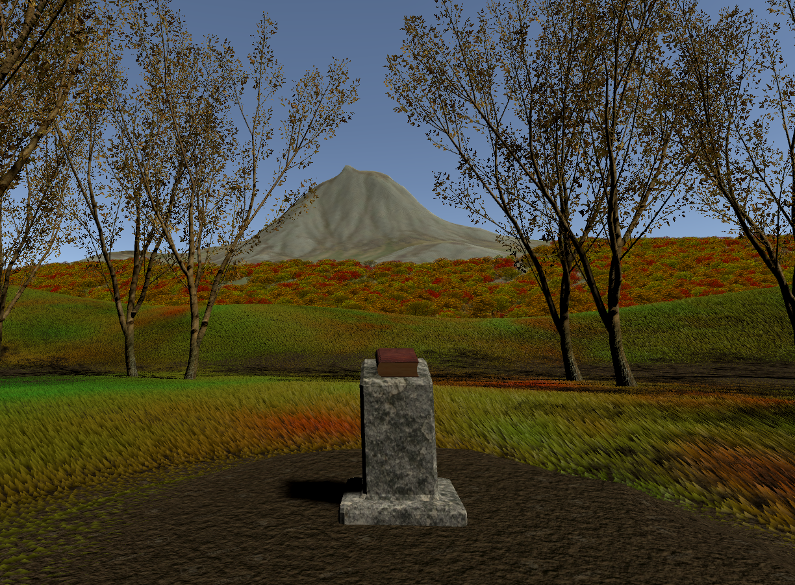
Vegetation

Slide 11
Grass Shader – General

Slide 12
Grass Shader – Tessellation

Slide 13
Grass Shader - Collision

Slide 14
Grass Shader – Live Demo

