Slide 1
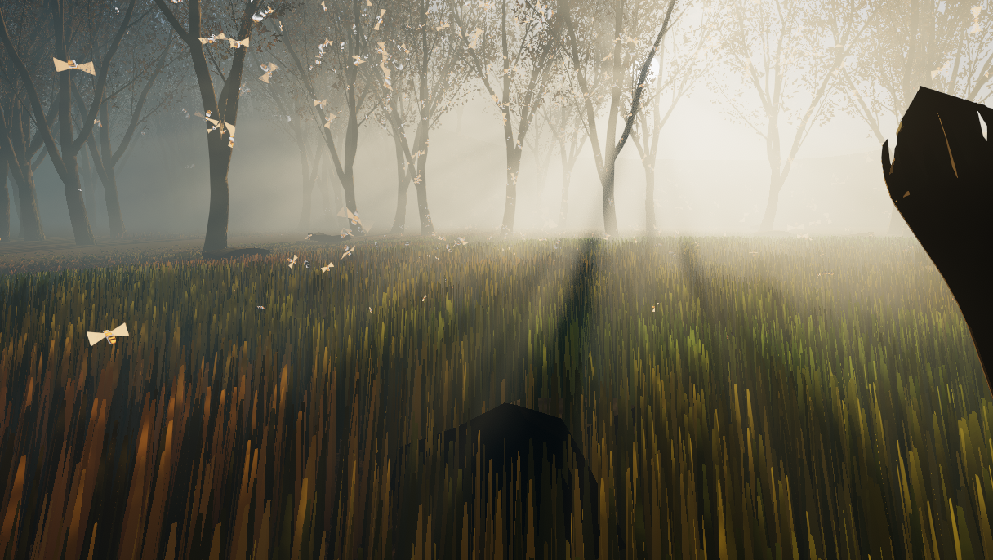
Shaders
Luca Türk, Samuel Knöthig, Sven Lüpke

Slide 2
Demo: Physically Based Volumetric Fog and Atmosphere

Slide 3
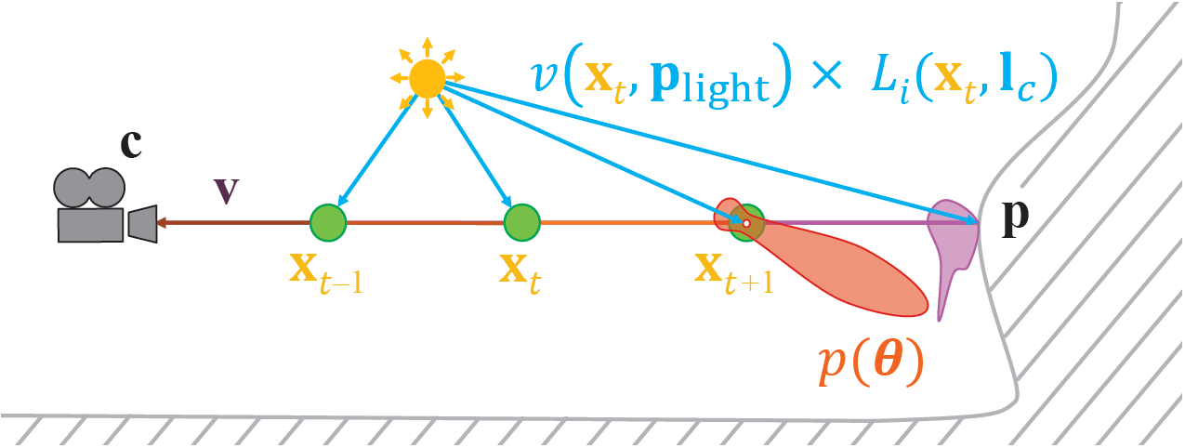
Light Scattering Theory

Slide 4
Light Scattering Theory
$$L_{i}\left(c, −v\right)=T_{r}\left(c, p\right)L_{o}\left(p,v\right)+\int_{t=0}^{\left\|p−c\right\|}{T_{r}\left(c, c−vt\right)L_{scat}\left(c−vt, v\right)σ dt}$$

Slide 5

Implementation
Frustum oriented volume
240x135x96
In-scattering in RGB
Scattering coefficient in Alpha
Exponential depth distribution
Covers scene up to 900 units from camera
3 passes:
Compute density and lighting at each sample position (Compute Shader)
Raymarch (Compute Shader)
Apply to scene (Pixel Shader)

Slide 6
Temporal Supersampling
Use previous frames to increase sample count
Jitter sample positions using Halton sequence
Exponential moving average
Need to compute position in history buffer if camera moves
Neighborhood clamping to avoid ghosting on moving lights
Raymarch
Compute Density and Lighting
Average and clamp
History Buffer
8%
92%

Slide 7
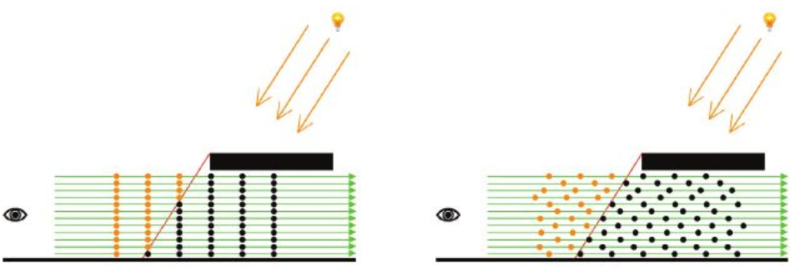

Dithering
Offset sample depth using blue noise
➔ Better sample distribution
Dithered sampling ➔ smoothed by TAA

Slide 8
Grass Shader – Live Demo

Slide 9
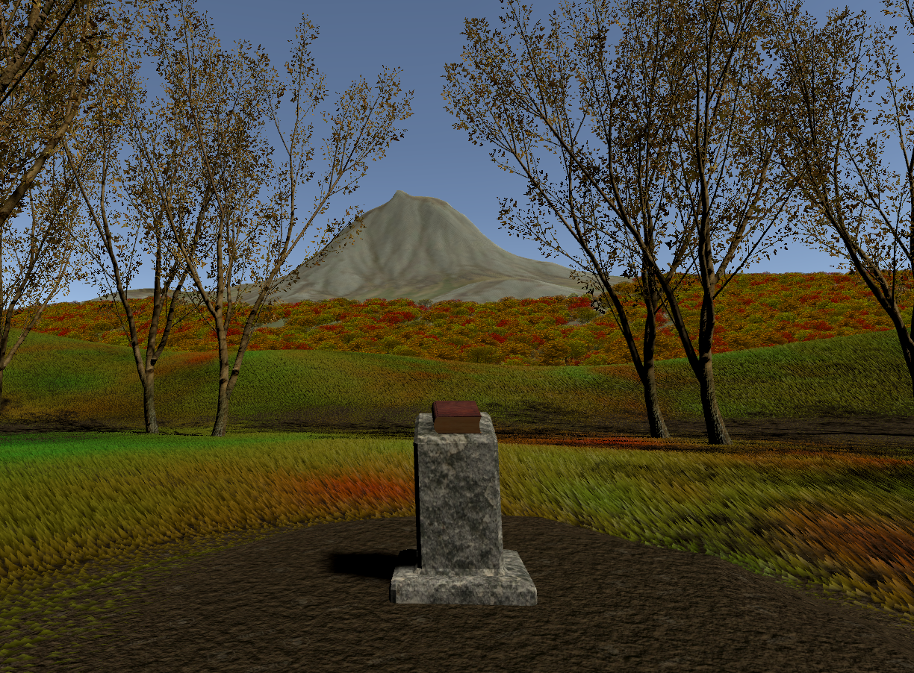
Vegetation

Slide 10
Grass Shader – General
Generate grass geometry in tessellation and geomety stage
Allow artist to pass properties such as height, color distribution and wind displacement
Collide grass blades with player and other specified objects

Slide 11
Grass Shader – Tessellation
Create additional ground verticies for geometry shader to work on, effectively increasing grass density
Optimizations: Tessellation fractors decrease with distance to player, and input verticies are frustum culled

Slide 12

Grass Shader – Geometry
Initially, a single grass blade was added in the centre of the input triangle.
But, a lot of tessellation required for the dense grass look.
==> Add multiple blades for each triangle

Slide 13

Grass Shader – Geometry
Grass blades are constructed out of four verticies, which allows for less pointy looking blades, by pushing down the top verticies.

Slide 14
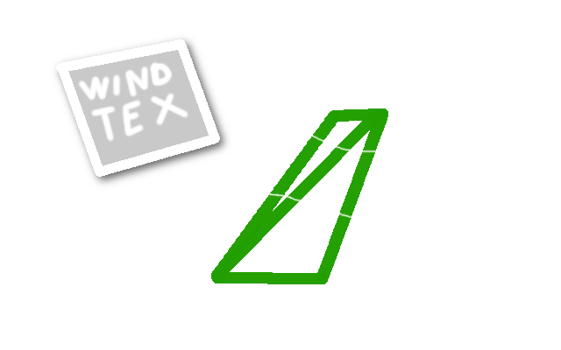
Grass Shader – "External" Influences
Grass Blades are influenced by wind, achieved by a displacement texture applied to the top vertex positions.

Slide 15
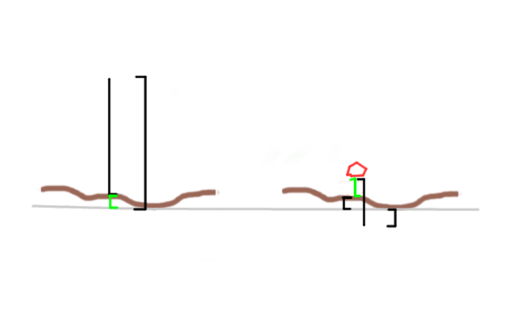
Grass Shader – "External" Influences
Additionally grass will collide with players or other objects, and bend away.

Slide 16
References
B. Wronski: Volumetric Fog: Unified compute shader based solution to atmospheric scattering, SIGGRAPH 2014
S. Hillaire: Physically Based and Unified Volumetric Rendering in Frostbite, SIGGRAPH 2015
F. Bauer: Creating the Atmospheric World of Red Dead Redemption 2: A Complete and Integrated Solution, SIGGRAPH 2019
T. Akenine-Möller, E. Haines, N. Hoffman, A. Pesce, M. Iwanicki, S. Hillaire, Real-Time Rendering, Fourth Edition, CRC Press 2018
S. Hillaire: Physically Based Sky, Atmosphere and Cloud Rendering in Frostbite, SIGGRAPH 2016
B. Karis: High Quality Temporal Supersampling, SIGGRAPH 2014
M. Salvi: An Excursion in Temporal Supersampling, GDC16
J. Jimenez: Filmic SMAA, Sharp Morphological and Temporal Antialiasing, SIGGRAPH 2016
T. Sousa, J. Geffroy: The Devil is in the Details: idTech 666, SIGGRAPH 2016

