Slide 1
Entering the Organic Hass Avocado Market With Disciplined Pilot Economics
West Valley Fresh Distribution Company 2026 IMA Student Case Competition
20,000 ORGANIC UNITS
40 CITY MARKETS IN SUPPLIED DATA
2019 TO JUNE 2025 HAB DATA
Prepared as an anonymized submission. The deck is designed to stand alone without speaker notes and focuses on profitability, volatility, and disciplined market entry.
ANONYMIZED TEAM SUBMISSION
1

Slide 2
EXECUTIVE SUMMARY
A selective 5-city pilot is the strongest entry path for the 20,000-unit organic order
RECOMMENDATION
BASE-CASE ECONOMICS
WHY IT IS RESILIENT
5-city launch
$13.7k avg profit
Same 5 cities
Seattle, Boise, Portland, Spokane, and San Diego maximize expected profit under the June 2026 pricing assumption.
The selected cities pair premium June pricing with manageable miles, producing a top-five average margin of 69.7%.
The recommendation does not change when shipping costs move up 50% or down 50%.
Model note: each city is scored as a comparable 20,000-unit scenario using June 2025 retail price as the June 2026 proxy.
ANONYMIZED TEAM SUBMISSION
2

Slide 3


FOUNDATION
Seasonality creates a timing gap between volume and price
Volume arrives early. Organic volume peaks in January, conventional peaks in May, and both soften into November.
Price crests later. Both organic and conventional prices peak in July and bottom in February.
The market absorbs more units before it offers peak pricing, so timing affects margin capture, promotions, and inventory allocation.
ANONYMIZED TEAM SUBMISSION
3

Slide 4

FOUNDATION
ANONYMIZED TEAM SUBMISSION
4

Slide 5
FOUNDATION
The pilot screen should be price support, organic readiness, and route efficiency
PRICE SUPPORT
ORGANIC READINESS
ROUTE EFFICIENCY
$2.09 to $2.66
Seattle leads 5 of 7
$813 to $1.0k
The selected five cities are also the five highest-price June 2025 organic markets in the model.
Organic adoption is uneven by city, so total sales scale alone is not enough to pick the best launch markets.
Even after a 50% freight increase, the recommended cities lose only about $0.8k to $1.0k each and keep the same ranking.
This deck tests those three filters against sales leadership, organic mix, profitability, freight sensitivity, and seasonality.
ANONYMIZED TEAM SUBMISSION
5

Slide 6

MARKET ANALYSIS
ANONYMIZED TEAM SUBMISSION
6

Slide 7

MARKET ANALYSIS
ANONYMIZED TEAM SUBMISSION
7

Slide 8

MARKET ANALYSIS
ANONYMIZED TEAM SUBMISSION
8

Slide 9

MARKET ANALYSIS
ANONYMIZED TEAM SUBMISSION
9

Slide 10
MARKET ANALYSIS
ANONYMIZED TEAM SUBMISSION
10

Slide 11

MARKET ANALYSIS
ANONYMIZED TEAM SUBMISSION
11

Slide 12

MARKET ANALYSIS
ANONYMIZED TEAM SUBMISSION
12

Slide 13

MARKET ANALYSIS
CONTEXT
ANONYMIZED TEAM SUBMISSION
13

Slide 14

MARKET ANALYSIS
CONTEXT
ANONYMIZED TEAM SUBMISSION
14

Slide 15

MARKET ANALYSIS
ANONYMIZED TEAM SUBMISSION
15

Slide 16

RECOMMENDATION
ANONYMIZED TEAM SUBMISSION
16

Slide 17

RECOMMENDATION
ANONYMIZED TEAM SUBMISSION
17

Slide 18

RECOMMENDATION
ANONYMIZED TEAM SUBMISSION
18

Slide 19

RECOMMENDATION
ANONYMIZED TEAM SUBMISSION
19

Slide 20

RECOMMENDATION
ANONYMIZED TEAM SUBMISSION
20

Slide 21

RECOMMENDATION
ANONYMIZED TEAM SUBMISSION
21

Slide 22

RECOMMENDATION
ANONYMIZED TEAM SUBMISSION
22

Slide 23

RECOMMENDATION
ANONYMIZED TEAM SUBMISSION
23

Slide 24

RECOMMENDATION
ANONYMIZED TEAM SUBMISSION
24

Slide 25
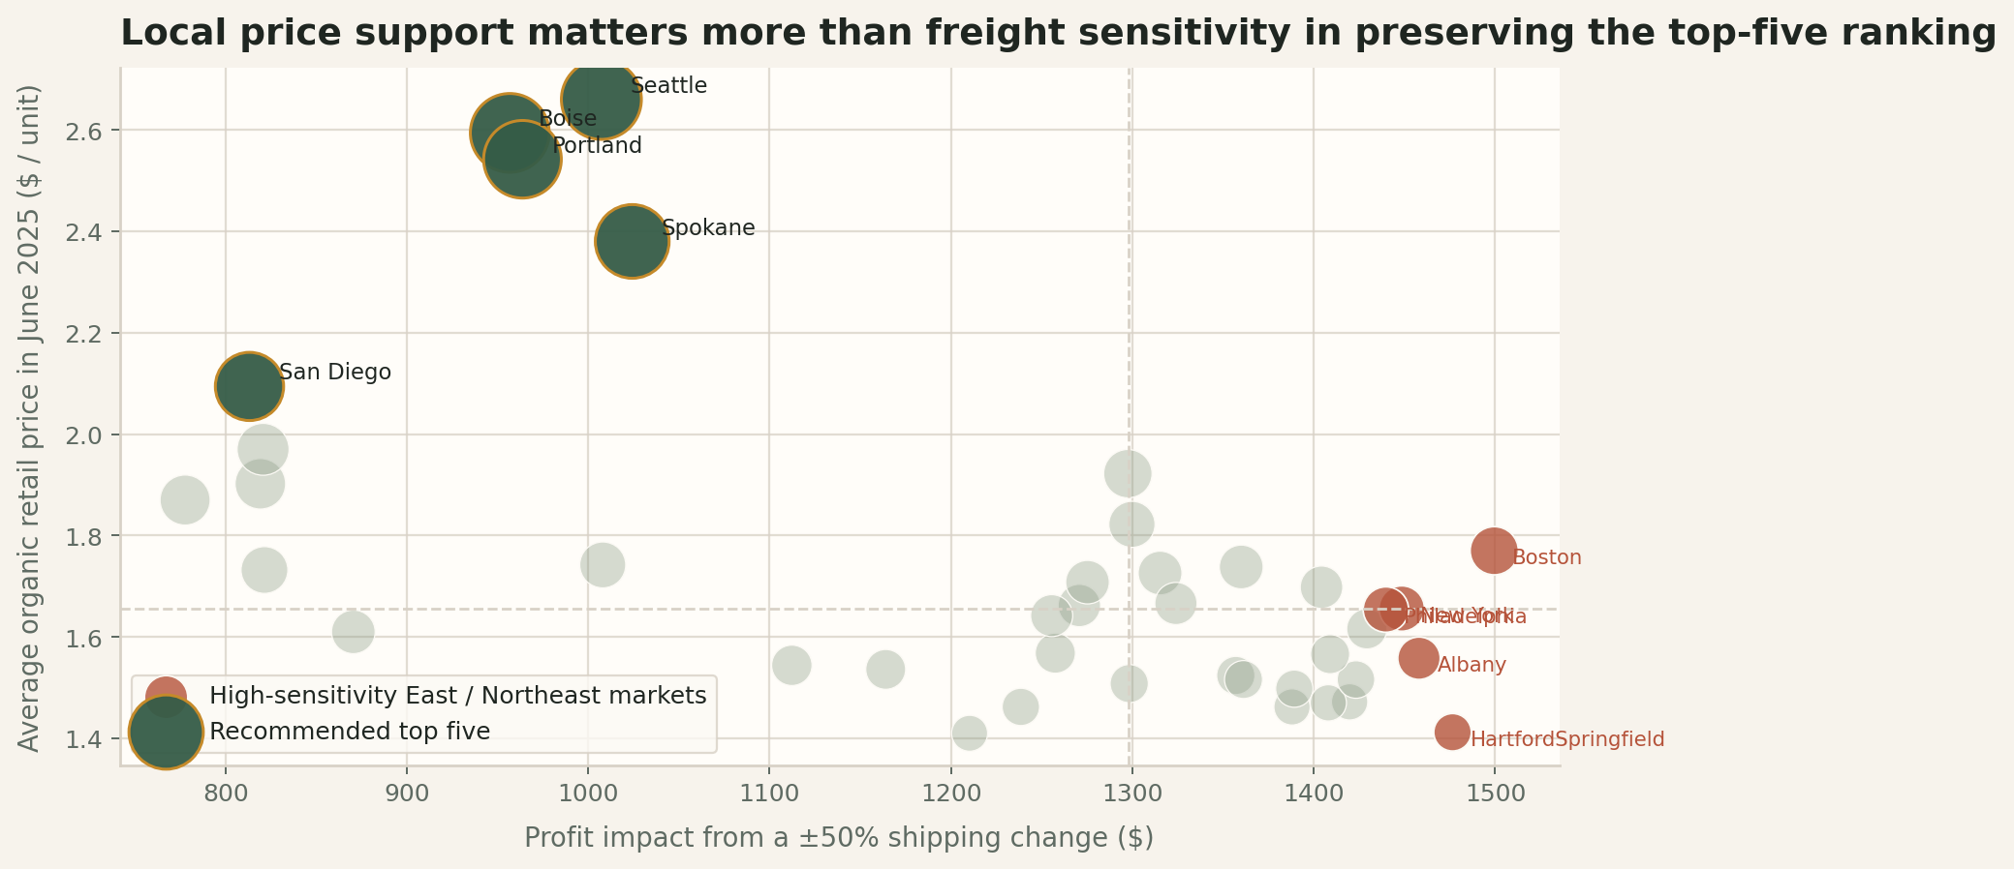
RECOMMENDATION
ANONYMIZED TEAM SUBMISSION
25

Slide 26
SEASONALITY
ANONYMIZED TEAM SUBMISSION
26

Slide 27
SEASONALITY
ANONYMIZED TEAM SUBMISSION
27

Slide 28
SEASONALITY
INFERENCE
Seasonality should change when West Valley pushes volume and when it protects margin
Jan
Feb
Mar
Apr
May
Jun
Jul
Aug
Sep
Oct
Nov
Dec
PUSH VOLUME
PROTECT MARGIN
STIMULATE DEMAND
Jan to May
Jul to Sep
Nov to Feb
Prioritize service, retailer availability, and flow discipline while market volume is naturally strongest.
Hold pricing discipline and allocate the strongest fruit to the best-paying markets while price support is highest.
Use promotions, alternate channels, and tighter inventory planning when both types face softer volume months.
Organic volume peaks in Jan while price peaks in Jul; that gap is the operating lever.
ANONYMIZED TEAM SUBMISSION
28

Slide 29
SEASONALITY
INFERENCE
A monthly operating calendar can convert seasonality from risk into advantage
 | Jan | Feb | Mar | Apr | May | Jun | Jul | Aug | Sep | Oct | Nov | Dec
Commercial posture | Stimulate | Stimulate | Support | Support | Service | Balance | Protect | Protect | Protect | Rebalance | Stimulate | Stimulate
Supply posture | Flex up | Flex up | Flex up | Flex up | Peak flow | Normalize | Tighten mix | Tighten mix | Tighten mix | Reset | Flex down | Flex down
Operating focus | Forecast | Promote | Allocate | Allocate | Service | Audit | Margin | Margin | Margin | Plan | Clear | Review
Suggested cadence: Jan-May prioritize service and flow, Jul-Sep protect margin, and Nov-Feb stimulate demand while tightening inventory.
ANONYMIZED TEAM SUBMISSION
29

Slide 30
SEASONALITY
INFERENCE
Growers need flexible contracts, better cold-chain readiness, and alternate lanes
CONTRACT TIERS
COLD-CHAIN READINESS
ALTERNATE LANES
Base + flex volume
Protect service
Reduce disruption
Lock a stable base volume, then add seasonal flex tiers so supply expands without overcommitting year-round.
Use better storage, transit monitoring, and receiving discipline during peak months to cut spoilage and stockouts.
Build backup carriers and routes so freight volatility or lane disruption does not force reactive city choices.
These actions translate Q9 into supply-side discipline rather than generic risk language.
ANONYMIZED TEAM SUBMISSION
30

Slide 31
SEASONALITY
INFERENCE
Trade associations should smooth demand in off-peak months
CONSUMER MESSAGING
CHANNEL MIX
Recipes + health
Food-service + institutional
Use recipe content and health messaging in softer months to keep avocados visible in weekly shopping decisions.
Shift more volume through restaurants, prepared foods, and institutional buyers when retail pull weakens.
PROMO TIMING
TRADE SUPPORT
Promote when the market is soft
Joint campaigns
Reserve the strongest promotional calendar for low-volume months instead of discounting away naturally strong demand.
Coordinate with trade associations on seasonal education campaigns so promotions align with the month-by-month operating calendar.
ANONYMIZED TEAM SUBMISSION
31

Slide 32
SEASONALITY
INFERENCE
A shared monthly S&OP cadence can align growers, West Valley, and retail partners
GROWERS
WEST VALLEY
RETAILERS
Supply commitment
Control tower
Demand signal
Set base volume, flex volume, and harvest timing updates by month.
Translate price, demand, and freight signals into allocation decisions.
Provide promo calendars, replenishment risk, and reorder visibility.
Monthly cadence: Forecast demand -> lock commitments -> allocate by city -> review realized margin and service
- Run the review monthly, not quarterly, because the volume-price gap changes within the season.
- Use the same cycle to adjust grower commitments, routing, and retailer promotion timing.
ANONYMIZED TEAM SUBMISSION
32

Slide 33
IMPLEMENTATION
Launch the 2026 pilot first, then scale what the market confirms
2026
2027
2028
PILOT
EXPAND
OPTIMIZE
2026
2027
2028
Launch the five-city test, validate realized margin, and refine routing assumptions.
Add retailer coverage only where realized economics and service levels hold.
Tighten contracts, allocation logic, and seasonal operating rules.
ANONYMIZED TEAM SUBMISSION
33

Slide 34
IMPLEMENTATION
Pilot KPIs should focus on margin, service, spoilage, and repeat orders
MARGIN
FREIGHT
SERVICE
Realized gross margin
Freight per unit
Fill rate
Confirms whether forecast economics survive execution.
Shows whether routing and lane discipline are improving.
Measures retailer execution quality during seasonal peaks.
SHRINK
DEMAND
PLANNING
Spoilage rate
Reorder rate
Forecast accuracy
Captures cold-chain and freshness failures directly.
Tests whether pilot demand is repeatable, not one-off.
Shows whether monthly S&OP is improving allocation decisions.
ANONYMIZED TEAM SUBMISSION
34

Slide 35
IMPLEMENTATION
Expansion should follow stage gates, not automatic geography growth
GATE 1
GATE 2
GATE 3
DECISION
Pilot live
Economics verified
Service verified
Scale selectively
Launch and collect clean economics by city.
Confirm realized margin and freight per unit.
Confirm fill rate, spoilage control, and retailer reorder behavior.
Expand only where pilot evidence remains strong.
This avoids pretending the current model can allocate the full 20,000-unit order with exact retailer-level precision.
ANONYMIZED TEAM SUBMISSION
35

Slide 36
RISKS
INFERENCE
The highest-risk threats are freight spikes, import disruptions, and forecast error
High impact
Import disruption
Freight spikes
Low prob.
High prob.
Labor pressure
Forecast error
Spoilage
Retailer uptake
Low impact
ANONYMIZED TEAM SUBMISSION
36

Slide 37
RISKS
Each major risk has a specific operational countermeasure
Risk | Countermeasure | Owner
Freight spikes | Lock core carrier capacity and maintain alternate lanes. | Logistics lead
Import or supply disruption | Use flexible grower contracts and staggered commitments. | Sourcing lead
Spoilage / service failures | Tighten cold-chain controls and receiving discipline. | Operations lead
Forecast error | Run monthly S&OP and reallocate by city using realized demand. | Commercial lead
Retailer uptake risk | Require stage gates before expanding beyond the pilot. | General manager
ANONYMIZED TEAM SUBMISSION
37

Slide 38
LIMITATIONS
CAVEAT
The current model is strong enough for city selection but not yet for exact allocation
What the model does well
What it does not do yet
- The case text references 41 metro regions, but the cleaned dataset resolves to 40 city markets.
- 2025 data is partial year only and should not be read as a full-year comparison period.
- The city ranking uses comparable 20,000-unit scorecards for selection, not a retailer-level allocation model.
- The model uses June 2025 retail price as the simple forecast for June 2026 retail price.
- It does not include spoilage shrink, retailer-specific demand curves, or a fully expanded operating cost stack.
- All 40 city scenarios remain profitable even at +50% shipping, so the choice is about optimization, not survival.
ANONYMIZED TEAM SUBMISSION
38

Slide 39
CONCLUSION
West Valley should pursue a 5-city organic entry with structured discipline
RECOMMENDATION
ECONOMICS
Launch the 5-city pilot
$13.7k avg profit
Base case
- Seattle, Boise, Portland, Spokane, and San Diego maximize expected profit.
- The same five remain top-ranked in the base, +50%, and -50% shipping scenarios.
- Seasonality requires monthly operating discipline, not a static annual plan.
RESILIENCE
Same 5 cities
All three shipping scenarios
OPERATING DISCIPLINE
Volume before price
Plan by month, not by annual average
Next decision: run the pilot, measure realized economics, and scale only where the pilot confirms the model.
ANONYMIZED TEAM SUBMISSION
39

Slide 40
APPENDIX
Q&A / backup: sources, assumptions, and supporting tables
Primary sources
Backup exhibits available
- case_full.md and case_context.md
- case_comp_data.csv
- outputs/question_1.md through outputs/question_9.md
- outputs/q5_city_profitability_base.csv and scenario variants
- outputs/q8_monthly_seasonality.csv and supporting charts
- Winner matrix and city trend lines
- Growth/share bridge and elasticity visuals
- Selection matrix, frontier zoom, and freight sensitivity
- Seasonality price and volume charts
- Model caveats and implementation stage gates
SOURCES AND BACKUP
40

