Slide 1
Update 17.03.26

Slide 2
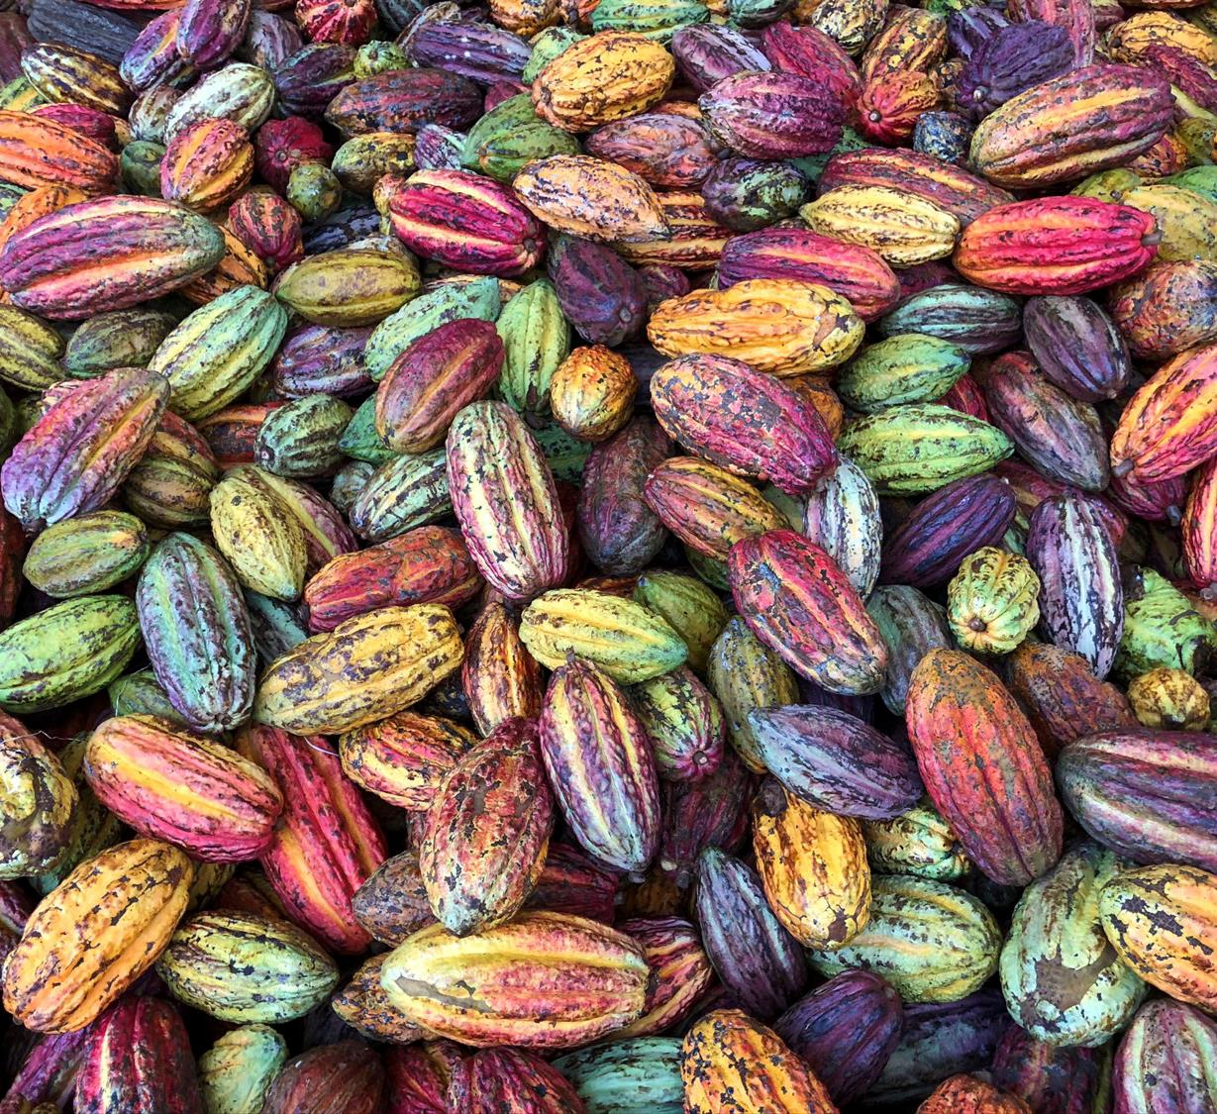
Methodology recap
Model Overview, Design decisions
Data
Empirical Results
QLIKE, Quantile Loss, MCS, RQ1, RQ2

Slide 3
Models
Geben Sie Ihren Untertitel ein
Feature | Hist. Vol | GARCH(1,1) | HAR-OLS | HAR-QR | HAR-X-QR
Model class | Non-param | ARCH-type | Linear reg. | Quantile reg. | Quantile reg.
HAR lags (d/w/m) | - | - | Yes | Yes | Yes
ENSO regressor | - | - | - | - | Yes
Quantile output | Empirical | Simulation | None | Direct | Direct
Multi-period design | Rolling window | Recursive | Direct | Direct | Direct
Thesis role | Naive BM | Recursive | HAR Benchmark | Main (RQ1) | Main (RQ2)

Slide 4


Key Design decisions
Evaluation
QLIKE
(Hist. Vol., GARCH, HAR-OLS)
Mean/median forecasts evaluation
Ranks forecasts consistently even when proxy is measured with noise
Penalizes under prediction more - relevant for tail risk
Quantile loss
(HAR-QR, HAR-X-QR)
Distributional forecasts
Natural scoring rule for quantile forecasts — penalizes under- and over-prediction asymmetrically depending on tau
Model confidence set
(All models)
Statistical significance
MCS identifies the group of statistically indistinguishable top performer

Slide 5
Research questions
1
2
Can HAR-based quantile regression models forecast cocoa futures volatility better than baseline models at horizons from 1 day to 12 months?
Does the ENSO climate index improve volatility forecasts, especially at long horizons?

Slide 6
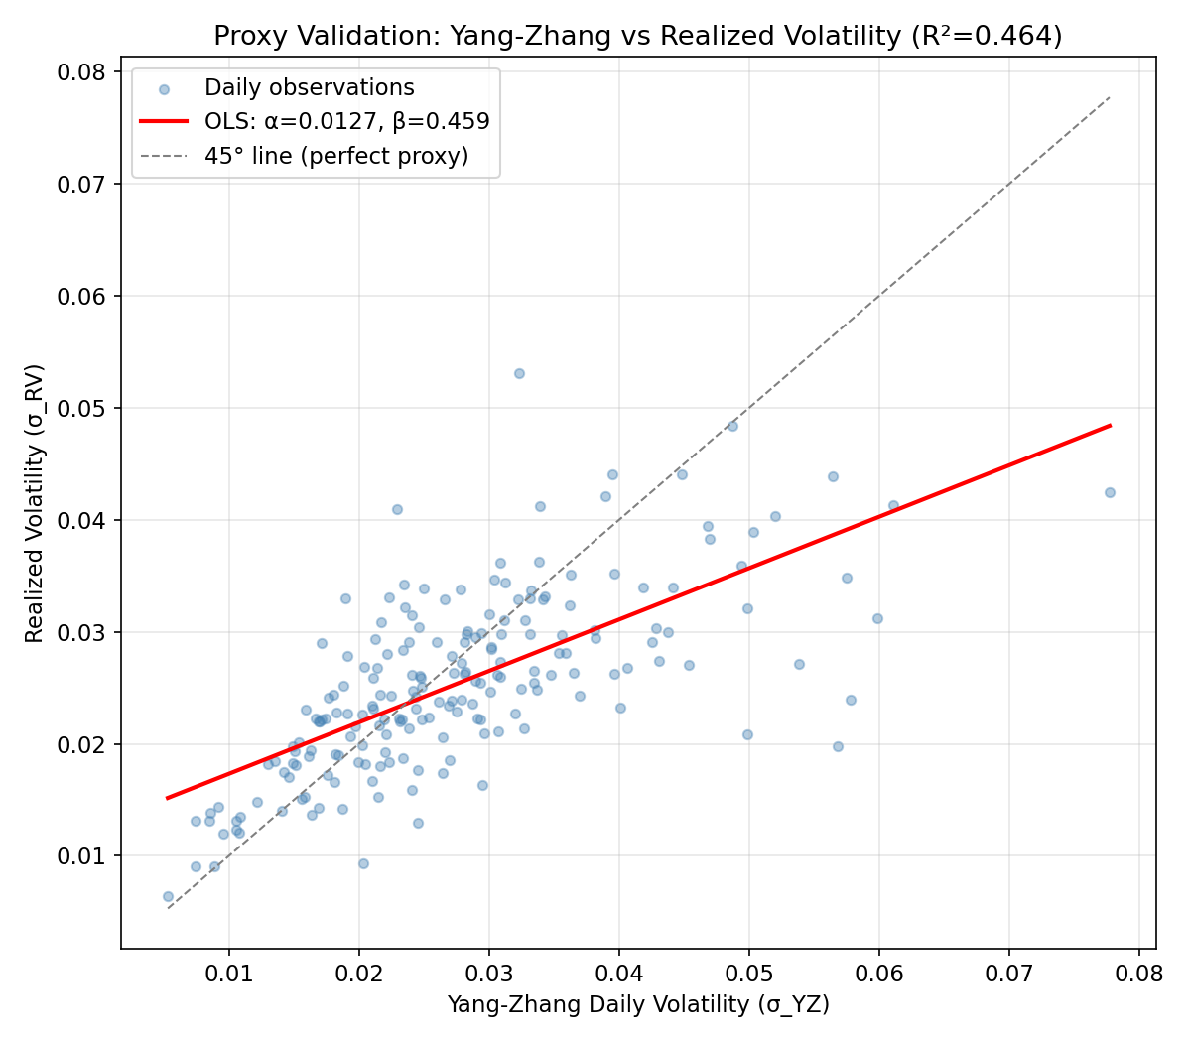
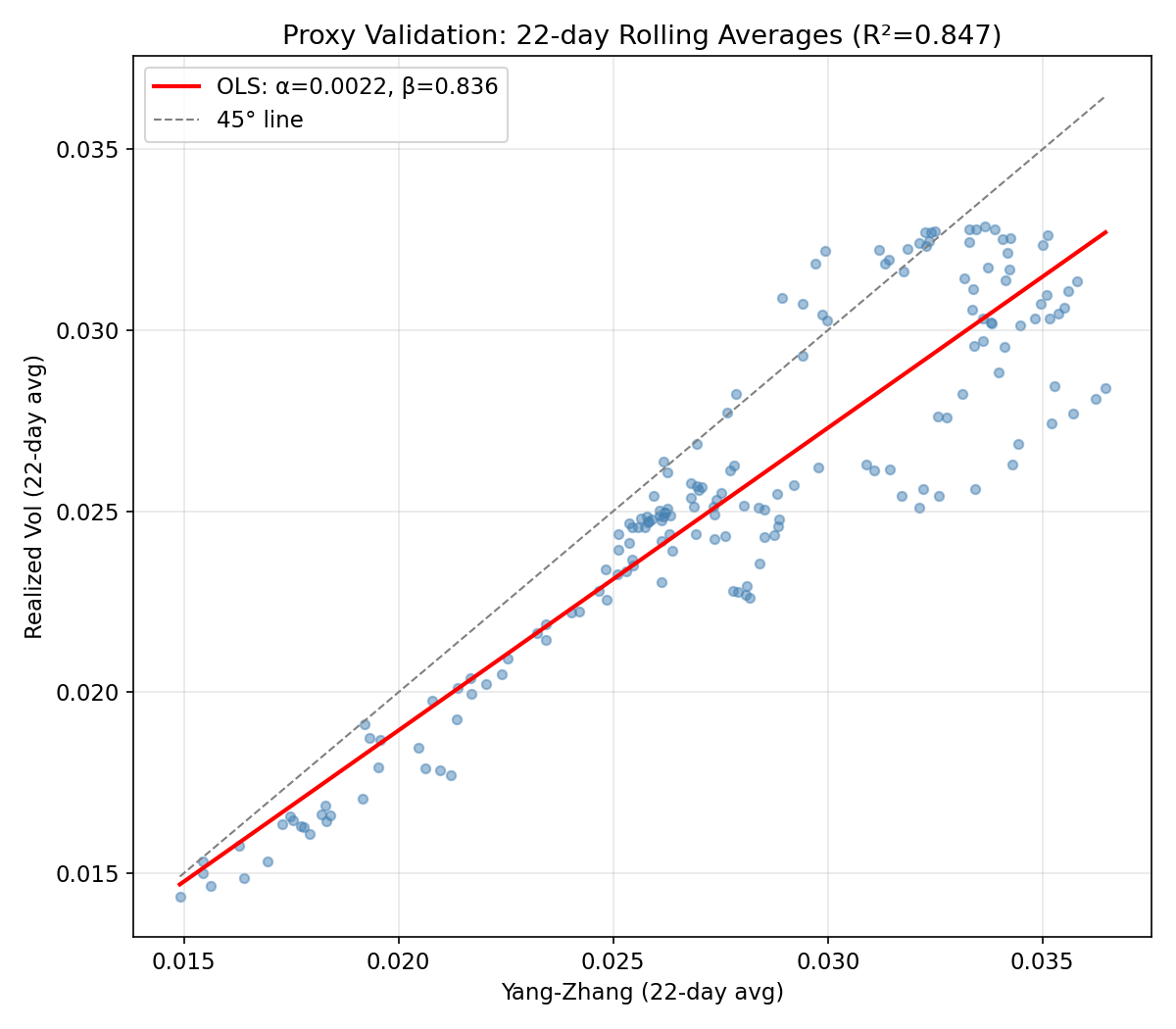
Proxy Validation – Yang-Zhang vs. 5 min RV
Mincer-Zarnowitz Regression

Slide 7
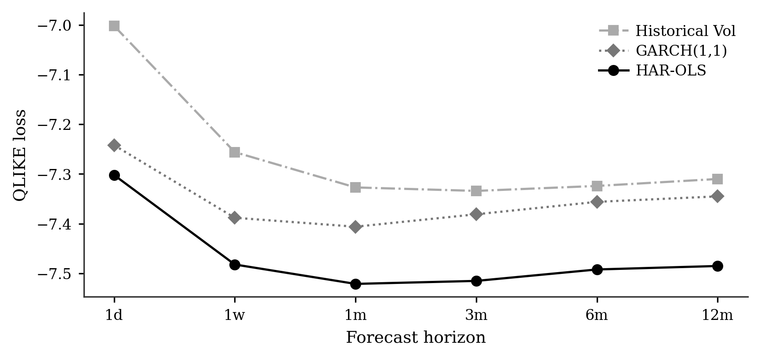
Mean Forecast Comparison
Loss by Model and Horizon

Slide 8
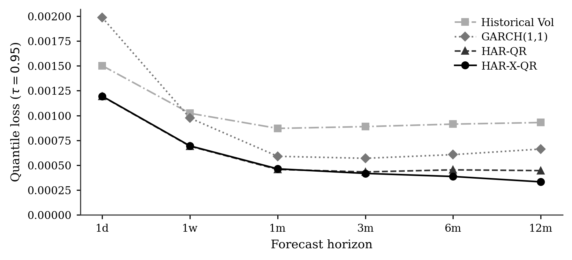
Upper-Tail Quantile Comparison
Quantile Loss by Model and Horizon
RQ1: Can HAR-based quantile regression models forecast cocoa futures volatility better than baseline models (GARCH, Hist. Vol) at horizons from 1 day to 12 months?

Slide 9
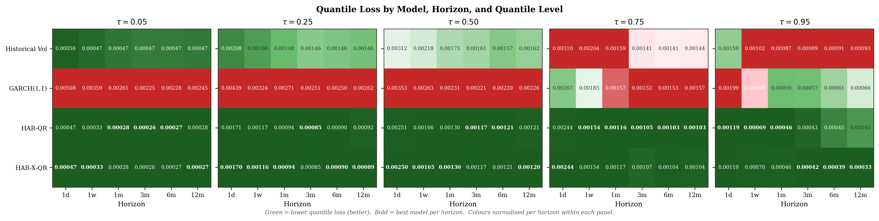
Upper-Tail Quantile Comparison
Quantile Loss by Model and Horizon

Slide 10
RQ 1 - Findings
Can the HAR-QR model forecast cocoa futures volatility better than baseline models at horizons from 1 day to 12 months?
1 - HAR-QR dominates both benchmarks at every horizon
2 - GARCH is worst at 1d but improves after 1w
3 - HAR-X-QR separates only at long horizons after 3m

Slide 11
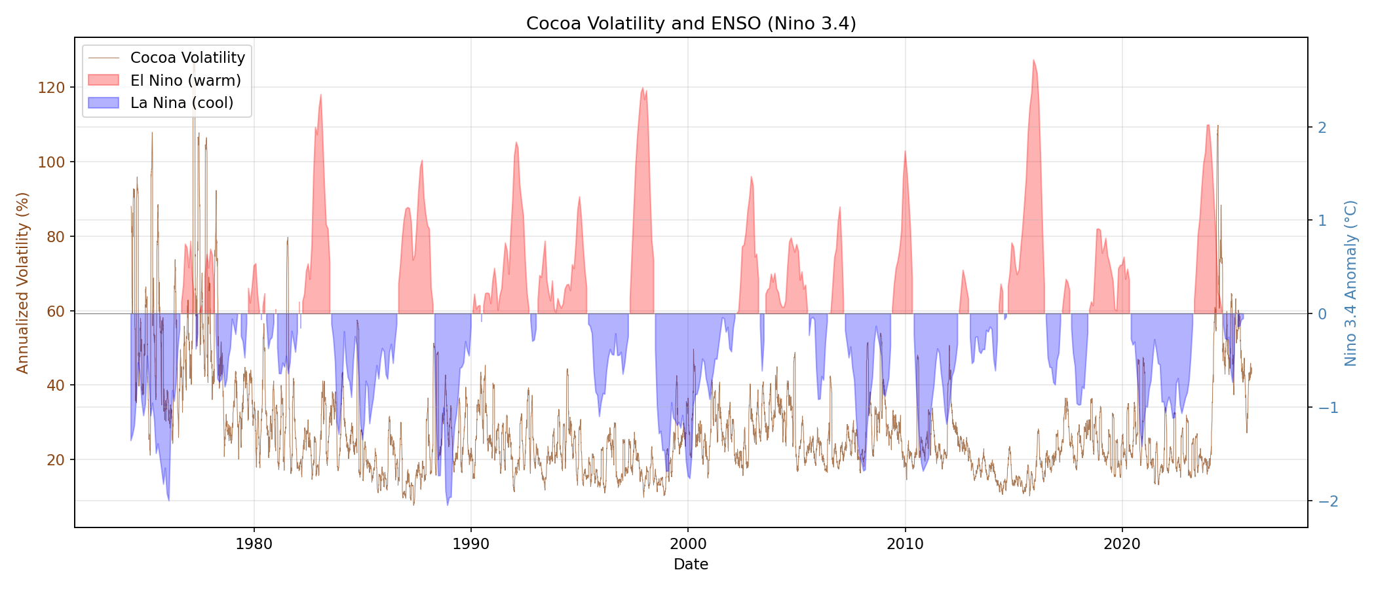
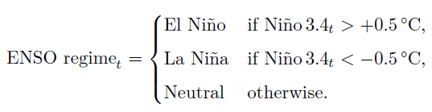
ENSO regimes
El Nino and La Nina classification

Slide 12
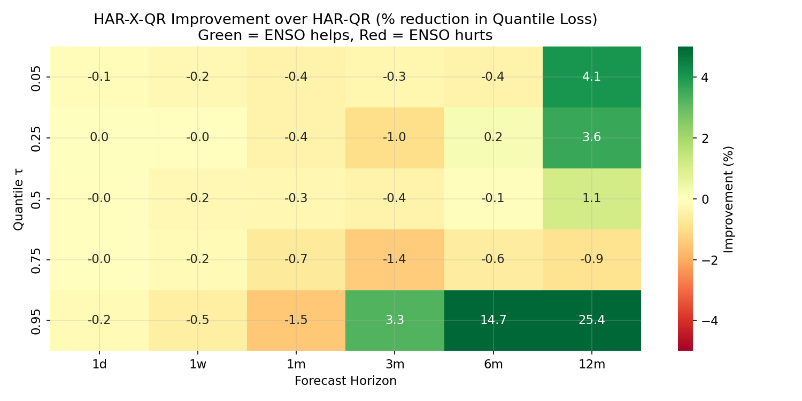
ENSO Augmentation
Quantile Loss improvements of HAR-X-QR (incl. ENSO) over HAR-QR
RQ2: Does the ENSO climate index improve volatility forecasts, especially at long horizons?

Slide 13
RQ 2 - Findings
Does the ENSO climate index improve volatility forecasts, especially at long horizons?
1 - Short horizons (1d–1m): ENSO adds nothing
Reason: ENSO is a slow-moving climate variable, can’t predict next days vol.
2 - Long horizons + upper tail: ENSO improves forecast
MCS confirms this pattern
3 - ENSO does NOT help middle quantile forecasts

Slide 14
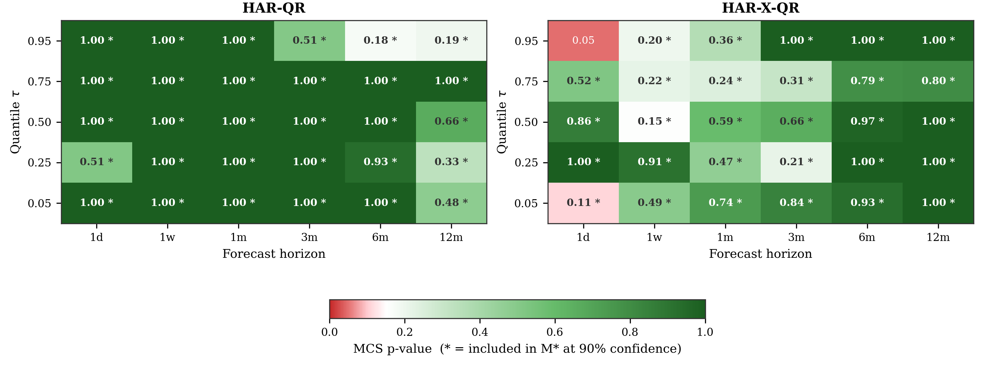
Model Confidence Set

Slide 16
Key Design decisions
Horizons: h ∈ {1, 5, 22, 66, 132, 264} days
Quantiles: τ ∈ {0.05, 0.25, 0.50, 0.75, 0.95}
Rolling estimation window: 2.520 trading days (~10 years)
Out-of-sample forecasts: ~10.500 daily forecast origins
Re-estimation frequency: every 5 days (HAR-QR/X-QR), every 22 days (GARCH)

Slide 17
Key Design decisions
Yang-Zhang volatility (Zhang et al. 2000)
40 years of daily OHLCV
Validated against correlation with 5-min RV
Compared against Garman-Klass, Parkinson & Close-to-close

Slide 18
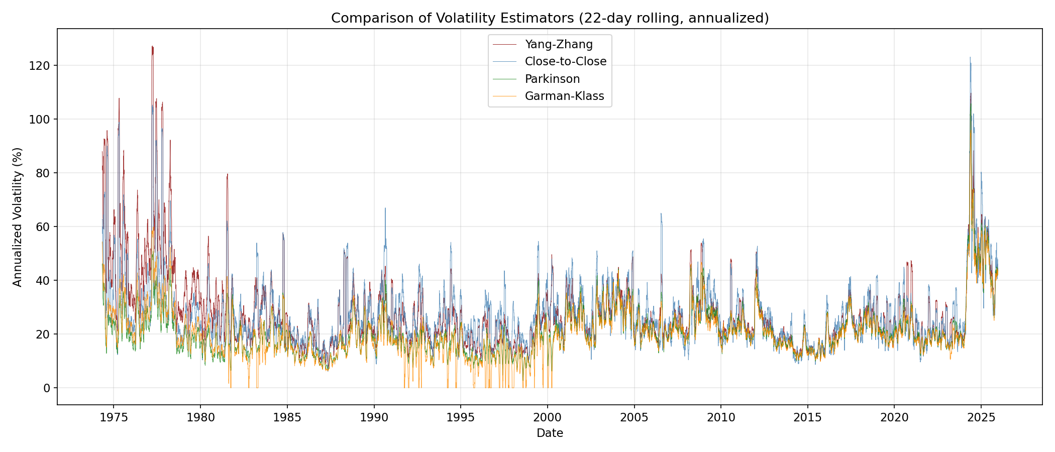
Key Design decisions
Volatility Estimator

Slide 19
Key Design decisions
Yang-Zhang volatility (Zhang et al. 2000)
Handles overnight jumps
Unbiased under drift
Compared against Garman-Klass, Parkinson & Close-to-close using 5-min RV correlation
Direct forecasting (separate model per horizon, not iterated)
Standard in HAR literature (Ghysels et al. 2019)
Essential for quantile regression, can‘t iterate quantile forecasts without distributional assumptions

Slide 20


Proxy Validation
Mincer-Zarnowitz Regression
To validate Yang-Zhang as a proxy for true (unobservable) volatility, we regress realized volatility on Yang-Zhang:
Null hypothesis:
Interpretation:
R^2 measures how much Variation in RV is explained by YZ
Our result:
R^2 = 0.46 at the daily level. R^2 = 0.85 at 22-day rolling window.

Slide 21
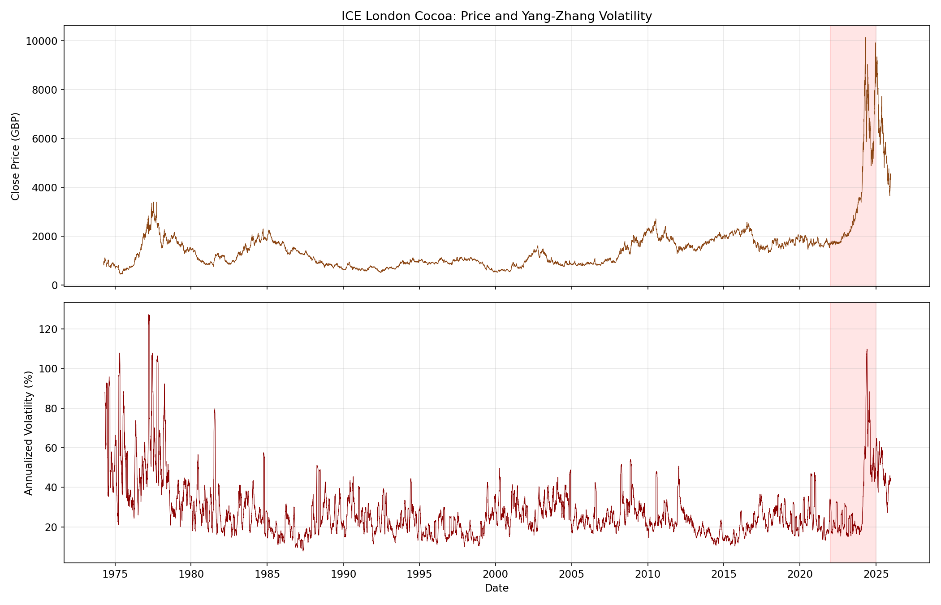
Annualized Volatility Time Series
Yang-Zhang ann. Vol.
22-day rolling window

Slide 22
How do Benchmarks Produce Quantile Forecasts?
Each BM uses a different mechanism to produce a full distribution of forecasts, from which we extract quantiles.
Model | Quantile Mechanism | Example for tau = 0.95
Hist. Vol. | Empirical quantiles of past 252 daily σ values | Sort the past year of volatilities; take the 95th percentile
GARCH(1,1) | Monte Carlo simulation of 5.000 future paths | Draw ε~N(0,1), simulate σ² forward h steps, repeat 5,000×, take 95th percentile of simulated average vol
HAR-QR | Direct estimation | Minimize the check function ρ₀.₉₅ to get the conditional 95th percentile directly

Slide 23


Upper-Tail Quantile Comparison
Quantile Loss
Quantile Loss for distributional forecasts:
Uses the same check function $ρ_{τ}$ as estimation. This makes HAR-QR „coherent“ (Puke and Schweikert 2026)

Slide 24
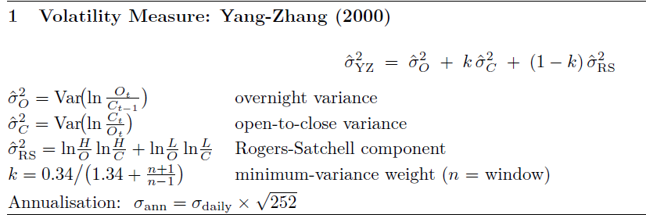
Annualized Volatility Time Series
Yang-Zhang ann. Vol.

