Slide 1
Thermonuclear Supernovae
Anirban Dutta and D K Sahu
2022-02-02

Slide 2
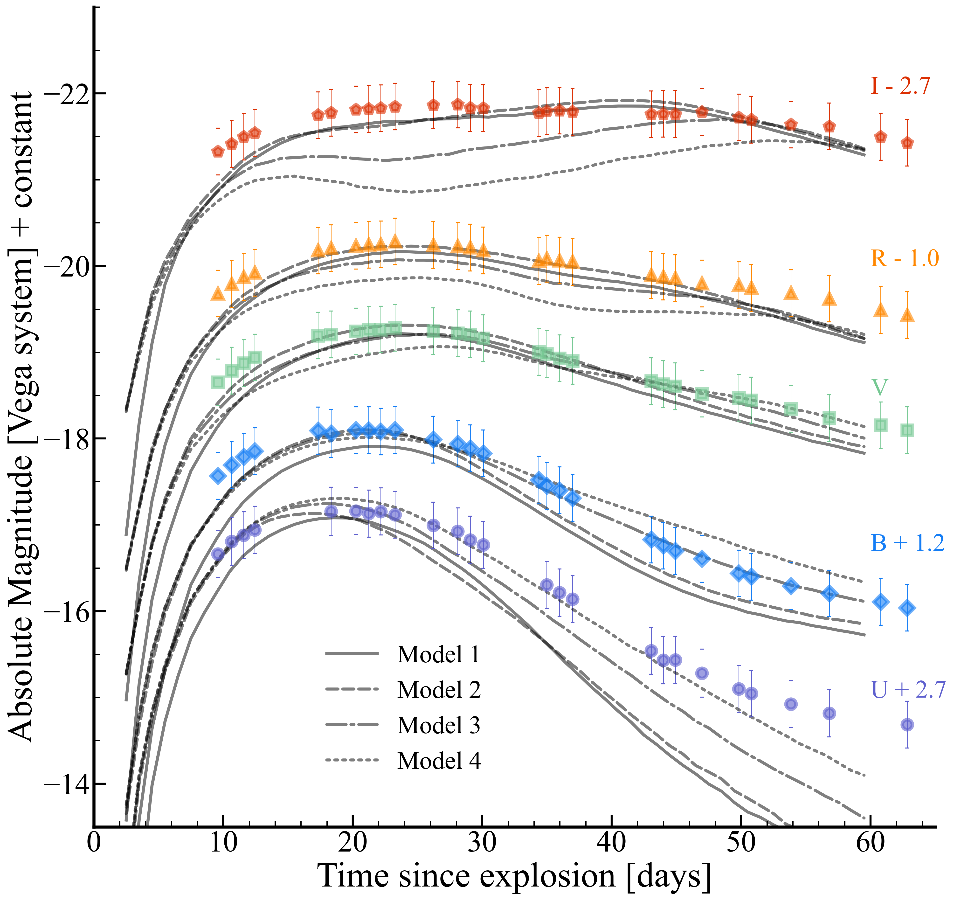
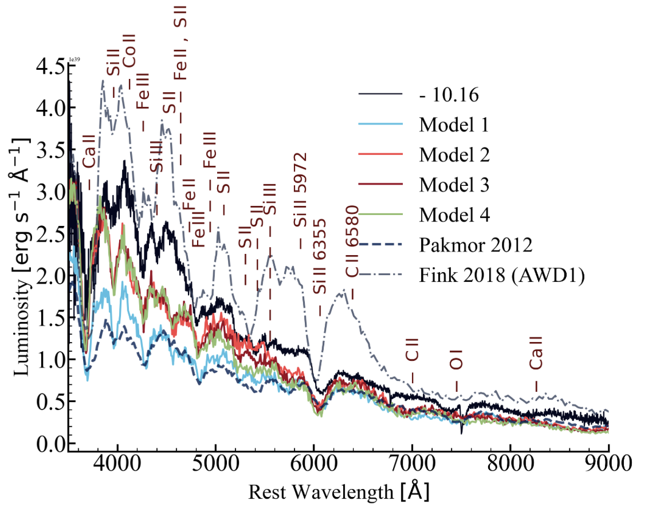
SN 2011aa - The slowest declining Type Ia
SN 2011aa has the slowest decline rate observed in a Type Ia supernova.
We model the UBVRI band light curves of SN 2011aa and found that the violent merger of white dwarfs is successful in explaining the observations.
We considered explosion models due to violent merger of white dwarfs, collision of white dwarfs and rotating white dwarfs.
The observed spectral evolution can be best understood by considering the abundance structure of the violent merger of two white dwarfs.
The Astrophysical Journal Letters, Volume 938, Number 2

Slide 3
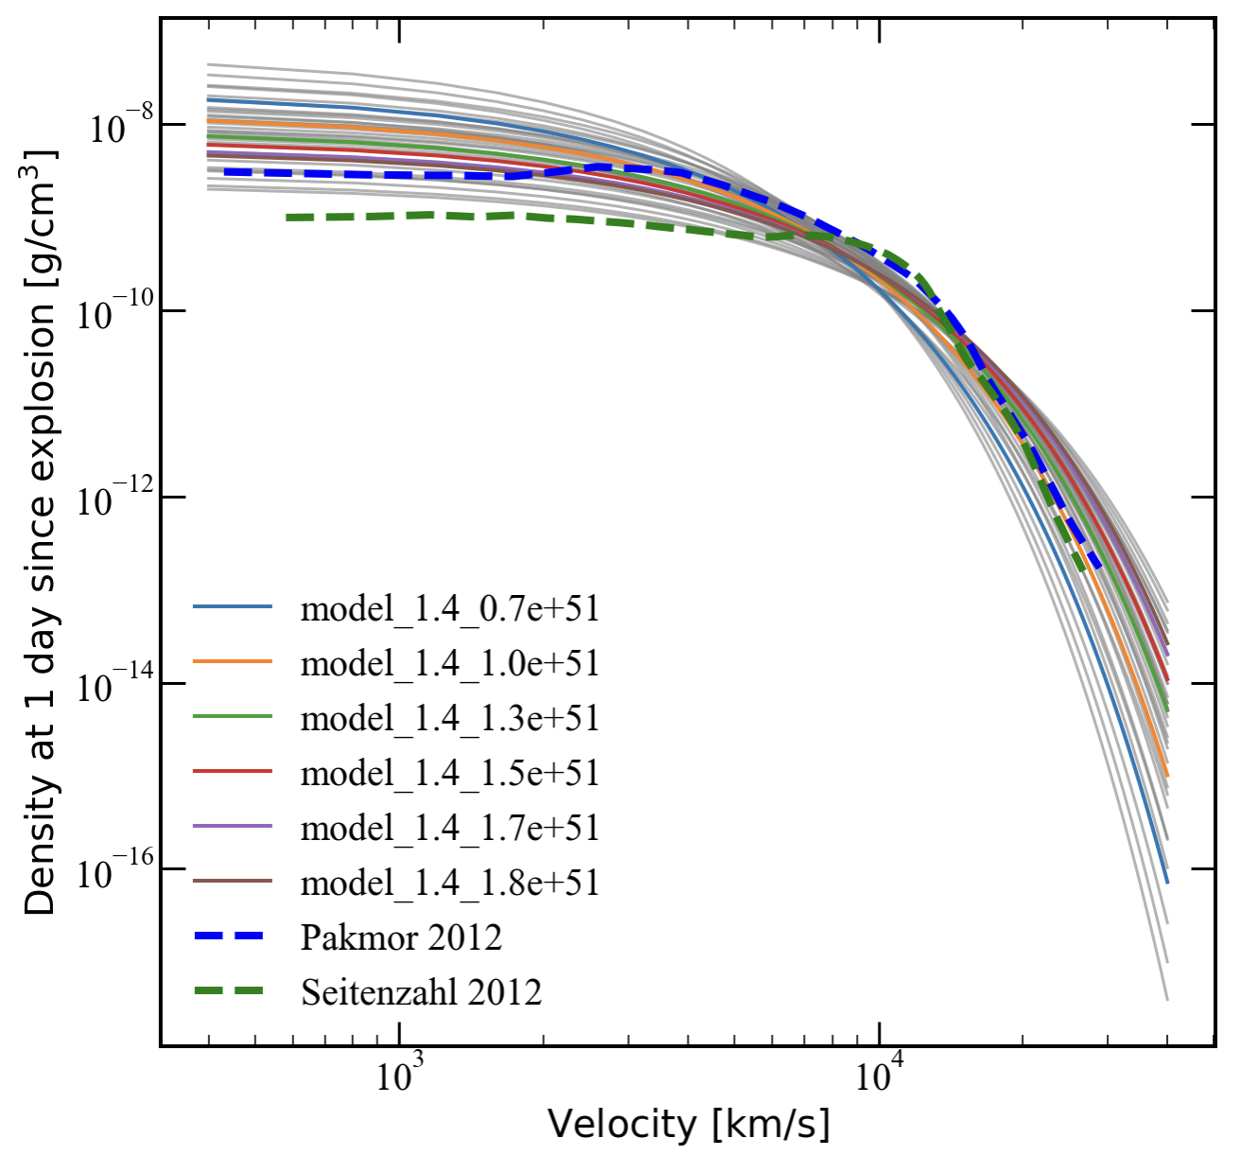
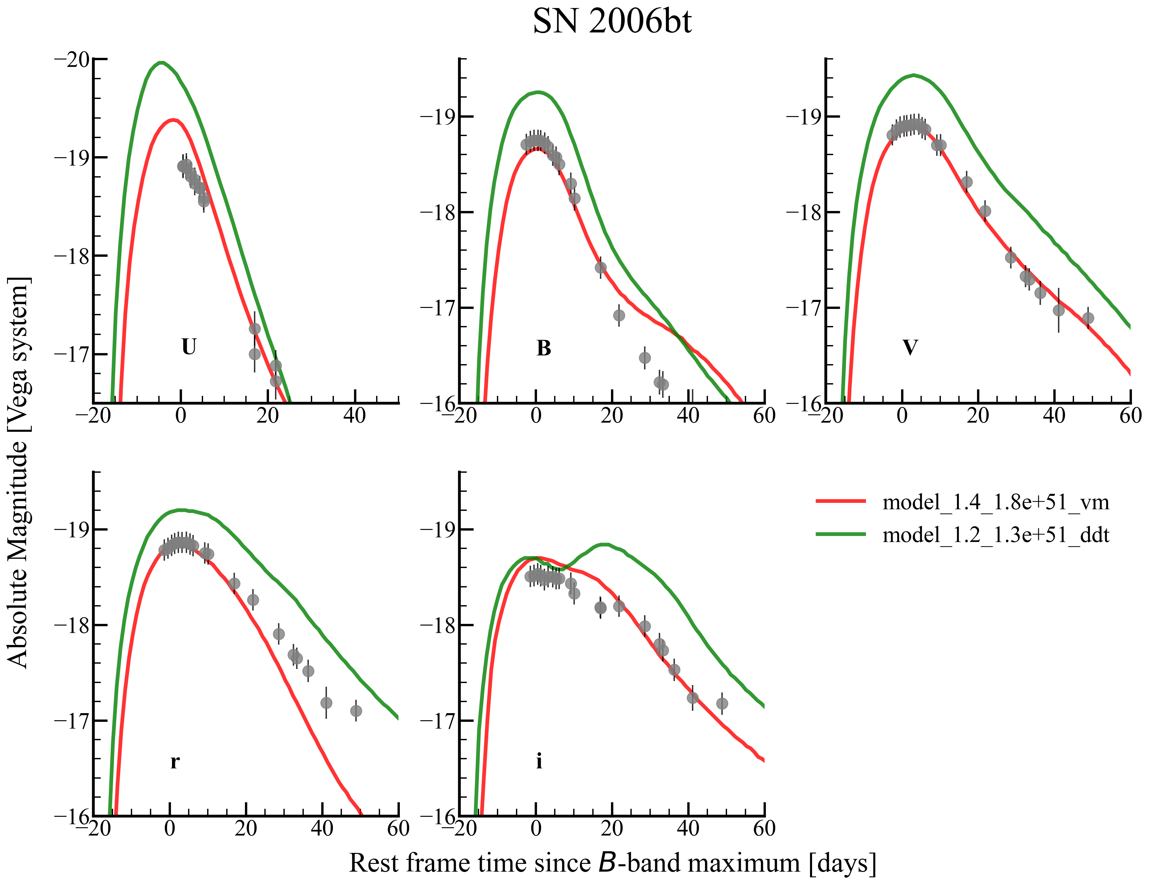
Probing the homogeneity / diversity in Type Ia supernova explosions
We generated 36 models based between mass 1.0 - 2.0 $M_{⊙}$ and 0.7 - 1.8 $×{10}^{51}$ erg based on the violent merger abundances (Pakmor+ 2012).
We generated 36 models based between mass 1.0 - 2.0 $M_{⊙}$ and 0.7 - 1.8 $×{10}^{51}$ erg based on the Deflagration-to-detonation transition in a $M_{ch}$ WD (Seitenzahl+ 2012).
Aim is to find the model that best matches the light curve properties like $Δm_{15}(B)$ and $M_{B}$.
Observed spectral evolution will constrain the abundances of the model further.
2006bt best fit with VM model with mass 1.4 $M_{⊙}$ and kinetic energy 1.8 x ${10}^{51}$ erg

