Slide 1
ZTF Early Observations of Type Ia Supernovae I: Properties of the 2018 Sample
Yao et al. , 2019
Journal Club - 2020-10-09

Slide 2
Type Ia Supernovae
Type Ia supernovae (SNe Ia) are widely regarded as an explo-
sion due to thermonuclear runaway in a degenerate stellar core, possibly a carbon-oxygen (C/O) white dwarf (WD).
Hoyle and Fowler (1960)

Slide 3
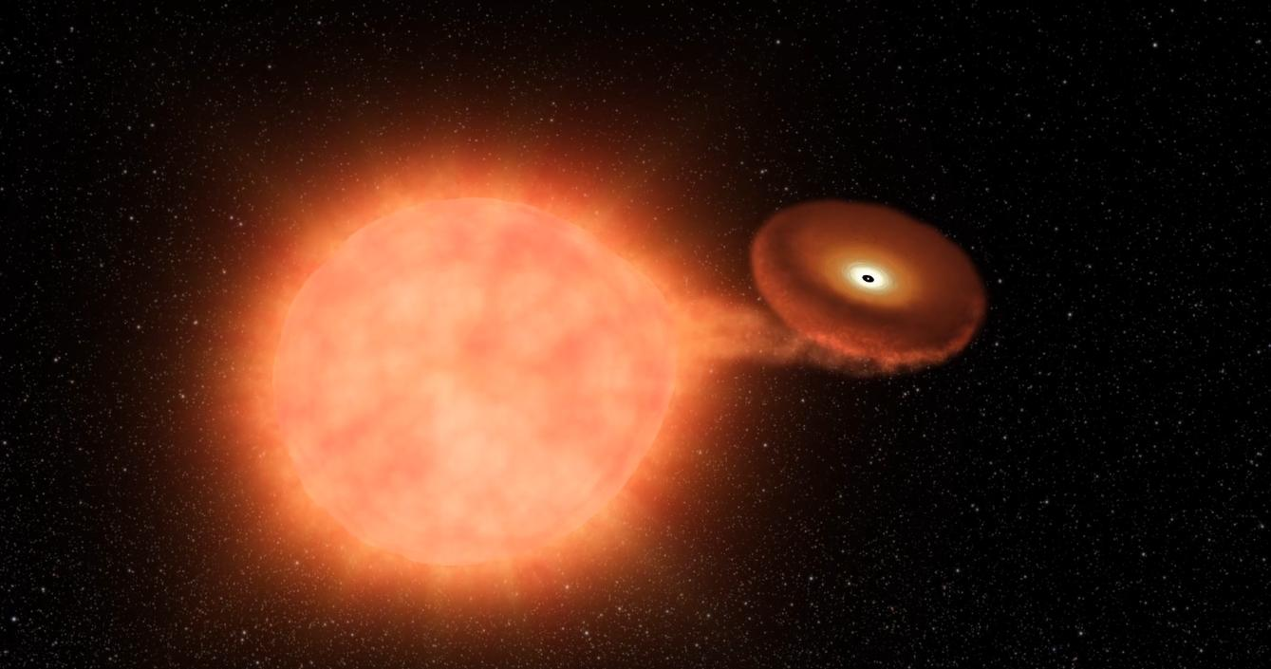
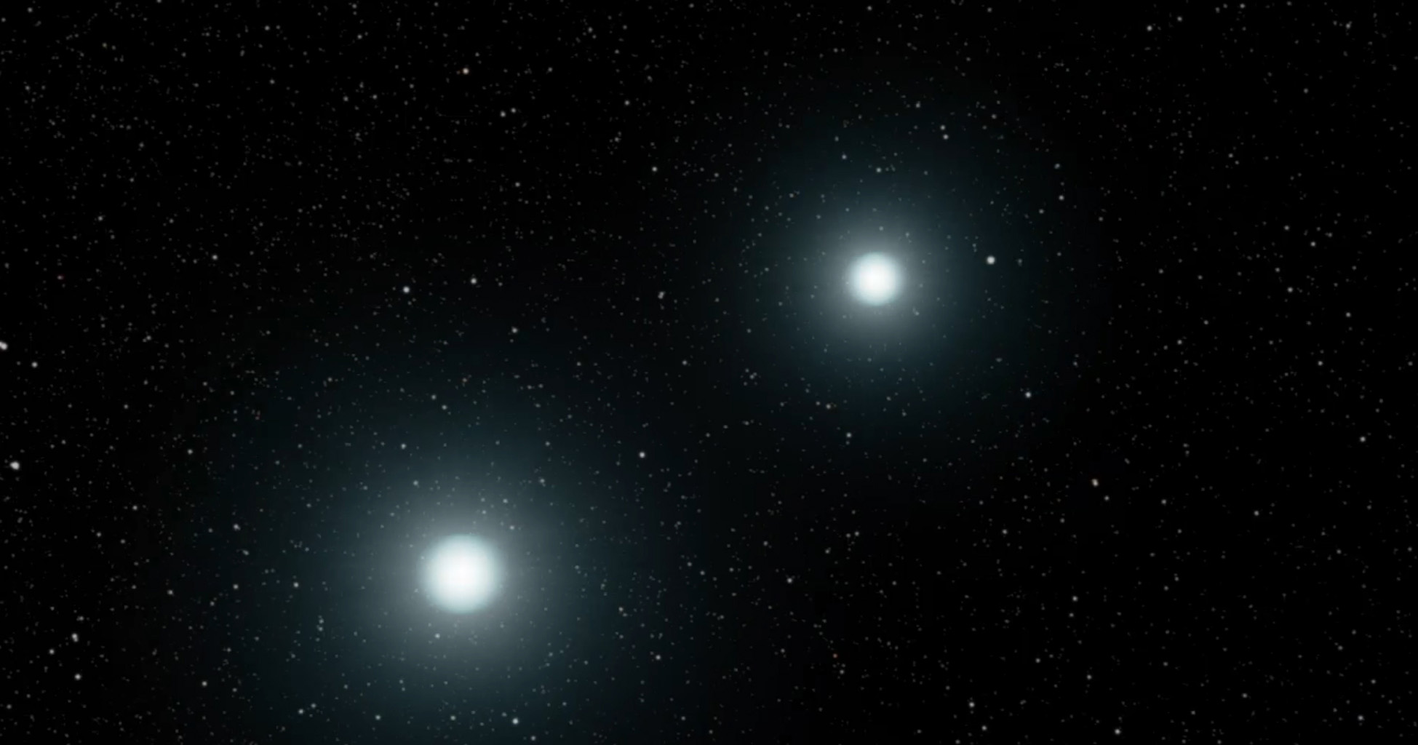
Single Degenerate
Double Degenerate
https://www.jpl.nasa.gov/spaceimages/

Slide 4
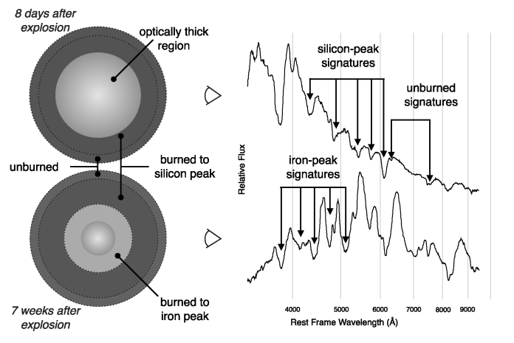
SN spectroscopy as a scan of stellar explosion.
Thomas, Nugent & Meza, 2010

Slide 5
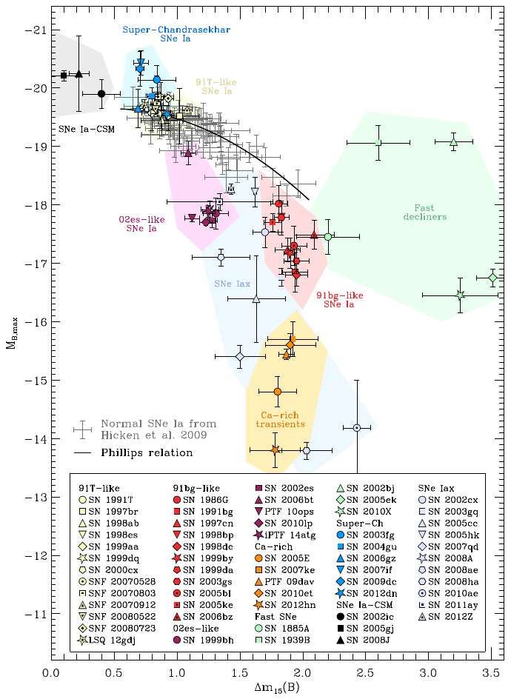
Diversity among thermonuclear transients
91T -like.
91bg -like.
Super-Chandrasekhar SNe Ia.
02es -like.
SNe Iax.
Ca - rich
Fast SNe.
Taubenberger, 2017

Slide 6
Motivation
Early time Photometry can constrain the radii of the possible companion and the progenitor star. (Kasen, 2010)
The shape and duration of the rising light curve probe the radial distribution of Ni-56 in the exploding core. (Piro & Nakar, 2014; Dessart et al. , 2014)
Existence of circumstellar material. (Miller et al., 2018)

Slide 7
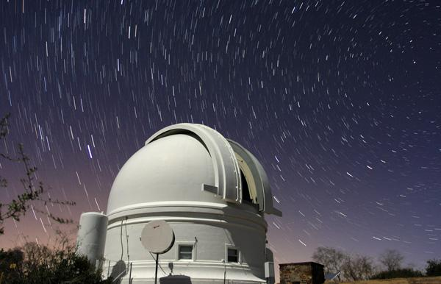
Zwicky Transient Facility
ZTF camera mounted on the 48-inch (1.2 m) Samuel Oschin Telescope.
Uses a camera with a 47 sqaure degree field of view.
Scan ~ 3750 square degree in ~ 1 hour with a depth of r~ 20.5 mag.
Equipped with custom filters, g_{ZTF}, r_{ZTF} , i_{ZTF.}.
Used for studies of SNe, variable stars, binaries, AGN, and asteroids.
Samuel Oschin Telescope dome
Dekany et al. 2016
https://sites.astro.caltech.edu/palomar/about/telescopes/oschin.html

Slide 8
Observation and Sample Selection
ZTF survey -- 40 % (public), 40 % (partnership), 20 % (Caltech)
85 % of public time -- 3 day cadence in g & r of the northern sky. 15 % -- Two visits to the galactic plane (1 g +1 r) every night.
Partnership time -- 2500 deg² with six visits (3 g + 3 r) every night. (extragalactic high cadence)
Caltech time -- One day cadence in g & r band covering 3000 deg².
Generates a ZTF alert once a detection is made.

Slide 9
Observation and Sample Selection
ZTF survey -- 40 % (public), 40 % (partnership), 20 % (Caltech)
85 % of public time -- 3 day cadence in g & r of the northern sky. 15 % -- Two visits to the galactic plane (1 g +1 r) every night.
Partnership time -- 2500 deg² with six visits (3 g + 3 r) every night. (extragalactic high cadence)
Caltech time -- One day cadence in g & r band covering 3000 deg².
Generates a ZTF alert once a detection is made.

Slide 10
Observation and Sample Selection
Spectroscopically classify SN Ia. # 336
Observed by the high cadence fields. # 247
At least one detection 5d before t_{max}. # 191
Selection where reference images are obtained 25 days before t_{max}. # 154
Target detected both (g + r) at least 5 nights before t_{max}. # 140
The first 3-sigma detection must be earlier than t_{max} - 10(1+z) in both (g+r). # 129
In t_{max} and t_{max} + 20 (1+z) the object must be detected at least once in both (g+r) # 127

Slide 11
Observation and Sample Selection
ZTF survey -- 40 % (public), 40 % (partnership), 20 % (Caltech)
85 % of public time -- 3 day cadence in g & r of the northern sky. 15 % -- Two visits to the galactic plane (1 g +1 r) every night.
Partnership time -- 2500 deg² with six visits (3 g + 3 r) every night. (extragalactic high cadence)
Caltech time -- One day cadence in g & r band covering 3000 deg².
Generates a ZTF alert once a detection is made.
Spectroscopically classify SN Ia. # 336
Observed by the high cadence fields. # 247
At least one detection 5d before t_{max}. # 191
Selection where reference images are obtained 25 days before t_{max}. # 154
Target detected both (g + r) at least 5 nights before t_{max}. # 140
The first 3-sigma detection must be earlier than t_{max} - 10(1+z) in both (g+r). # 129
In t_{max} and t_{max} + 20 (1+z) the object must be detected at least once in both (g+r) # 127

Slide 12
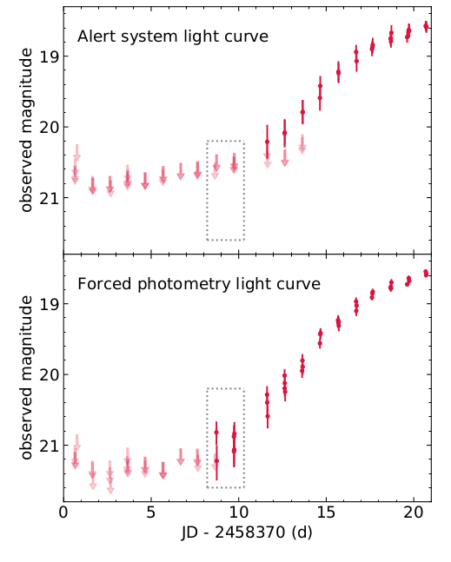
Forced Photometry
Forced PSF photometry can provide deeper non-detection upper limits.
Reveal structure in early time light curves.
Can put tighter constraint on epoch of explosion.
Performed on difference image.
ZTF18abxxssh (r-band)

Slide 13
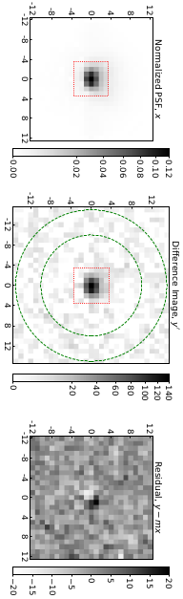
Forced Photometry Recipe
Astrometry with sub-pixel accuracy.
Difference image and its normalized model psf.
Difference image created by ZOGY algorithm.
(Zackay, Ofek and Gal-Yam, 2016).
PSF template image generated such that the difference image can be modelled by the psf image multiplied by a number plus some random noise.
Task is to find “the number(m)” and “the noise(σ)”.
Sample the posterior probability distribution for (m, σ).
Median value of the distribution as flux and flux unc.

Slide 14
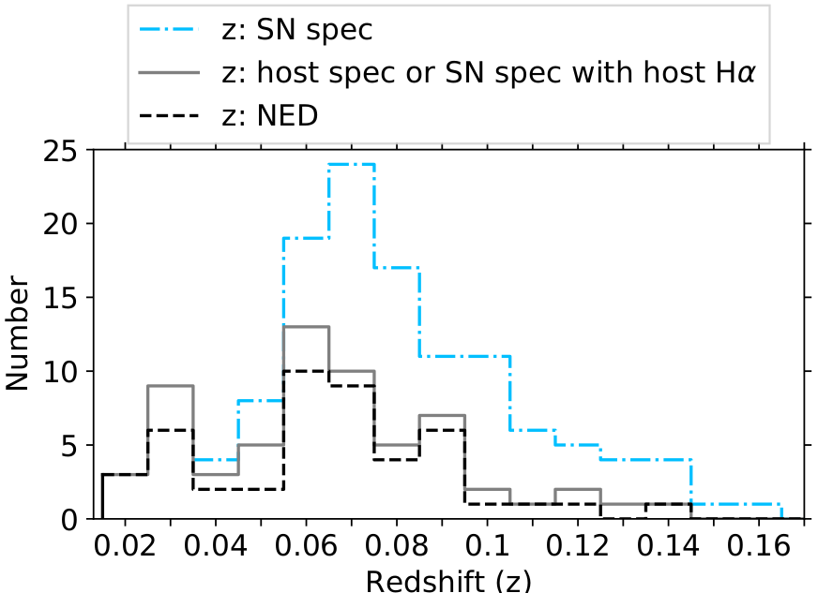
Redshift Distribution
z = 0.0181 - 0.165, with a median of 0.074
46 -NED, 16 - host galaxy lines, 65 - SN spectrum.
The median time of first detection is -13.6 days relative to t_{max}.

Slide 15
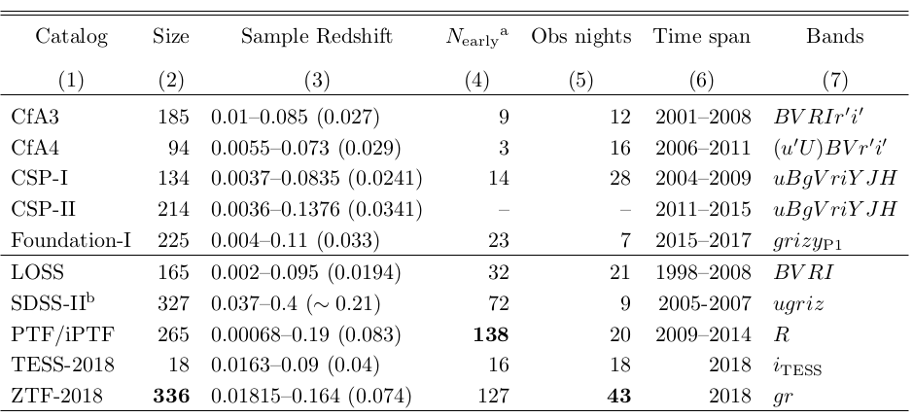

Slide 16
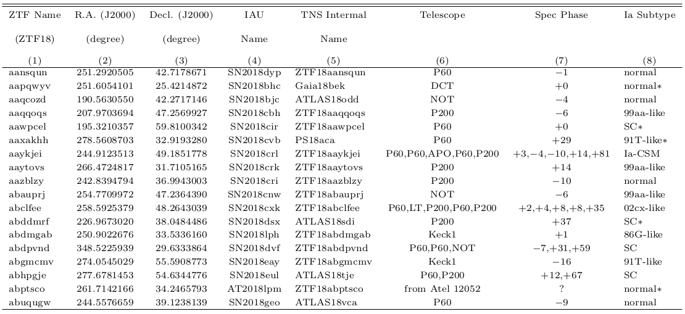

Slide 17
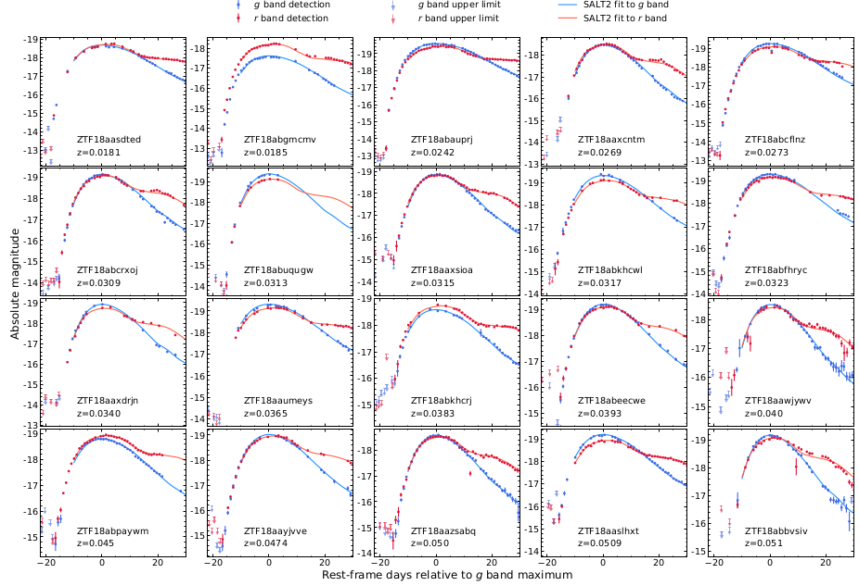
P48 Light curves of SNe.
Shown here is LC upto z = 0.051

Slide 18
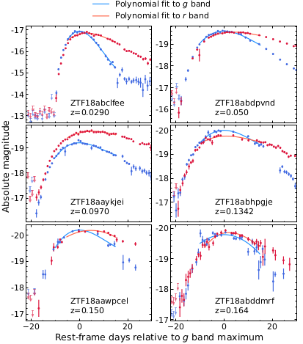
P48 Light Curve of 6 SNe in the sample.
ZTF18abclfee (2002cx - like) M_{r} = -16.85 +/- 0.02
ZTF18abdpvnd (S-Ch ) M_{r} = -19.56 +/- 0.23
ZTF18aaykjei (Ia-CSM)
M_{r} = -19.65 +/- 0.04
ZTF18abhpgje, ZTF18aawpcel, ZTF18abddmrf (S-Ch)

Slide 19
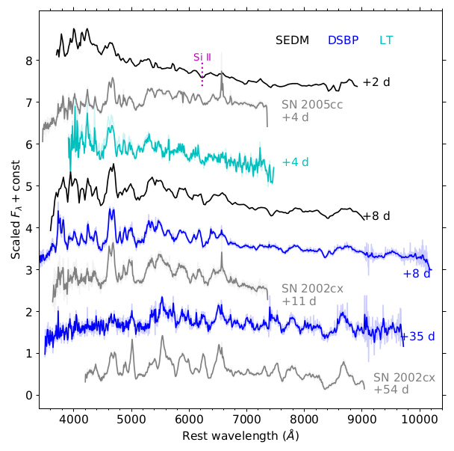
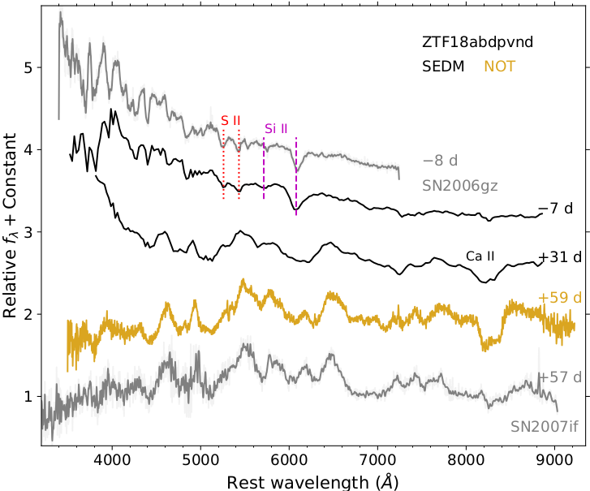
ZTF18abclfee ZTF18abdpvnd

Slide 20
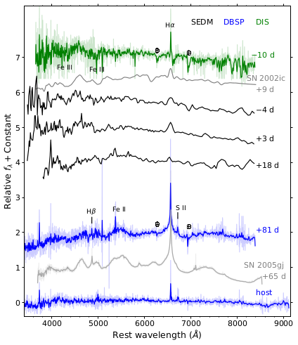
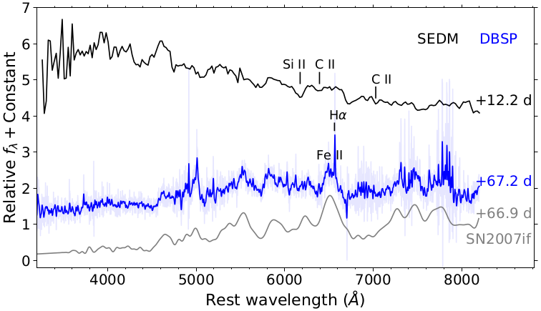
ZTF18aaykjei ZTF18abhpgje

Slide 21
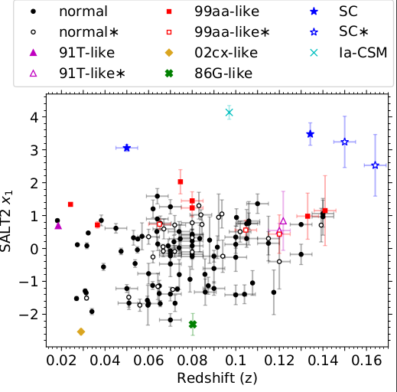
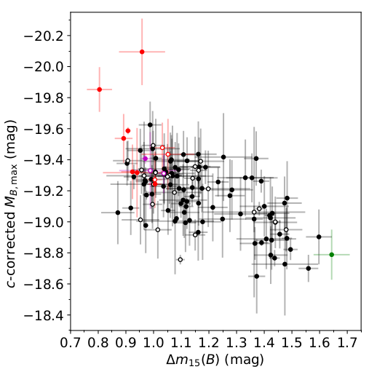
Light Curve Parameter Space

Slide 22
Takeaways from the Paper
Early high-cadence observations of 127 SNe.
Multiple passbands (g+r) allowing study of colour evolution.
How to make a forced psf photometry pipeline.
Exploration of the diversity among type Ia SNe with photometric and spectroscopic classification.

