Slide 1
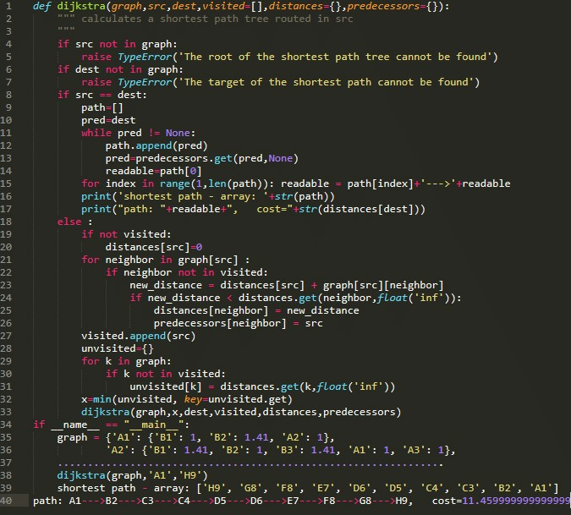

Python
lesson
2
Powered by knightsbytes! Find us here

Slide 2
Lesson objectives
In this lesson you will be learning about inputs I, ELSE, ELIF, WHILE and FOR statements. You will make a basic shopping app which you can enter names of products to purchase. If you purchase an item that doesn’t exist it will ask you to try another item. For reading purposes all code will be Green. After reading this powerpoint, please complete the worksheet.
Powered by knightsbytes! Find us here

Slide 3
Loops and ifs
Using loops and if statements is the best way to test for what a variable is. This can then be used to do conditional arguments.
var = “hello”
if var = “hello”:
print(“hello!”)
Notice how the print(“hello!”) is indented? This is how we make these statements work. The indentation usually happens automatically but can be done artificially with the TAB key.
Powered by knightsbytes! Find us here

Slide 4
Getting inputs
Getting an input in python is easy just do var = input(“what do you want the var to be?”) You can pair this with the if statements from before to make tests to detect if an answer given is correct. You can also use a while statement to ask questions several times:
while True: input(“Get inputted”)
You can also check if an input is in a list.
Powered by knightsbytes! Find us here

Slide 5
Lists
A list is a variable that can contain multiple values. You can define a list as such. my_list = [var1,var2,”string1”,”string2”]. Using lists we can store lots of data but to access it we have to use an index. You use indexes like so: print(my_list[0]). This will print out the first item in my_list which is currently var1.
You can add things to a list by doing my_list.append(“string3”) which will add ”string3” to the end of my_list. You can remove items from a list by doing my_list.pop(0) replace 0 with the index of the item which you want to remove.
Powered by knightsbytes! Find us here

Slide 6
More lists
What if I want to do something for every item in a list? Or what if I want to detect if something is even in a list?? Well for that we have for and if loops. To tell if an item is in a list you can do the following:
if var in my_list:
print(f“{var} is in my_list”)
Or if you want to do something for everything in a list do this:
for i in my_list:
print(“some text”)
However, this time don’t’ replace i with the name of a variable.
Powered by knightsbytes! Find us here

Slide 7
Loops
Loops are fun. You can use them to do something repeatedly until a certain condition is met.
while var > 10:
print(“var smaller than 10”)
var +=1
Powered by knightsbytes! Find us here

Slide 8
More lists
What if I want to do something for every item in a list? Or what if I want to detect if something is even in a list?? Well for that we have for and if loops. To tell if an item is in a list you can do the following:
if var in my_list:
print(f“{var} is in my_list”)
Or if you want to do something for everything in a list do this:
for i in my_list:
print(“some text”)
However, this time don’t’ replace i with the name of a variable.
Powered by knightsbytes! Find us here

