Slide 1
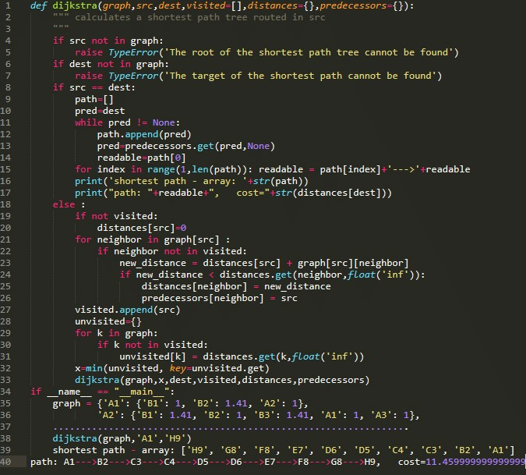

Introduction
to
Python
Powered by knightsbytes! Find us here

Slide 2
Introduction
Python is a large-scale programming language used by BILLIONS of people worldwide. It is one of the best languages for beginners which just so happens to be you. The language is used for a variety of services such as games and even AI such as chat GPT. Python is a great language to start with and is used by millions of beginners worldwide and is perfect for most uses. All code will be in green for readability.
Powered by knightsbytes! Find us here

Slide 3
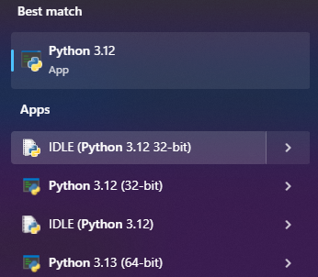

How to use
1st go into the search bar at the bottom of your screen and type "python"
Then, select the IDLE and open it
Powered by knightsbytes! Find us here

Slide 4
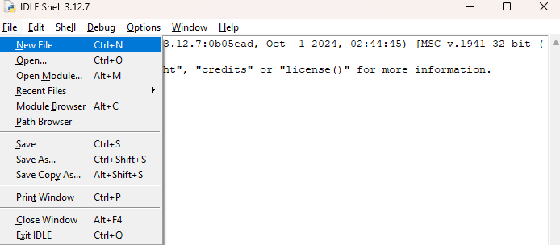
How to use
After opening the IDLE, select file and then "New File". After doing this, you can finally start coding!
Powered by knightsbytes! Find us here

Slide 5
Hello World!
After creating your file, all you have to do is save it. To do this, all you simply press CTRL+S, give your file a name and then save it in your computing folder. Then go back into the IDLE if you left it and type the following code: print("Hello World!") and then press f5 on your keyboard. It should output Hello World!.
If it throws an error you may of written the code wrong. After this, change the text in the quotation marks to whatever text you would like it to say.
Powered by knightsbytes! Find us here

Slide 6

Advanced
Ok, you’ve officially made the most simple python script. But what now? This is where variables come in helpful. You can define a variable by going back into your script and typing the code from the image: This code prints the new_var variable. Notice how in this example new_var isn't in quotation marks in the print statement? This is because you are printing the variable not a string. What's a string? It's complicated but it's essentially anything that you put in quotes; in this example new_var is a string and so we can print it outputting the variable new_var.
Tip: if you're stuck with any of this code go here and download the corresponding file
Powered by knightsbytes! Find us here

Slide 7
Advanceder?
After this, things get more complicated. I've shown you how to print a variable and a string separately but why not both? Well, here's how you do that!
Its' simple really, you just do print(new_var+" string").
Simple, right? But that's not quite the best practice; instead, use a Fstring or a formattable string:
print(f"{new_var} string")
Powered by knightsbytes! Find us here

Slide 8
Final ideas
Ok, so what if you want to print only certain parts of a string/variable? Well, it's stupidly easy.
print("some_text"[0])
This prints the first letter in some_text so "s". You can change the 0 to 0:5 and it will print the first 6 letters.
Now you can do the tasksheet.
Powered by knightsbytes! Find us here

