Slide 1
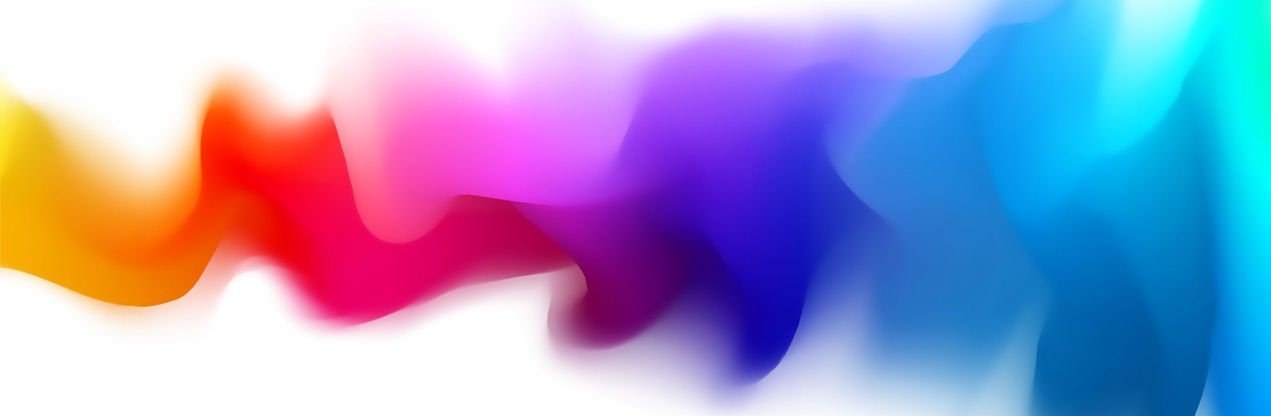
Rhythm Render
FYP Interim Presentation
John Hinch

Slide 2
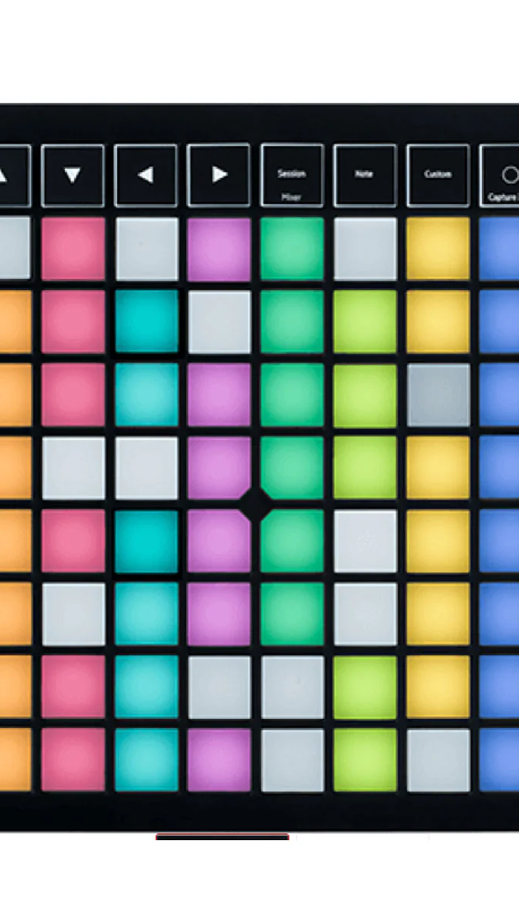
Description
Creation of musical sequences based on MIDI music pads
Create a 3D animation performing the user’s music
Designed in Virtual Reality for an immersive experience

Slide 3
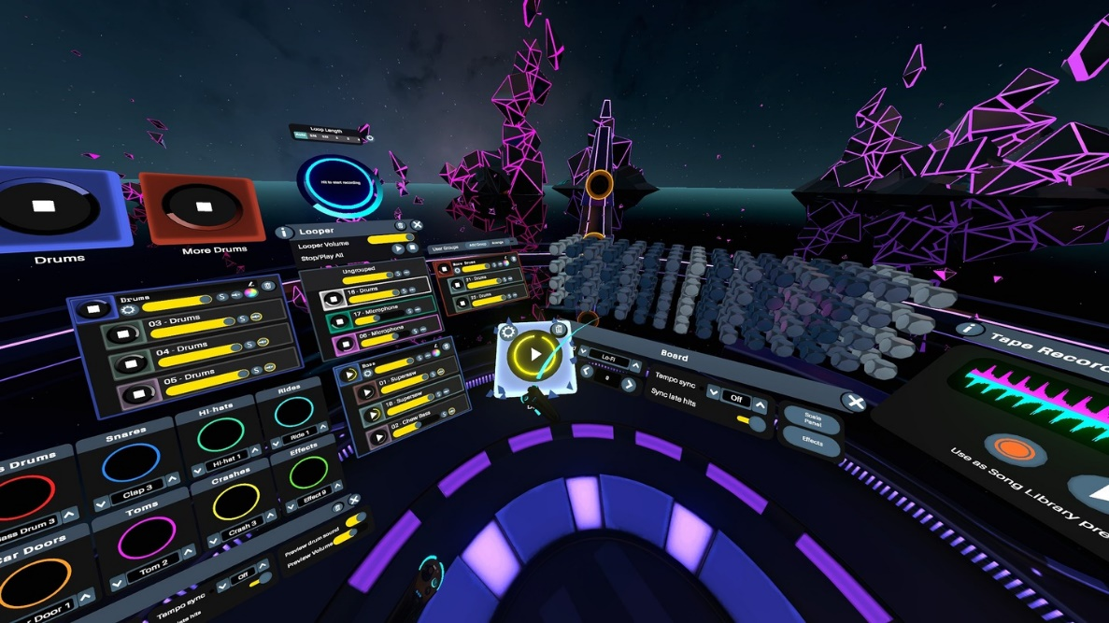
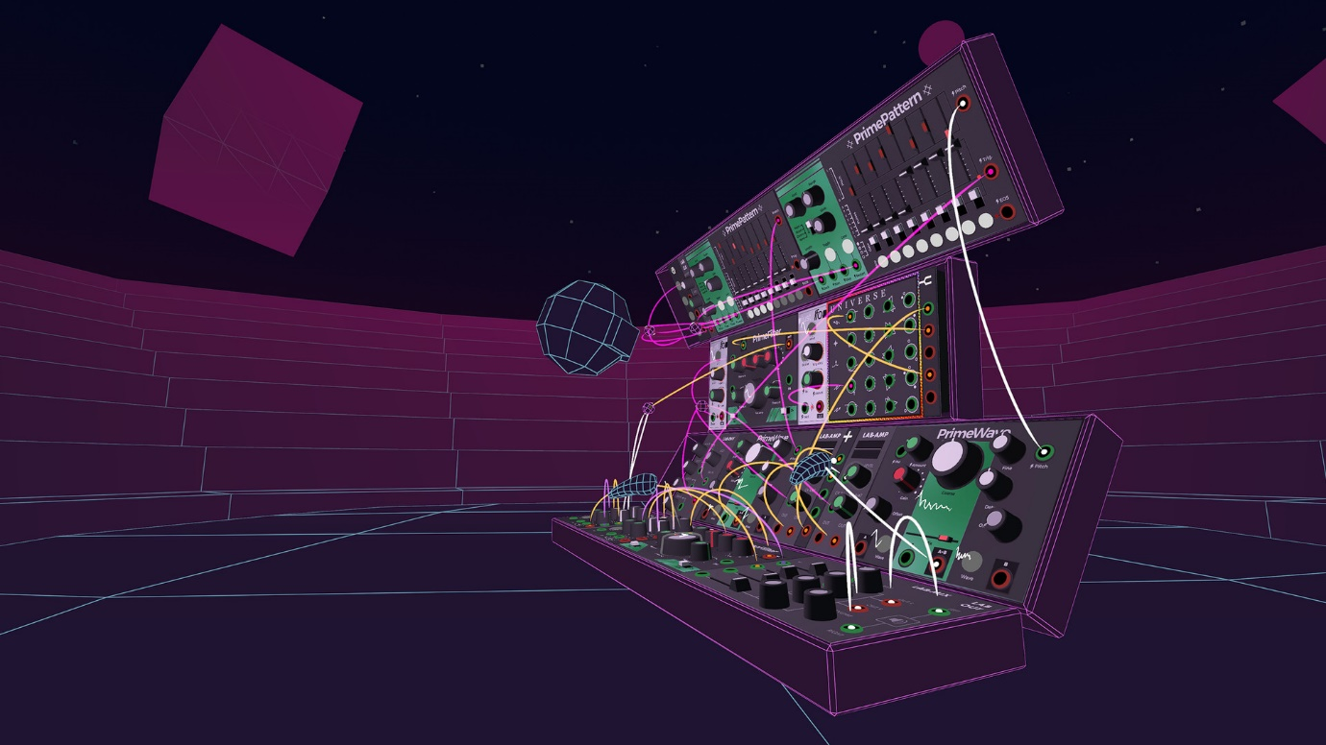
Alternatives
Virtuoso – High Fidelity VR application. Created by Reality Interactive AB
Synth VR – Highly Technical VR Application created by 42tones

Slide 4


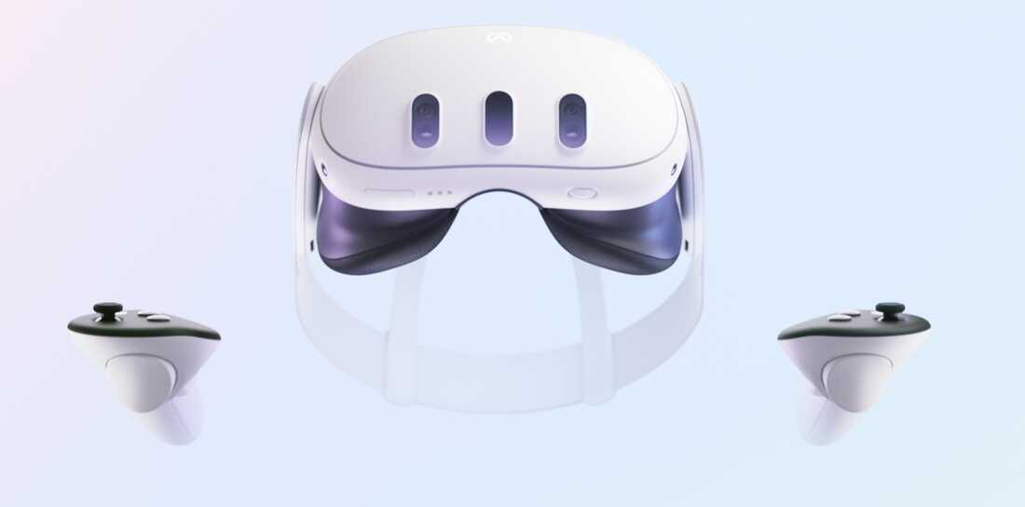
Technologies Being Used
Meta Quest 3 – Virtual Reality Headset developed by Meta.
Godot 4 – Open-source Games Engine
FreeMoCap – Open-source Motion Capture Software

Slide 5

Developement
Developed using GDScript in Godot
Application consists of two main scenes – Sequence Scene and Performance scene
Sequence Scene – User Creates their Sequence
Performance Scene – Animation for Sequence plays

Slide 6
Future Work
Implement Motion Capture Animations
Fix 3D Interactivity
Implement VR Logic

Slide 7

Any Questions?

