Slide 1
How annual members and casual riders use Cyclistic bikes differently
Cyclistics

Slide 2
Problem
Solution
Annual members are significantly more long-term value than casual riders.
To grow long‑term revenue, Cyclistic needs to convert more casual riders into annual members.
Effective conversion requires understanding how these two groups use bikes differently.
Analyze historical bike‑share data to compare annual members and casual riders.
Examine differences in:
Ride frequency
Timing of usage (weekday vs weekend, time of day)
Trip duration and variability
Use:
Population‑level analysis to understand when and how often bikes are used
Sample‑based analysis to understand how riders behave on individual trips

Slide 3
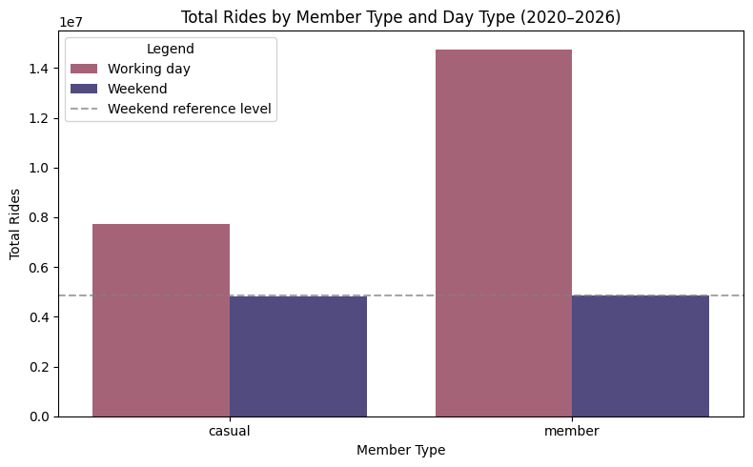
Weekday vs Weekend Usage
Annual members generate significantly more rides during working days, indicating routine, commute‑related usage.
Weekend ride volumes are relatively similar across both rider types, suggesting leisure‑oriented behavior regardless of membership status.

Slide 4
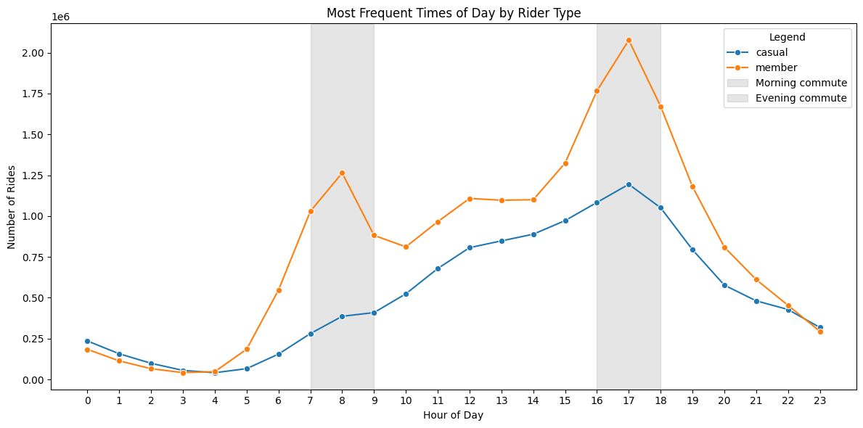
Time of the day usage pattern
Annual members show pronounced usage peaks during morning and evening commuting hours.
Casual riders exhibit a more evenly distributed usage pattern throughout the day.

Slide 5
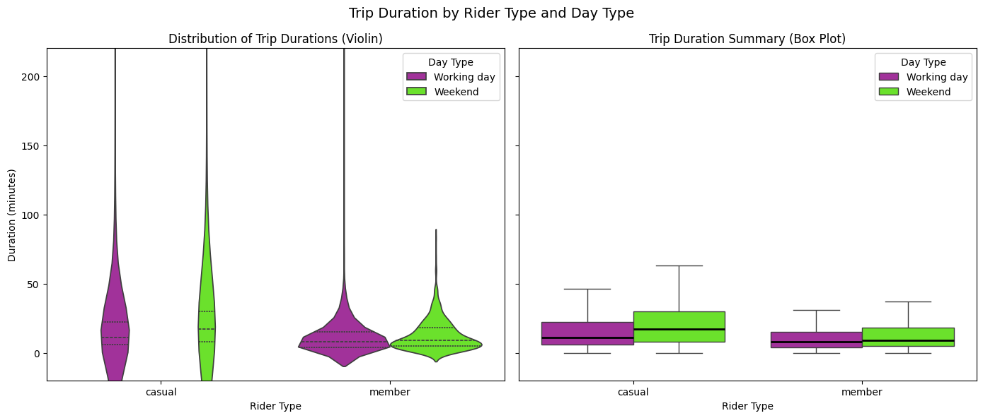
Trip Duration Reveals Fundamental Behavioral Differences
Casual riders exhibit longer and highly variable trip durations, especially on weekends, indicating leisure‑oriented usage.
Annual members take shorter and more consistent trips, with minimal differences between working days and weekends.

Slide 6
How we can use this information ?
Focus membership conversion efforts on weekday usage and commuting hours, where member behavior is most distinct.
Promote membership benefits for frequent, short trips, such as cost savings and convenience for daily travel.
Use weekend activity primarily for brand awareness, rather than direct membership conversion.

