Slide 1
KIP-Git Assignment
-by:
Satvik Gupta(Emp Code-1872)
Sheshnath(Emp Code-1875)

Slide 2
Git Assignment
Clone the repository at https://github.com/KnoldusLabs/kip-jan-23-git-assignment a new branch as feature/<emp-code-1>-<emp-code-2>. eg. feature/2084-2085
Add a file to the participants directory that describes you.
Add that file to the repository, take file name as participants name example: himanshu-gupta.md.
Commit your change. Use a meaningful message like "Added information about your commit here."
Send your change to the primary repository.
Look online to see if your change has been pushed.
Wait until your partner has pushed their update. Then use git pull to get their change into your repository. Verify that you have the new file.
Use git log or git log | less to see a list of changes to the repository.
Edit the file participants.md to add your name. Then add the file, commit it, and push it.
Whoever tries to push the file first will likely succeed. Whoever tries to push the file second will likely get an error message. Figure out how to resolve the error message.
Deal with any conflicts that have arisen and commit the result.

Slide 3
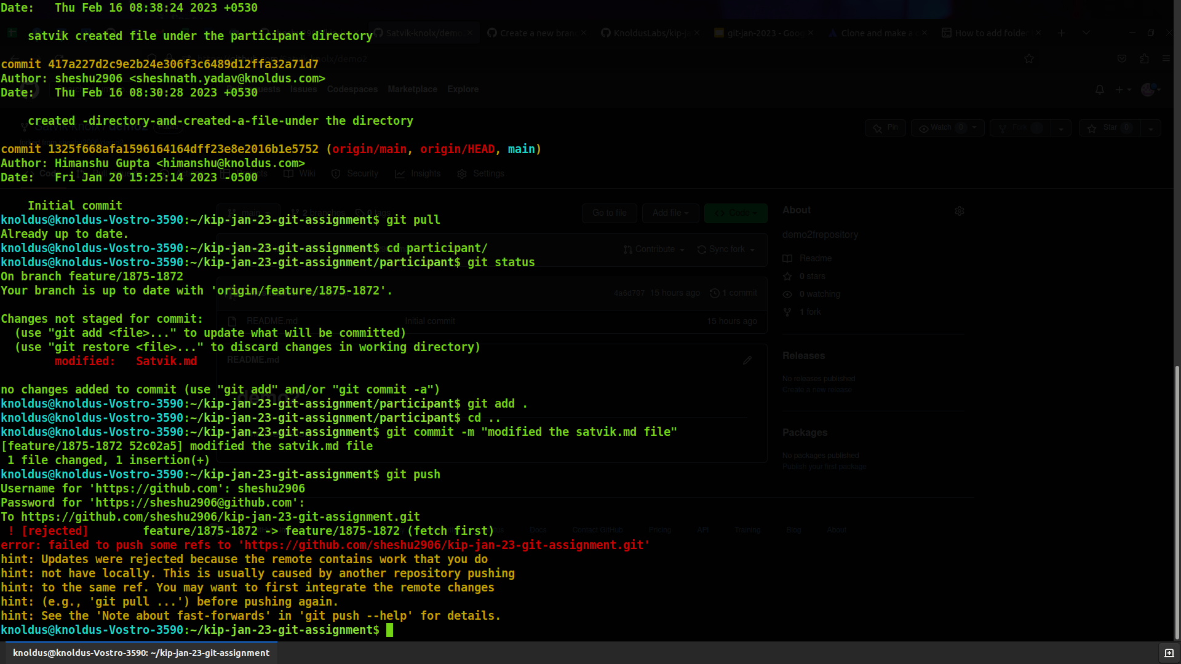
Terminal Screen
(Conflict Arises)

Slide 4
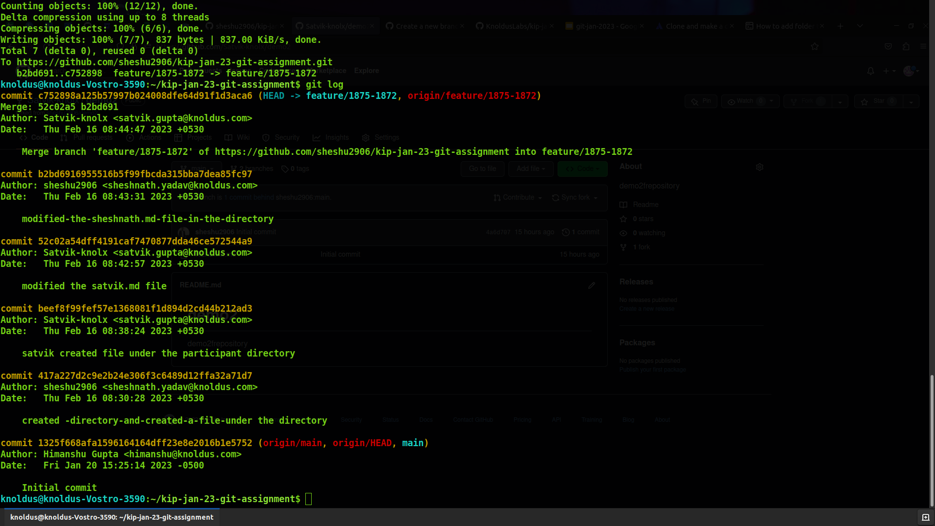
Terminal Screen
(Conflict Handled)

Slide 5
Repository url to the git repository
https://github.com/KnoldusLabs/kip-jan-23-git-assignment.git

Slide 6
Thank You

