Slide 1
CS 377 Final Project
Database of Stories

Slide 2
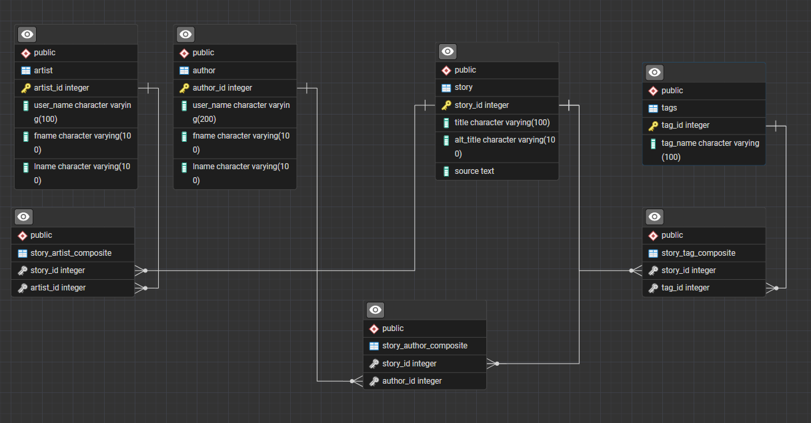
The Structure
A many to many relationship exists between Story, Tags, and Author

Slide 3
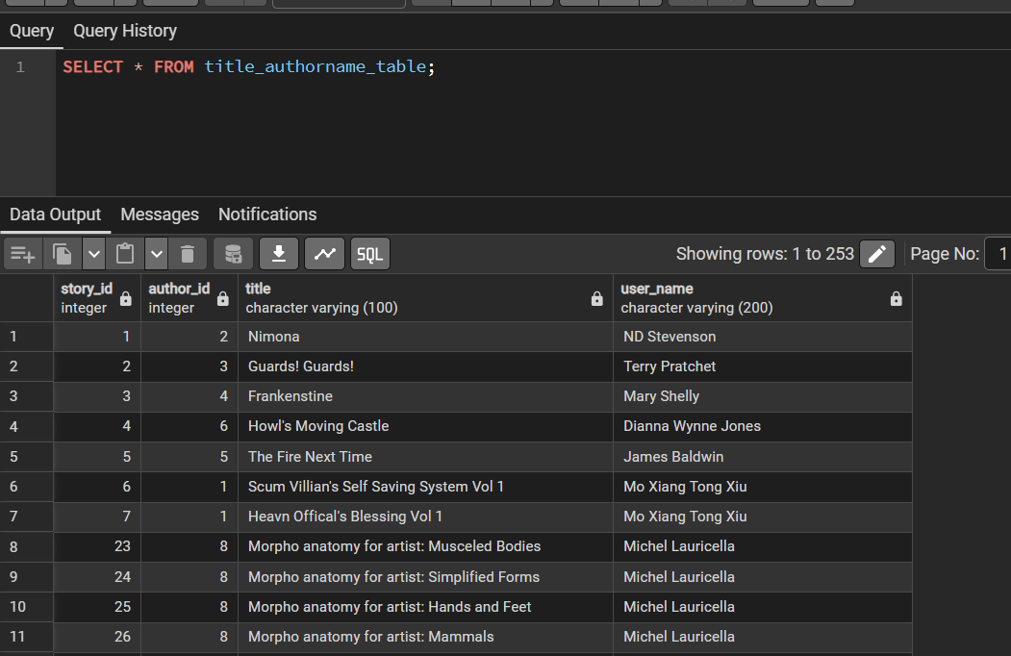
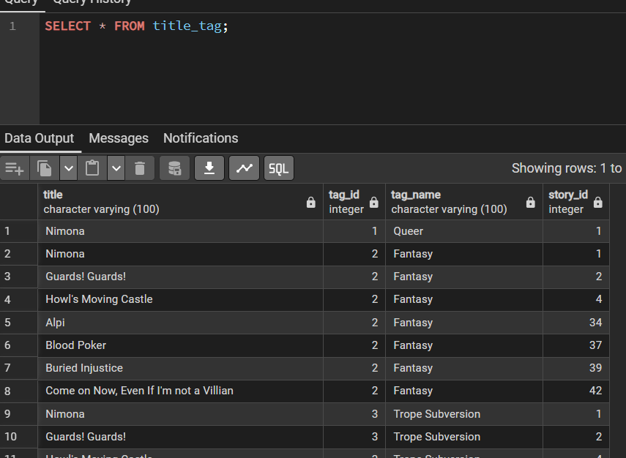
Views

Slide 4

Procedures

Slide 5
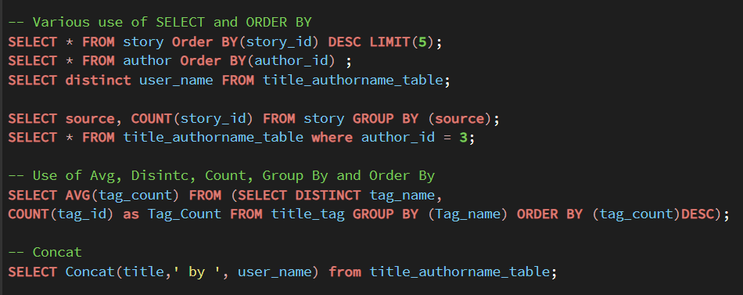
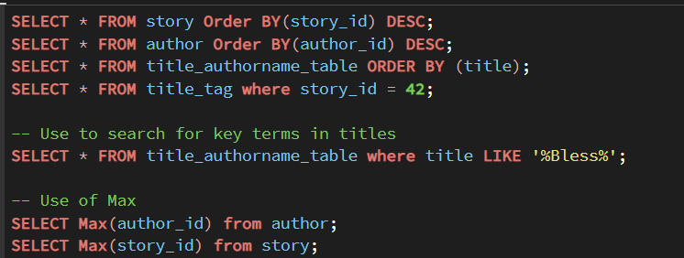
Example Queries

