Slide 1
CS 377 Final Project
Database of Stories

Slide 2
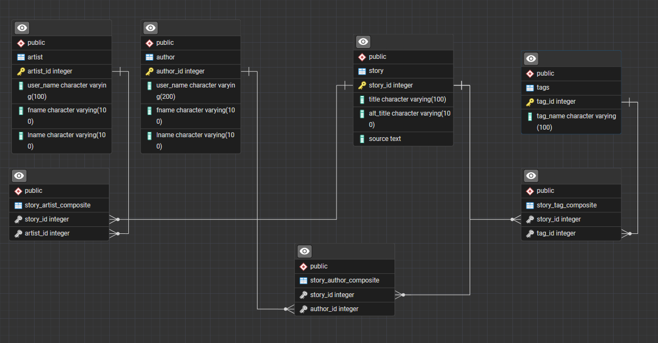
The Structure
A many to many relationship exists between Story, Tags, and Author

Slide 3
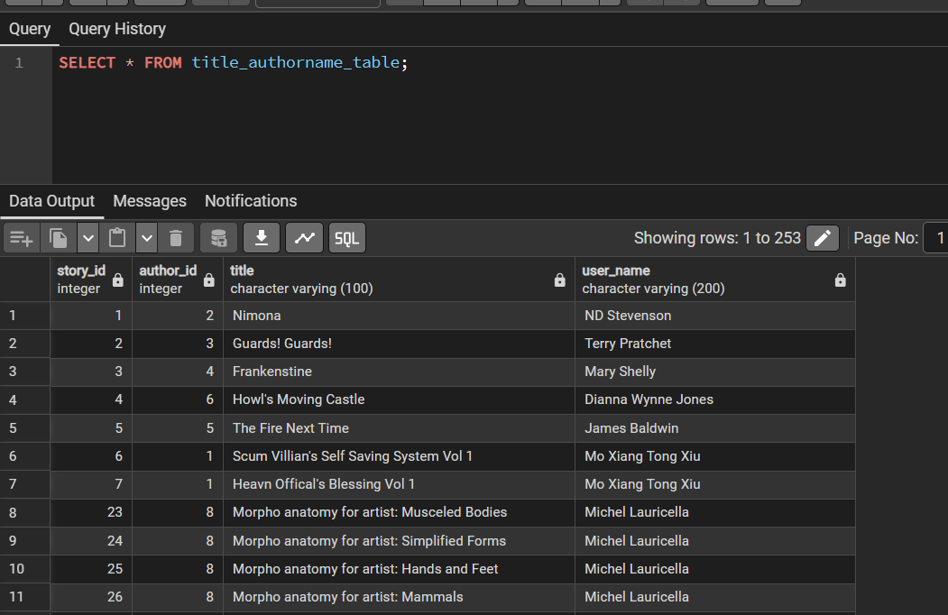
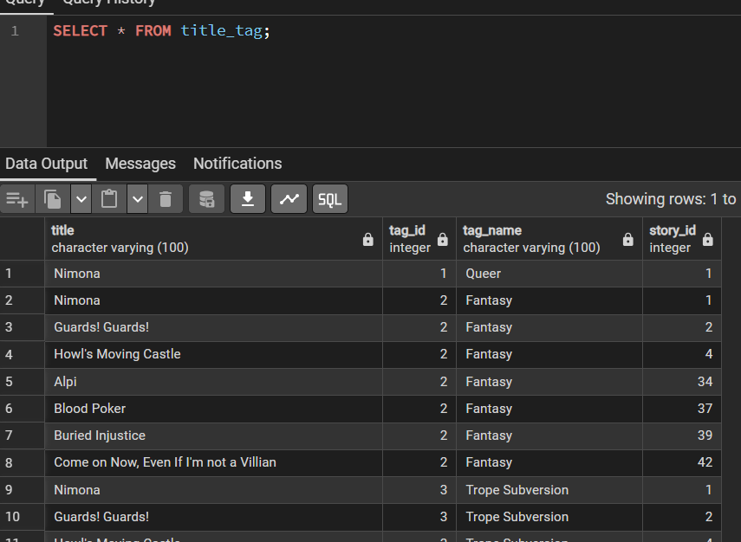
Views

Slide 4
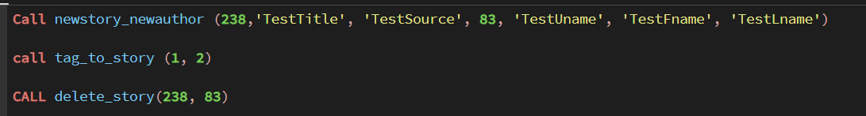
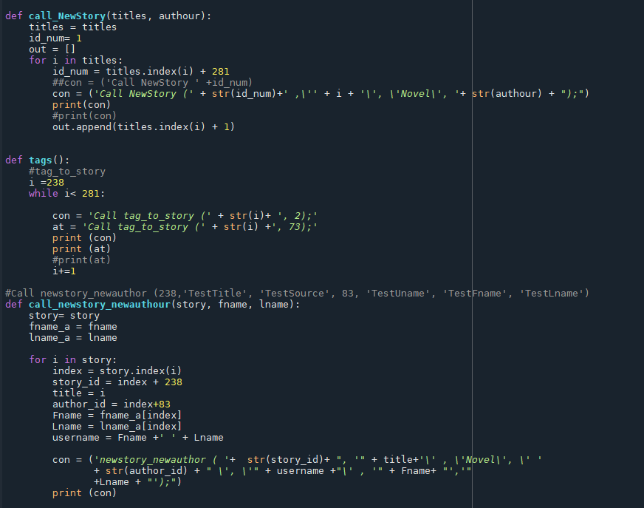
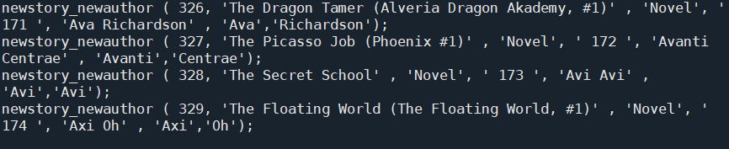
Procedures + Features
SQL Procdedure + Python
Lets me do large batches of data insertion
(So far over 400, Seriously James Patterson has over 400 books)

Slide 5
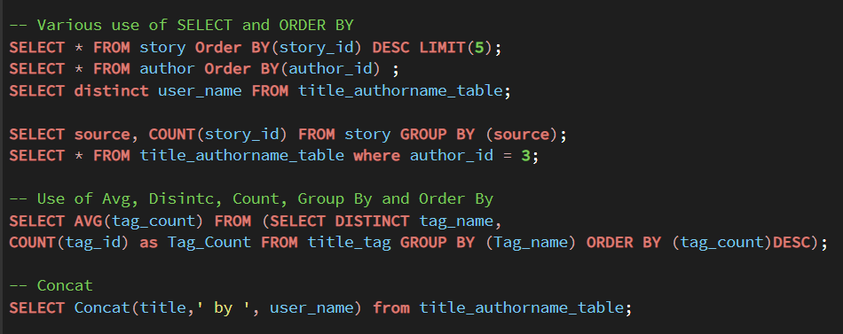
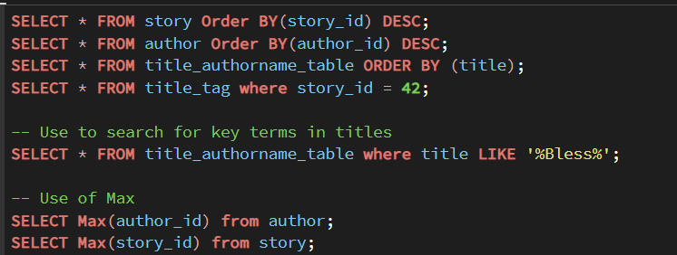
Example Queries

