Slide 1
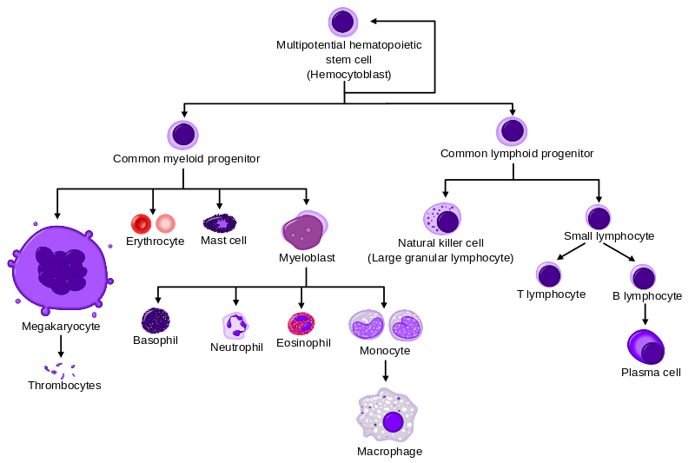
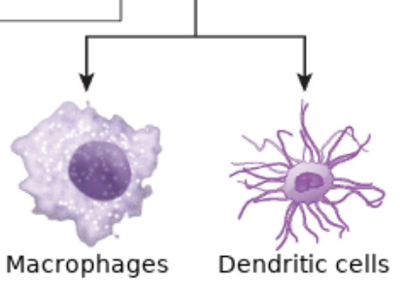
(CMP)
(CLP)
Granulocytes
(Platelets)

