Slide 1

COVID-19
Global Pandemic Analytics Data Warehouse

Slide 2
Agenda
The dataset and why it needed a data warehouse
Design decisions and the final star schema
Implementation and ETL process
Real-world challenges and how I solved them
Analytical capabilities with example queries
Conclusion and key takeaways

Slide 3

The Dataset
The source is from Our World in Data.
Had over 50,000 daily rows covering 200+ countries from 2020 to 2025.
It contains cases, deaths, excess mortality, hospital admissions, testing, vaccination rollout, reproduction rate, static country demographics, etc.

Slide 4
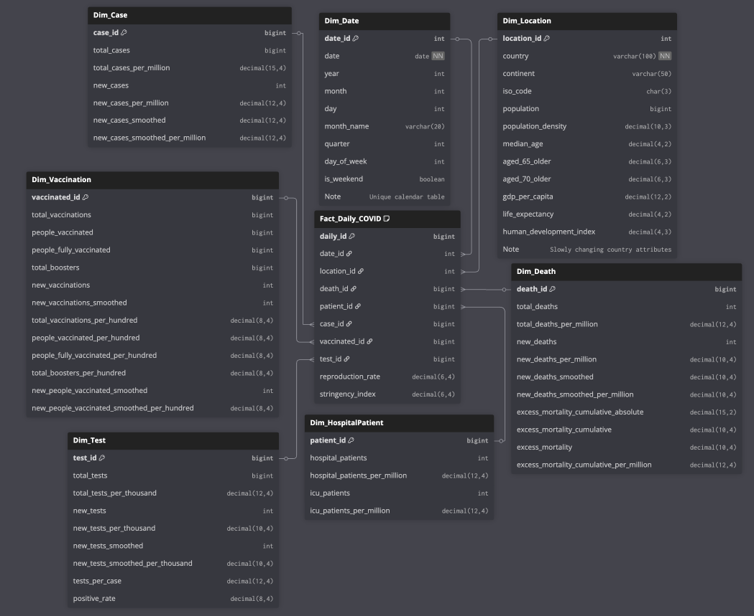
Star Schema Diagram
At the center:
Fact Daily COVID
It has exactly 50,000 rows, one per country per day.
Surrounding it:
Date (full calendar)
Location (countries + demographics)
Multiple dimensions for cases, deaths, hospital patients, vaccination, and testing. These metric groups are sparse and high-cardinality.
All relationships are enforced with foreign keys and a unique constraint on
date and location.

Slide 5
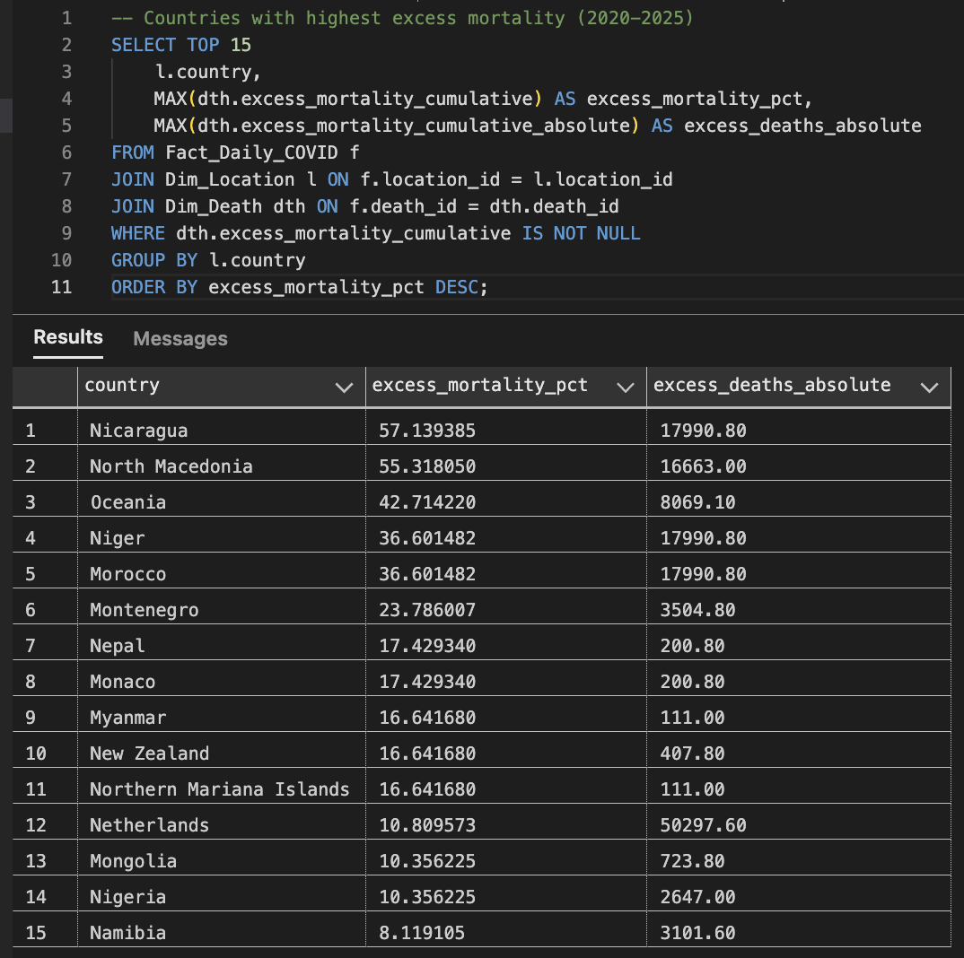
Design Goals & Methodology
Query performance:
Simple star schema joins deliver sub-second response times even on 50,000 fact rows with multiple sparse metric groups.
Intuitive for users:
Analysts can easily understand and write reports using country, date, and meaningful dimensions instead of a 60+ column flat table.
Handles extreme sparsity gracefully: Degenerate dimensions (Case, Death, Vaccination, etc.) avoid billions of NULLs while preserving historical accuracy.
Fast aggregation: Conformed dimensions + denormalized facts enable instant roll-ups (e.g., total cases by continent, monthly deaths per million) without complex subqueries.

Slide 6
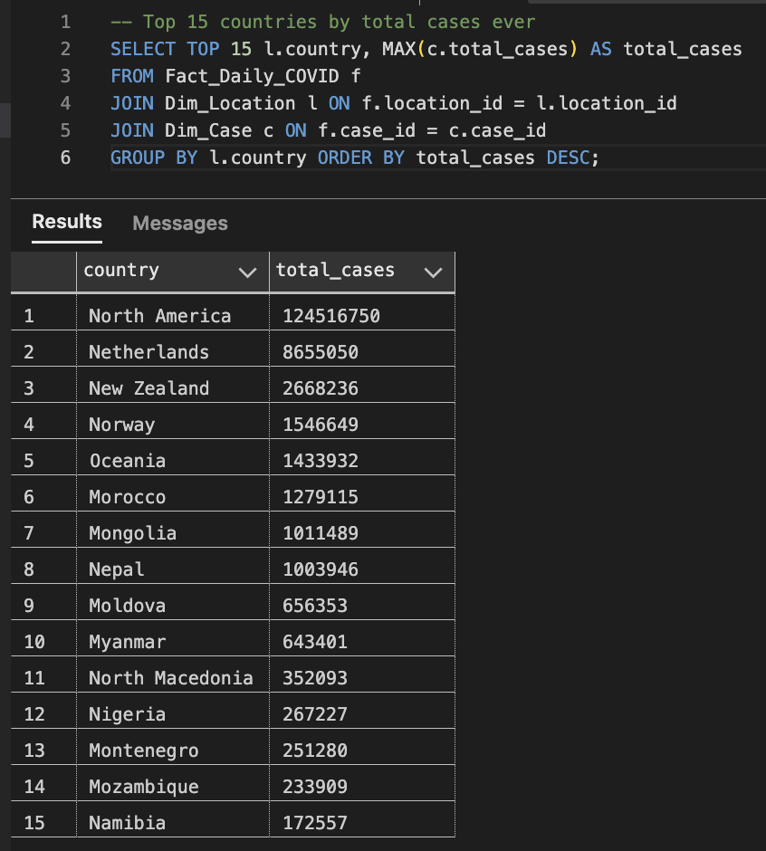
Analytical Power
The warehouse is now ready for serious public health analytics.
Here are just a few of the queries:
Top 15 countries by total cases
Case fatality rates ranked
Vaccination impact: cases before vs after 50% and 70% fully vaccinated
Highest excess mortality nations
Fastest vaccination rollouts
Hospital and ICU peak occupancy

Slide 7
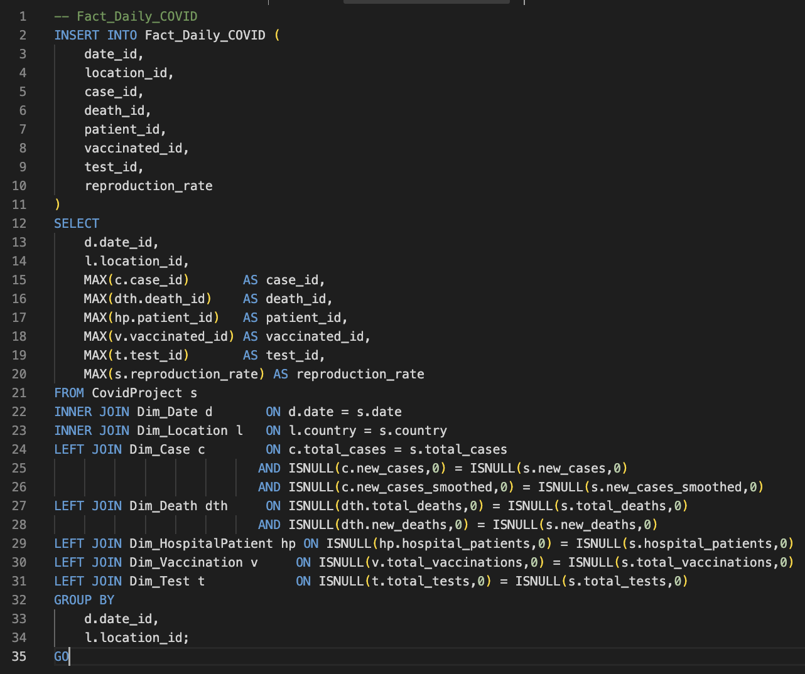
Implementation in Azure SQL Database
Steps:
Created a staging table matching the CSV
Built Date with a recursive CTE
Loaded static Dim_Location
Created degenerate dimensions using DISTINCT combinations
Final fact load using GROUP BY and MAX(surrogate_key):
This was the pattern that finally worked.

Slide 8
Challenges
Real data is messy. I learned the hard way.
I hit several issues:
Duplicate country-date rows
Problem: Same country+date appeared 2–3 times in staging
Fix: ROW_NUMBER() OVER (PARTITION BY country, date) → keep only row #1
Unique constraint violations
Problem: Partial loads left old fact rows → new inserts collided
Fix: TRUNCATE Fact_Daily_COVID + GROUP BY date_id, location_id + MAX(surrogate_key)
NULL ≠ NULL join failures
Problem: Legitimate missing metrics broke dimension lookups
Fix: ISNULL(column, 0) = ISNULL(column, 0) in every join

Slide 9
Conclusion
To wrap up:
I successfully transformed a complex COVID-19 dataset into a production ready, 3NF star schema in Azure SQL.
Key achievements:
100% referential integrity
Handles data elegantly
Supports public health analytics
This warehouse can help answer critical questions like:
Which countries had the best outcomes?
How effective were vaccines?
Who suffered the most excess mortality?

