Slide 1
Group D presentation

Slide 2
Part1 Problem statement

Slide 3
Problem statement (sn)
Before we get the best parameters
How many registration window do we need
How many visiting room do we need
How many hospital bed do we need
How many medicine window do we need
After we get the best parameters
How efficient our model is

Slide 4
Problem statement (SPD)
Document subject | Community Client Model | Community Client Model
1.Problem statement | 1.1:Hierarchy of objectives for a simulation study: | Overall objective: decide the best number of windows and beds and analyse the community client
 | 1.2:Input and output valuables | Inputvariables/Parameter: + Arriving time of patients + Service time of registering + Service time of visiting a doctor + Service time of being in hospital + Service time of taking medicine + Probability of leaving directly + Probability of taking medicine + Probability of being in hospital + The number of the register window + The number of the visiting doctors window + The number of the patients bed + The number of the taking medicine window Outputvariable/Parameter: + Queuing length for registering + Queuing length for visiting doctors + Queuing length for being in hospital + Queuing length for taking medicine + Average waiting time for registering + Average waiting time for visiting doctors + Average waiting time for being in hospital + Average waiting time for taking medicine + The best number of the register window + The best number of the visiting doctors window + The best number of the hospital bed + The best number of the medicine-taking window

Slide 5
Problem statement (SPD)
2.Description of real system | 2.1 Objects, Structure, Properties, Dynamic
 | Description of use cases, scenarios | 1. Control of the number of the windows and the number of the beds. 2. Generating the arrival rate of patients 3. After decide the number of windows and beds, consider the length of the queue and the waiting time.
3. Nutzung desModells | 3.1.Application purpose:e.g. Plan Training Analysis Decesion supporting | For the purpose of plan and analyse.
 | 3.2 Application area: | For the community client in someplace
4.Rahmenbe dingungen | 4.1Project-specific conditions | Duration: 4 hours Manpower3
 | 4.2 Delivery condition

Slide 6
Part2 Module design

Slide 7
Module design (CM)
A Patient arrives at the community client;
He/She go to register in hospital;
He/She waits in the queue for registering in hospital;
It’s he/she’s time to register in hospital;
He/She registered in hospital;
He/She is waiting for visiting a doctor;
He/She visited a doctor;
He/She may need to be in hospital or take medicine or leave directly;
He/She leave the hospital;

Slide 8
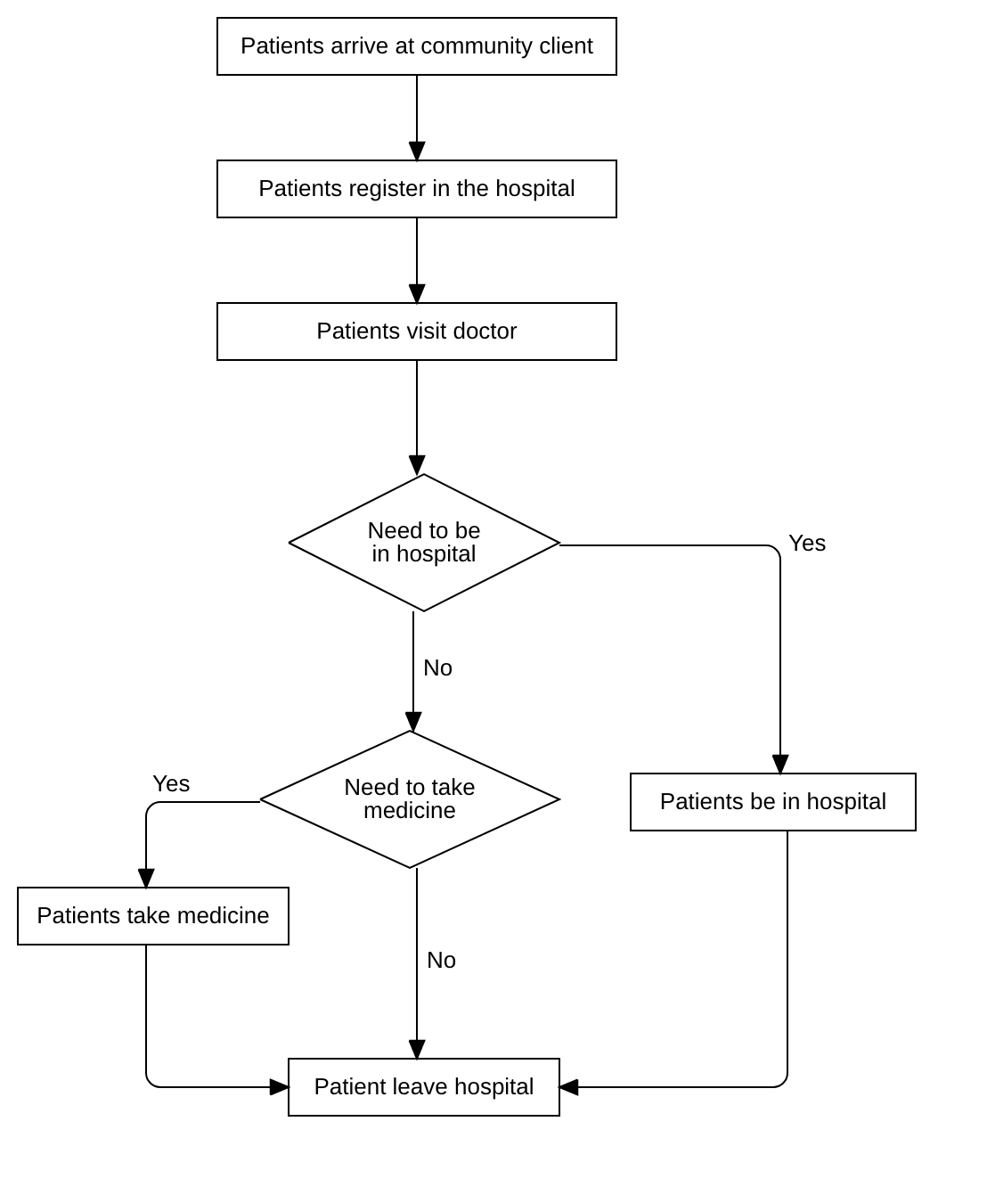
Module design (CM)

Slide 9
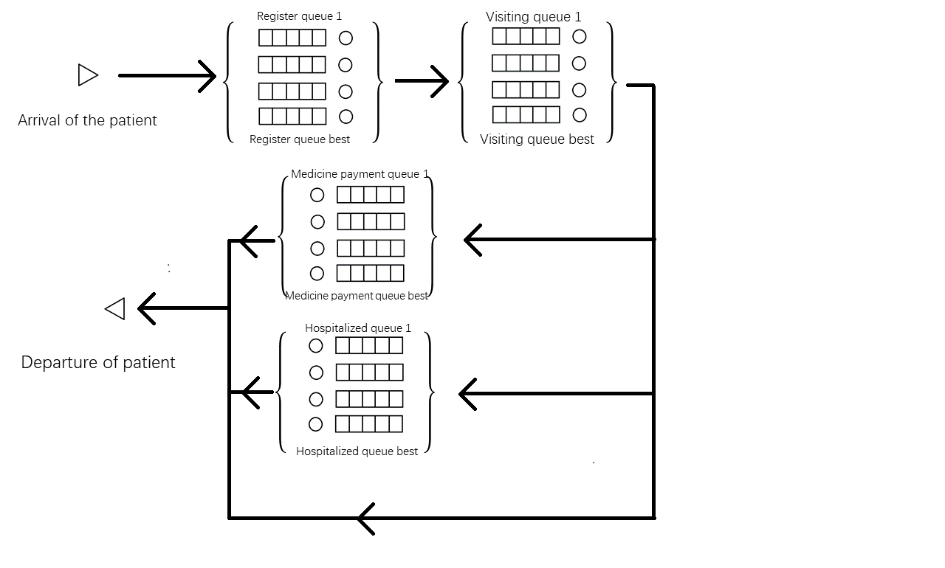
Module design (FM)

Slide 10
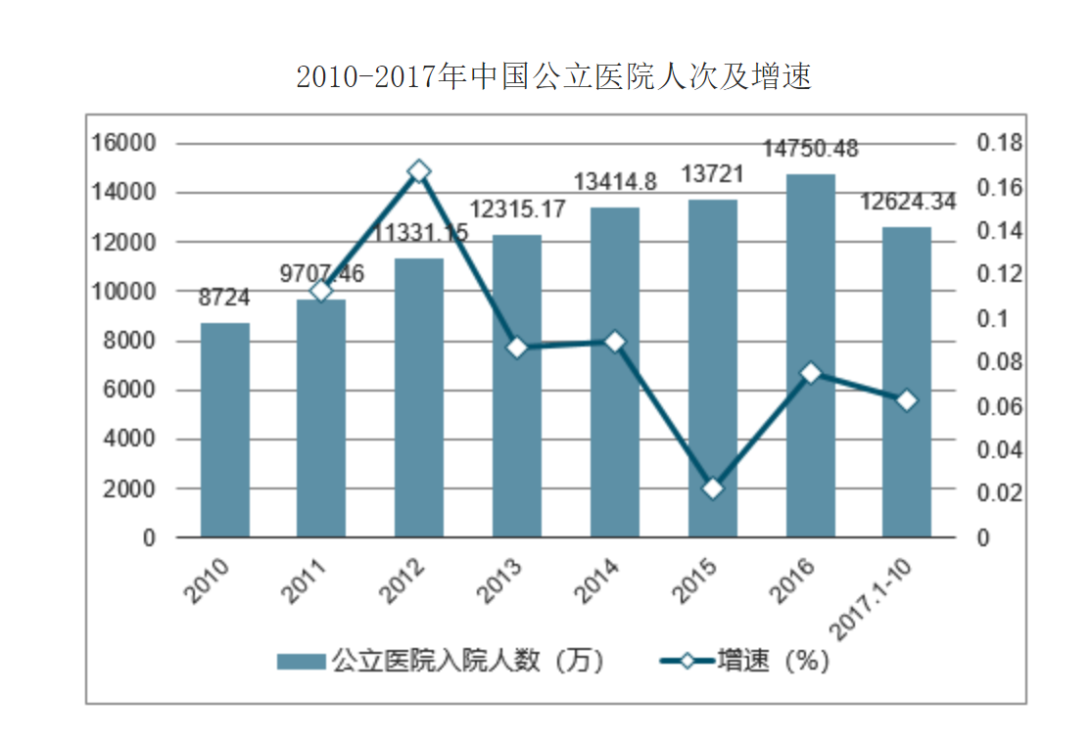
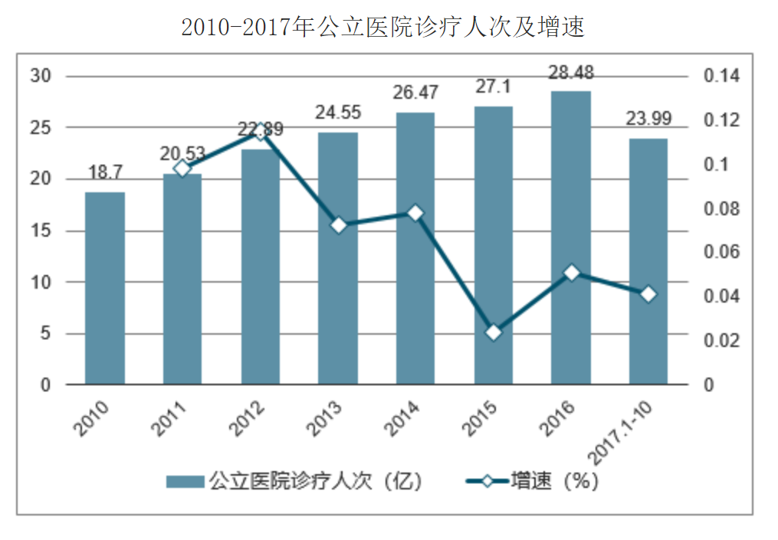
The data of people in hospital

Slide 11
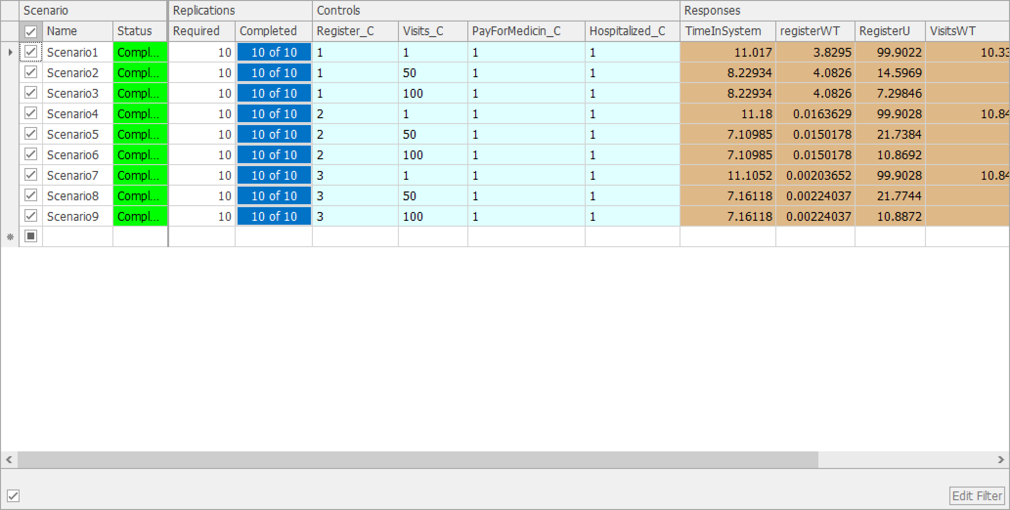
Simulation for register window

Slide 12
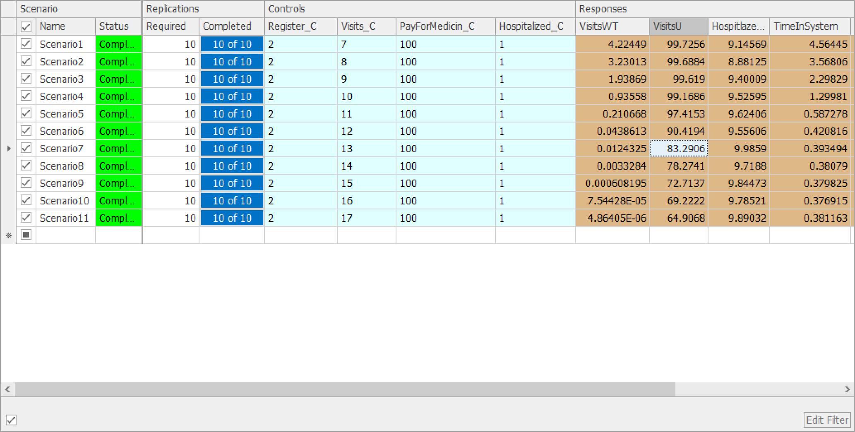
Simulation for doctor number

Slide 13
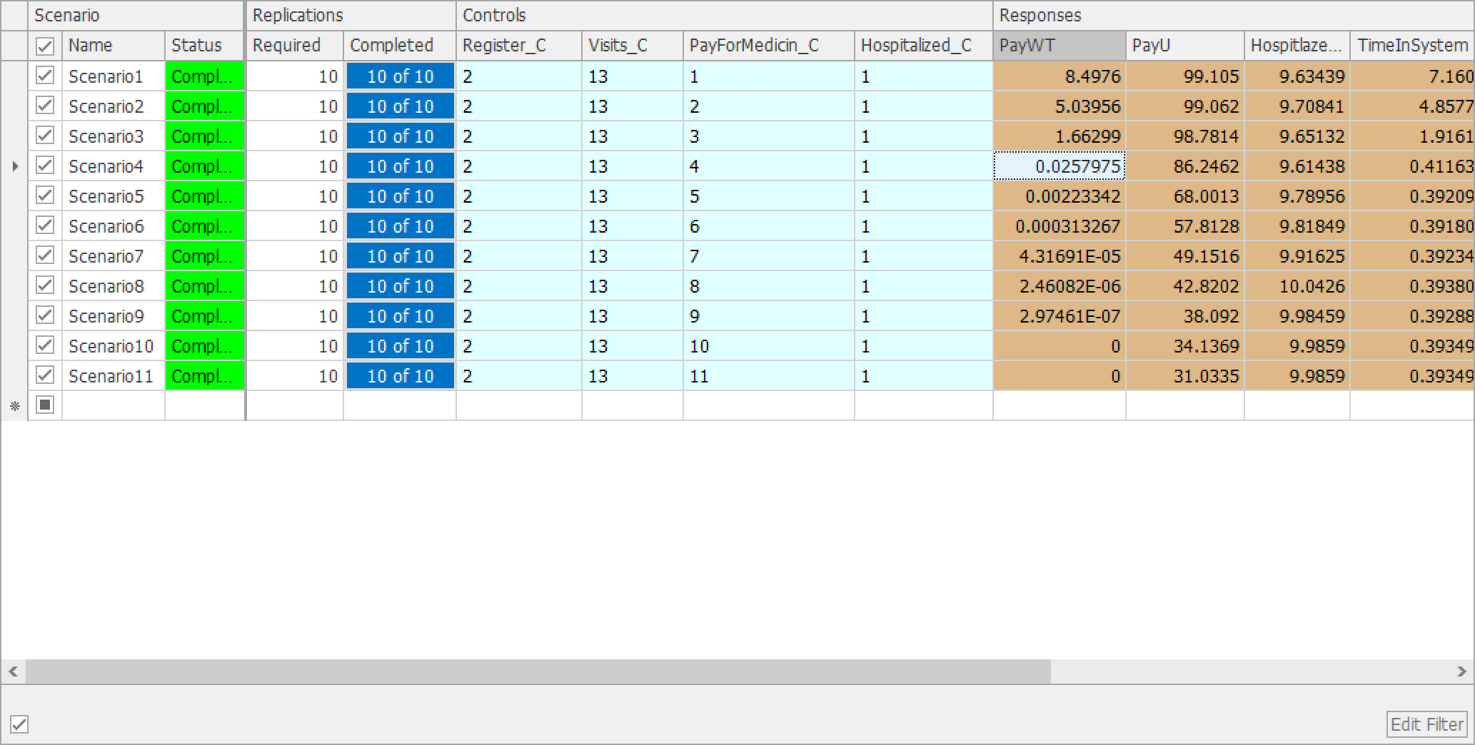
Simulation for medicin payment window

Slide 14
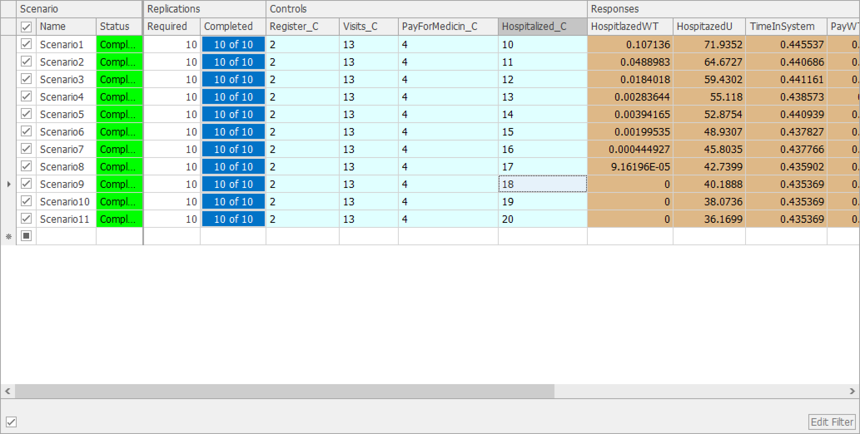
Simulation for the hospitalized bed

Slide 15
Part3 Analysis result of simulation

Slide 16
Analysis result of simulation
In our model, the best combination of numbers is 2 registration windows, 13 treatment windows, 4 drug collection windows, and 17 inpatient beds. Among them, the workload of real life community hospitals based on online surveys, we The patient's waiting time and the working intensity of the medical staff are considered comprehensively.
In our model, the waiting time per service window is less than 0.03 hours, which is 1.8 minutes. In particular, the waiting time for our inpatient medical service is only 0.001 hours, which is the waiting time of tens of seconds. . At the same time, in our model, the working hours of the staff are all about 80%. From the perspective of the clinic, there is neither waste of staff nor high-strength pressing of employees, which is more benign.
In summary, we can conclude that in the actual community clinic, the ratio of 2:13:4:17 will be more reasonable, and patients, employees and bosses can achieve better benefits.

Slide 17
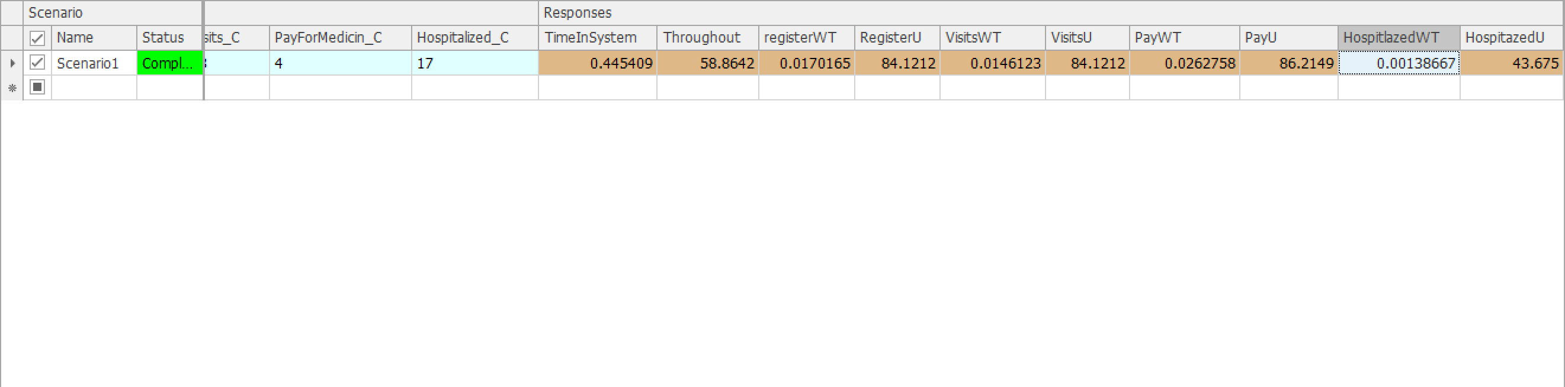
Final data analyse

Slide 18
Thankyou for your listening

