Slide 1
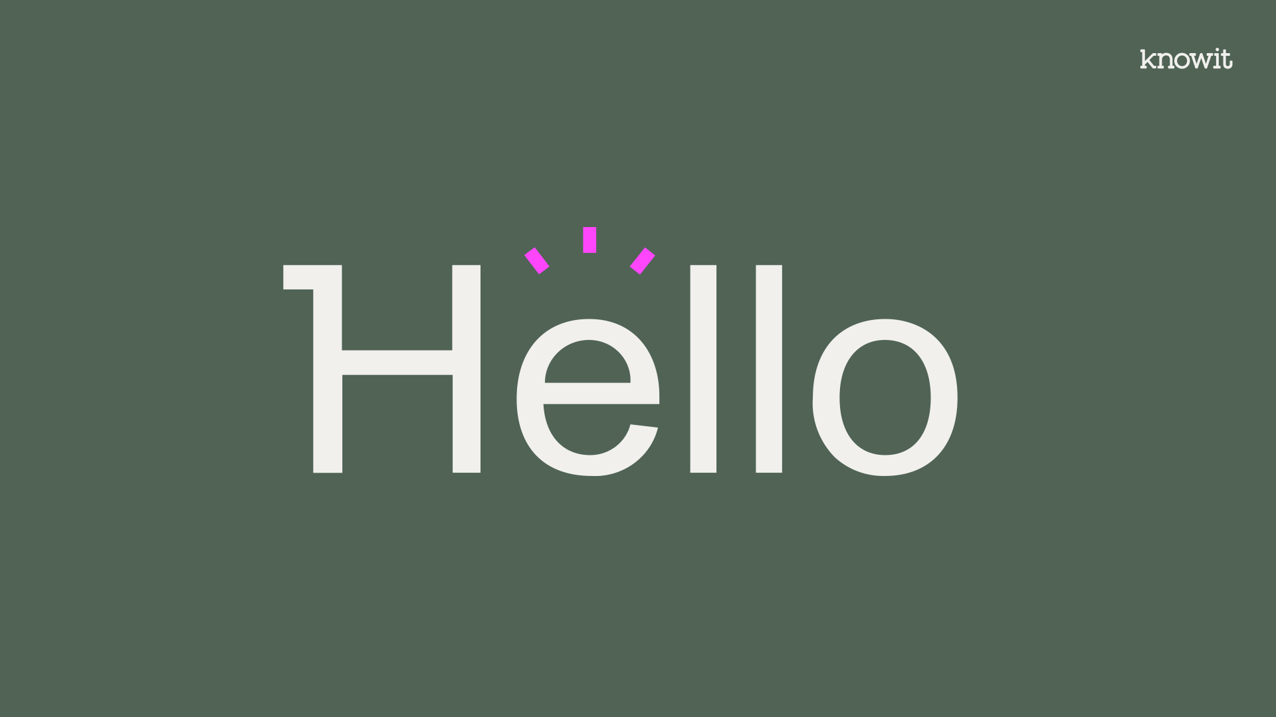

Slide 2



Module Federation
Webpack 5 ModuleFederationPlugin. A brief introduction to Micro front ends
Notes:
Welcome and thank you all for attending to this GUILD meeting. Today will be talking about webpack 5 Module federation plugin as a brief introduction to micro front ends.
Tervetuloa ja kiitos kaikille osallistumisesta tähän GUILD-kokoukseen. Tänään puhutaan webpackin 5 Module Federation -lisäosasta lyhyenä johdannona MFE:iin.

Slide 3
How did I find this?
Module federation
Some example

Slide 4
How did I find this?
Notes:
First let me recap a bit and tell you briefly about the history of my finding
Kerron teille ensin lyhyesti miten minä löysin tämän uuden ominaisuuden

Slide 5
Design System
Components
Notes:
I was in charge (apart from coding some of the components) of publishing and sharing our IZ design system made using React and styled components and using storybook as a way to have our UI component library published online.
Olin vastuussa (joidenkin komponenttien koodaamisen lisäksi) React- ja styled components tehdyn IZ-design system julkaisemisesta ja jakamisesta sekä storybookin tapana julkaista käyttöliittymäkomponenttikirjastomme verkossa.

Slide 6
Design System
Components
NPM library
Notes:
The best possible way we could find was throuhg NPM transforming the design system into a consumable NPM library. Paras mahdollinen tapa, jonka pystyimme löytämään, oli tehdä NPM:n paketin

Slide 7
Design System
Components
NPM library
App 1
App 2
App 3
Notes:
So that our components could then be consumed by any app using React. Nothing new under the sun, and quite complex as well because in order to be able to do that, we needed to integrate the project into a CI/CD pipeline, implement a version control system and go through the same publish process over and over again every time we make a change to the design system.
A duplicated task because we already have in place our unit tests and we have already a CI/CD pipeline in place to publish those modifications into our site. And what if I just want to use one of the components, and not al the stuff in the package? Am I not sharing those same components already through the storybook website? Wouldn´t it be easier to share straight from the public site? Jotta komponenttimme voisi sitten kuluttaa mikä tahansa Reactia käyttävä sovellus.
Ei mitään uutta auringon alla, ja myös melko monimutkaista, koska voidaksemme tehdä sen, meidän piti integroida projekti CI/CD-putkiin, ottaa käyttöön versionhallintajärjestelmä ja käydä läpi sama julkaisuprosessi uudelleen ja uudelleen. aina kun muutamme design systemia.
Kaksinkertainen tehtävä, koska meillä on jo yksikkötestejämme ja meillä on jo CI/CD-putki, jotta voimme julkaista kyseiset muutokset verkkosivustollamme. Mitä jos haluaisimme käyttää vain yhtä komponenteista enkä kaikkea pakkauksessa olevaa tavaraa? Emmekö ole jaamassa verkkosivuston kautta samat komponentit? Eikö olisi helpompaa jakaa suoraan julkiselta sivustolta?

Slide 8
How did I find this?
Module federation
Some example

Slide 9

Module Federation
Webpack 5 Module Federation Plugin allows JavaScript applications to dynamically import/export code from/to another application. The module will build a unique JavaScript entry file which can be downloaded by other applications by setting up the Webpack configuration.
MFE
Supports and encourages MFE (micro frontend) architecture for web applications.
Allows us to expose javascript modules to be consumed from another application.
Allows us to dynamically run code from another application, on client and server in runtime.
Notes:
So webpack version 5 includes a plugin called module federation
It´s also mandatorilly telling you briefly about micro front ends that it might be a new concept for some of us, at least for me it was.
Webpack-versio 5 sisältää lisäosan nimeltä module federation
Puhun myös lyhyesti mikrokäyttöliittymästä, joka saattaa olla joillekin teistä uutta.

Slide 10
MFE (Micro FrontEnd) architecture?
” An architectural style where independently deliverable frontend applications are composed into a greater whole. ”
SOURCE: microfrontends.com
” The idea behind Micro Frontends is to think about a website or web app as a composition of features which are owned by independent teams. Each team has a distinct area of business or mission it cares about and specialises in. A team is cross functional and develops its features end-to-end, from database to user interface.”
SOURCE: micro-frontends.org
Notes:
Some definitions of micro frontends. It might need a new GUILD session to explain in detail but adopting this architectural method changes the organisations/teams works upside down.
Jotkut micro frontends määritelmät. Aihe vaati oma kiltamiitti selvittämään MFE yksityiskohtaisesti, ja miten tämän arkkitehtuurin muuttaa organisaatioiden/tiimien toimintaa kokonaan.

Slide 11
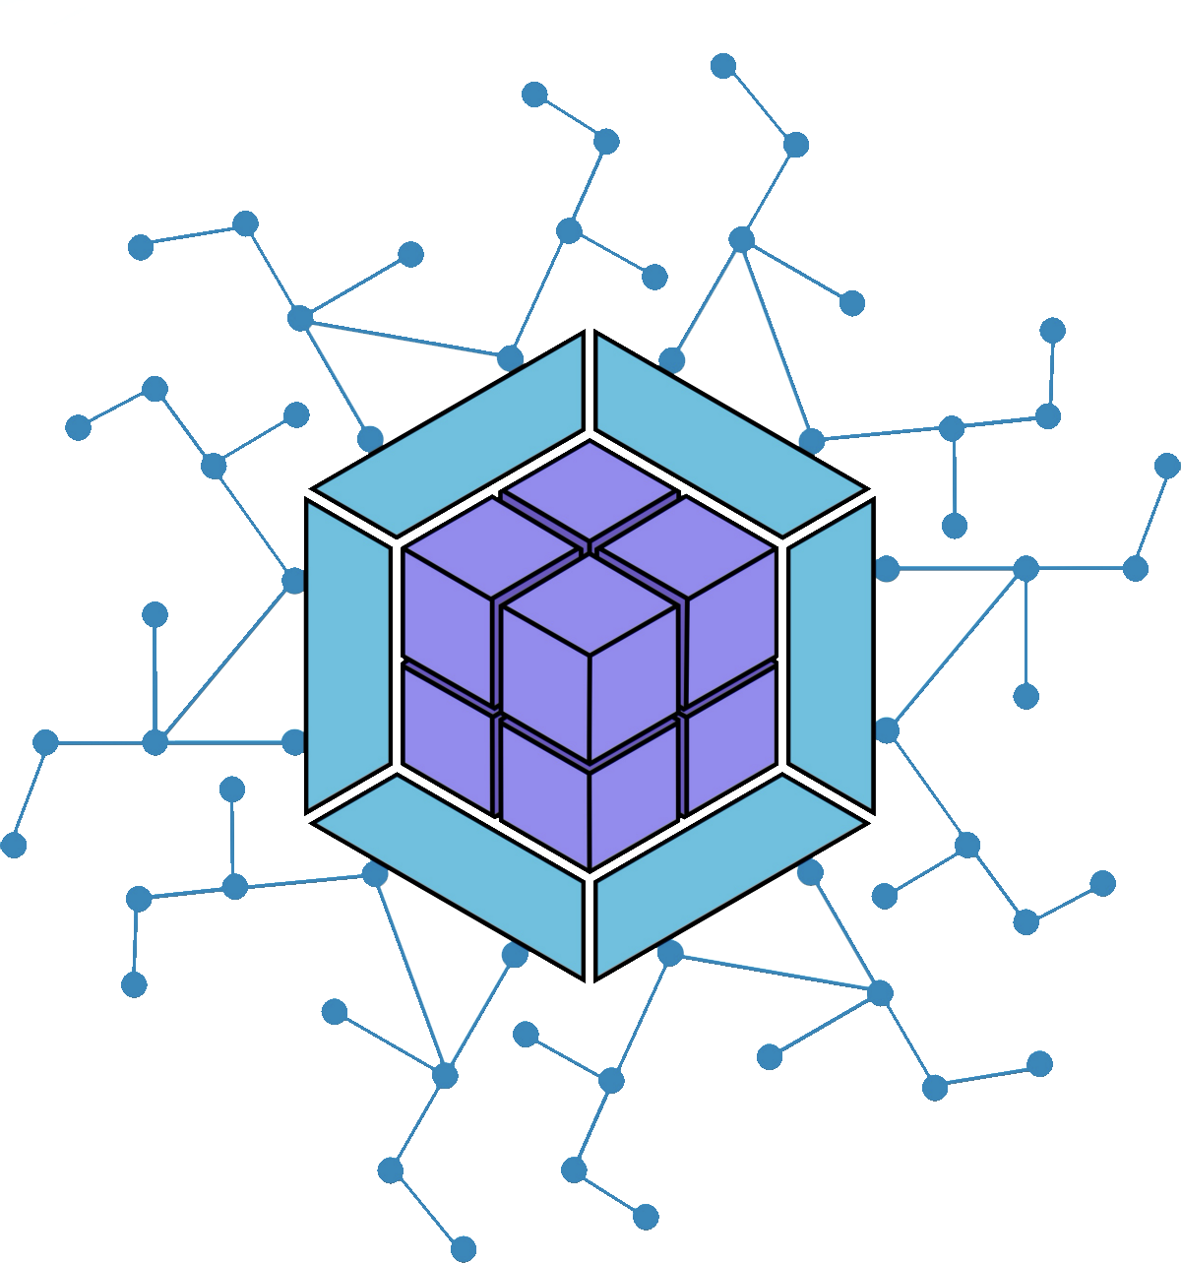





Why MFE and module federation?
SystemJS
Notes:
While there are some other similar tools or frameworks to achieve similar outcomes I think webpack 5 module federation plugin is the way to go for javascript MFE.
Vaikka on olemassa joitain muita samankaltaisia työkaluja tai kehyksiä samanlaisten tulosten saavuttamiseksi, uskon itse että webpack 5 – module federation on paras tapa JavaScriptin MFE:lle, ja voidaan webpackin module federation lisäosa käyttää yhdessä muiden parissa

Slide 12
WebApp 1
Libraries
Store
Components
Notes:
An example here, And let me change from our afore mentioned IZ design system to a normal web application where we have our libraries, our data store and finally our javascript modules.

Slide 13
WebApp 1
WebApp 2
Libraries
Libraries
Store
Store
Components
Components
Notes:
Let’s say we have another web application that in tis case is using the same architecture as the first one but is missing one thing.

Slide 14
WebApp 1
WebApp 2
Libraries
Libraries
Store
Store
Components
Components
Notes:
And that one thing is one of the javascript modules from the WebApp1, let’s say a carousel

Slide 15
WebApp 1
WebApp 2
Libraries
Libraries
Store
Store
Components
Components
Notes:
So now I would like to integrate that module into my project,

Slide 16
WebApp 1
WebApp 2
Libraries
Libraries
Store
?
Store
Components
Components
Notes:
What options do I have?

Slide 17
WebApp 1
WebApp 2
Libraries
Libraries
Store
Store
Components
Components
NPM library
Notes:
The first one is to use the same solution we used to share our design system and well known to everyone here

Slide 18
WebApp 1
WebApp 2
Publish flow
Publish
New version
Libraries
Libraries
Store
Store
Components
Components
NPM library
Notes:
So we create an external entity with it’s own CI/CD pipeline for other apps to grab and utilise

Slide 19
WebApp 1
WebApp 2
NPM library
Libraries
ESI *1
Libraries
MFE *2
Store
…..
Store
Components
Components
*1 Edge Side Includes (ESI) is a small markup language for edge level dynamic web content assembly.
*2 Micro Front End Frameworks can bring together multiple microservices to serve a broader range of users.
Notes:
What if it´s coded using a different framework…. We can use … an iframe…?

Slide 20
WebApp 1
Remote
WebApp 2
Host
Libraries
Libraries
Federated modules
Store
Store
Components
Components
Notes:
What if we could achieve this keeping the module at home? So there´s no need to externalise it and it gets it´s own updates without installing the package again? In this scenario we will have mainly two actors

Slide 21
WebApp 1
Remote
The Remote Federated Module / Micro frontend
Exposes javascript modules
Exposes libraries
Libraries
Store
Components
Notes:
The remote, or from where the javascript module is shared, Also special or custom libraries and types can be shared from the remote. Highlighting here that virtually anything that webpack can handle can be exported/exposed

Slide 22
WebApp 2
Host
The host/portal/ container/consumer Federated Module
Import javascript modules in runtime asynchronously
Dependency sharing
Avoids increasing bundle size
Libraries
Store
Components
Notes:
And the host, the application that consumes this javascript module importing it in runtime using dependency sharing, which means that it will try to use the code that is already in place and importing just the necessary avoiding increasing unnecessarilly increasing bundle size, As the component is invoked asynchonously, we can use a fallback if the module build fails or is not available somehow.

Slide 23
WebApp 1
Remote
WebApp 2
Host
Federated modules
Keeps the module at home
No need to step out from coding, and republish
Seamlessly export javascript modules & import at runtime
We can expose and consume any javascript, virtually anything that webpack can handle.
Reduces friction & speeds up development
Cross framework compatibility of MFE?
Libraries
Libraries
Store
Store
Prevents sibling containers from overriding their modules.
Environment-independent features that can function on the Web and Node.js
Enables dependency sharing
Components
Components
Notes:
Keeps the js module at home, no need to externalise it. We don’t need to quit developing to publish the change and modifications updates through already existing infrastucture.
So it works like charm and magically then? …. Well the answer is no
“Pitää js-moduulin kotona”, sitä ei tarvitse ulkoistaa. Meidän ei tarvitse lopettaa kehitystä julkaistaksemme muutos- ja muutospäivitykset jo olemassa olevan infrastruktuurin kautta.
Joten se toimii heti ja maagisesti sitten? …. No vastaus on ei

Slide 24
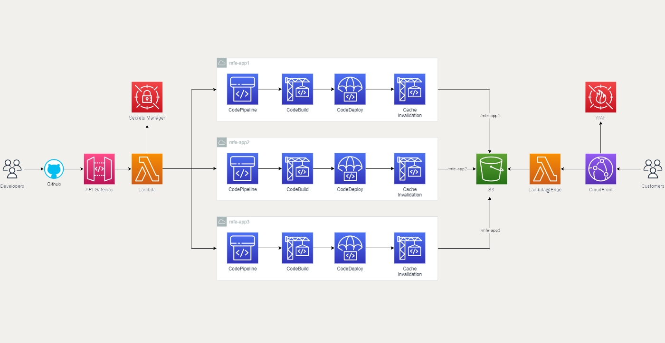
Some cloud
Source: A complete AWS Architecture for Module-federated micro-frontends
Notes:
What we will end up having is our micro frontends published on a S3 or equivalent solution and consuming from there also
Lopulta saamme MFE jukaistettuna S3:lla tai vastaavalla ratkaisulla ja otetaan siitä käytöön myös sieltä kautta

Slide 25



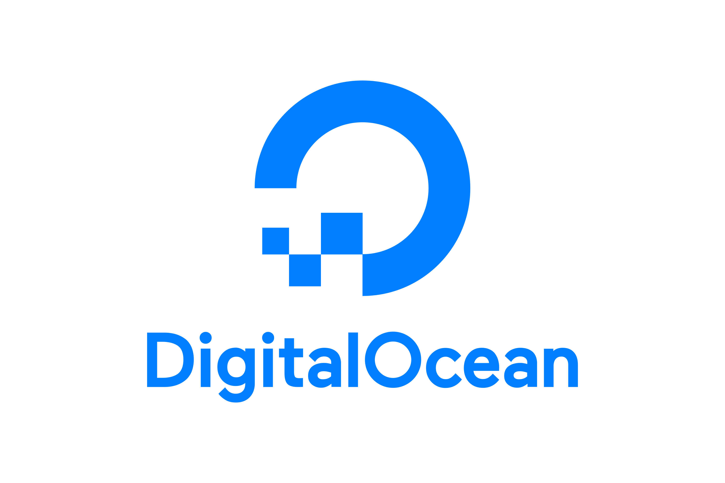







Companies using module federation
…and many more
Notes:
These are some of the companies that are using module federation
Muutama yritystä, jotka käyttävät module federation

Slide 26
How did I find this?
Module federation
Some example

Slide 27

Module Federation workshop

Slide 28



