Slide 1
CSCE 606- Software Engineering
Shockwave-Kickers
Colton Simpson, Jacob Kelly, Kunal Vudathu, Rahul Shah, Stuart Nelson

Slide 2
CSCE 606- Software Engineering
Abstract
Procedure
Testing
Conclusion
Application Use-Cases
Help Professor Lightfoot memorize his students’ names with intuitive quizzes
Help Professor Lightfoot keep track of his former students
Look up a student and their attributes: what classes they took, their grade, professor notes, etc.
Will be used when a former student reaches out for a recommendation letter

Slide 3
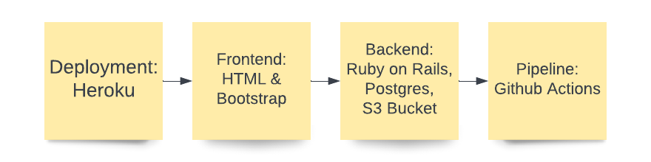
CSCE 606- Software Engineering
Abstract
Procedure
Testing
Conclusion
Tech Stack

Slide 4
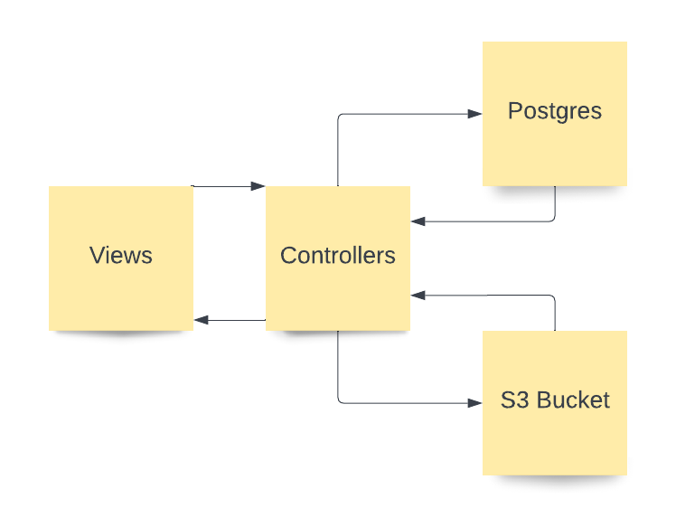
CSCE 606- Software Engineering
Abstract
Procedure
Testing
Conclusion
System Flow

Slide 5
CSCE 606- Software Engineering
Abstract
Procedure
Testing
Conclusion
Application Pages
Login
Home
Courses
Students
Quizzes
Upload

Slide 6
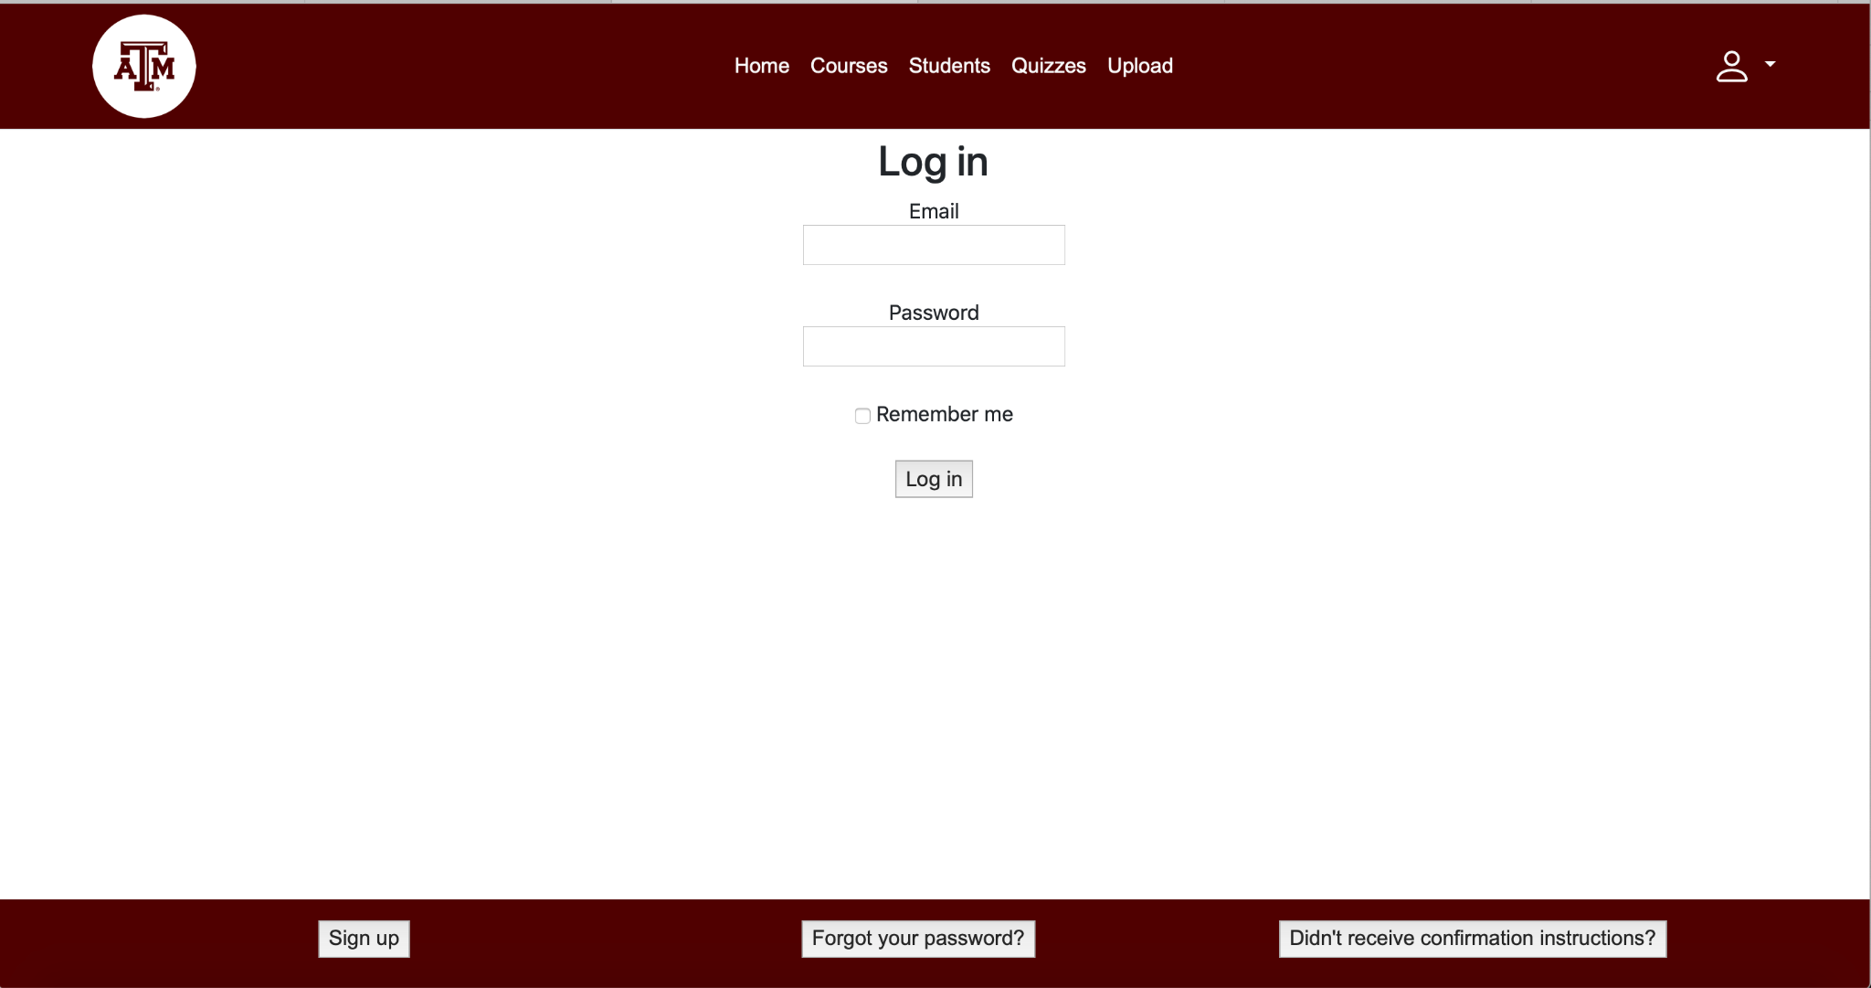
CSCE 606- Software Engineering
Abstract
Procedure
Testing
Conclusion
Login
User logs in via email/password
User can create an account and reset their password
Routes the user to the home page after authenticated

Slide 7
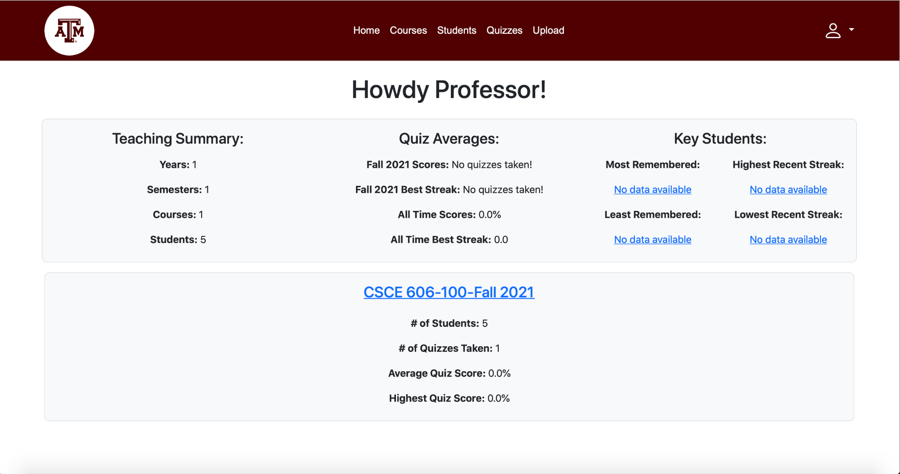
CSCE 606- Software Engineering
Abstract
Procedure
Testing
Conclusion
Home
Displays quiz statistics from the database about students and courses that are currently being taught
Displays current courses and their quiz statistics

Slide 8
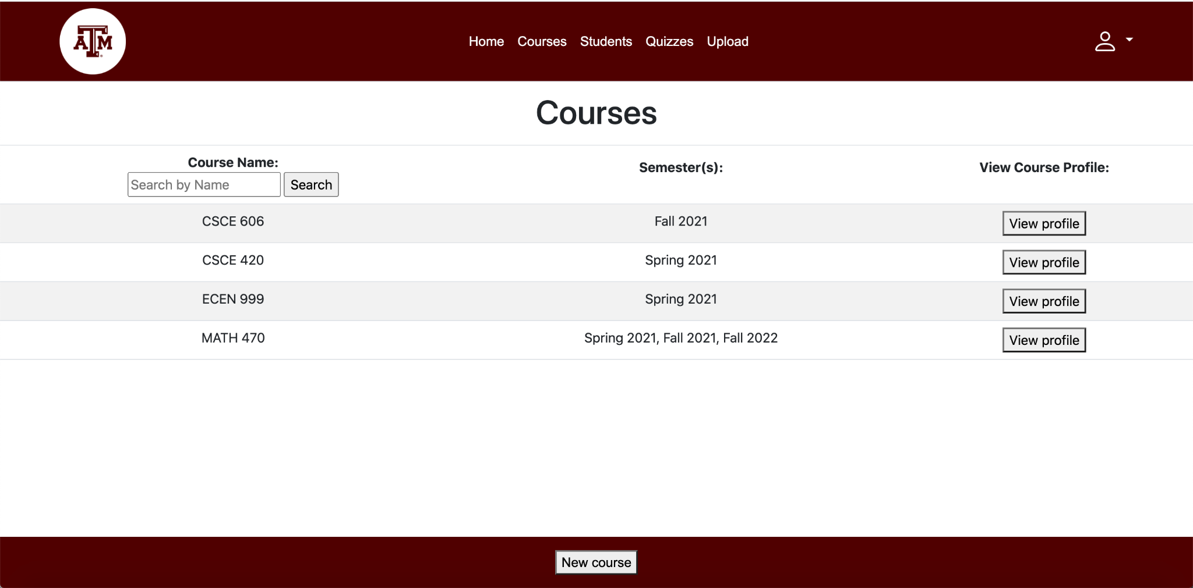
CSCE 606- Software Engineering
Abstract
Procedure
Testing
Conclusion
Courses Page
Lists courses tagged by semester and year
Search for courses by name

Slide 9
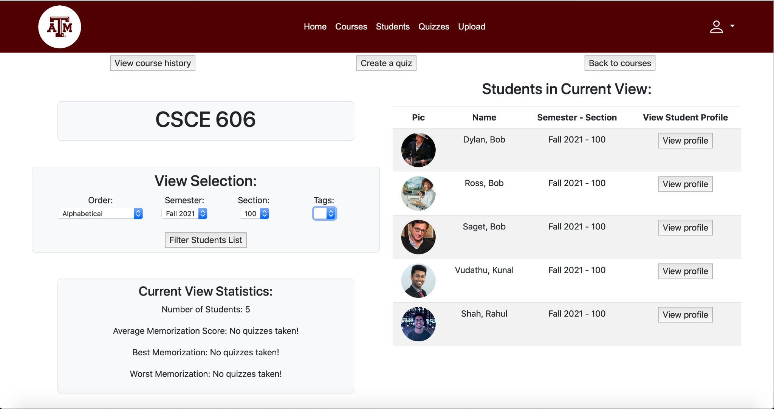
CSCE 606- Software Engineering
Abstract
Procedure
Testing
Conclusion
Course Profile
View current/former students list on each course profile
Filter the students list by semester, section, and tags
Sort student list alphabetically or reverse alphabetically

Slide 10
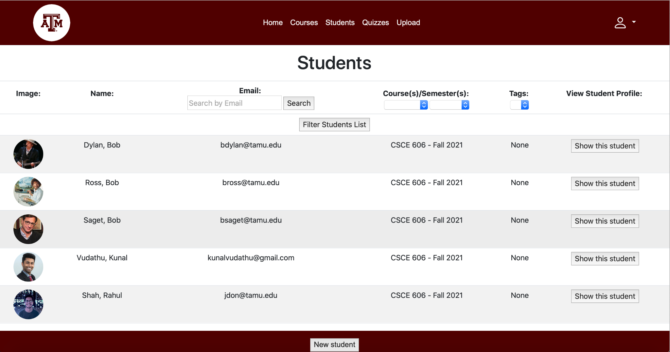
CSCE 606- Software Engineering
Abstract
Procedure
Testing
Conclusion
Students Page
Lists all current/former students alphabetically
Filters by email, course, semester, and tag

Slide 11
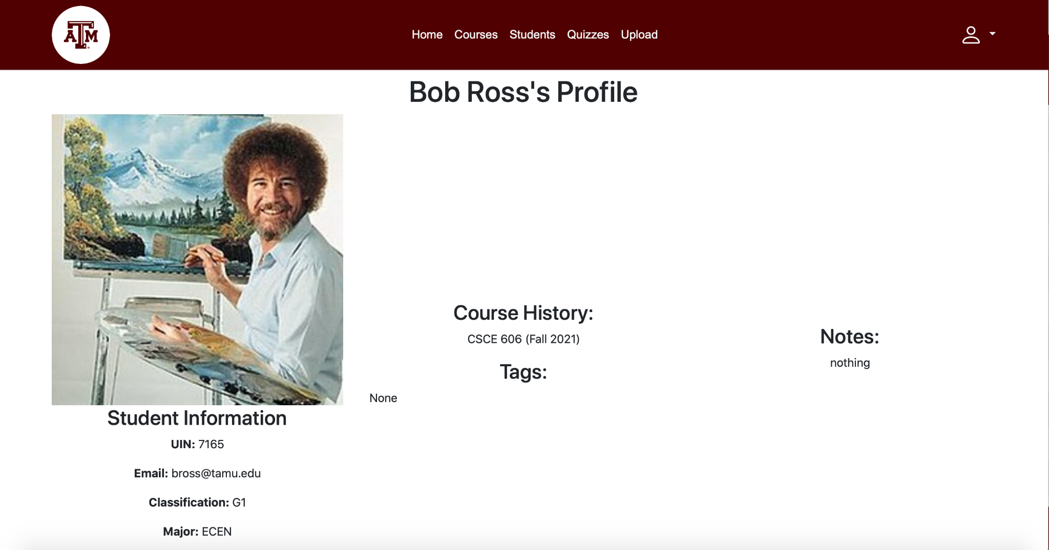
CSCE 606- Software Engineering
Abstract
Procedure
Testing
Conclusion
Student Profile
Student Profile:
Displays email, course history, and custom notes, tags

Slide 12
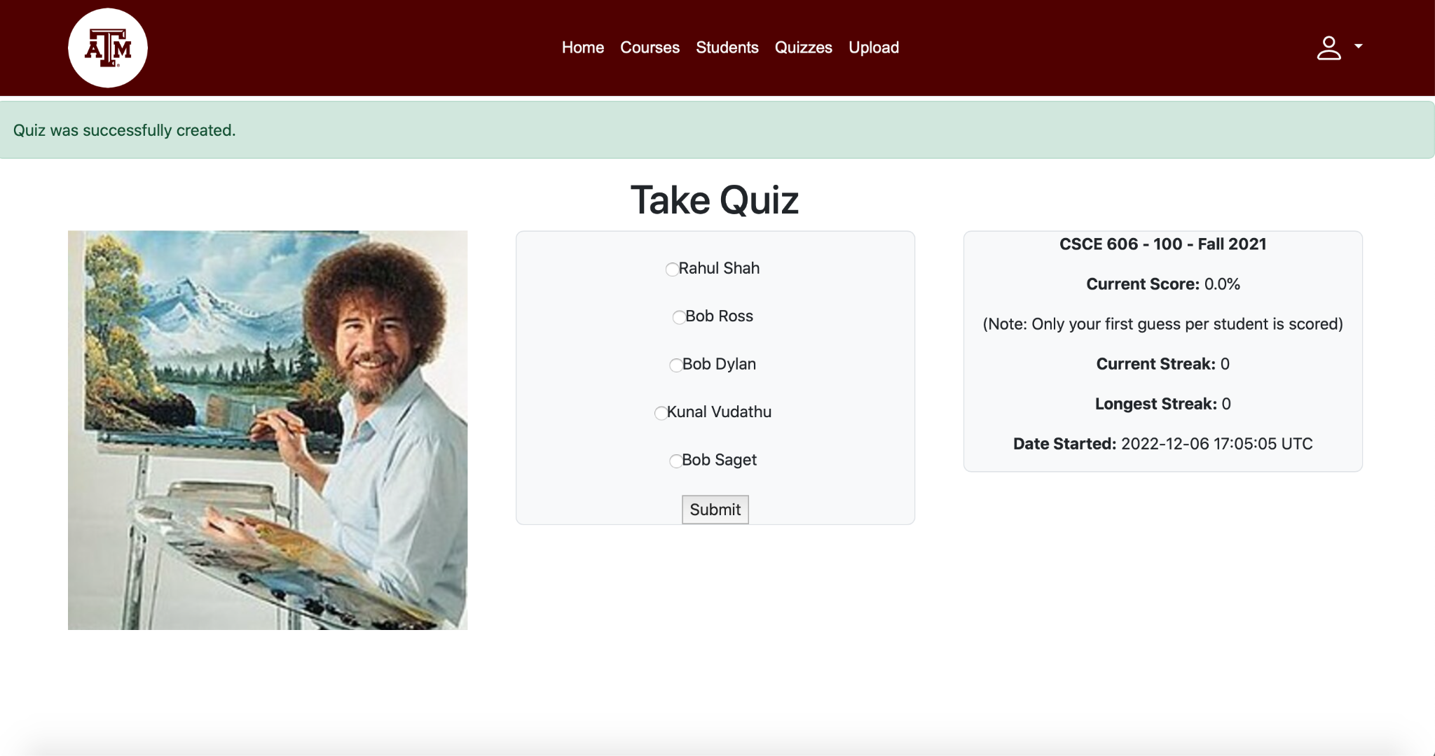
CSCE 606- Software Engineering
Abstract
Procedure
Testing
Conclusion
Quiz Page
Multiple choice quiz that asks the user to match a photo with a name
Keeps track of pending quizzes, quiz scores, and streaks
Gives feedback based on answers

Slide 13
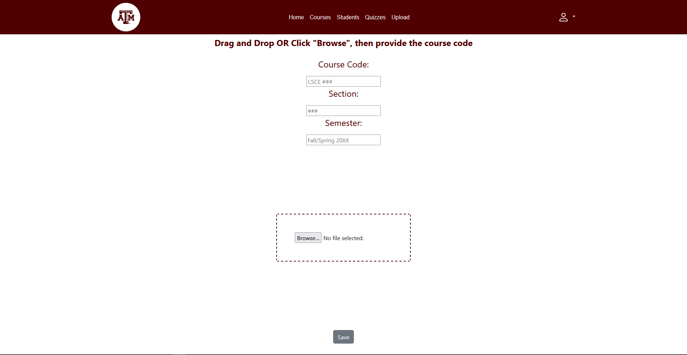
CSCE 606- Software Engineering
Abstract
Procedure
Testing
Conclusion
Upload Page
Upload a zip file containing the student roster and student images
generated by Howdy
Parses the CSV, then populates the database
Student images uploaded to S3

Slide 14
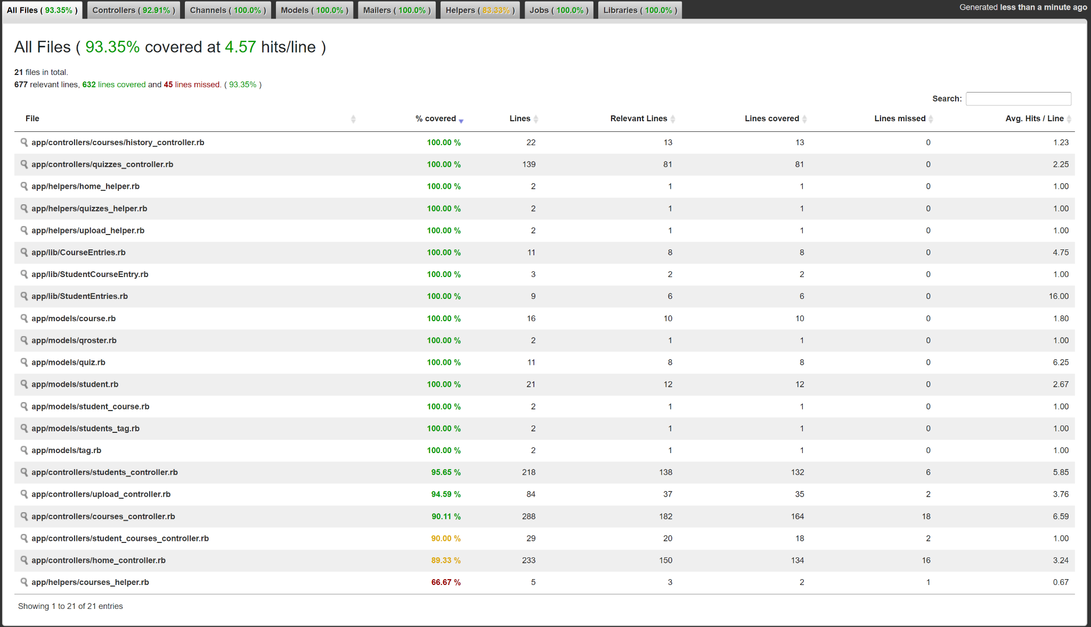
CSCE 606- Software Engineering
Abstract
Procedure
Testing
Conclusion
Implemented 78 unit tests and 134 assert statements
Achieved test coverage of 93.35%.
Test Coverage

Slide 15
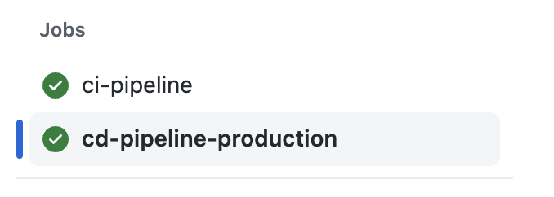
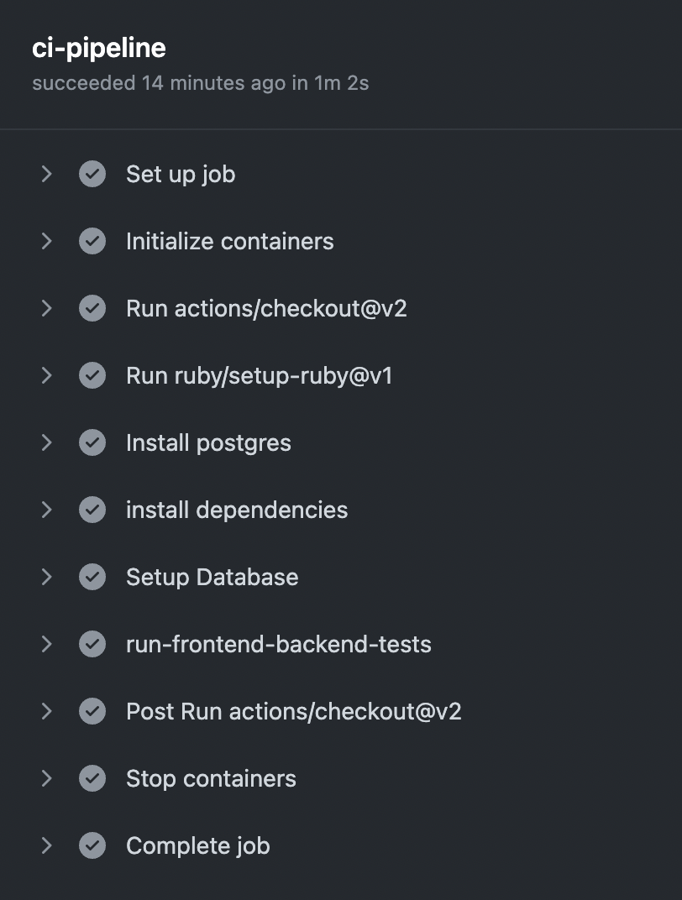
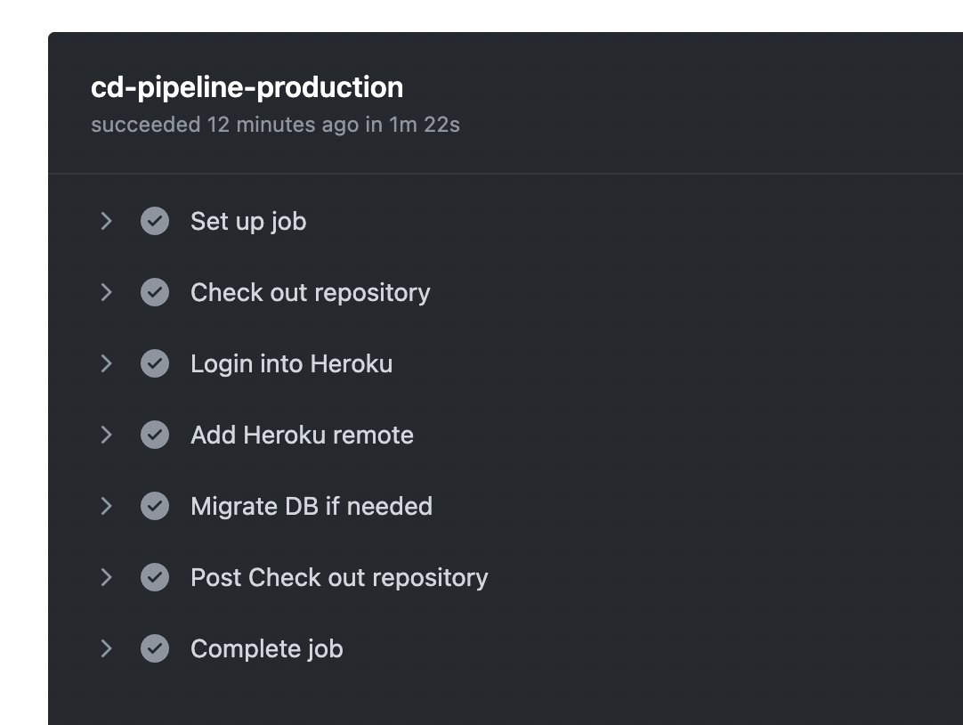
CSCE 606- Software Engineering
Abstract
Procedure
Testing
Conclusion
CI pipeline:
Runs in every PR commit
All unit cases should pass for the pipeline to pass
Can’t merge until the pipeline passes
CD pipeline:
After commit is merged to master, runs after CI pipeline passes
Deploy the commit to prod
Db migrated if needed
CI/CD Pipeline

Slide 16
CSCE 606- Software Engineering
Abstract
Procedure
Testing
Conclusion
Challenges
Creating the app from scratch
Learning from Db schema mistakes, migrating db to fix them

Slide 17
CSCE 606- Software Engineering
Demo

