Slide 1

Student Knowledge System
CSCE 606
Team Members: Client: Dr. Philip Ritchey
Shubham Mhaske
Vivek Narukurthi
Akshit Bansal
Shreshth Kushwaha

Slide 2
Introduction to Student Knowledge System (SKS)
Welcome to the Student Knowledge System (SKS), an innovative web application designed to simplify the way professors manage student information and courses.
SKS serves as a centralized platform, offering a seamless solution for educators to enhance their teaching experience.
This web application seeks to meet the needs of professors and integrates interactive games and note-taking features to enhance the way educators engage with their students.

Slide 3
Addressing Educational Challenges
Professors often handle multiple courses at the same time and face challenges in juggling between student data and course details
Professors also face challenges while engaging with their students and remembering them which this application addresses by introducing fun games
Traditional methods may be time-consuming and lack efficiency, leading to a need for a comprehensive solution.

Slide 4
How SKS Solves These Challenges
1. Effortless Course Management:
- Navigate through courses seamlessly, keeping all essential details at your fingertips.
- Streamline student enrollment info with a centralized and intuitive interface.
2. Individualized Student Focus:
- Empower instructors to track courses and monitor student enrollments effortlessly.
- Enhance your connection with each student by gaining valuable insights into their academic journey.

Slide 5
Key Features:
Access courses and students enrolled with one click.
Add new students and Courses easily with option to edit.
Sort, Filter, Archive courses however you want.
Keep track of individual student performance by adding notes.
Fun student quiz to remember your students by their face, and see course wise stats of your performance in the game

Slide 6
Use cases:
I want to see students in my ABC course for Fall 2023 semester
Just go to courses tab and filter the course you want to see enrollment.
I want to see student named XYZ details
Just simply start searching on student page - you can filter them as well with courses and semester with option to sort
Student XYZ performed good , how to make note of it ?
Just open student profile and add notes with comes with timestamp to keep track
Some course / Student info changes
No worries - edit any info with one click

Slide 7
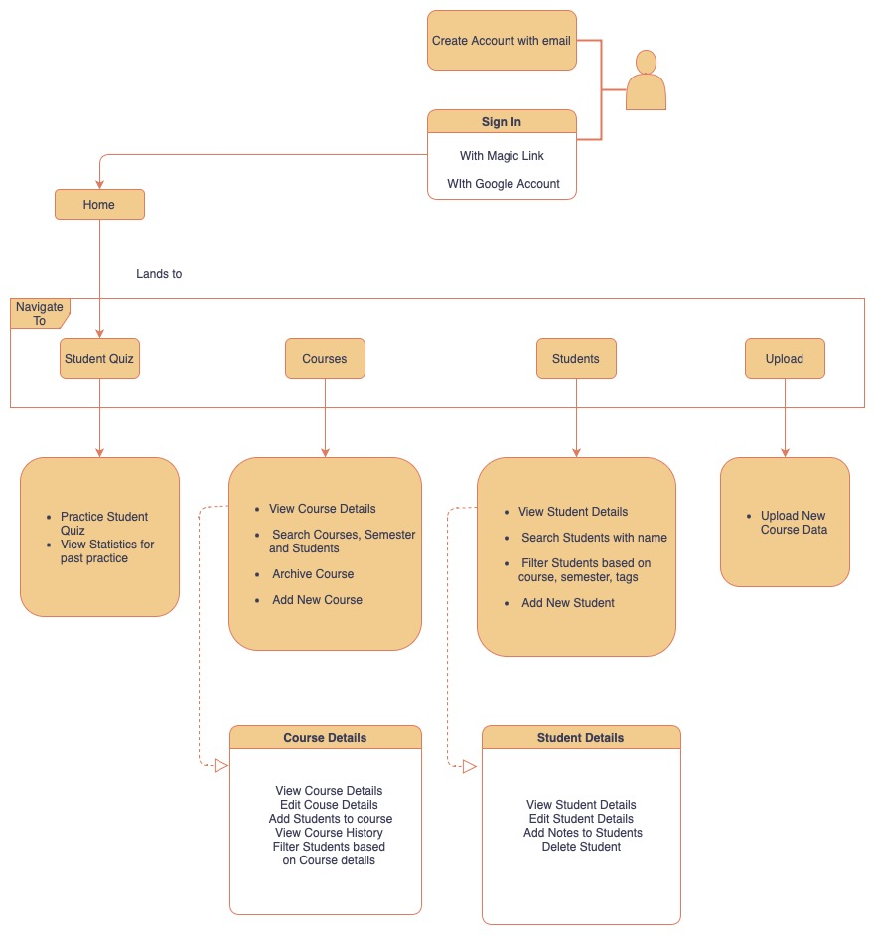
Application Flow

Slide 8
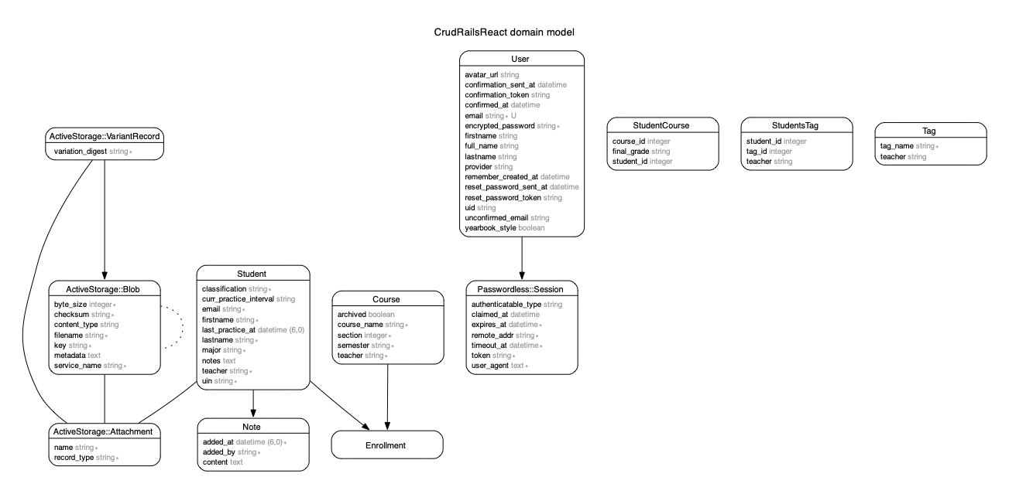
Design

Slide 9
Challenges faced and Learnings
Understanding the code and application workflow of the previous teams without relevant documentation
Oftentimes we had difficulty rolling back changes without affecting the rest of the code so we would recommend creating new branches and having protections for both the dev and master branches.
Github Actions posed some challenges during initial setup but that was mostly because of the environment variables being configured incorrectly so ensure your environment variables and secrets are correct and up to date.

Slide 10
Challenges faced and Learnings
Testing is very important!
Version control can save lives; There were times where we ran into big problems where without version control our project would have been collapsed completely.
Proper sprint and agile planning can speed up the development
Model View Controller architecture applications should be designed correctly from beginning else they can cause issues later when app expands

Slide 11
Thank You!

