Slide 1
Screenshots ASSET Outline https://balsamiq.cloud/sm2gs3f/p80z315
Anant Chandra

Slide 2
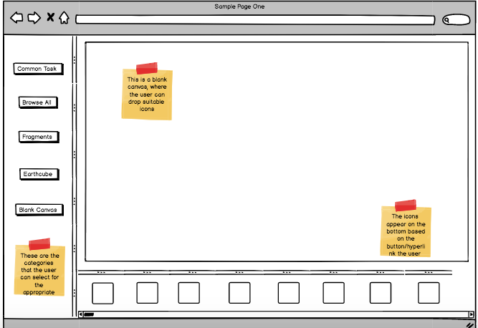

Slide 3
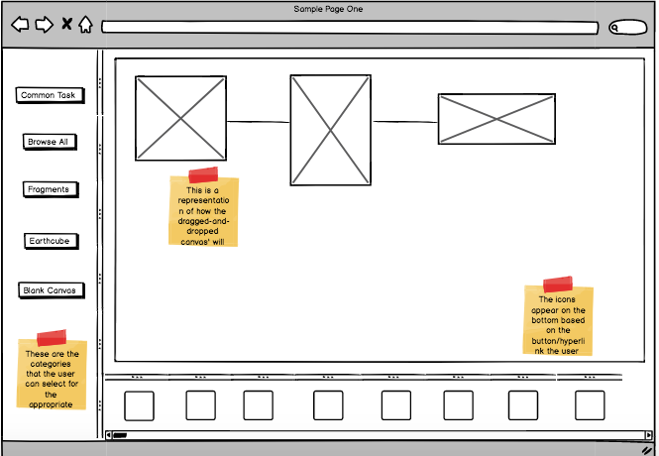

Slide 4
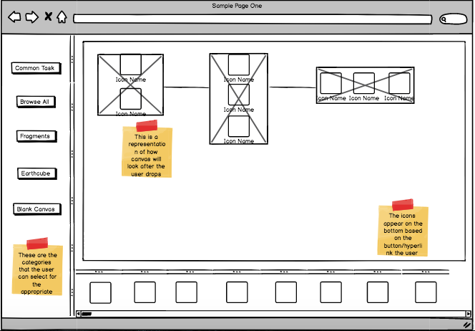

Slide 5
