Slide 1
AI Methods for
Clinical Trials Comparison

Slide 2
Work Accomplished:
Analysis of Wolff’s paper
STAGE 1: COMPARE DESIGN
STAGE 2: REFLECT ON ACCIDENTAL SIMILARITIES
STAGE 3: COMPARE OUTCOMES
STAGE 4: REFLECT ON OUTCOMES
STAGE 5: REFLECT ON SIDE EFFECTS
STAGE 6: FIND OTHER RELEVANT CLINICAL TRIALS AND STUDIES
STAGE 7: REFLECT ON POTENTIAL PATIENT SUBGROUPS WITH YET UNPROVEN EFFECTS
STAGE 8: REFLECT ON BIOLOGICAL PATHWAYS

Slide 3
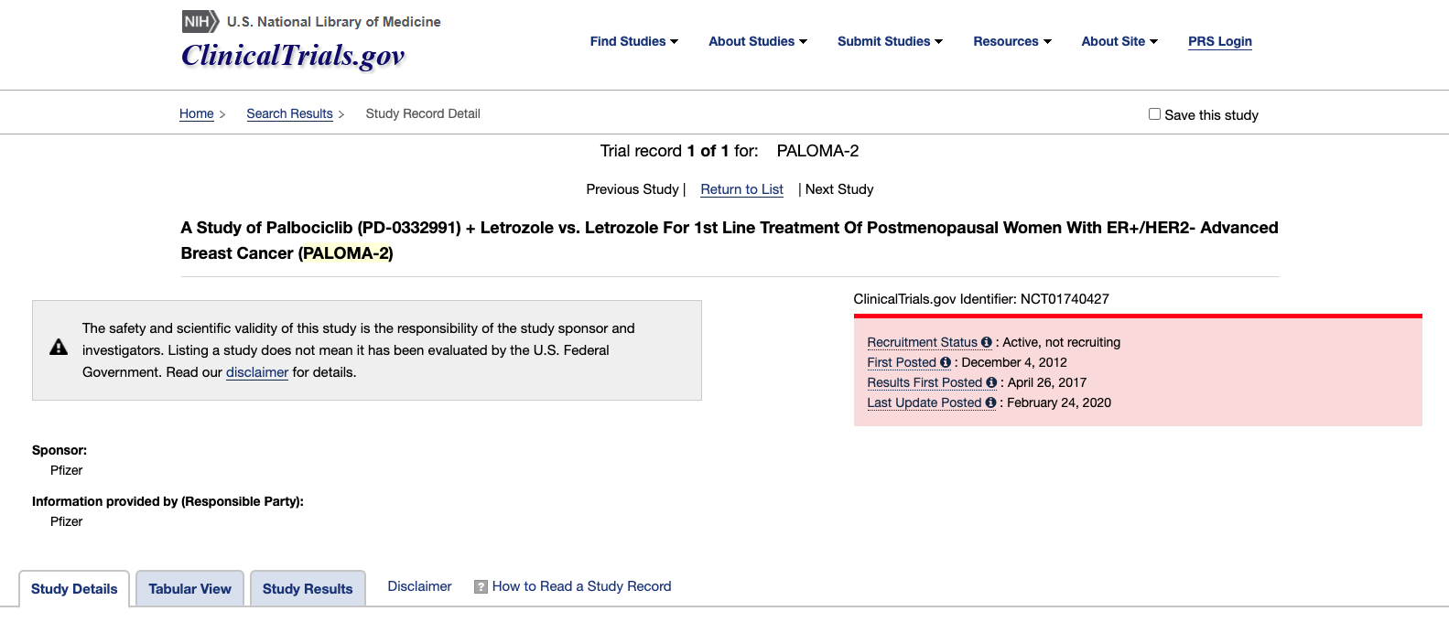
Work Accomplished:
Data retrieval

Slide 4
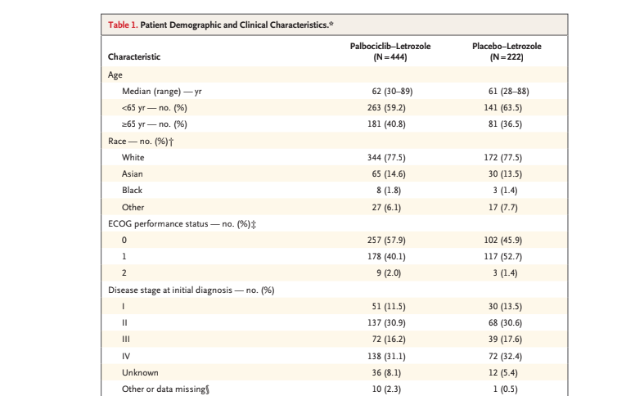
Work Accomplished:
Data retrieval

Slide 5
Work Accomplished:
Manually Comparison of CT
 | PALOMA-2 | MONALEESA-2 | WOLFF COMPARISON
Inclusion Criteria | Postmenopausal women
 | Adult women with locoregionally recurrent or metastatic disease not amenable to curative therapy
Additional Statistics | 77.5% of the patients are white | 80.5% of the patients are white | “Approximately 80% of the patients were white”
 | “37.2% had newly diagnosed advanced breast cancer” | “A total of 227 patients (34.0%) had newly diagnosed advanced or metastatic disease” | “A third had advanced disease”
Treatment Plan | TREATMENT GROUP: Participants received letrozole 2.5 milligram (mg) orally QD (once daily) combined with ... | TREATMENT GROUP: LEE011 (ribociclib) oral (3 weeks on/ 1 week off) in combination with oral once daily letrozole. 600mg LEE011 QD + 2.5 mg letrozole QD

Slide 6
Work Accomplished:
Quantitative Comparison: 1/2
 | PALOMA-2 | MONALEESA-2 | Comparison Score: min/max | Weight | score
Other observations(criteria that Wolff mentioned)-calculations of each criteria
percentage of white(avg) | 77.50% | 0.8215 | 94% | 0.008 | 0.007547169811
visceral disease | 0.4863333333 | 0.5885 | 0.826394789 | 0.008 | 0.006611158312
had received prior adjuvant chemotherapy | 0.4836666667 | 0.4355 | 0.9004135079 | 0.008 | 0.007203308063
had advanced disease | 0.372 | 0.34 | 0.9139784946 | 0.008 | 0.007311827957

Slide 7
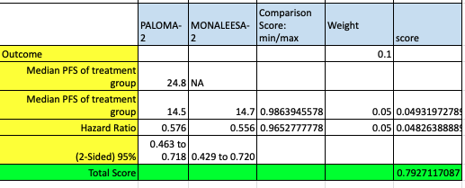
Work Accomplished:
Quantitative Comparison: 2/2

Slide 8
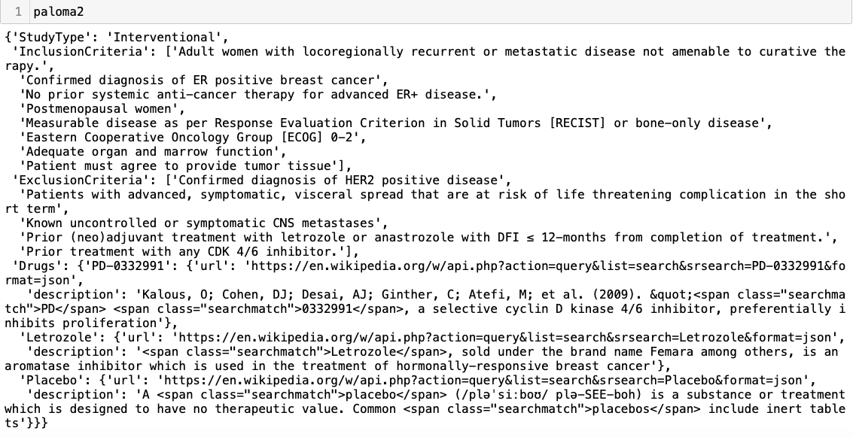
Work Accomplished:
Data Retrival 2.0: Inclusion, Exclusion, Drugs

Slide 9
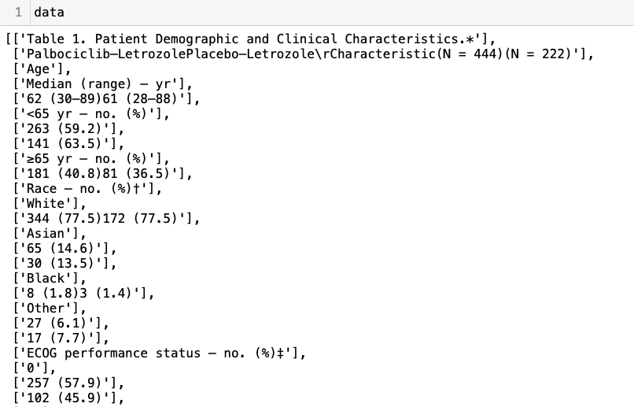
Work Accomplished:
Data Retrival 2.0: patient statistics

Slide 10
Work Accomplished:
Similarity Match: Inclusion Criteria
Paloma2 | Monaleesa2 | Similarity
Adult women with locoregionally recurrent or metastatic disease not amenable to curative therapy | Women with advanced (locoregionally recurrent or metastatic) breast cancer not amenable to curative therapy. | 0.6875
Confirmed diagnosis of ER positive breast cancer | Patient has a histologically and/or cytologically confirmed diagnosis of estrogen-receptor positive and/or progesterone receptor positive breast cancer by local laboratory. | 0.2857142857
No prior systemic anti-cancer therapy for advanced ER+ disease. | No prior systemic anti-cancer therapy for advanced disease. | 0.8888888889
Continued on next page:

Slide 11
Work Accomplished:
Similarity Match: Inclusion Criteria
Continued:
Paloma2 | Monaleesa2 | Similarity
Measurable disease as per Response Evaluation Criterion in Solid Tumors [RECIST] or bone-only disease | Measurable disease, i.e., at least one measurable lesion as per RECIST 1.1 criteria (Tumor lesions previously irradiated or subjected to other locoregional therapy will only be considered measurable if disease progression at the treated site after completion of therapy is clearly documented). | 0.14
Eastern Cooperative Oncology Group [ECOG] 0-2 | Patient has an Eastern Cooperative Oncology Group (ECOG) performance status 0 or 1 | 0.357143
Patient must agree to provide tumor tissue | Patient must have either | 0.22222

Slide 12
Work Accomplished:
Similarity Match: Exclusion Criteria
Paloma2 | Monaleesa2 | Similarity
Patients with advanced, symptomatic, visceral spread that are at risk of life threatening complication in the short term | Patients who received ≤ 14 days of letrozole or anastrozole for advanced disease prior to randomization are eligible. | 0.125
Known uncontrolled or symptomatic CNS metastases | That are known strong inducers or inhibitors of CYP3A4. | 0.1538461538
Prior (neo)adjuvant treatment with letrozole or anastrozole with DFI ≤ 12-months from completion of treatment. | Patients who received ≤ 14 days of letrozole or anastrozole for advanced disease prior to randomization are eligible. | 0.2222222222
Prior treatment with any CDK 4/6 inhibitor. | Patient who received any CDK4/6 inhibitor. | 0.1818181818

Slide 13
Work Accomplished:
Similarity Match: Drugs
Paloma2 | Monaleesa2 | Similarity
Letrozole | Letrozole | 1
Placebo | Placebo | 1
PD-0332991: a selective cyclin D kinase 4/6 inhibitor, preferentially inhibits proliferation
LEE011: CDK Inhibitor Showing Early Promise in Drug-Resistant Cancers

Slide 14
Future Work
Initial example, manually convert the 2 clinical trials criteria into KG
Improve Similarity Matching Methods on: Inclusion, Exclusion criteria, and drugs
Similarity Matching on Additional Statistics, Treatment Plan and Outcome (data from papers)
Assign weights on each criteria to get final similarity between 2 clinical trials
Given a clinical trial, how to convert it fully and automatically into KG
Compare with other clinical trials in the KG

