Slide 1
Feedback System – A Polymer Project
By
Sanjana Srinivasa
Shreyas Kolpe
April 4, 2018

Slide 2
Architecture
There is a single web component defined, called <feedback-app>. This component encapsulates everything in the page.
The definition consists of two parts – defining the structure and defining some programmability, within <dom-module>.
The structure is defined in <template> tag. Script code for interactions is placed in the <script> tag.
<dom-module id="my-app">
<template>
</template>
<script>
</script>
</dom-module>

Slide 3
Styling, which is part of the structure, is included in the <template> tag. Custom styles can also be applied using <custom-style> tag.
<template>
<custom-style>
<style is="custom-style">
/* CSS style rules go here */
</style>
</custom-style>
<!-- The structure of the document is created by putting in tags -->
<web-component-one on-click="eventHandler">
"Content"
</web-component-one>
<web-component-two attribute="value"></web-component-two>
</template>

Slide 4
Within <script>, we define an ES6 class to associate with the web component.
The class FeedbackApp is defined, and registered to be associated with the string “feedback-app”.
So, whenever the component <feedback-app> is imported and used, an instance of FeedbackApp class is created in the browser.
<script>
class MyApp extends Polymer.Element {
static get is() { return 'my-app'; }
static get properties(){
/* Return properties as an object*/
}
/*Event handlers go here*/
eventHandler(e){
/*Code to handle events*/
}
}
/*Most crucially, registration
*/
window.customElements.define(MyApp.is, MyApp);
</script>

Slide 5
This implicitly enforces Model View Controller (MVC) architecture.
The structure forms the view and the scripts constitute the controlling logic.
The data model is made up of the attributes of web components/tags in the structure as well as the properties of the associated class.

Slide 6
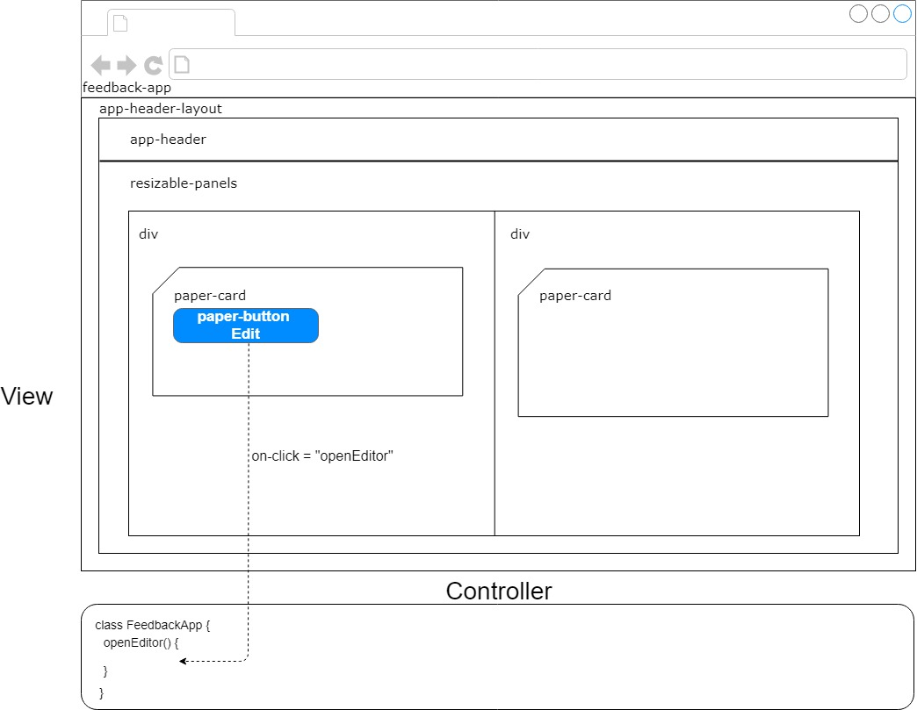

Slide 7
Coming to <feedback-app>, the layout of the page contains a header and two resizable panels side by side.
The layout is made by wrapping the header content in <app-header> and wrapping the <app-header> and the <resizable-panels> components in <app-header-layout>.
Within <resizable-panels>, the panels are actually <div> containers, the left one is for holding the narrative views and the right one is for holding the narrative editor.

Slide 8
Within both of the panels, a suitable web-component called <paper-card> is used to hold the narrative views and the editor.
For the views, a <paper-card> contains a heading wrapped in <paper-toolbar>, tooltip display via <paper-tooltip>, followed by the actual body of the card.
This body is encapsulated in a div, which is further wrapped in a Polymer behavior component called <iron-collapse>, which is to be able to expand/hide the narrative view.
The buttons at the top are made with <paper-button> component.

Slide 9
To deliver some of the functionalities, the appropriate event handlers are registered for Polymer events on the target elements.
All event handlers are properties of FeedbackApp class, defined in <script> tag.
The functionalities so far are -
Collapsible <paper-card> for holding the views - tap on blue toolbar to expand or collapse.
<paper-card> that holds narrative view has 'See More' and 'See Less' functionality.
Clicking on 'Edit' button opens up the narrative editor with the content loaded. Clicking on 'Close' in the narrative editor will collapse the editor and clear it of the loaded content.
Above all, the narrative data holds the data loaded from the JSON file data_narratives.json.

Slide 10
Limitations and Improvements,
Working with only one view. Need to generate a list of views and apply <paper-card> template to them using <dom-repeat>.
Styling issues. Fix panel width.
Narrative editor can be associated with ‘state’ variables. These variables capture which narrative view is being edited and which phase of the editing process (eg. ‘Edit Links’/’Edit Text’)
Add functionality to ‘Edit Links’ to highlight links, change link label and save it. Similar with ‘Edit Text’. In both cases, build the JSON object that stores metadata.

Slide 11
Extensibility –
Documentation can be studied to change <feedback-app> to suit needs.
Also, can be extended with the meaning of inheritance.

