Slide 1
Wikidata API & Command-Line Tools
Daniel Garijo, Pedro Szekely
Information Sciences Institute and Department of Computer Science
@dgarijov, @szeke {dgarijo, pszekely}@isi.edu

Slide 2
Tools
Wikibase API
https://www.mediawiki.org/wiki/Wikibase/API
querying, adding, removing and editing information on any Wikibase instance
Wikibase command line interface
https://github.com/maxlath/wikibase-cli
the Command-line interface interface to Wikibase instances
Wikidata taxonomy
https://github.com/nichtich/wikidata-taxonomy
https://wdtaxonomy.readthedocs.io
command-line tool and library to extract taxonomies from Wikidata
Wikidata client library for Python
https://github.com/dahlia/wikidata
easy APIs to use Wikidata for Python
Wikidata Integrator
https://github.com/SuLab/WikidataIntegrator
Python module integrating the MediaWiki API and the Wikidata SPARQL endpoint
Wikidata extraction tools (old)
https://github.com/jimbelton/wikidata
extract items from a JSON dump of wikidata.org

Slide 3
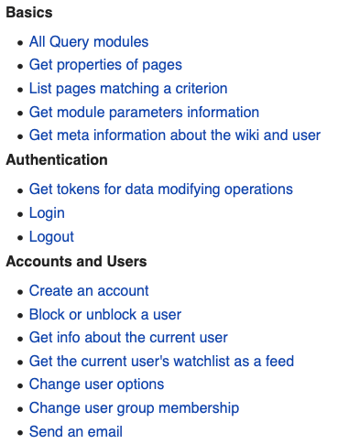
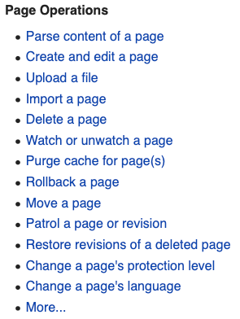
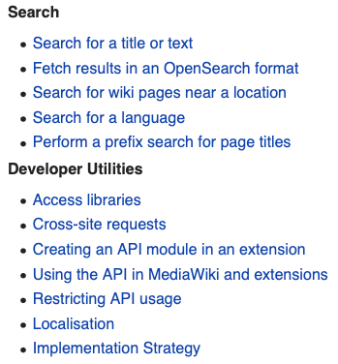
Wikibase API https://www.mediawiki.org/wiki/Wikibase/API https://developer.ibm.com/articles/use-wikidata-in-ai-and-cognitive-applications-pt1/
The official and most comprehensive API

Slide 4
Wikibase Command Line Interface

Slide 5
Wikibase Command Line Interface https://github.com/maxlath/wikibase-cli
Installation:
npm install -g wikibase-cli
Search for entities
$ wd search feinstein
Q21452207 Feinstein family name
Q7733638 The Feinstein Institute for Medical Research
Q3703178 David Feinstein
Q48705413 Feinstein and study design. scientific article published in December 2002
Q18354968 Feinstein AK Mag
Q49302322 Feinstein Lake lake of the United States of America
Q16250366 Feinstein International Center
Q43259048 Showcase Providence Place IMAX Theatre movie theater in Providence, Rhode Island, United States
Q230733 Dianne Feinstein United States Senator from California
Q2713108 10988 Feinstein asteroid

Slide 6
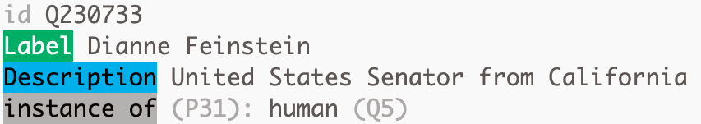
Get Summary, Label and Aliases
$ wd summary Q230733
$ wd label Q230733 -l ru
Файнстайн, Дайэнн
$ wd aliases Q230733
Dianne Goldman Berman Feinstein | Dianne Emiel Goldman

Slide 7
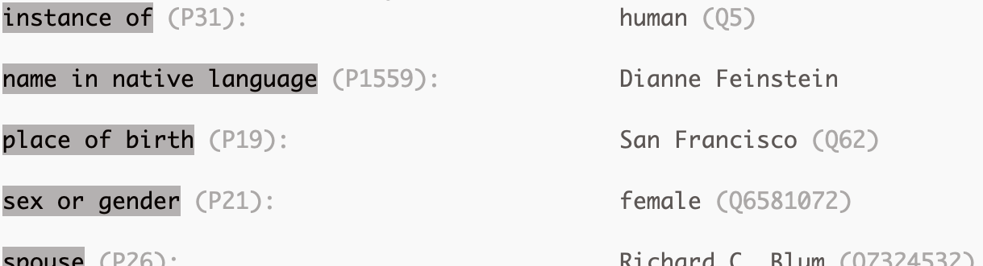

Get Claims
$ wd claims Q230733
$ wd claims Q230733 birth

Slide 8
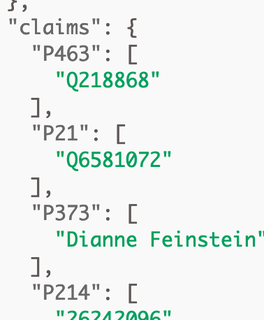
Get Raw Data
$ wd data Q230733 Q7324532
# A quick way to access an entity's raw JSON data
wd data Q230733| jq . | less
# format JSON with jq
wd data --format ttl Q230733
# get the data in RDF turtle
wd data --simplify Q230733 | jq .

Slide 9
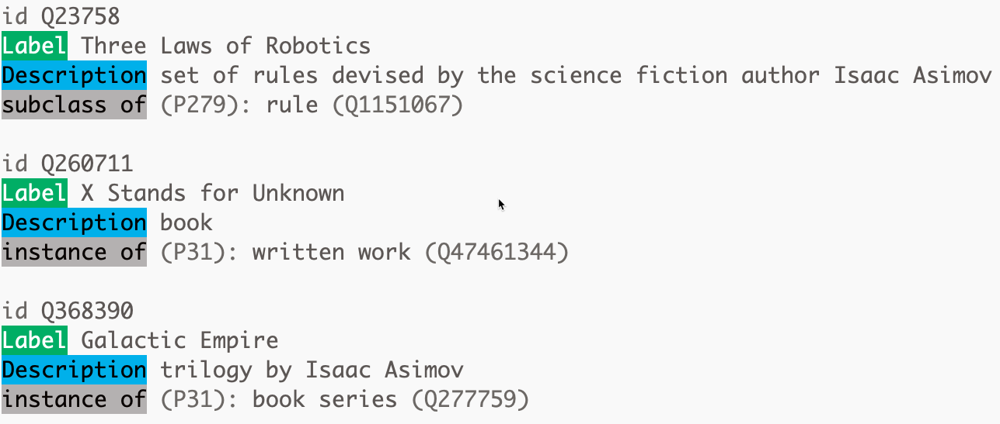
Simple Queries
author
Isaac Asimoc
$ wd query --property P50 --object Q34981
# works that Asimov authored
Q23758 Q260711 Q368390 Q372968 Q375422 …
$ wd summary Q23758 Q260711 Q368390 Q372968

Slide 10
Wikidata Taxonomy

Slide 11
Wikidata Taxonomy https://github.com/nichtich/wikidata-taxonomy https://wdtaxonomy.readthedocs.io
Installation:
npm install -g wikidata-taxonomy

Slide 12
Wikidata Taxonomy
Print taxonomies defined using any property
$ wdtaxonomy Q634
# subclasses of planet (Q634)
$ wdtaxonomy Q458 -P P463
# Members of (P463) the European Union (Q458)
Print taxonomies in reverse order
$ wdtaxonomy Q634 -r
# super-classes of planet (Q634)
wdtaxonomy Q458 -P P463 –r
# Orgs that the European Union (Q458) is a member of (P463)

Slide 13
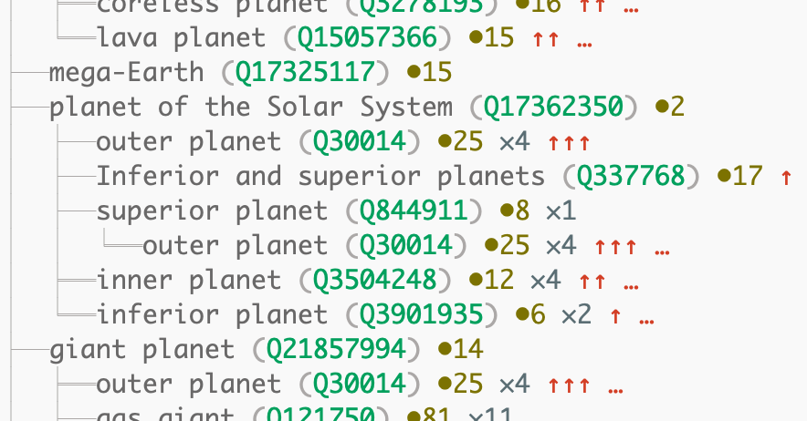
Output Format
# connected Wikimedia sites
# instances
additional superclasses

