Slide 1

Tutorial: Linking, Extending, Exploiting and Enhancing Tabular Data with Wikidata Part 2: Getting data from Wikidata
Daniel Garijo, Pedro Szekely
Information Sciences Institute and Department of Computer Science
@dgarijov, @szeke {dgarijo, pszekely}@isi.edu

Slide 2
Wikidata SPARQL Endpoint

Slide 3
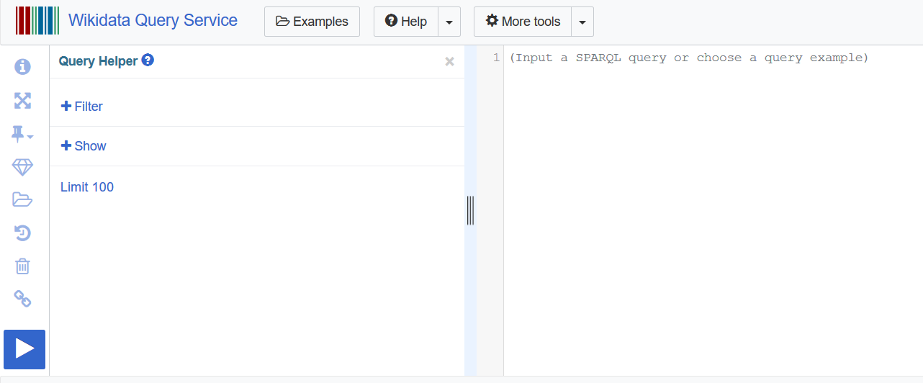
Wikidata SPARQL endpoint
https://query.wikidata.org
Show help
Full screen
Show prefixes
Features:
Fast
No named graphs/reasoning
One client is allowed 60 seconds of processing time each 60 seconds.
One client is allowed 30 error queries per minute
Format query
Examples
Undo
Clear
Link to this query
Having trouble with a query? Request it: https://www.wikidata.org/wiki/Wikidata:Request_a_query

Slide 4
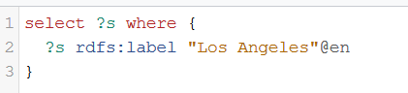

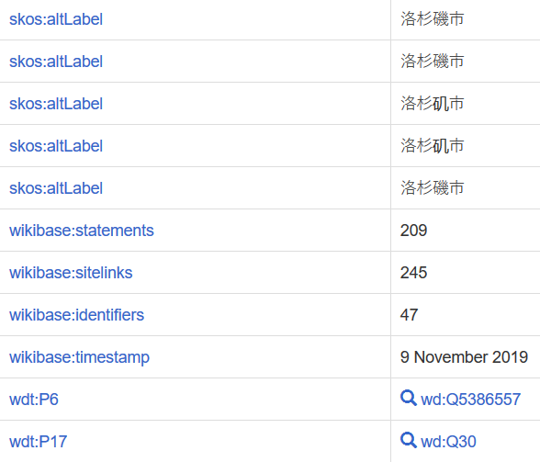
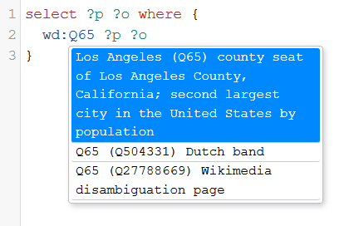
SPARQL Endpoint Helpers: Auto completion
Available in JSON, Turtle, JSON-LD...
More information: https://www.wikidata.org/wiki/Wikidata:SPARQL_query_service/A_gentle_introduction_to_the_Wikidata_Query_Service

Slide 5
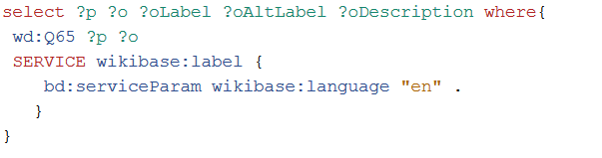
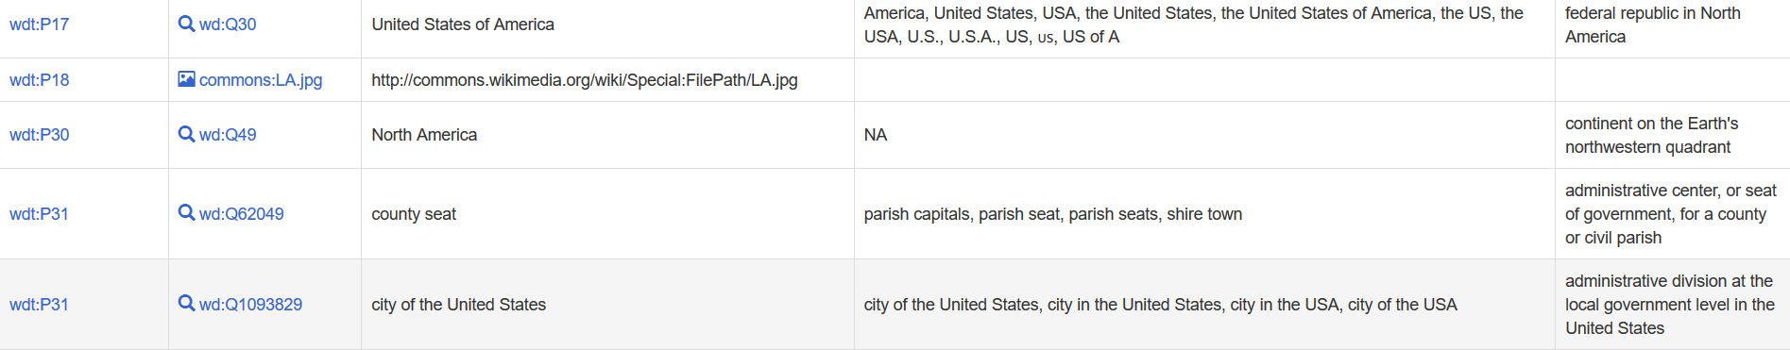
SPARQL Endpoint Query Service
SERVICE wikibase:label { bd:serviceParam wikibase:language "en" . }
Functionality designed to facilitate recovering basic resource metadata

Slide 6
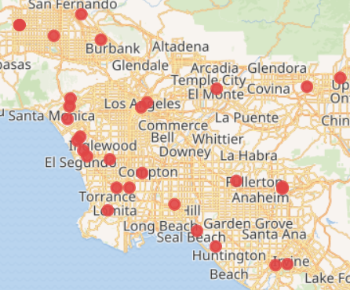
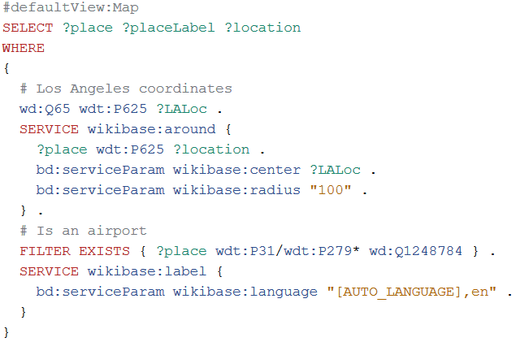
SPARQL Endpoint query service (advanced)
Geospatial search (may be slow)
Could also be “box” (and pass the bounding box)
More info: https://www.mediawiki.org/wiki/Wikidata_Query_Service/User_Manual

Slide 7
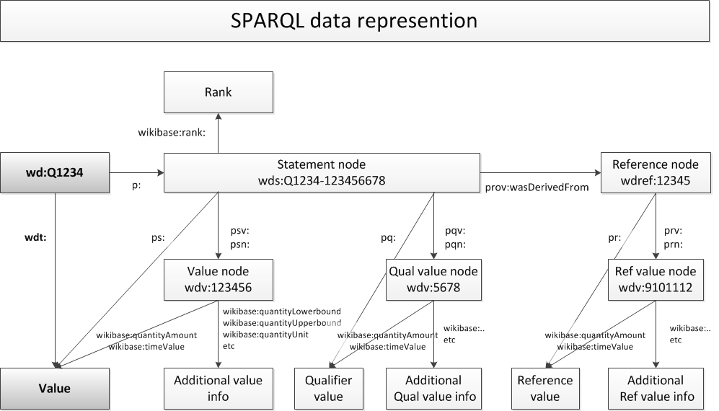
SPARQL endpoint cheat sheet

Slide 8
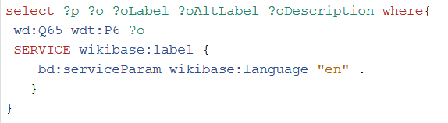
Example: Simple fact from Los Angeles
Who is the governor?
Link to query: https://w.wiki/CFf

Slide 9
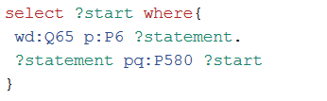

Example: Simple fact from Los Angeles: Qualifiers
How long has the governor been in office?
Link to query: https://w.wiki/CFh

Slide 10
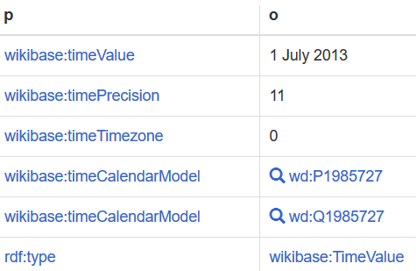
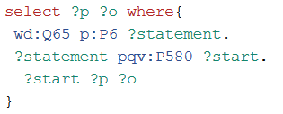
Example: Simple fact from Los Angeles: Additional Qualifier information
If we want to know more about how the qualifier value has been represented (e.g., calendar, etc.)
Link to query: https://w.wiki/CFj

Slide 11


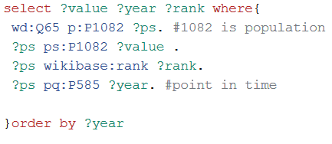
Advanced: Truthy triples
Let’s retrieve the population of LA:
This returns a single result, which corresponds to the “truthy” statement (first rank). In Wikidata, the truthy statement for population is set to the latest available year:
Link to query: https://w.wiki/CFj, https://w.wiki/CFn

Slide 12
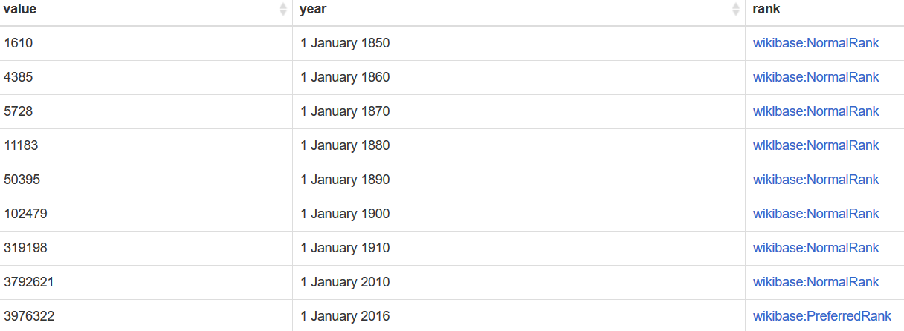
Advanced: Truthy triples - Results

Slide 13
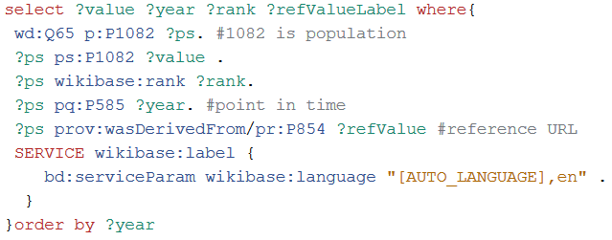
Advanced: References
Population in LA: What is the source (reference URL) for the triples?
Link to query: https://w.wiki/CFo

Slide 14
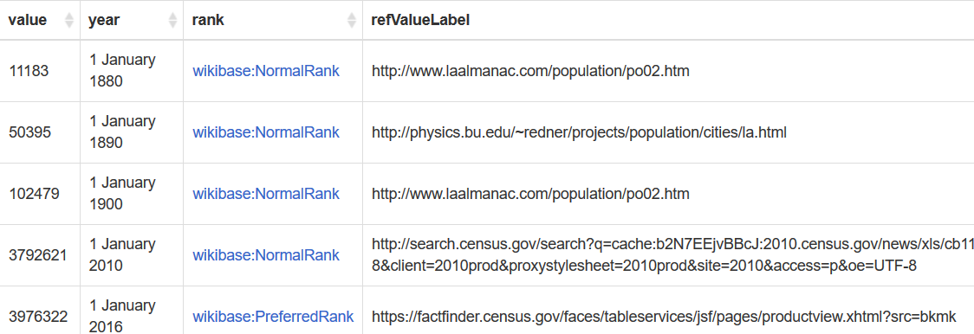
Advanced: References - Results
Link to query: https://w.wiki/CFo

Slide 15
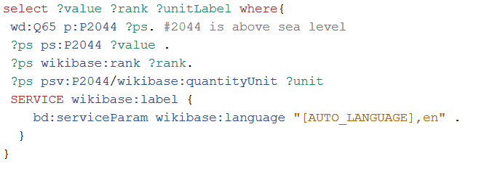
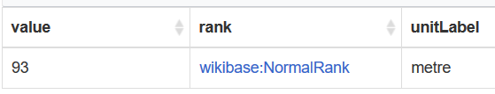
Advanced: Units
Elevation above sea level in LA? (with units in which it’s measured)
Link to query: https://w.wiki/CFs

Slide 16
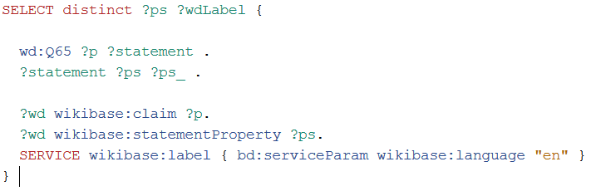
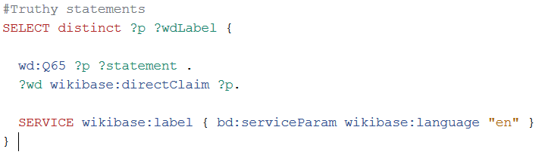
Advanced+: Properties
What if next I need to know the properties used to describe LA? (Q65)

Slide 17
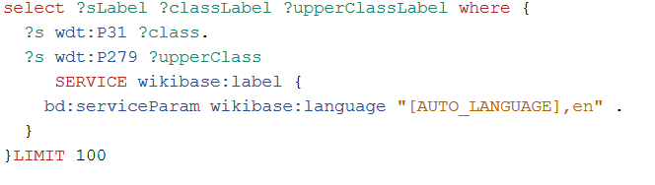
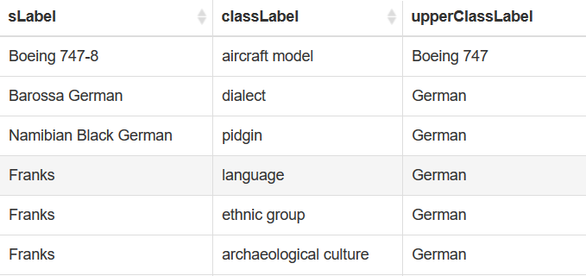
Advanced+: Querying for Classes
An entity can be a class and an instance in Wikidata:
Link to query: https://w.wiki/CFv

Slide 18
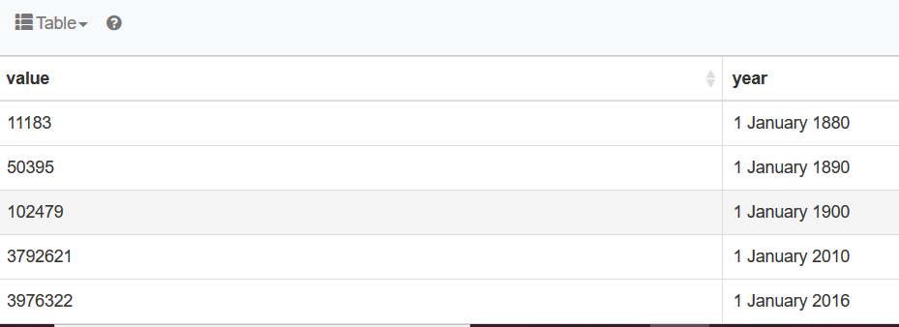
Using SPARQL to plot results
Plotting population by year:

Slide 19
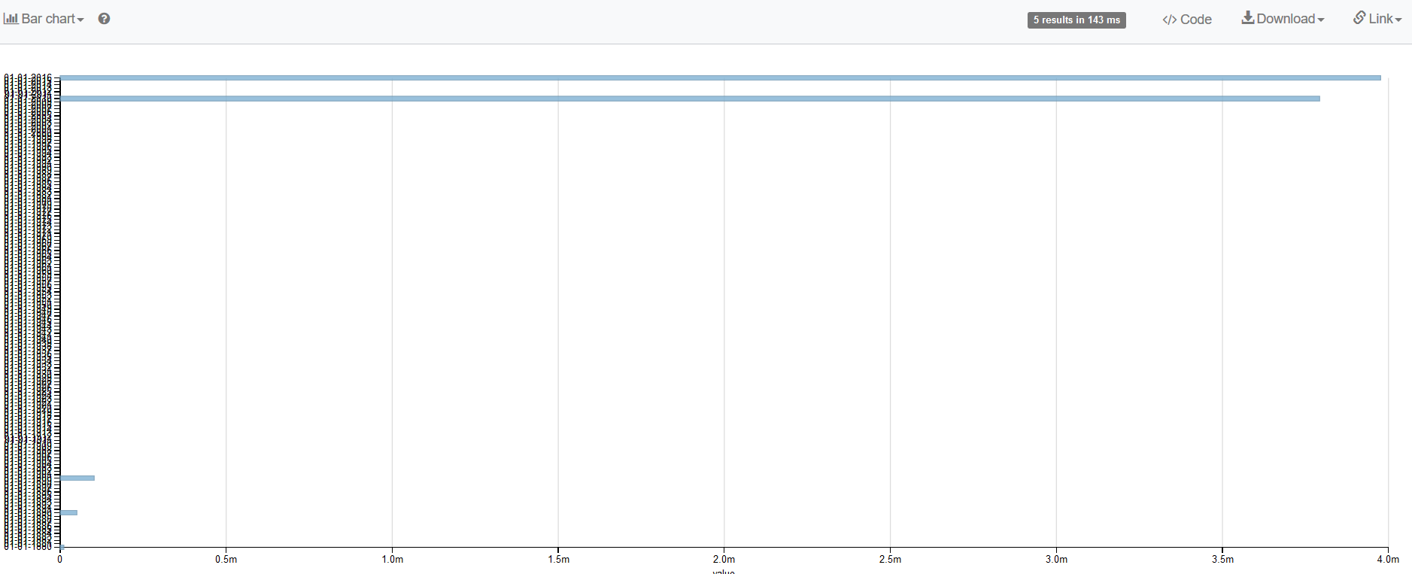
Using SPARQL to plot results

Slide 20
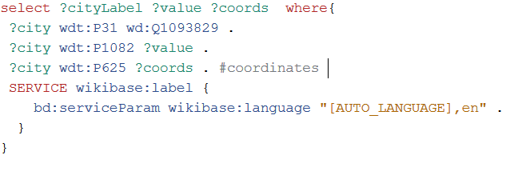
Using SPARQL to plot results – geospatial queries
If we want to know the latest known population for all cities in the US:
Link to query: https://w.wiki/CFy

Slide 21
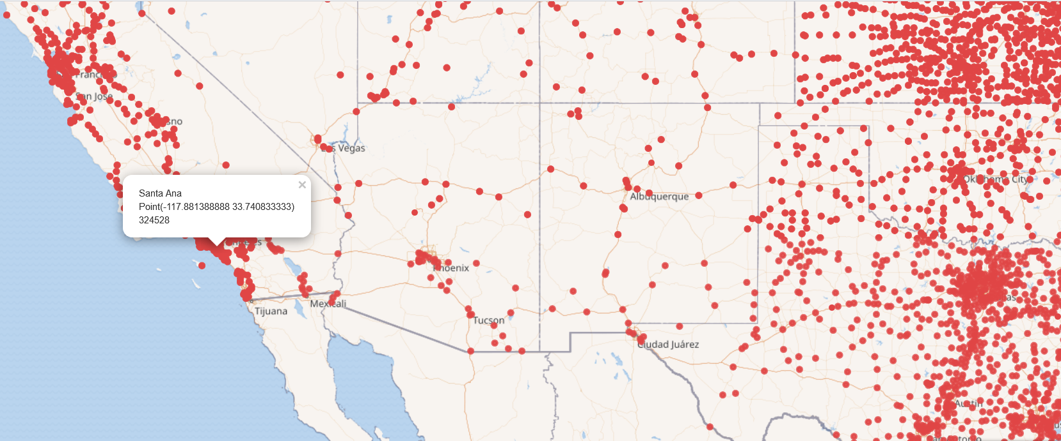
Using SPARQL to plot results – geospatial queries
Link to query: https://w.wiki/CFy

