Slide 1

Entity Linking to Knowledge Graphs
Avijit Thawani, Minda Hu, Erdong Hu, Husain Zafar, Naren Teja Divvala, Amandeep Singh, Ehsan Qasemi, Pedro Szekely, and Jay Pujara
Notes:
Add pics and TAbularISI here

Slide 2
The challenge
Column Header = ?
...
Madonna
...

Slide 3
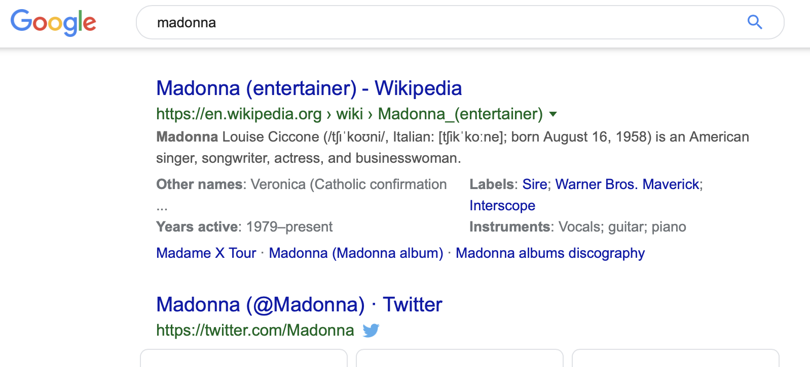

Slide 4
The challenge
Column Header = Singer
...
dbpedia.org/page/Madonna_entertainer
...

Slide 5
The challenge
Column Header = ?
St Fernandez
Madonna
Pope John

Slide 6
The challenge
Column Header = Saints
dbpedia.org/page/St._Fernandez
dbpedia.org/page/Saint_Madonna
dbpedia.org/page/Pope_John

Slide 7
The insight
Generate candidates
Annotate easy cells
Figure out what’s common
Apply on hard cells
Notes:
Easy = disambiguous

Slide 8
Labels | Candidates
John | dbr:Pope_John dbo:Person dbo:Saint dbp:Religion
Saint Francis | dbr:St_Francis dbo:Person dbo:Saint dbp:Religion | dbr:Pope_Francis dbo:Person dbo:Saint dbp:Religion
Madonna | dbr:Madonna dbo:Person dbo:Singer dbp:Albums | dbr:Saint_Madonna dbo:Person dbo:Saint dbp:Religion
Adalgott | dbr:St_Adalgott dbo:Person dbo:Saint dbp:Religion
St Mary | dbr:Mary dbo:Person dbo:Saint dbp:Religion

Slide 9
The insight
Generate candidates
Annotate easy cells
Figure out what’s common
Apply on hard cells
Notes:
Easy = disambiguous

Slide 10
Labels | Candidates
John | dbr:Pope_John dbo:Person dbo:Saint dbp:Religion
Saint Francis | dbr:St_Francis dbo:Person dbo:Saint dbp:Religion | dbr:Pope_Francis dbo:Person dbo:Saint dbp:Religion
Madonna | dbr:Madonna dbo:Person dbo:Singer dbp:Albums | dbr:Saint_Madonna dbo:Person dbo:Saint dbp:Religion
Adalgott | dbr:St_Adalgott dbo:Person dbo:Saint dbp:Religion
St Mary | dbr:Mary dbo:Person dbo:Saint dbp:Religion

Slide 11
Labels | Candidates
John | dbr:Pope_John dbo:Person dbo:Saint dbp:Religion
Saint Francis | dbr:St_Francis dbo:Person dbo:Saint dbp:Religion | dbr:Pope_Francis dbo:Person dbo:Saint dbp:Religion
Madonna | dbr:Madonna dbo:Person dbo:Singer dbp:Albums | dbr:Saint_Madonna dbo:Person dbo:Saint dbp:Religion
Adalgott | dbr:St_Adalgott dbo:Person dbo:Saint dbp:Religion
St Mary | dbr:Mary dbo:Person dbo:Saint dbp:Religion
EASY!
EASY!
EASY!
Notes:
Note that’s not how we calculate

Slide 12
Labels | Candidates
John | dbr:Pope_John dbo:Person dbo:Saint dbp:Religion
Saint Francis | dbr:St_Francis dbo:Person dbo:Saint dbp:Religion | dbr:Pope_Francis dbo:Person dbo:Saint dbp:Religion
Madonna | dbr:Madonna dbo:Person dbo:Singer dbp:Albums | dbr:Saint_Madonna dbo:Person dbo:Saint dbp:Religion
Adalgott | dbr:St_Adalgott dbo:Person dbo:Saint dbp:Religion
St Mary | dbr:Mary dbo:Person dbo:Saint dbp:Religion
EASY!
*Easy can be redefined.
EASY!
EASY!
Notes:
Note that’s not how we calculate

Slide 13
Labels | Candidates
John | dbr:Pope_John dbo:Person dbo:Saint dbp:Religion
Saint Francis | dbr:St_Francis dbo:Person dbo:Saint dbp:Religion | dbr:Pope_Francis dbo:Person dbo:Saint dbp:Religion
Madonna | dbr:Madonna dbo:Person dbo:Singer dbp:Albums | dbr:Saint_Madonna dbo:Person dbo:Saint dbp:Religion
Adalgott | dbr:St_Adalgott dbo:Person dbo:Saint dbp:Religion
St Mary | dbr:Mary dbo:Person dbo:Saint dbp:Religion
Semantic Feature | dbo: Person | dbo: Saint | dbo: Singer | dbp: Religion | dbp: Albums
dbr: madonna | 1 | 0 | 1 | 0 | 1
dbr: saint_ madonna | 1 | 1 | 0 | 1 | 0

Slide 14
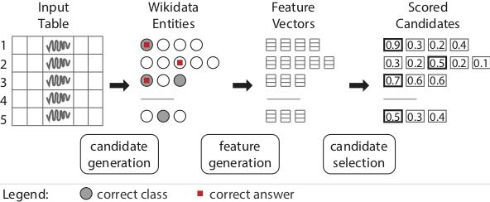
The approach
Notes:
Be clear!

Slide 15
The insight
Generate candidates
Annotate easy cells
Figure out what’s common
Apply on hard cells
Notes:
Easy = disambiguous

Slide 16
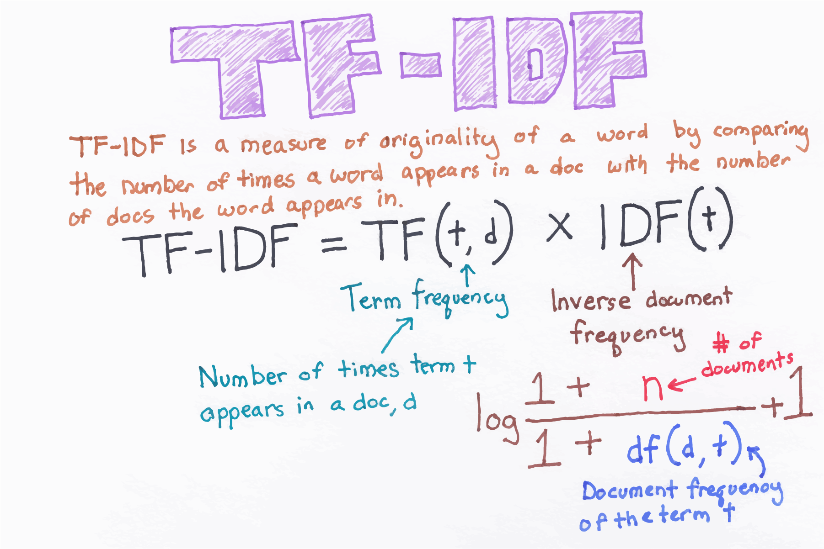
Image Source: becominghuman.ai blog

Slide 17
Saliency
Each class is a feature: (Saint, Person, Singer, …)
Saint Madonna: (1, 1, 0, …) Madonna - the singer: (0, 1, 1, …)
TF (term frequency) (3, 3, 1, …) IDF (inverse document frequency) (0.48, 0.25, 0.95, …)
Saliency of feature = TF x IDF (1.5, 0.75, 0.95, …)

Slide 18
Labels | Candidates
John | dbr:Pope_John dbo:Person dbo:Saint dbp:Religion
Saint Francis | dbr:St_Francis dbo:Person dbo:Saint dbp:Religion | dbr:Pope_Francis dbo:Person dbo:Saint dbp:Religion
Madonna | dbr:Madonna dbo:Person dbo:Singer dbp:Albums | dbr:Saint_Madonna dbo:Person dbo:Saint dbp:Religion
Adalgott | dbr:St_Adalgott dbo:Person dbo:Saint dbp:Religion
St Mary | dbr:Mary dbo:Person dbo:Saint dbp:Religion
Semantic Feature | dbo: Person | dbo: Saint | dbo: Singer | dbp: Religion | dbp: Albums
dbr: madonna | 1 | 0 | 1 | 0 | 1
dbr: saint_ madonna | 1 | 1 | 0 | 1 | 0

Slide 19
Labels | Candidates
John | dbr:Pope_John dbo:Person dbo:Saint dbp:Religion
Saint Francis | dbr:St_Francis dbo:Person dbo:Saint dbp:Religion | dbr:Pope_Francis dbo:Person dbo:Saint dbp:Religion
Madonna | dbr:Madonna dbo:Person dbo:Singer dbp:Albums | dbr:Saint_Madonna dbo:Person dbo:Saint dbp:Religion
Adalgott | dbr:St_Adalgott dbo:Person dbo:Saint dbp:Religion
St Mary | dbr:Mary dbo:Person dbo:Saint dbp:Religion
Semantic Feature | dbo: Person | dbo: Saint | dbo: Singer | dbp: Religion | dbp: Albums
(TF) Term Frequency | 5 | 4 | 1 | 4 | 1
Document Frequency | 8 | 6 | 2 | 6 | 2
(IDF) Inverse Document Frequency | 0.05 | 0.18 | 0.65 | 0.18 | 0.65
(TFIDF) TF ⊗ IDF | 0.25 | 0.72 | 0.65 | 0.72 | 0.65 | Score TFIDF ∙ v_{i}^{T}
(v₁) dbr: madonna | 1 | 0 | 1 | 0 | 1 | 1.55
(v₂) dbr: saint_ madonna | 1 | 1 | 0 | 1 | 0 | 1.69

Slide 20
Entity Linking
Column Header = ?
St Fernandez
Madonna
Pope John
Column Header = ?
dbpedia.org/page/St._Fernandez
dbpedia.org/page/Saint_Madonna
dbpedia.org/page/Pope_John

Slide 21
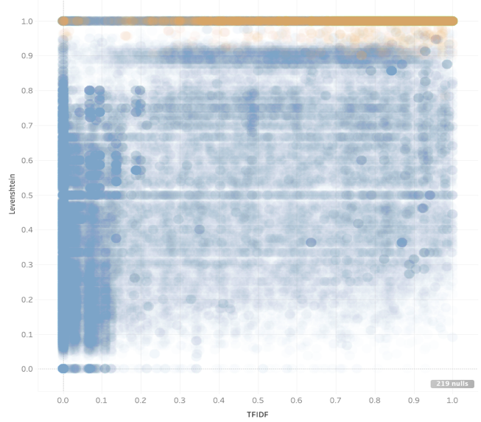
Analysis
Levenshtein Similarity
tf-idf
Notes:
Orange is high precision. A very hand built approach that got us 0.96 precision (but low recall) on Round 4 CEA.

Slide 22
Semantic Labelling
Column Header = ?
dbpedia.org/page/St._Fernandez
dbpedia.org/page/Madonna_entertainer
dbpedia.org/page/Pope_John
Column Header = Saints
dbpedia.org/page/St._Fernandez
dbpedia.org/page/Saint_Madonna
dbpedia.org/page/Pope_John

Slide 23
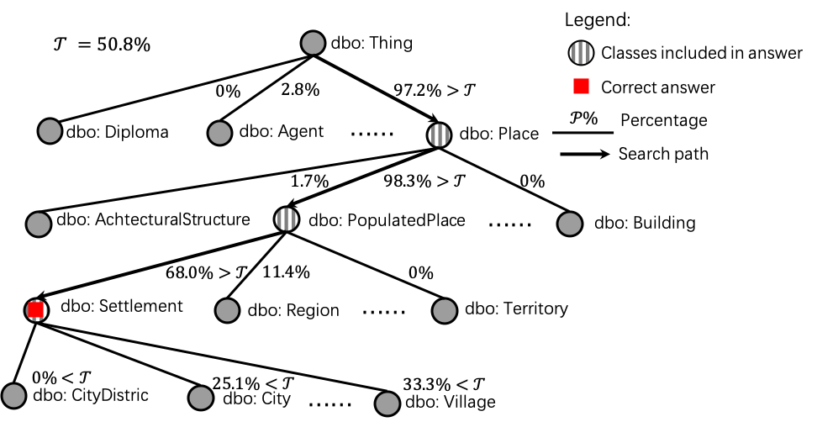
Notes:
Walk down the tree till we lack support (until a threshold).

Slide 24
Hands On
git clone https://github.com/usc-isi-i2/wikidata-wikifier
cd wikidata-wikifier/wikifier/sample_files
curl -X POST -F 'file=@clubs.csv' -F columns=clubs http://sitaware.isi.edu/wikify -o 'clubs_result.csv'
curl -X POST -F 'file=@countries.csv' -F columns=countries http://sitaware.isi.edu/wikify -o 'countries_result.csv'
curl -X POST -F 'file=@footballers.csv' -F columns=footballers http://sitaware.isi.edu/wikify -o 'footballers_result.csv'

