Slide 1
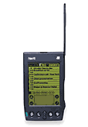
Teamcore
proxy
Friday
Agent

