Slide 1
TEAMCORE:
Rapid, Robust Teams From Heterogeneous, Distributed Agents
Milind Tambe & David V. Pynadath

Slide 2
Why Integrate Heterogeneous Distributed Agents?
No single agent can perform entire task
Pool agents together, not build from scratch
Difficulties:
  Agents not built to team with each other
  Agents heterogeneous & distributed
GOAL: Execution of desired task,
  with minimal developer specification effort

Slide 3
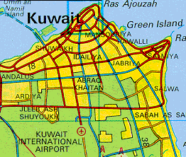
Example: Evacuation Task
Evacuate civilians from threatened location
  Human commander provides location, required helicopters, & other mission parameters
  Flight must avoid no-fly zones and missile launchers
  Robustness in the face of crashes, route changes

Slide 4
Example: Available Agents
Quickset (Cohen, OGI): C,Prolog; NT
Ariadne (Minton, USC/ISI): Lisp; Solaris
Route Planner (Sycara, CMU): C++; NT
Helo Pilots (Tambe, USC/ISI): Soar; Solaris
Agents have NO teamwork capabilities

Slide 5
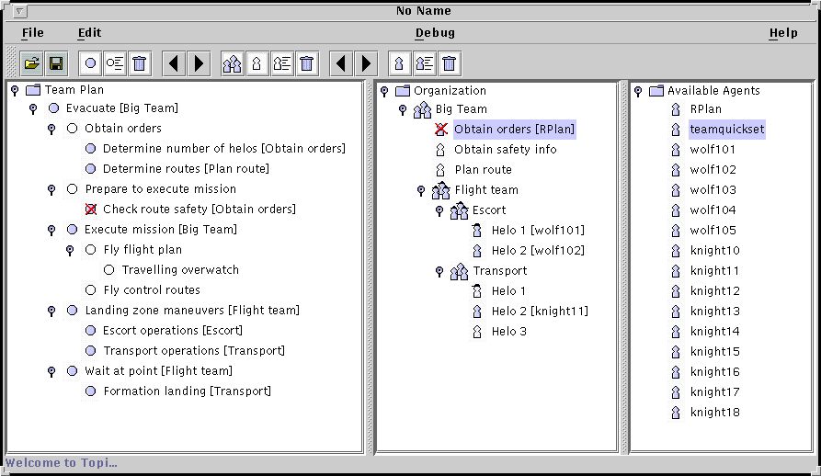


Domain
Agent
Registration
Directory
5
5
1
3
TEAMCORE
proxy
TEAMCORE
proxy
KARMA
4
TEAMCORE
broadcast net
4
2
3
1
TOPIs
TEAMCORE
proxy
TEAMCORE
proxy
Software
Developers
Middle
agents
5
5
Registration

Slide 6
TEAMCORE Proxy
Team Program
Teamwork model: STEAM
  Coherent execution of team plans
  Reorganization on failure
  Selective communication
STEAM
Domain-level
Interface
Capability matching generates task & monitoring requests
Tasks and
monitors
Monitoring
results
Domain-level
Agent
Sensors
Actions

Slide 7
Karma:
The Knowledgable
Agent Resources Manager Assistant
Analogue of a human resources manager
Aids in organization construction
  Identifies organizational needs from team plan
  Finds agents suitable for organizational roles
Aids in organization maintenance
  Monitors agent and team performance
  Dynamic reorganization

Slide 8

Facilitating Human Teamwork

Slide 9
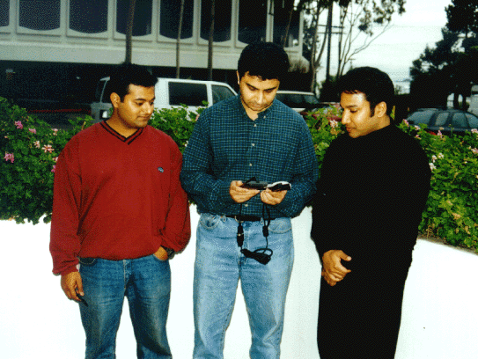

Domain
Agent
Registration
Middle Agent
5
5
TOPIs
1
3
TEAMCORE
proxy
TEAMCORE
proxy
KARMA
4
6
TEAMCORE
broadcast net
4
2
3
Middle Agent
TEAMCORE
proxy
TEAMCORE
proxy
5
5

Slide 10
Issues in Agent-Based Coordination of Humans
Adjustable Autonomy
  Cannot make commitments on user’s behalf
  Cannot “task” human agents
  Must be able to explain decisions
  Must allow intervention to override decisions
Large-scale, long-term organizations
  Heterogeneous tasks, capabilities, teams
  Dynamic tasks, capabilities, teams

Slide 11
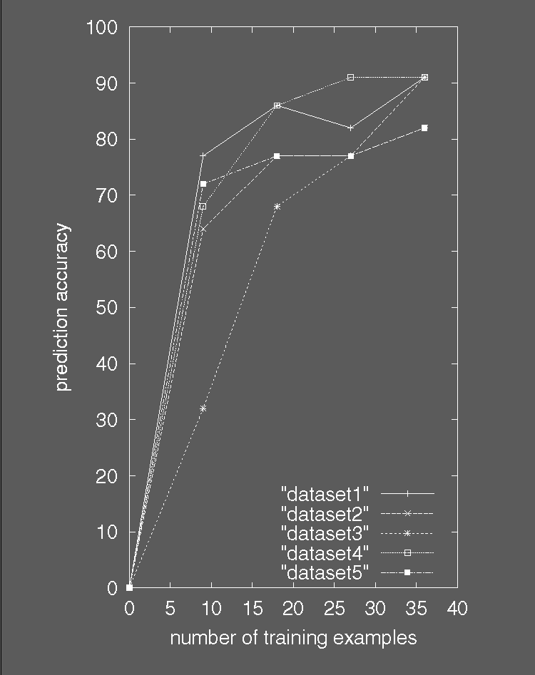
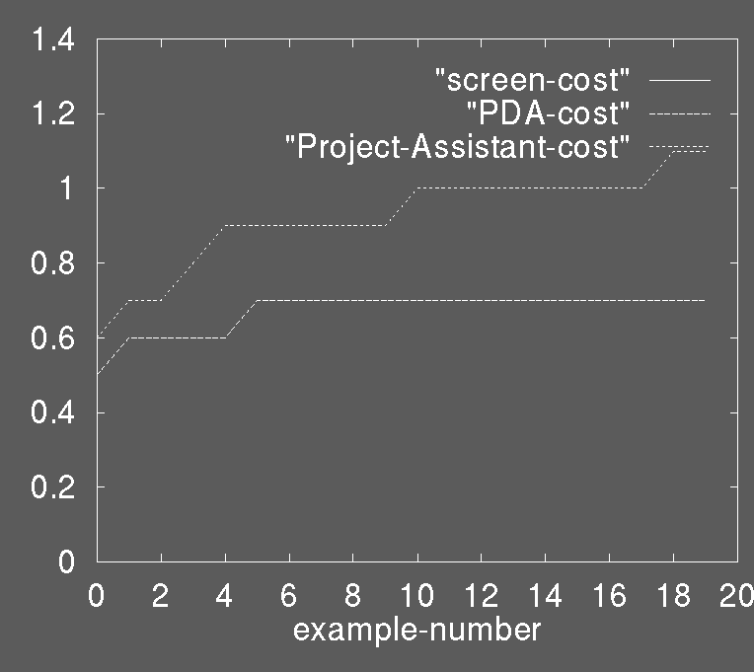
Adjustable Autonomy
Teamcore proxy acts on agent’s behalf:
  Ensure that actions are consistent with agent’s wishes
  ...without burdening agent with excessive queries

Slide 12
Summary
Karma:
  Facilitates organization construction
  Need to expand maintenance capabilities
TEAMCORE proxies:
  Simplifies problem specification
  Preliminary experiments in adjusting autonomy
  Need to expand dynamic teaming capabilities
  Need to expand adjustable autonomy

