Slide 1
Beyond the Elves:
Making Intelligent Agents Intelligent
Craig Knoblock
University of Southern California
Information Sciences Institute

Slide 2

Outline
The Electric Elves
  Motivation
  Applications
  Accomplishments
  Limitations
Beyond the Elves

Slide 3
The Electric Elves
Multi-research group project
  Agent interactions with human users – Milind Tambe, David Pynadath, Paul Scerri
  Agents for reliable information access – Craig Knoblock, Kristina Lerman, Jean Oh
  Deriving organizational knowledge from unstructured sources – Hans Chalupsky, Tom Russ
  Flexible assignment of tasks – Yolanda Gil, Varun Ratnakar

Slide 4
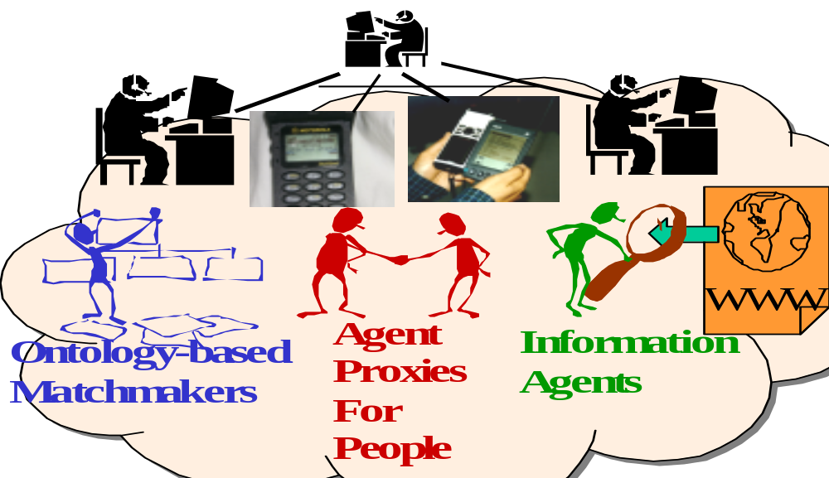
Agent-Facilitated
Human Organizations

Slide 5

Goal
Agent-Facilitated Human Organizations
Develop software agents that automate routine tasks within organization
  E.g., obtaining info, monitoring, distributing information
Enable software agents and humans to act coherently within the organization
  Humans have agent proxies that assist in coordinating with other agents
Coordination of tasks within the organization
  Efficient use of resources (physical and human)
  Monitoring progress of both individual and overall tasks
  Suggest/execute corrective actions when goals appear endangered

Slide 6
Example Tasks
Supporting our own research organization:
Coordinating routine project activities
  Eliminate email about meeting delays/postponments
  Eliminate email about who will present at next mtg
  Track visitor’s flights and arrival times
Support for external meetings
  Monitor all aspects of a traveler’s plans
    Notify traveler of prices changes, schedule changes, flight delays
    Send fax to hotel if traveler is delayed
Similar issues arise in many organizations: corporations, military, etc.

Slide 7
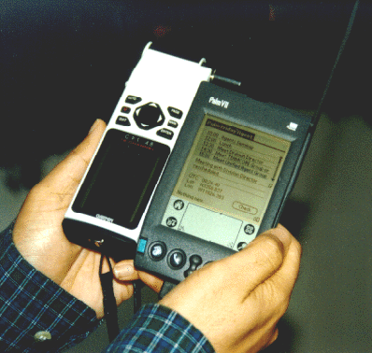
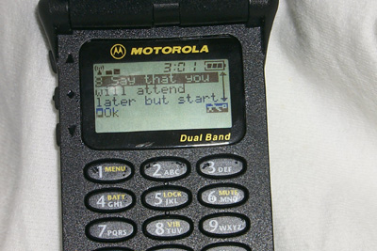
Agent Organization is
Grounded in the Real World
On-line information sources
  Flight schedules, restaurants, etc.
  Calendar information
“Sensors” and “actuators”
  GPS, “finger”, etc.
  Postpone/cancel meetings, faxes to hotels and restaurants, etc.
Interaction with people
  Communicate through personal portable devices (PDAs, phones, etc.)

Slide 8
Accomplishments
Agents for reliable information access
  Learn expectations about the information to be extracted and automatically repairs the wrappers
Agent interactions with human users
  Proxy agents act on user’s behalf within limits: Adjustable autonomy
Deriving organizational knowledge from unstructured sources
  Extracting information from documents and text
Flexible assignment of tasks
  Matching unanticipated requests with available services

Slide 9
Status
Working application for monitoring travel plans – Travel Elves
System being used by several DARPA PMs
  We just trained the IPTO person that does all of the travel arrangements
Quick demonstration…

Slide 10
Example Agents
Flight-Status Agent:
  Flight delayed message:
  Your United Airlines flight 190 has been delayed.
  It was originally scheduled to depart at 11:45 AM and is now scheduled to depart at 12:30 PM.
  The new arrival time is 7:59 PM.
  Flight cancelled message:
  Your Delta Air Lines flight 200 has been cancelled.
  Fax to hotel message:
  Attention: Registration Desk
  I am sending this message on behalf of David Pynadath, who has a reservation at your hotel. David Pynadath is on United Airlines 190, which is now scheduled to arrive at IAD at 7:59 PM. Since the flight will be arriving late, I would like to request that you indicate this in the reservation so that the room is not given away.

Slide 11
Monitoring Agents
Airfare Agent: Airfare dropped message
  The airfare for your American Airlines itinerary
  (IAD - LAX) dropped to $281.
Earlier-Flight Agent: Earlier flights message
  The status of your currently scheduled flight is:
  # 190 LAX (11:45 AM) - IAD (7:29 PM) 45 minutes Late
  If you would like to return earlier, the following
  United Airlines flights will arrive earlier than your
  scheduled flights:
  # 946 LAX (8:31 AM) - IAD (3:35 PM) 11 minutes Late
  --------
  # 388 LAX (9:25 AM) - DEN (12:25 PM) 10 minutes Late
  # 1534 DEN (1:20 PM) - IAD (6:06 PM) On Time

Slide 12
The Good…
Agents technology …
  Makes it possible to integrate diverse components written in different languages on different platforms
    Significant accomplishment of the Darpa CoABS program
  Provides services and capabilities that would be impractical or time-consuming for human assistants
  Significant contributions in many critical subproblems

Slide 13
… the Bad, and the Ugly
But…
  Agents today are carefully designed to work together,
  Are only capable of responding to failures for which they were designed,
  Cannot always explain their behavior,
  Often require specialized interfaces to interact with them,
  And require significant effort to design and build

Slide 14
Beyond the Elves
We plan to build a new cognitive architecture that addresses these limitations
  Extend to tasks such as battlefield awareness, network management, and disaster response
  Wider variety of agents and other embedded systems
This architecture would support “intelligent agents” that
  Robustly accomplish their tasks, responding appropriately to failures
  Communicate flexibly with humans and software agents
  Explain their behavior both on success or failure
  Dynamically compose new agents and behaviors from existing agents
  Rapidly build personalized agents without manual programming
  Learn from their past experience

Slide 15
Research Plans
Knowledge Representation (Chalupsky & Russ)
  Rich representation of goals, plans, and knowledge using a KR system
Agent Communication (Knight & Hobbs)
  Build an agent communication language based on a restricted subset of natural language
  Support both agent-agent and agent-human communication
  Simplify the composition and addition of new agents
Agent Explanation (Gil & Hobbs)
  Introspect into the current state of their tasks
  Richer models of their tasks to support troubleshooting
Agent Conversation (Gil & Pynadath)
  Conversations as FSMs with state changes

Slide 16
Research Plans (cont.)
Agent Composition and Replanning (Ambite & Knoblock)
  Dynamically compose agents to support more complex tasks using automated planning techniques
  Replan tasks in response to failures or unexpected results
Building New Agents (Knoblock & Gil)
  Define personalized agents through an interactive user interface
Agent Learning (Pynadath & Knoblock)
  Exploit machine learning techniques to
    improve the interaction with the user
    perform their tasks more efficiently

