Slide 1

Using and modifying plan constraints in Constable
Jim Blythe and Yolanda Gil
Temple project
USC Information Sciences Institute
http://www.isi.edu/expect/temple

Slide 2
Why we need to customize constraints in active templates
Draft
Active Templates can use constraints to:
  restrict possible values for an information element,
  supply a default value,
  link the elements to live data sources.
End users must be able to add and modify constraints in templates to suit their needs.
  The initial constraints will not anticipate all possible situations.
  Operations often have unique constraints or use new equipment.
  Users will need to define new templates

Slide 3
Outline
Draft
Review of Constable’s current capabilities
Using and sharing constraints
Ongoing work
  Integration with Active Templates tools
  Improvements in adding and modifying constraints
  Ongoing research in visualization
Constable status and future work

Slide 4
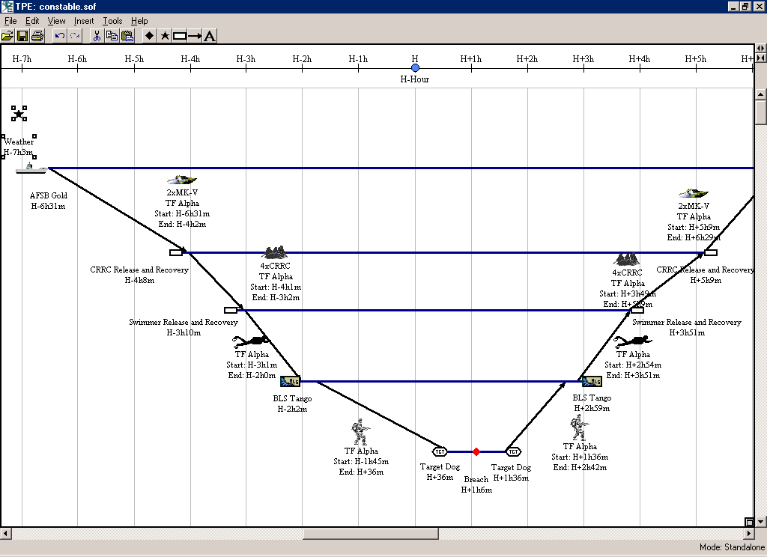

Slide 5
Viewing data sources, planning factors and assumptions
Draft
Several ways for users to access planning factors, assumptions and data sources used to critique plans.
  Planning factors and assumptions shown on form
  Factors and external information relevant to each field gathered dynamically
User can change the values in local version and save the changes
  Constable gives visual feedback when a value is changed

Slide 6
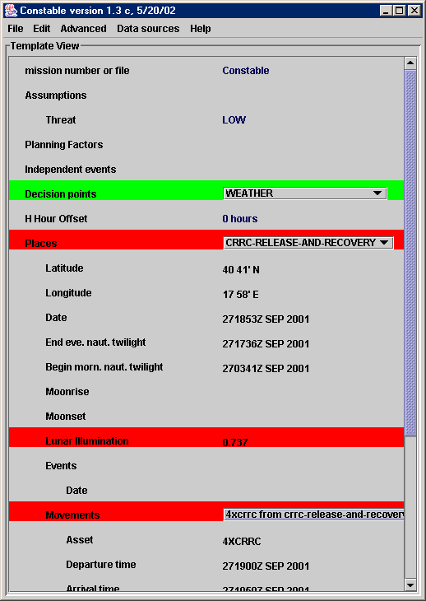
Viewing planning factors and assumptions
Several ways to access planning factors, assumptions and data sources
Assumptions and planning factors can be viewed on-screen and changed for what-if analysis

Slide 7
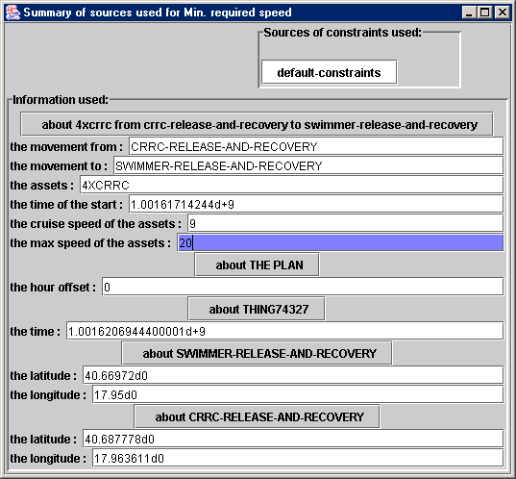
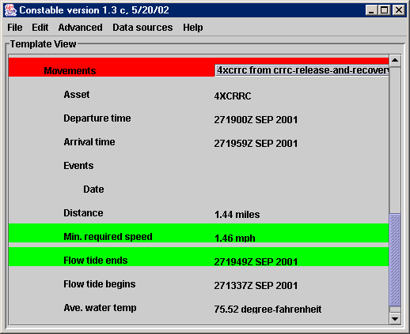
Relevant assumptions can be edited in-place. Color shows when this has happened. Changes can be saved and re-used

Slide 8
Caching and control of live data access
Draft
Information from Heracles agents can be cached.
User can inspect cache to see when it was made, and can tell Constable to use agents directly.
Since agents are integrated in the same architecture, user can view assumptions made when they are used, e.g. nearest tide station, TAF ICAO, …

Slide 9
Using and sharing constraints
Draft
API, representation and XML format for constraints agreed with Heracles and Command Link.
Next version of Heracles will be able to use constraints (rules, applications of agents) built and modified in Constable

Slide 10
XML format
<apply>
<predicate>subtract</predicate>
<arg><name>obj</name>3</arg>
<arg><name>from</name>7</arg>
</apply>
<apply>
The method name is the same as the predicate name
<name>subtract</name>
<arg>5</arg>
<arg>8</arg>
</apply>

Slide 11
Using and sharing constraints II
Draft
Constable uses the agreed XML format
  Any constraint can be shared
Constable implements the agreed constraint API
  Other tools can send constraint definitions to Constable and receive results from applying the constraint
  Other tools can query Constable for any constraint in use

Slide 12
Outline
Draft
Review of Constable’s current capabilities
Using and sharing constraints
Ongoing work
  Integration with Active Templates tools
  Improvements in adding and modifying constraints
  Ongoing research in visualization
Constable status and future work

Slide 13
Integration of Constable and SOFTools
Draft
Works with latest revision of SOFTools (2.03 Final)
  Imports SOFTools plans in XML format
Can handle all SOFTools assets and location types
Exports relevant information such as tides into the SOFTools plan in addition to critiques

Slide 14
Integration: enhancements to Constable form
Draft
Form organized to match features in SOFTools plan
  Movements grouped by place
  User-given names used in display
  The display elements vary based on asset or temporal relations
Easier to match up output and understand critiques
Demo of form goes here

Slide 15
Integration of plan checker: new wrappers
Draft
Uses the new Fetch/Heracles agents directly
Explicit library of agent encapsulations
  Standardize input and output formats of the agents
  Represent assumptions explicitly, e.g. use nearest tide station
  Can be applied to new data sources with drag-and-drop (details later in presentation)

Slide 16
Fetch/Heracles agent encapsulations
Draft
Ensure a standardized input/output format for each agent
  Types are meaningful for users, e.g. latitude, time, temperature
  Planned: user can use any units, e.g. knots, centigrade, and the tool will add the conversion for input or output to the agent
  Now: encapsulations are explicit about the units required, users must include conversions through pre-defined rules
Enables drag-and-drop use of agents along with pre-defined constraints

Slide 17
Outline
Draft
Review of Constable’s current capabilities
Using and sharing constraints
Ongoing work
  Integration with Active Templates tools
  Improvements in adding and modifying constraints
  Ongoing research in visualization
Constable status and future work

Slide 18
Improvements in adding constraints
Draft
Libraries of pre-defined constraints now easier to find and use.
  Organized by source, e.g. USSOCOM-M525-6, and type, e.g. constraints on times.
  A constraint from a list can be used in a Constable field through drag-and-drop.

Slide 19
New graphical interface
Draft
Allows explicit incorporation of encapsulated agents and pre-defined constraints
Complements the English editor:
  easier to use for simpler task of incorporation
  User can view English paraphrase of graphical view

Slide 20
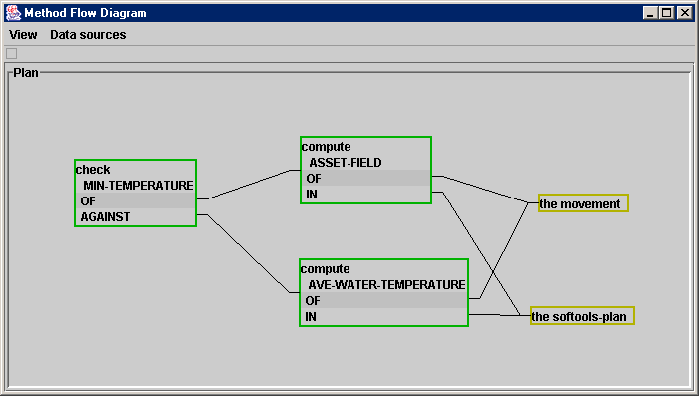
Graphical editor demo
Outline

Slide 21
Outline
Draft
Review of Constable’s current capabilities
Using and sharing constraints
Ongoing work
  Integration with Active Templates tools
  Improvements in adding and modifying constraints
  Ongoing research in visualization
Constable status and future work

Slide 22
Ongoing research in visualization
Outline
Users need to be able to explore alternative plans
  Over-write values for quick “what-if” testing
  Generate and store contingency plans
  Specify alternatives for Constable to evaluate
  Save chosen alternative back into Softools
  Display many alternative plans graphically
Displaying alternative plans graphically
  Provide a sense of how key choices affect the number and quality of possible plans

Slide 23
Ongoing research in visualization
Draft
Can provide an overview of several alternative plans based on Constable constraints
Developed a visual approach for incremental utility elicitation, Veil, applied to travel planning domain
[Blythe, AAAI 02 oral presentation]
Applying to input from SOFTools

Slide 24
Why incremental utility elicitation helps
Draft
To quickly judge a large number of alternatives, users need visual feedback on how good each alternative is (its utility).
The plan browser guesses what a user considers a good alternative
While the user explores the alternatives, the plan browser improves its guess based on user actions.
Converges quickly, since the utility model is much smaller than the space of alternatives.

Slide 25
Applying VEIL to the SOF planning
Draft
Generate alternative plans by leaving key plan features open to modification
  e.g. asset of initial approach,
  time of operation (within operational constraints)
Any Constable constraint can be used as part of the model of how good an alternative is
Layout of alternatives can be based on any plan feature, either basic of derived in Constable

Slide 26
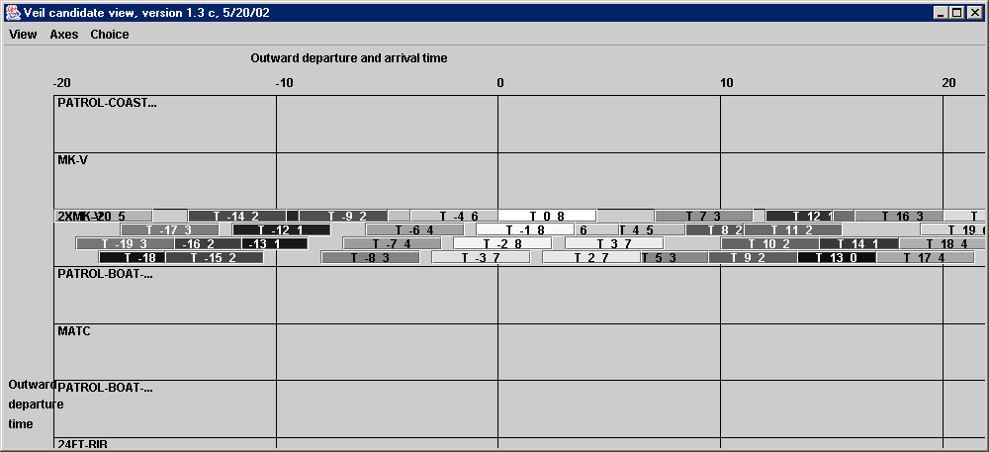
Veil in SOF: screenshot
Outline

Slide 27
Stages of planning where Veil has high potential payoff
Draft
In initial phase: consider a broader range of alternatives early in planning
During execution: Track changing utilities of contingency plans as information becomes available

Slide 28
Constable status
Draft
Version 1.4 now available, integrates these features.
To be shown to planners in the upcoming June exercise
Aim to participate in September exercise

Slide 29
Future work in Constable
Draft
Continue integration efforts aimed at September exercise
  Integrated with new version of Heracles, Command Link
  Improve integration with SOFTools based on planner feedback
Continue research in plan visualization approaches
  High potential payoff in finding suitable man-machine partnership based on visual interfaces
  Based on planner feedback identify suitable dimensions for exploration and display

Slide 30
Summary
Draft
Improving integration with SOFTools to provide useful timely critiques of plans
Integration of constraints with other AcT tools ready to use
Improved tools for using pre-defined constraints and Heracles agents appropriate for end users
Alternatives visualization ready for planner feedback
On track for September exercise

Slide 31
Old slides

