Slide 1

Using and modifying plan constraints in Constable
Jim Blythe and Yolanda Gil
Temple project
USC Information Sciences Institute
http://www.isi.edu/expect/temple

Slide 2
Why we mean by constraints and why they need to be modifiable
Active Templates can use constraints to:
  restrict possible values for an information element,
  supply a default value,
  link the elements to live data sources.
End users need to add and modify constraints in templates to suit their needs.
  The initial constraints will not anticipate all possible situations.
  Operations often have unique constraints or use new equipment.
  Users will need to define new templates

Slide 3
Outline
Review of Constable’s current capabilities
Using and sharing constraints
Ongoing work
  Integration with Active Templates tools
  Improvements in adding and modifying constraints
  Ongoing research in visualization
Constable status and future work

Slide 4
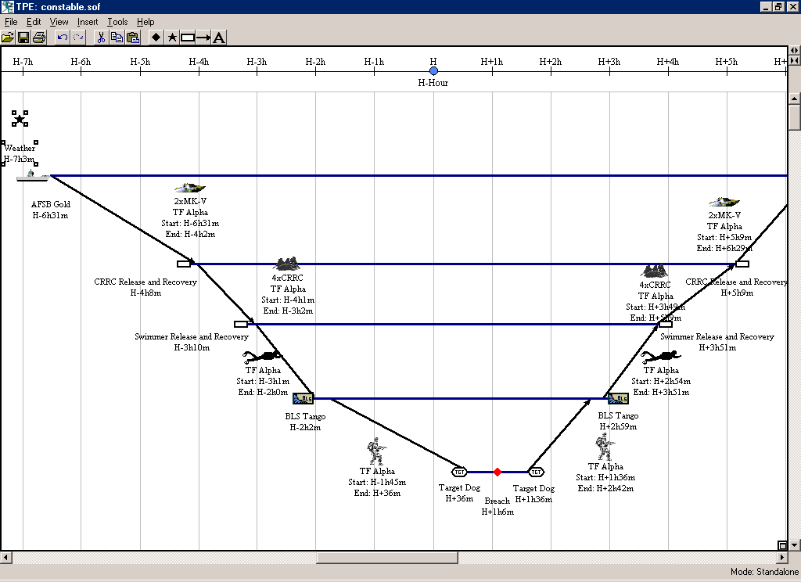
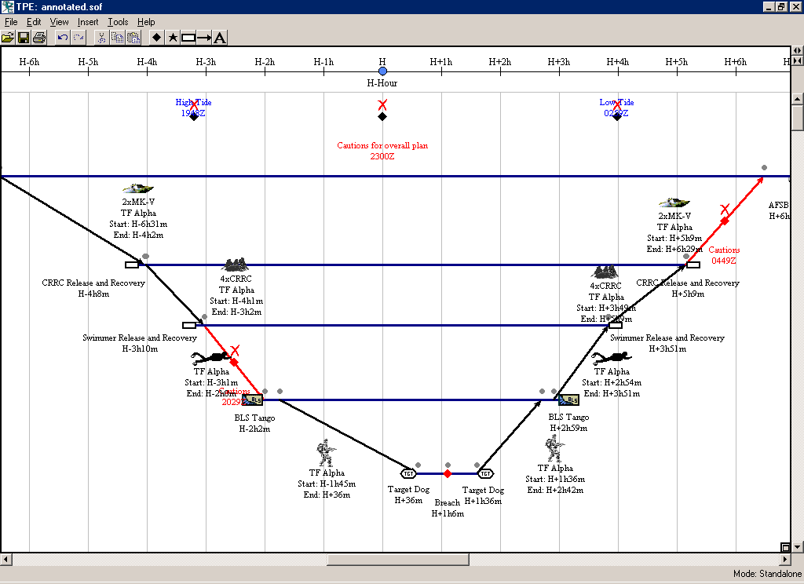
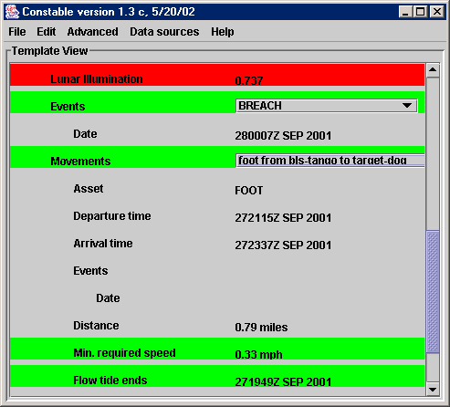
Checking SOFTools plans
Line color shows potential problems
Each element is defined and checked using constraints

Slide 5
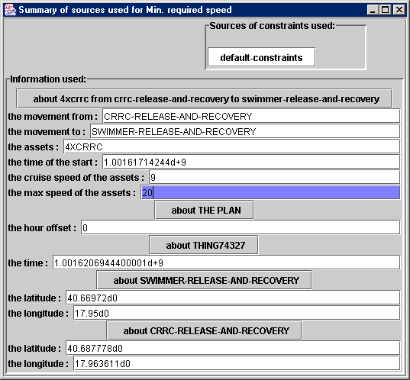
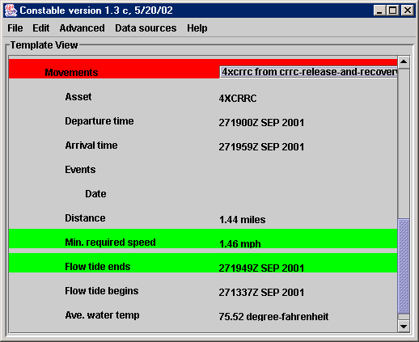
Inspecting data sources used by constraints
Relevant assumptions can be edited in-place. Color shows when this has happened. Changes can be saved and re-used

Slide 6
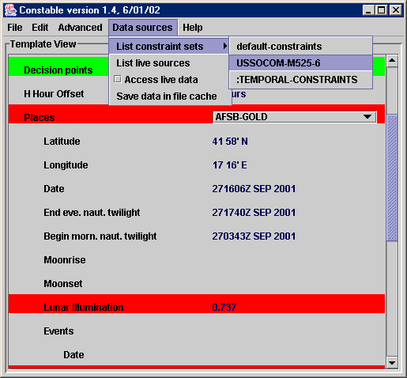
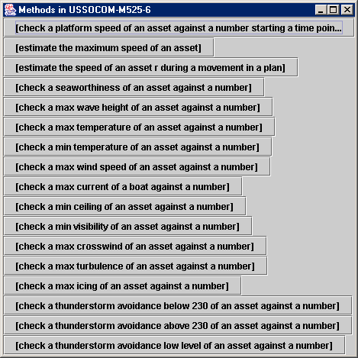
Inspecting Constable’s critiquing knowledge
Available constraints are organized by source. Can be applied to any element.

Slide 7
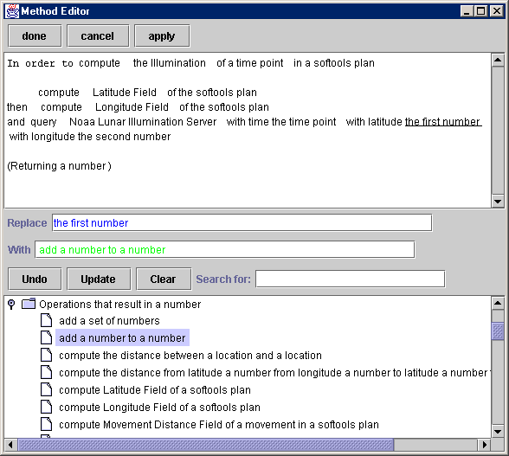
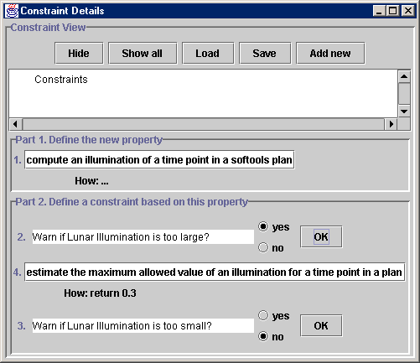
Creating and modifying constraints
English-based editor
Constraint wizard
bounds check
upper bound
lower bound
“Warn if the value is too large?”

Slide 8
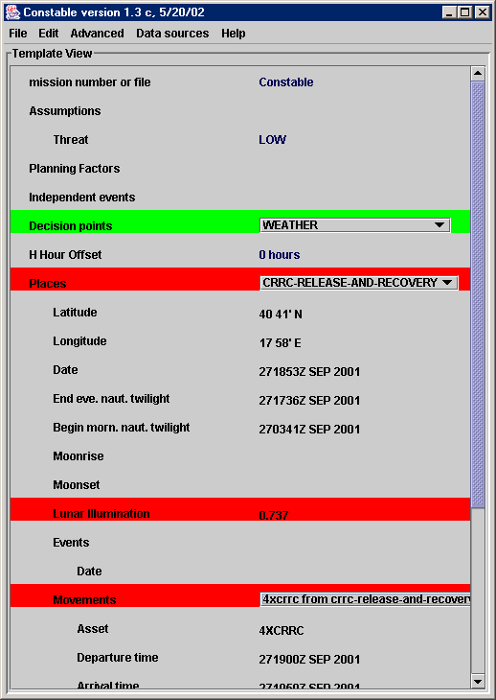
Viewing planning factors and assumptions
Several ways to access planning factors, assumptions and data sources
Assumptions (and soon planning factors) can be viewed on-screen and changed for what-if analysis

Slide 9
Accessing of live data through Fetch data agents
Fetch data agents are incorporated as constraints that provide data
Assumptions made when they are used, e.g. nearest tide station, TAF ICAO, can be inspected just as other assumptions
Information from Fetch agents can be cached and shipped with application.
  User can inspect cache and force refreshing.

Slide 10
Outline
Review of Constable’s current capabilities
Using and sharing constraints
Ongoing work
  Integration with Active Templates tools
  Improvements in adding and modifying constraints
  Ongoing research in visualization
Constable status and future work

Slide 11
Using and sharing constraints
Proposed common representation with API and XML format for constraints, agreed with Heracles and Command Link.
  Proposal released in December, available on web site
Next version of Heracles will be able to use constraints built and modified in Constable.

Slide 12
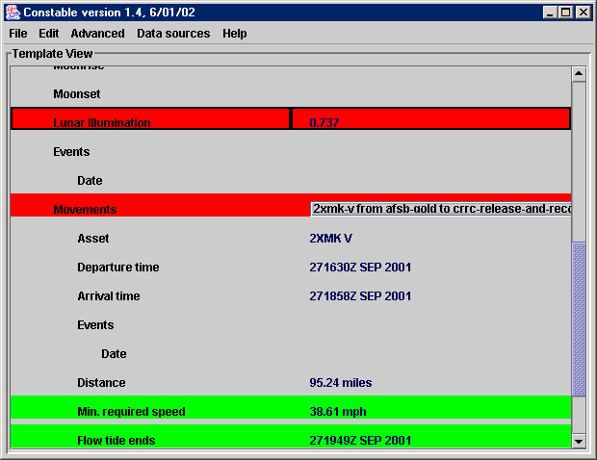
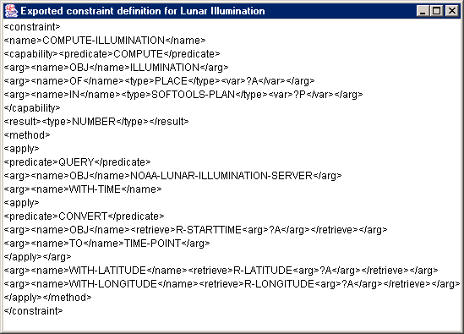
XML format

Slide 13
More on using and sharing constraints
Constable uses the proposed XML format
  Any constraint can be shared
Constable implements the proposed constraint API
  Other tools can send constraint definitions to Constable
  Tools can ask Constable to run a constraint, and receive the results
  Other tools can query Constable for the definition of any constraint in use

Slide 14
Outline
Review of Constable’s current capabilities
Using and sharing constraints
Ongoing work
  Integration with Active Templates tools
  Improvements in adding and modifying constraints
  Ongoing research in visualization
Constable status and future work

Slide 15
Integration of Constable and SOFTools
Works with SOFTools 2.03 Final
  Imports SOFTools plans in XML format
  Handles all SOFTools assets
Exports critique results to be viewed in SOFTools with the plan.
Also exports relevant information such as tides.

Slide 16
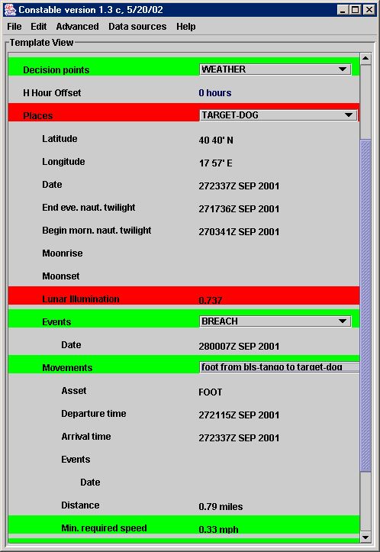
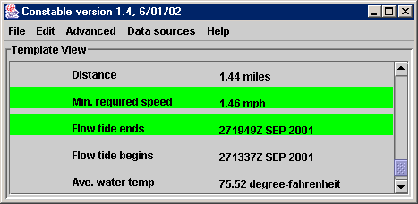
Integration: form organization changed to match SOFTools plan
Movements are grouped by place
User-provided names are used throughout
Units shown where possible, including for computed values

Slide 17
Integration with Fetch agents
Uses the Fetch/Heracles agents directly
Provide library of agent encapsulations
  Standardize input and output formats of the agents
  Represent assumptions explicitly, e.g. use nearest tide station
  Make it relatively easy to use agents flexibly through constraints

Slide 18
Fetch/Heracles agent encapsulations
Ensure a standardized input/output format for each agent
  Types are meaningful for users, e.g. latitude, time, temperature
  Planned: user can use any units, e.g. knots, centigrade, and the tool will add the conversion for input or output to the agent
  Now: encapsulations are explicit about the units required, users must include conversions through pre-defined rules
A step towards letting users flexibly attach agents to forms
  More details on encapsulations in Oct 01 PI slides

Slide 19
Outline
Review of Constable’s current capabilities
Using and sharing constraints
Ongoing work
  Integration with Active Templates tools
  Improvements in adding and modifying constraints
  Ongoing research in visualization
Constable status and future work

Slide 20
Improvements in adding constraints
Libraries of pre-defined constraints now easier to find and use.
  Organized by source, e.g. USSOCOM-M525-6, and type, e.g. constraints on times.
  Can be applied to elements of the form by the user.

Slide 21
New graphical constraint editor
Allows simple incorporation of encapsulated agents and pre-defined constraints
Complements the English-based editor:
  easier to use for the simpler task of incorporation
  User can view English paraphrase of graphical view

Slide 22
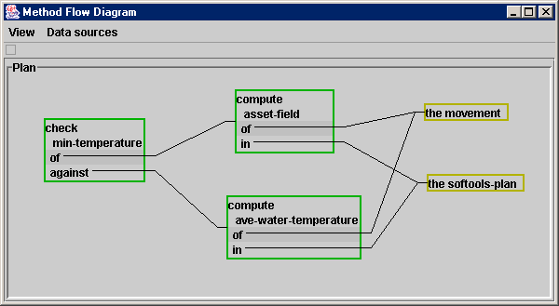
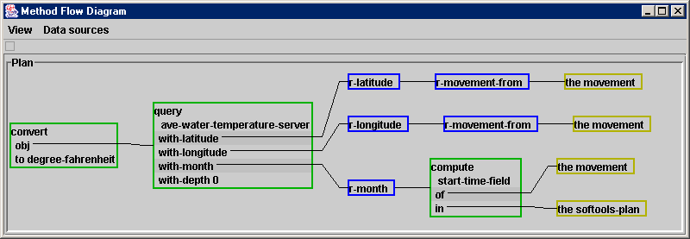
Example: average water temperature

Slide 23
Outline
Review of Constable’s current capabilities
Using and sharing constraints
Ongoing work
  Integration with Active Templates tools
  Improvements in adding and modifying constraints
  Ongoing research in visualization
Constable status and future work

Slide 24
Ongoing research in visualization
Problem: Users need to explore alternative plans
  Over-write values for quick “what-if” testing
  Quickly get an overview of a collection of possible plans
Approach: Displaying alternative plans graphically
  Specify which alternatives Constable should generate
  Display many alternative plans graphically
  Save chosen alternative back into Softools
Benefit:
  Provide a sense of how key choices affect the number and quality of possible plans
  [Blythe, AAAI 02]

Slide 25
Plan visualization approach
Each alternative plan is shown as an object on a display. Typically tens or hundreds of plans may be examined. [Ahlberg & Schneiderman 94, Marks 97]
Location on the display gives information about the choices that it represents
Color of the candidate gives information about how useful the plan seems

Slide 26
Visualizing alternatives to SOFTools plans
Generate alternative plans by leaving key plan features open to modification
  e.g. asset of initial approach, time of operation (within operational constraints)
  features that might not be fixed early in the planning process
Layout of alternatives can be based on any Constable constraint
Any Constable constraint can be used as part of the model of how an alternative is preferred

Slide 27
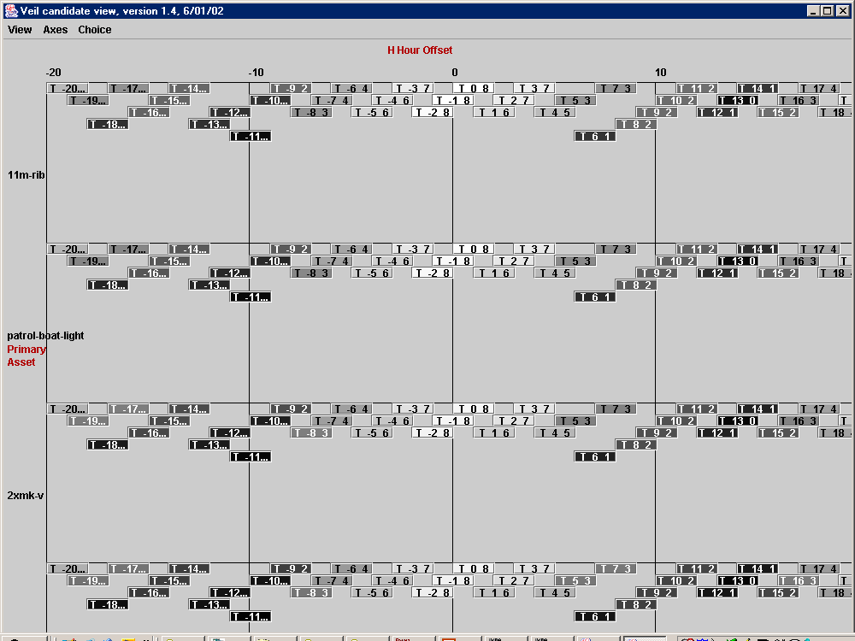
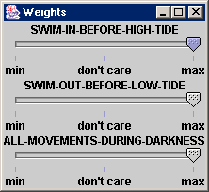
Example: trying different times and assets

Slide 28
Estimating plan quality
The color can help a user locate better plans easily, IF the colors chosen by the planner match the user’s preferences.
Begin with a default set of weights on the plan constraints. The user can alter the weights by hand.
Optionally, while the user explores the alternatives, the plan browser updates its weights based on user actions.
Converges quickly, since the set of possible weights is much smaller than the space of alternative plans.

Slide 29
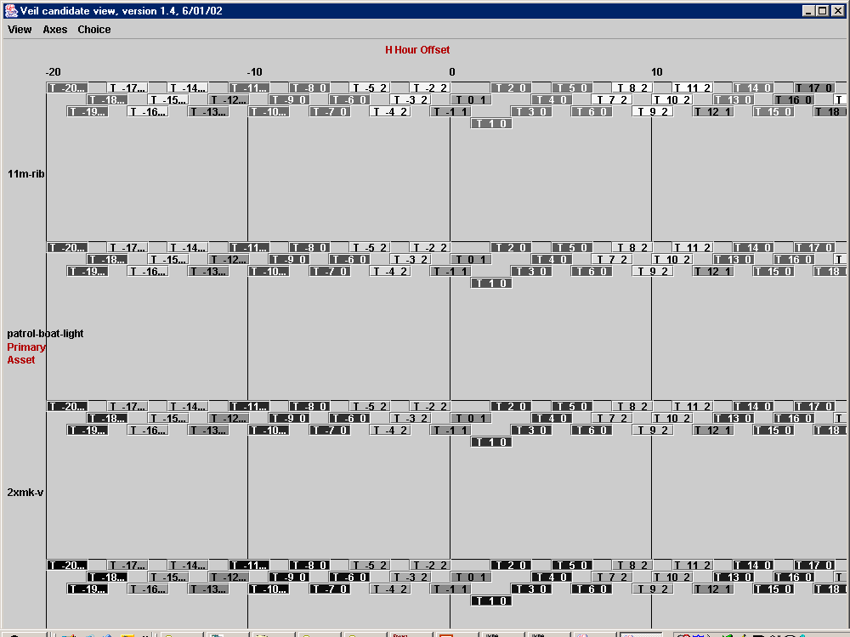
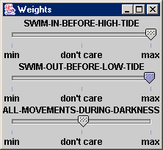
Increasing the importance of tides over daylight

Slide 30
Stages of planning where visualizing alternative plans has high potential payoff
In initial phase: consider a broader range of alternatives early in planning
During execution: Track changing utilities of contingency plans as information becomes available

Slide 31
Outline
Review of Constable’s current capabilities
Using and sharing constraints
Ongoing work
  Integration with Active Templates tools
  Improvements in adding and modifying constraints
  Ongoing research in visualization
Constable status and future work

Slide 32
Constable status
Version 1.4 now available, integrates these features.
To be shown to SOF planners in the upcoming June exercise
Aim to participate in September exercise

Slide 33
Future work in Constable
Continue integration efforts
  Integrate with new version of Heracles, Command Link
  Improve integration with SOFTools based on planner feedback
Continue research in plan visualization approaches
  High potential payoff in finding suitable man-machine partnership based on visual interfaces
  Based on planner feedback identify suitable dimensions for exploration and display

Slide 34
Summary
Improving integration with SOFTools to provide useful timely critiques of plans
Integration of constraints with other AcT tools ready to use
Improved tools for using pre-defined constraints and Heracles agents appropriate for end users
Alternatives visualization ready for planner feedback
On track for September exercise

