Slide 1

Using and modifying plan constraints in Constable
Jim Blythe and Yolanda Gil
Temple project
USC Information Sciences Institute
http://www.isi.edu/expect/temple

Slide 2
Why we need to customize constraints in active templates
Active Templates can use constraints to:
  restrict possible values for an information element,
  supply a default value,
  link the elements to live data sources.
End users must be able to add and modify constraints in templates to suit their current needs.
  The initial constraints will not anticipate all possible situations.
  Operations often have unique constraints or use new equipment.
  Users will want to customize templates.

Slide 3
Highlights
Users can customize default constraints
  Can modify constraint parameters or use full Constable editor
  [Blythe et al IUI 01, Blythe IJCAI 01]
Integration
  Uses XML schemas & data from other systems.
  Used to critique a plan created in Softools
Up to date info
  Integrates calls to live data sources in constraints (e.g. Data Agent)

Slide 4
Users can select from libraries of default constraints
E.g., from Manual M525-6: constraints of a platform from wave height
Default constraints are attached to movement data and live Metoc data sources
More general pre-defined constraints also useful
  Time A must be before Time B, or within an interval
  Location X must be near Location Y, or within a region

Slide 5
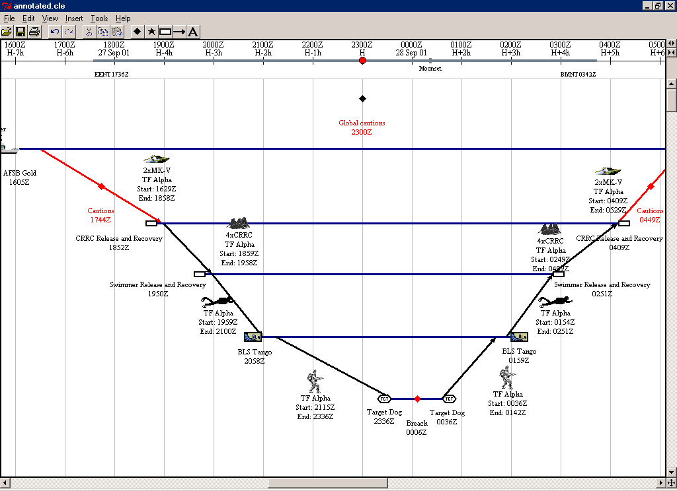
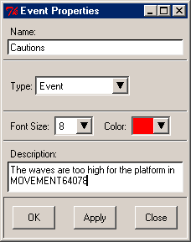
Constable can critique Softools 2.0 plans and show its results in Softools
All constraints can be seen in one place
Constraints are attached to the relevant step

Slide 6
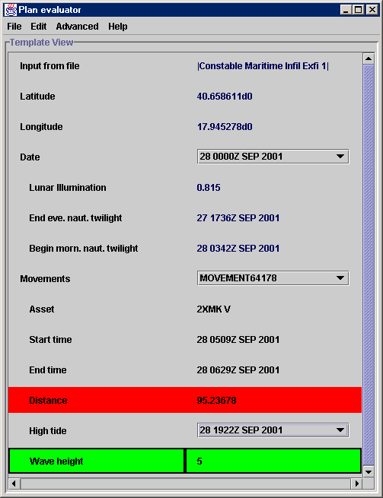
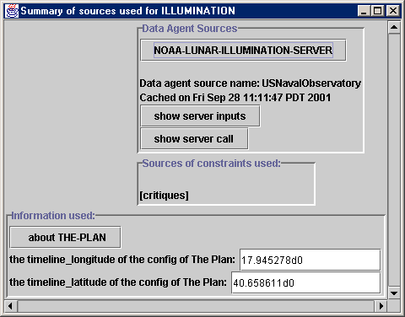
Constraint details can be seen through Constable

Slide 7
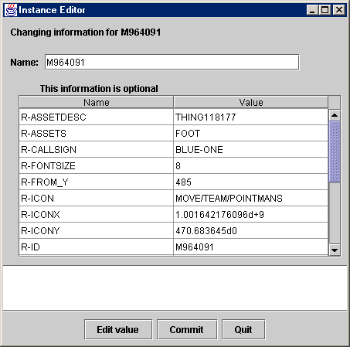
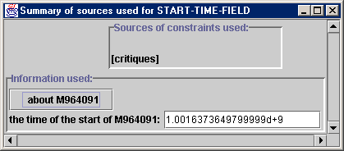
Planning factors and assumptions can easily be altered
Relevant factors are automatically identified by analyzing parameters in the constraint definition
Can also modify full object information

Slide 8
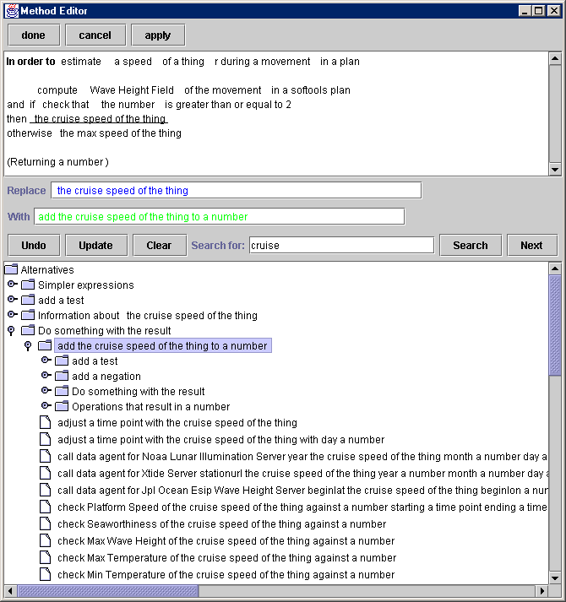
More complex modifications to constraints

Slide 9
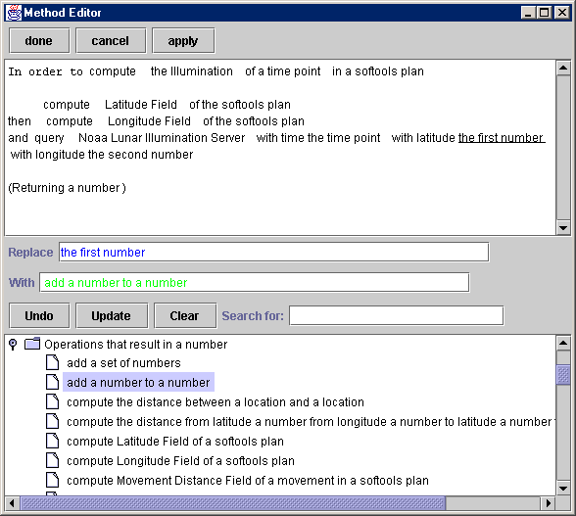
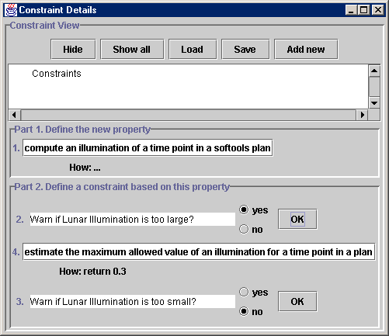
Users can add new constraints using a constraint wizard
bounds check
upper bound
lower bound
“Warn if the value is too large?”

Slide 10
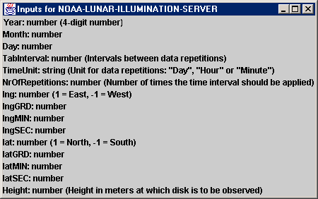
Integrating Constable with live data sources
Data sources (e.g. Data Agent wrappers) require parameterized inputs and return structured data:
Inputs:
Output: Lunar Illumination
Time,
Latitude,
Longitude,
{
<agent_output>
<LunarIllumination>
<ROW>
  <Fraction>0.5
  </Fraction>
  </ROW>…
{
{

Slide 11
Challenges to using live data sources in constraints
Providing inputs for data source
  Need to convert from representation in external systems (e.g., Softools) to source’s required inputs
Extracting the desired output
  Sometimes as simple as data-base retrieval, sometimes requires further processing or retrieval from secondary URLs
Allowing end user control
  Tools to help users convert inputs and outputs where possible

Slide 12
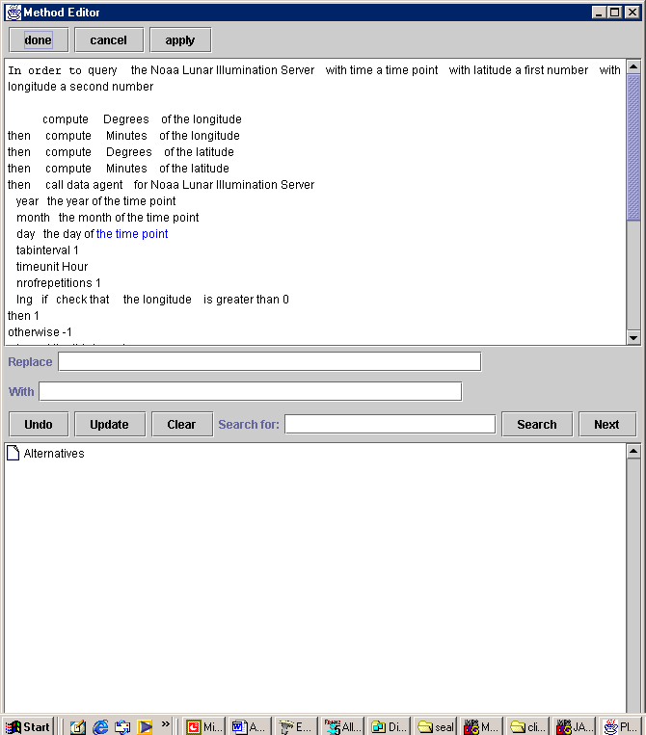
Solution used in Constable: encapsulation of data sources
Models the required input types and outputs of the data source
Provides an abstraction that is easier to use in constraint definitions

Slide 13
Examples of providing inputs
Lunar Illumination data source uses these parameters for latitude:
  lat (1 or –1), latGRD, latMIN, latSEC
Nautical twilight data source uses these parameters:
  NorthOrSouth (“North” or “South”), latDegrees, latMinutes
Their encapsulations use decimal latitude (as used in Softools) and make appropriate transformations.
  Fewer parameters, intuitive parameters

Slide 14
Examples of extracting outputs
Lunar Illumination server XML:
  <agent_output>
  <LunarIllumination>
  <ROW><Fraction>0.5</Fraction></ROW>…
  Simple to extract the desired field, but must be specified
Server for nautical twilight
  returns URL that must be separately retrieved,
  which yields a table in plain text
  Which contains time in HHMM format in local time
Encapsulation retrieves URL, extracts cells from table and converts the time format.
  Easy to use, hard to build

Slide 15
User control of data sources in constraints
Encapsulation can be edited with the English Expect editor
  Simple input and output mappings can be created
Future plan: initial body created automatically from server specification

Slide 16
User skills and capabilities
New users: view results of Constable in Softools2.0
After 1 day: alter parameters in constraints
After 1 week: modify constraints, attach default constraints to external systems and pre-encapsulated live data sources
Advanced: create constraints without defaults, create encapsulations of live data sources

Slide 17
Status and future work
25 default constraints: 15 from M525-6 (maritime and air platforms),
4 temporal constraints, 4 spatial constraints
Encapsulated Data Agent wrappers: covering JSOA domain
Release in Web site (or see me for CD)
Work with Fred, Warren and others to
  Test modifying constraints, adding new constraints
  Identify further sources of default constraints
  Further integration with AcT software

Slide 18
Multiple constraints per information element
Can attach several constraints to an information element
Plan to model constraint priorities
  Some constraints might be show-stoppers, others merely preferences
Plan to model degree of violation
  Ranges of values that are not ideal but still acceptable

Slide 19
Future work: browsing alternative plans
Users need to be able to explore alternative plans
  Over-write values for quick “what-if” testing
  Generate and store contingency plans
  Specify alternatives for Constable to evaluate
  Save chosen alternative back into Softools
  Display many alternative plans graphically
Displaying alternative plans graphically
  Provide a sense of how key choices affect the number of possible plans

Slide 20
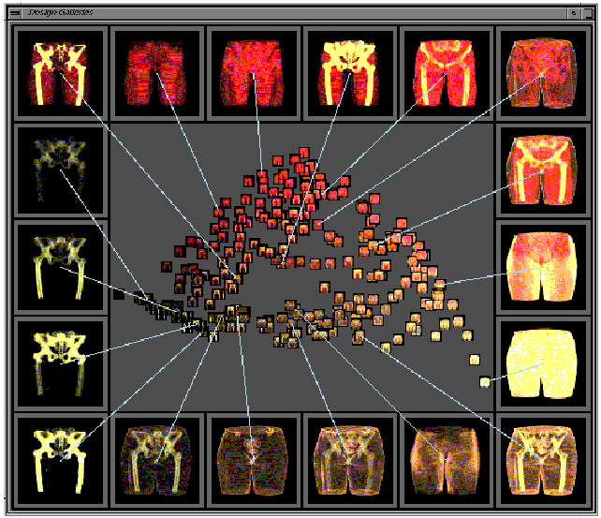
Approach based on Design Galleries
[Marks et al. SIGGRAPH 97]
  A set of candidates, + a feature set that characterizes them
  A distance function between candidates
  A sampling method (to find a good subset of candidates)
  An arrangement method (to position candidates on display)

Slide 21
Plan galleries: potential benefits and challenges
Galleries of candidate plans could help planners find sweet spots and better understand the tradeoffs, but:
How should the candidates be chosen and visualized to best help this?
Investigate using the constraints expressed in Constable:
  To choose the set of candidates to display
  To show important details about each candidate
  To arrange the candidates meaningfully on the display

Slide 22
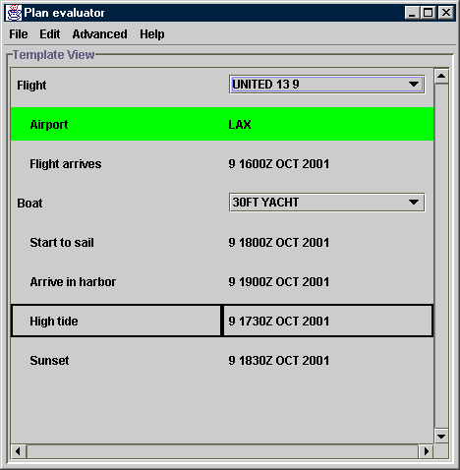
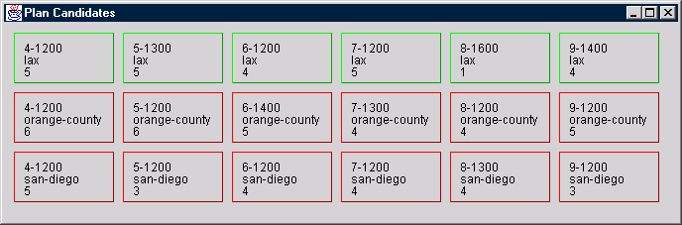
Using a plan gallery in Constable
Candidates shown are grouped and organized by constraints.
Users can see the number of alternatives satisfying constraints.

Slide 23
Summary
Constable includes libraries of default constraints and encapsulated data sources for critiquing plans
Open to external data: e.g. reads and writes Softools2.0 XML for inter-operation
Provides help for users to attach default constraints to data, modify constraints, build encapsulations of new live data sources
Provides framework for modeling constraints within AcT family of tools

