Slide 1
Specifying Planning Objectives
Yolanda Gil
Jim Blythe
Jihie Kim
Surya Ramachandran
http://www.isi.edu/expect/projects/temple

Slide 2
Outline
Previous work on editors for air campaign planning objectives
Grammars for air campaign planning objectives
Grammar editor

Slide 3
Structured Representations of Air Campaign Objectives and Plans
Problem: air campaign objectives lack structure needed to enable automation and promote plan sharing
  not possible to ensure that users enter valid objectives
    “Conduct operations” <- too vague
    “Disrupt C2” <- incomplete (does not specify where)
  not possible for planning tools to reason about them
  hard to understand another person’s plan
Approach: develop structured representation of objectives
  bottom-up development by analysis of air campaign objectives
  represent underlying structure as a suite of typical objective patterns
  template: DISRUPT OBJ action-capability OVER area
  ACP objective: DISRUPT OBJ C2 OF RED OVER NW sector

Slide 4
Structured Representations of Air Campaign Objectives and Plans (Cont’d)
Results:
  representations used in several DARPA demonstrations and systems
    Force application objectives (ARPI)
    Force support (logistics) objectives (JFACC)
    Defense objectives (JDP)
  structured editors have been built with these representations
    Mastermind and Adaptive Forms
  integrated with ontologies and knowledge bases
Benefits:
  common representation promotes plan sharing and standardization
  enables the development of plan editors and decision support tools
  planners have guidance about what are well-defined objectives

Slide 5
A Grammar of Force Support Objectives
Functional logistics objectives
  General
    Provide DOB object
    Provide DOB object FOR action | object
  Load- and Munitions-related
    Provide DOB load
    Provide DOB load FOR action | object
    Check DOB load availability
    Source DOB load
    Request DOB transportation OF load
    FROM place TO place
  Fuel-related
    Provide DOB fuel | additive
    Provide DOB fuel | additive FOR action|obj
    Receipt DOB fuel | additive
    Dispense DOB fuel | additive
    Issue DOB fuel | additive
    Store DOB fuel | additive
    Transport DOB fuel | additive
  Maintenance-related
    Provide DOB part | maintenance-aspect
    Ensure DOB maintenance-aspect
Top level
  Deploy DOB object
  Deploy DOB object
  TO area
  Sustain DOB object
  Sustain DOB object
  AT area
  Redeploy DOB object
  Redeploy DOB object
  TO areas
Indirect support objectives
  Beddown DOB forces
  Beddown DOB object FOR forces
  Select DOB bases
  Establish DOB aspect |
  line of comm
Direct support objectives
  Ensure DOB closure of
  all supply classes
  Provide DOB crew-ready aircraft

Slide 6
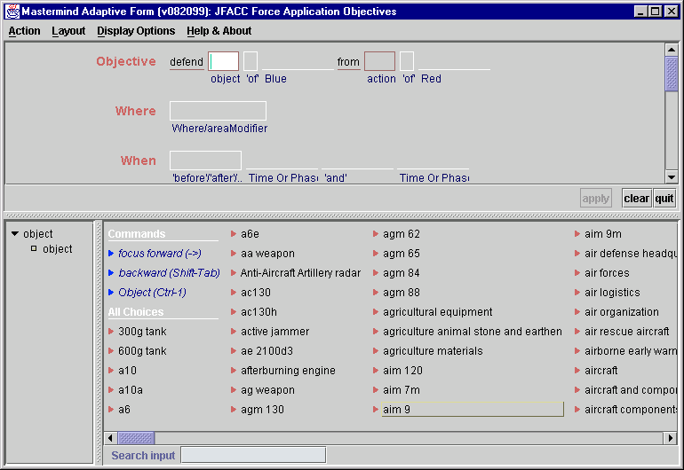
Mastermind defensive objectives editor

Slide 7
The need for a grammar editor
These grammars capture the essential structure of their data but:
They need to be adapted to each operation
  The grammars may not mention situation-level objects (e.g. assets, resources, locations) – these may be accessible from a data base in the software suite.
Users may want to refine their structure
  For example by organizing lists of alternatives that the grammars often contain, or adding new items.

Slide 8
A grammar editor
We are building tools to help users to manage grammars
The tools can guide the user to change the grammar, using simple background knowledge within the domain and by analyzing interdependencies in the grammar.
Some initial funding from Joint Defense Planner (JDP) program from Air Force Research Laboratory at Rome - joint work with ISI’s Mastermind group

Slide 9
What a grammar editor enables users to do
Tailor the grammar while objectives are created.
Add (or remove) alternatives.
Manage long lists of alternatives by adding structure or removing alternatives as desired.
Link parts of the grammar to a data base, e.g. to retrieve a list of assets to defend.

Slide 10
Fundamental capabilities needed to support users editing grammars
Protect the core structure of the grammar.
  Distinguish fixed and changeable parts of the grammar.
Avoid inconsistency and ambiguity.
  Use canonical sets of suggested additions (“blessed” terms).
Ensure that the global effects of individual changes are considered:
  Changes to choices made for one part of the grammar can have effects on other parts of the grammar that are hard for users to track, for example because many terms are shared.
  Check global effects, warn the user and offer remedies.

Slide 11
Distinguishing fixed and changeable parts of the grammar.
We can categorize terms as follows:
  Grammar-level: ‘before’, ‘defend’ – probably should not be changed.
  Domain-level: ‘f15 task force’ – might be changed on set-up for a new scenario.
  Situation-level: ‘East cyberland’, ‘phase 1’ – likely to be changed whenever there is a new planning situation.
The categories could form the basis for user authorization for grammar editing.
  only trusted users can make fundamental changes, while populating situation-level objects is more common.
  alternatively, just allow some changes and disallow others.

Slide 12
Avoiding inconsistency
Long lists, like those from the BFO or the JDP data base, can make the objectives editor hard to use.
But without them, users may add the same object in different ways.
Instead, we will keep these lists in the background so that the grammar is initially small.
When the user wants to add new alternatives, we use the background lists to suggest possibilities.
Notes:
There are other things we can do with these lists, such as notice when the user appears to be re-creating a standard list of items, eg naval bases, and offer to complete the list, or merge it with the similar list in another part of the grammar.

Slide 13
Mock-up example session

Slide 14
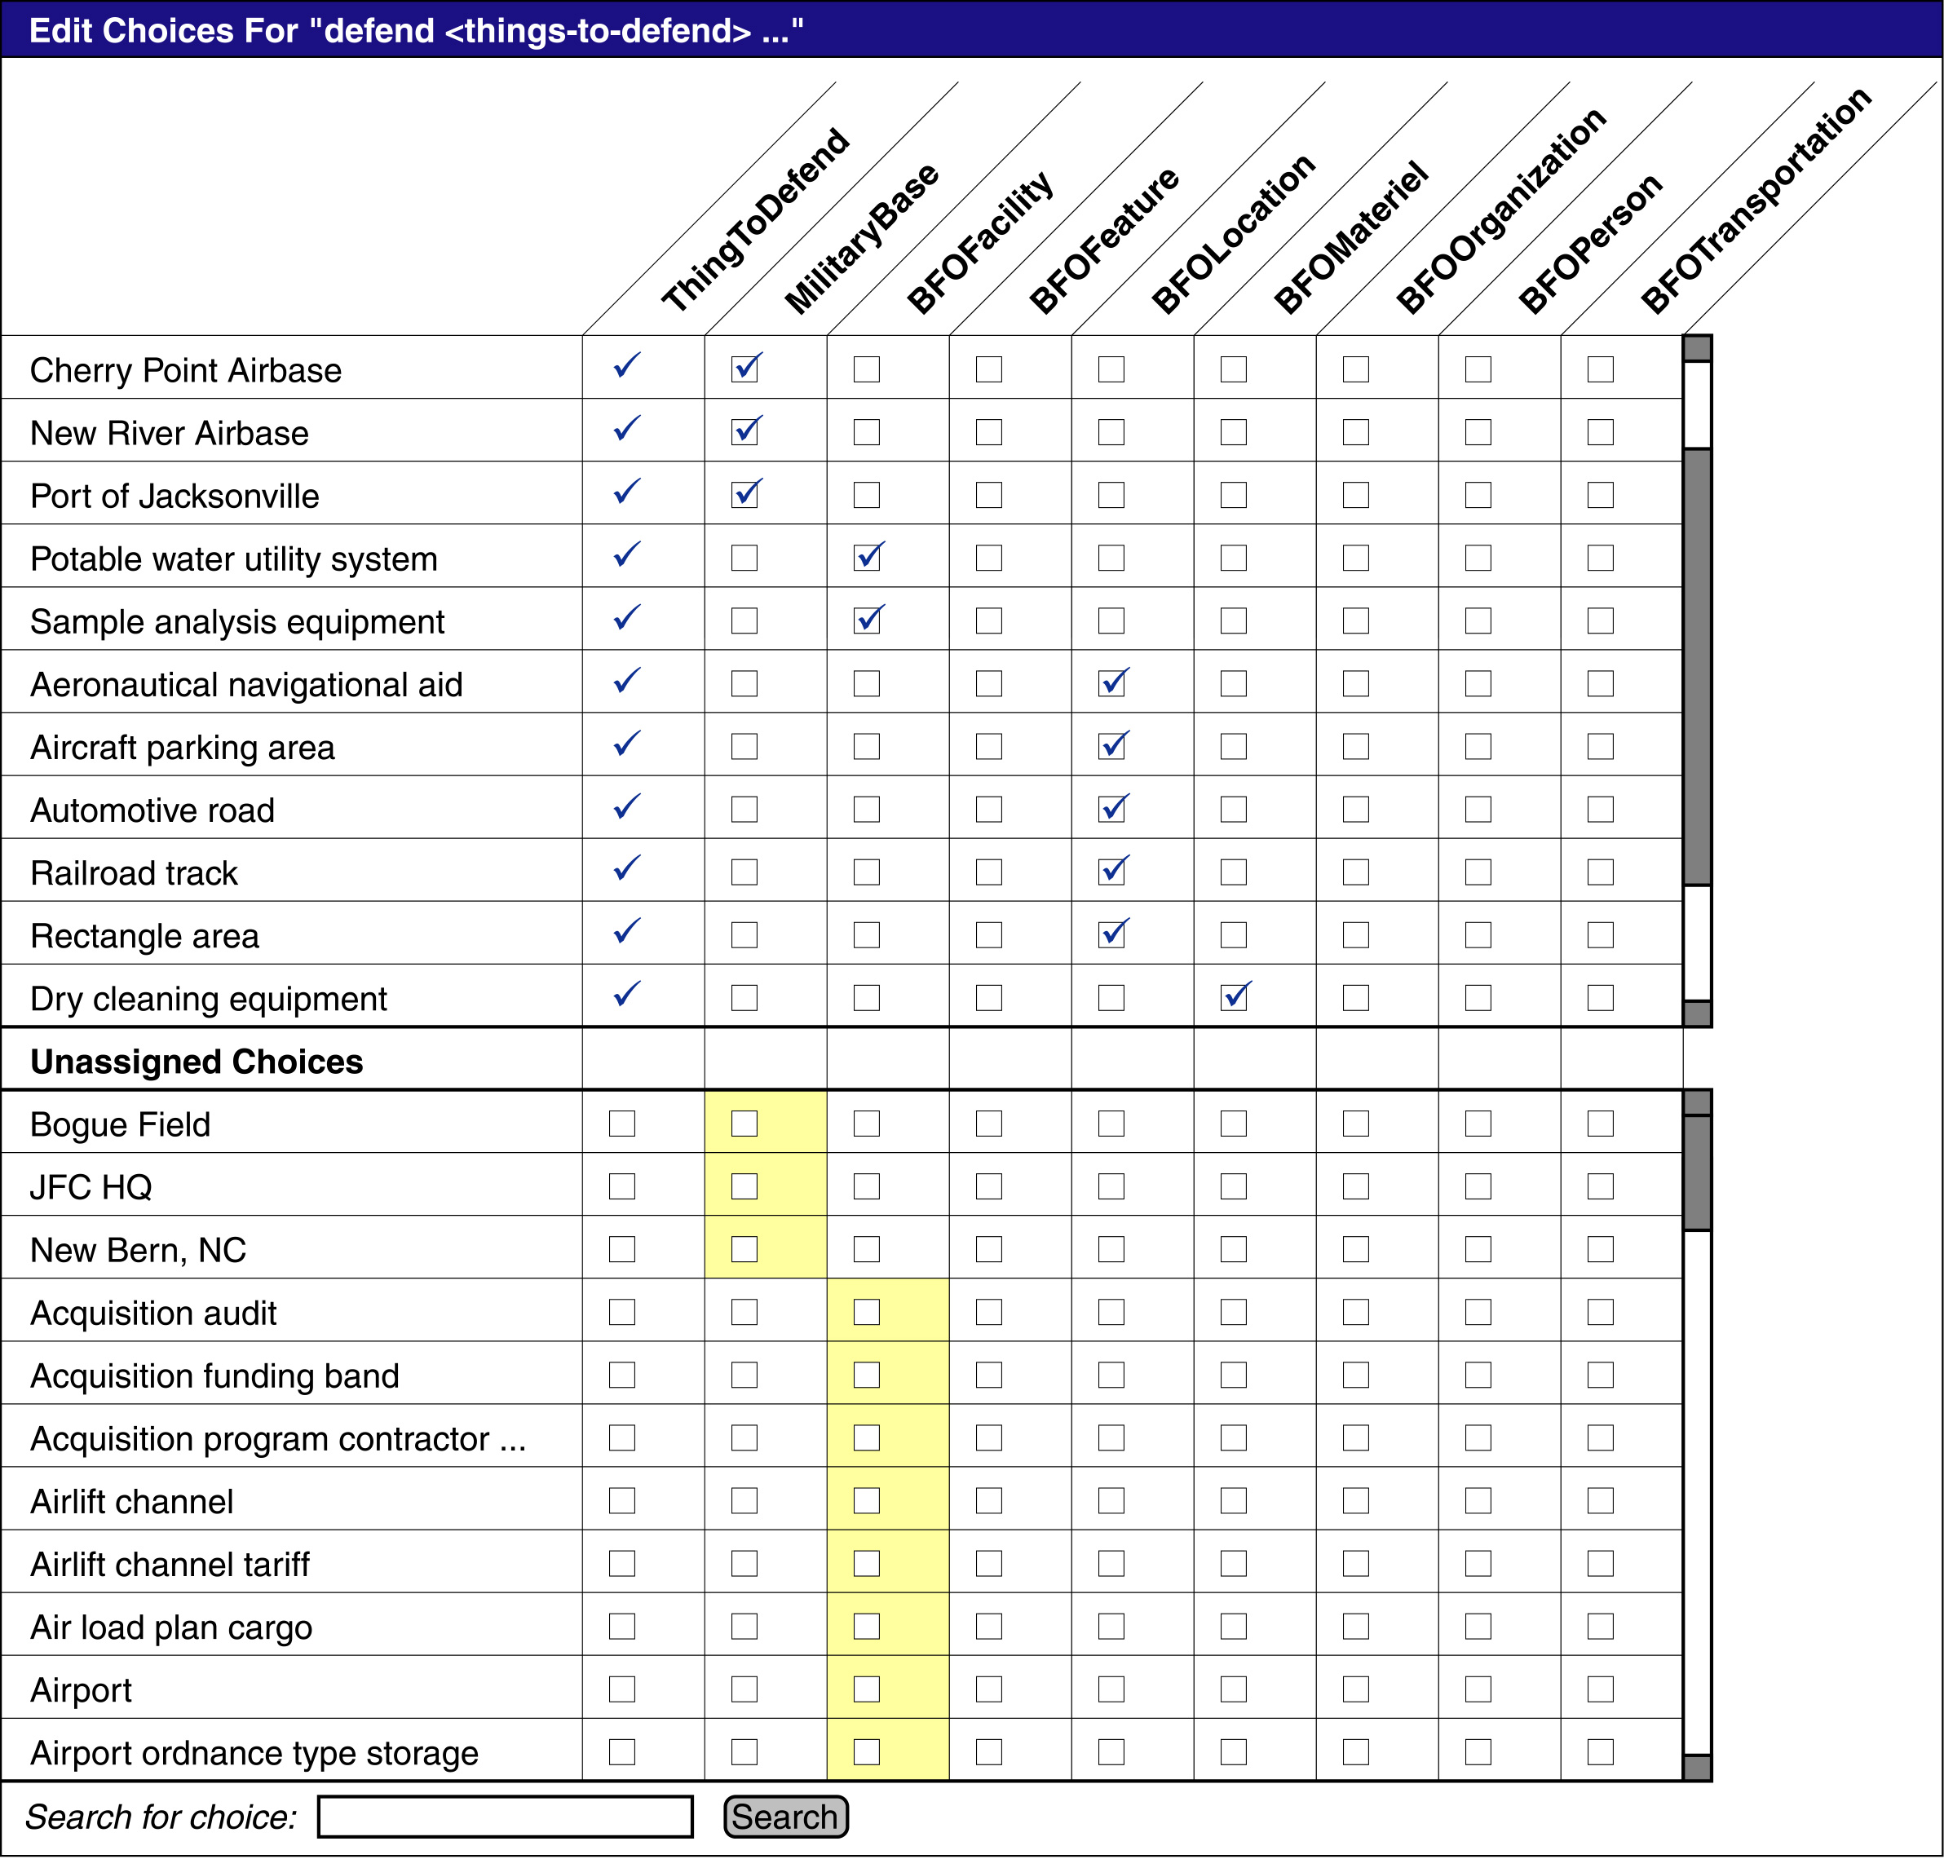

Slide 15
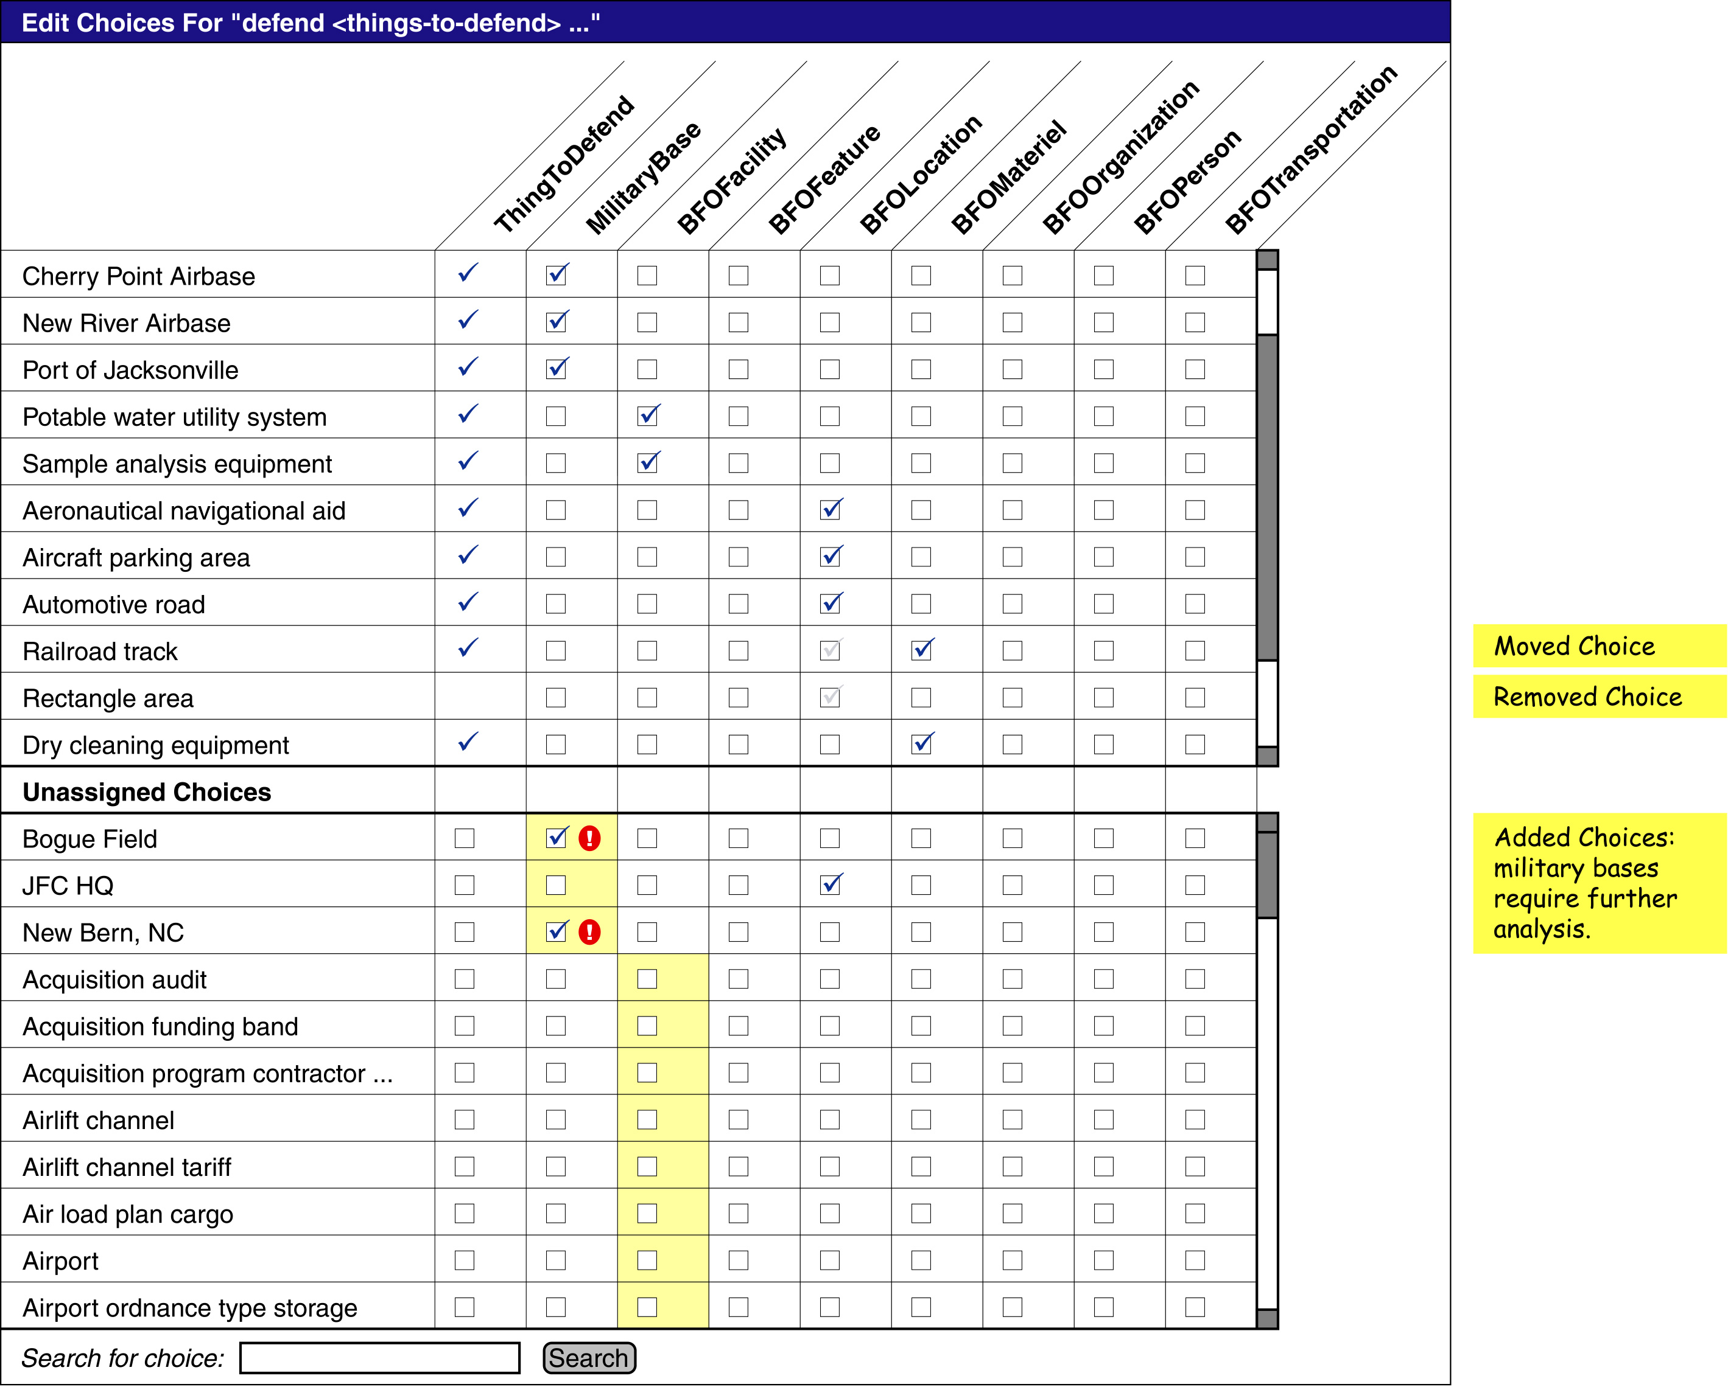

Slide 16
The unexpected effects of grammar editing: an example
‘defend’ ThingToDefend ‘from’ SomeAction –
Alternatives for ThingToDefend include militaryBases. In the example, the user adds a new militaryBase to defend.
But now the grammar will allow any action to use resources flying from that base. This is because the resource location alternatives use the same class militaryBase.
If they did not share the class, then you would have to add or delete the items twice (which is not better).

Slide 17
Our solution – grammar wizards that warn and guide the user.
When changes to the grammar (such as adding or deleting alternatives) can have a number of different effects, warn the user about effects that may be overlooked.
Help re-structure the grammar, if desired, to reduce these effects.
  We can help to produce two sub-classes of militaryBase, which the user names airforce-base and non-airforce-base, and to alter the grammar to give the desired effect.

Slide 18
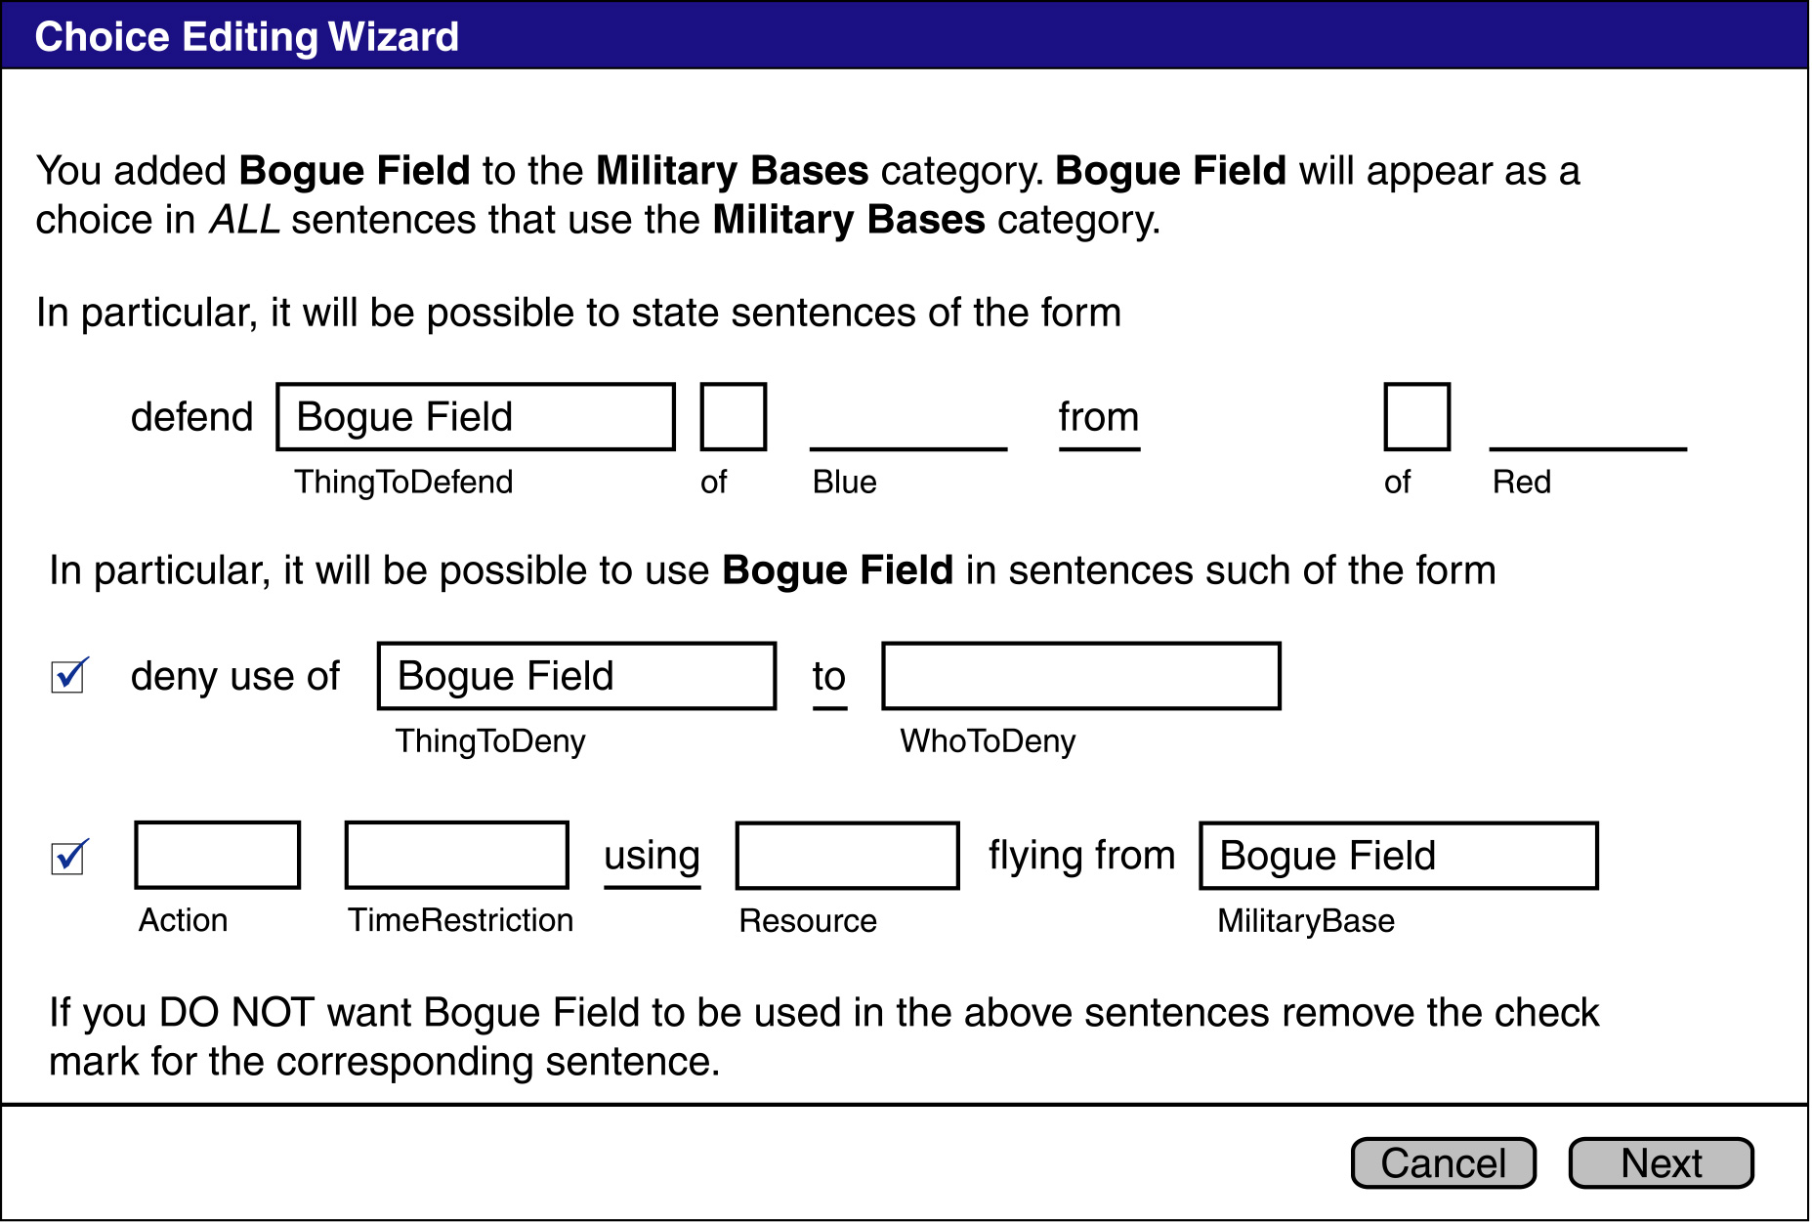
Wizard example

Slide 19
Other potential grammar wizards
The same wizard is useful when alternatives are removed, to warn the user about other statements that are no longer possible.
If the user adds structure to a list of alternatives, to reduce the set of choices at some point, a script can ask if the structure would help at other places in the grammar where the same alternatives are used.

Slide 20
Summary
A grammar editor is needed to adapt objectives grammar
Current work: editing situation-level terms
Users will need help because the grammars are large and complex
We propose several ways to avoid pitfalls:
  Distinguish fixed and changeable parts of the grammar
  Background lists of new alternatives
  Grammar wizards to manage global effects

