Slide 1

An Integrated Environment for Knowledge Acquisition
Jim Blythe (blythe@isi.edu)
Jihie Kim (jihie@isi.edu)
Surya Ramachandran (surya@isi.edu)
Yolanda Gil (gil@isi.edu)
www.isi.edu/expect

Slide 2
Outline
Acquiring procedural knowledge
Knowledge acquisition tools in EXPECT
Walk-through of integrated KA system
Benefits of integration: more than the sum of the parts

Slide 3
Acquiring knowledge for intelligent systems
Intelligent systems rarely meet the exact needs of their users
Users’ requirements will change over time, perhaps frequently
  In military planning domains, the situation is never the same
Users need to be able to modify intelligent systems to address their needs

Slide 4
Different kinds of knowledge need to be acquired.
Specific instances or constants
  Situation-specific: “the meeting is in Santa Fe”
  Persistent: “the traveller’s home city is Boston”
Object classes
  New information about classes: “hotels sometimes allow pets”
  New classes: “beaches”
Procedural knowledge
  “To compute the total cost, multiply hotel rate by the length of stay”

Slide 5
EXPECT’s Support for KA:
Key Technologies for procedural knowledge
Where does the user start?
  An acquisition wizard guides the user to start the KA process through a dialog, based on problem-solving methods.
KA takes many steps; users will be lost…
  The acquisition wizard manages the process from end to end.
Users don’t know the computer language.
  An English-based procedure editor
    Users modify the English paraphrase of the formal representation.
How do users ensure all the needed information is added?
  An interdependency analyzer understands which pieces of knowledge are used to solve a problem.

Slide 6
Integrating separately developed tools
These techniques were studied separately and later integrated in a KA tool to cover the entire process.
The guidance given by the collection of all KA component tools working together is greater than the sum of the parts.
  The tools share information about the common task

Slide 7
Example: adding knowledge to a travel assistant
An travel assistant tool makes judgments about travel itineraries:
  e.g., the airline should be United or American,
  e.g., the hotel should be within walking distance, unless I am renting a car.
Use the integrated KA tools to allow the system to make a new kind of judgment:
“the hotel can cost up to 20% more than the government per diem rate for the city.”

Slide 8
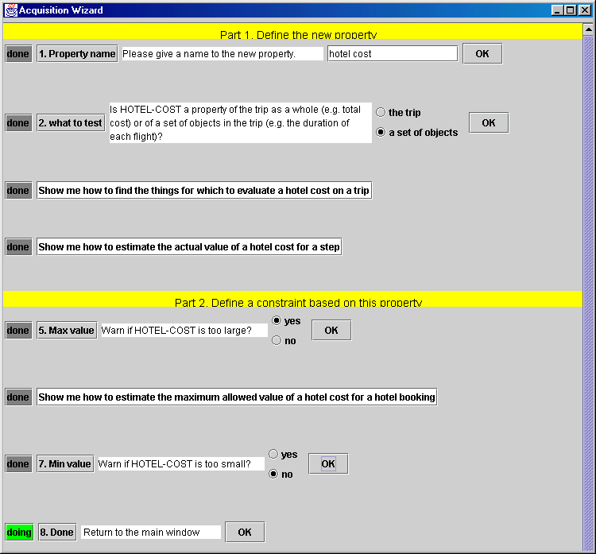
Acquisition wizard
Dialog with user to start the process.
Some questions use menus or text input.
Others use the English editor to refine procedural knowledge

Slide 9
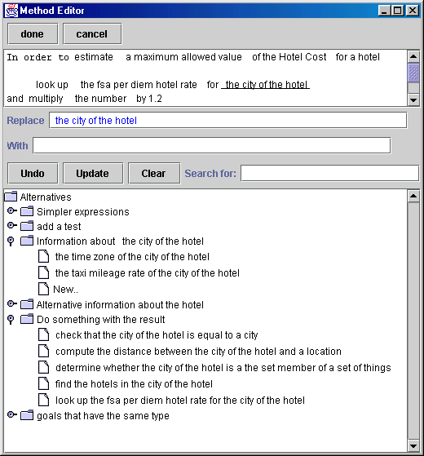
Procedure editor
NL description of
method
(multiply
(obj (look-up
(obj fsa-per-diem-hotel-rate)
(for (r-city ?hotel))))
(by 1.2))
Alternatives for
selected text fragment
Notes:
Should be a better procedure being edited.

Slide 10
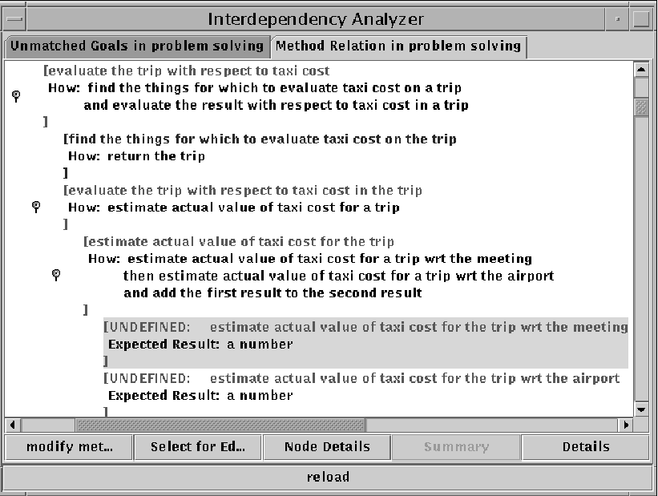
Interdependency analyzer
Detects missing knowledge
Directly calls the procedure editor

Slide 11
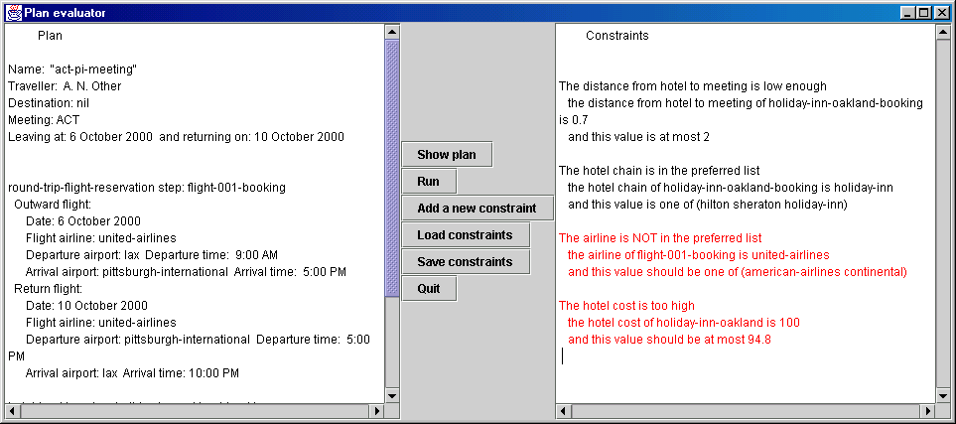
The new knowledge is tested

Slide 12
How the tools are used together
Application
Acquisition
wizard
Interdependency
analyzer
Acquisition
analyzer
Procedure editor
Relation/concept editor
Instance editor

Slide 13
The acquisition wizard
Guides the user through the initial steps of adding new knowledge.
Structures the knowledge to be added using default procedural knowledge.
Questions are generated from a problem-solving theory.

Slide 14
Problem-solving theory for plan evaluation
A hierarchy of generic types of plan judgments with default procedural knowledge.
judgment
global judgment
local judgment
bounds check
extensional check
completeness
judgment
upper bound
lower bound
positive
negative
hotel cost
judgment
“Warn if the value is too large?”
DEFINED: check that the value is less than the maximum value
ASK USER: compute a maximum value for each object

Slide 15
The English-based method editor
Automatically generates English paraphrases of procedural knowledge
User can select phrases corresponding to terms
System suggests possible replacements based on domain models and background knowledge

Slide 16
Benefits of integration:
The acquisition wizard and the method editor
Each component receives information from the other that helps the user:
The wizard provides to the editor:
  An initial version of the method, with the correct capability
  An expectation of the result type of the method
The editor provides to the wizard:
  A more detailed method result type
  Used to help classify the new task in the ontology

Slide 17
bounds check
upper bound
lower bound
“Warn if the value is too large?”

Slide 18
The interdependency analyzer
Helps the user keep track of the knowledge that still needs to be added,
by building a model of the interdependencies between pieces of knowledge in the system.
Highlights missing procedural information that is needed for the current task.

Slide 19
Benefits of integration
The acquisition wizard creates the initial context for the interdependency analyzer.
The interdependency analyzer provides the method editor with an initial version of the method, with a correct capability and an expectation of the result type.

Slide 20
Integrating other KA tools
EXPECT tools focus on acquiring procedural knowledge
A KA task may also require adding class or instance information, as done by, e.g., Puerta et al. 92
Again, integrating such tools can be mutually beneficial
  We show this with simple versions of the tools

Slide 21
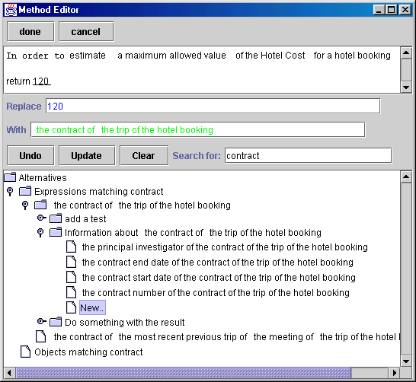
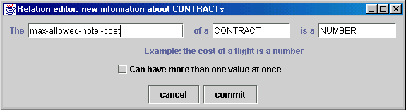
Relation editor
Used for entering new relations on classes

Slide 22
Benefits of integration
The method editor can suggest the domain and range of the new relation.
  Suggest domain from the term to which the relation is added
  Suggest range from the term being replaced in the editor
The interdependency analyzer can similarly suggest domain and range

Slide 23
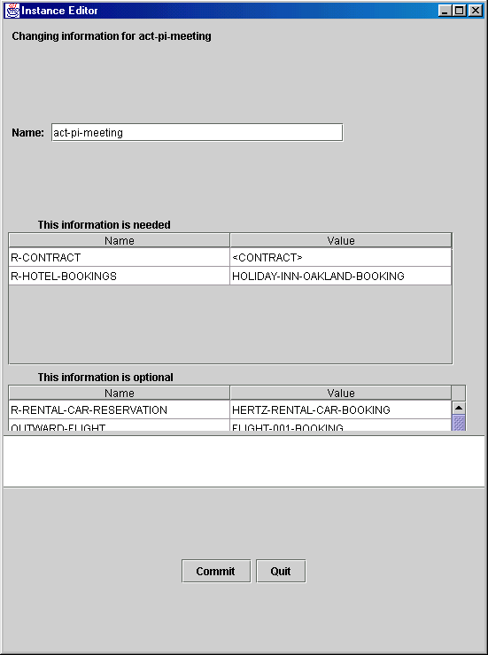
Instance editor
To enter information about specific instances.
The instance editor separates information that is needed for the current task from the rest, using the interdependency model
(For a different task, different fields would be needed)

Slide 24
Summary
Expect’s KA tools provide help for a range of tasks that a user must perform to add procedural knowledge
In combination, the tools can provide more assistance than the sum of their individual contributions:
  Together the tools provide context for each other.
  Tools pass information in the form of expectations.

Slide 25
Future work
Preliminary experiments show that users can use the tool to add procedural knowledge with little training. We are planning more thorough experiments.
Investigate integrating other tools to help the user, e.g. showing similar previously-defined judgments that could provide guidance.

Slide 26
Back-up slides
Application
Acquisition
wizard
Interdependency
analyzer
Acquisition
analyzer
Method editor
Relation/concept editor
Instance editor

Slide 27


EXPECT: A User-Centered Framework for Developing KBSs [Swartout&Gil KAW-95; Gil AAAI-94]
EXPECT
Ontologies and
Method libraries
Knowledge Base
Method
instantiator
General
ontologies
Domain
ontologies
and factual
knowledge
CYC/Sensus
Upper
Problem
solving
methods
Plans
(PLANET)
Evaluations and
Critiques
Domain
dependent
KBS
Resources
(OZONE)
Evaluation
PSMs
KA tool
KBS
compiler
Interdependency
Model (IM)
EMed
KA Scripts
KA Strategies
PSMTool
Knowledge-Based
System
Instrumentation

Slide 28
EXPECT’s Approach to Knowledge Acquisition
Key idea: Tool can understand how different pieces of knowledge are related, and guides user to provide knowledge needed to make them work together
Tool has expectations about what knowledge it needs to acquire
EXPECT exploits many sources of expectations:
  Existing domain knowledge
  General principles and middle-level theories
  How problem solving works
  Typical acquisition strategies

Slide 29
Using Declarative Representations to Guide Knowledge Acquisition
Domain Ontology
Problem-Solving Methods
...
(evaluate (obj coa)
    (wrt logistics))
r-location
port
INTERDEPENDENCIES
airport
seaport
r-berths
...
r-pols
r-piers
...
(r-location
port)
inland
waterway
seaport
maritime
seaport
r-storage-area
...
(r-berths
seaport)
U: new port: Havana
S: I need to know if it is an airport or a seaport
U: seaport
S: I need to know the location and the berths
Interdependencies guide Knowledge Acquisition

Slide 30
English-Based KA Tools:
Isolating Users from Internal Representations
number
measurement
value
55 miles
unit
distance-
value
distance-unit
55
55-mile
mile

Slide 31
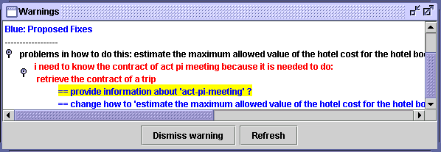
Acquisition analyzer
Maintains an agenda of KA tasks that are pending, based on the current KA process.
Capabilities
  Highlights missing procedural and factual information that is needed for the current task
  Can organize questions in different ways

Slide 32
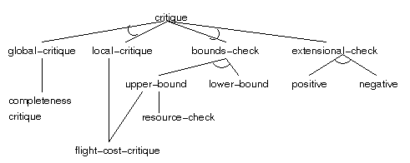

Slide 33
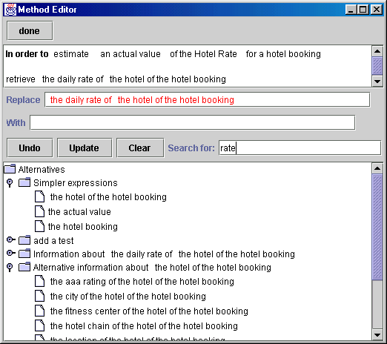

Slide 34
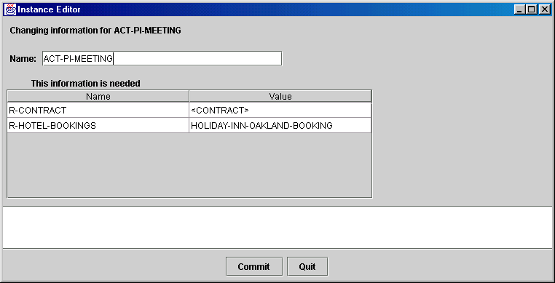
Instance editor
To enter information about specific instances.
The instance editor separates information that is needed for the current task from the rest, using the interdependency model
(For a different task, different fields would be needed)

